Slide 1
Introduction to ParaTools ThreadSpotter
ParaTools, Inc.
OpenSHMEM@bwtech
8 September 2017
Baltimore, MD

Slide 2
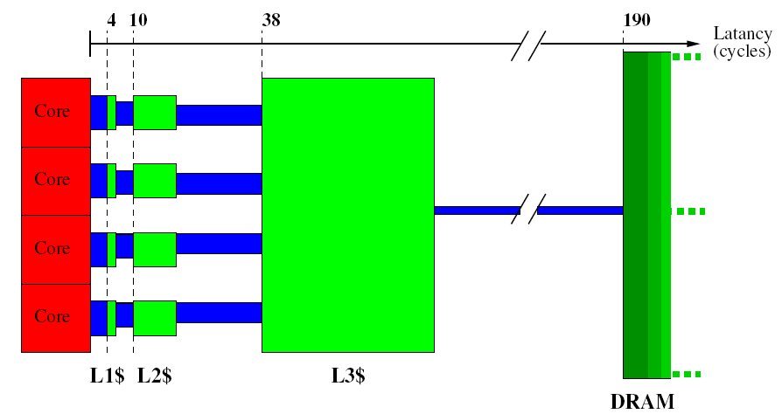
Cache Capacity/Latency/BW
Latency (cycles)

Slide 3
Typical Cache Implementation
Cacheline, here 64B:
AT
S
Data = 64B
Generic Cache:
SRAM:
C
MSB LSB
Addr [63..0]
L3 $ 24MB
tag
index
Cache Set:
Associativity = 8-way
L2 $
256kB
...
D1 ¢
64kB
I1 ¢
64kB
Hit
Sel way ”6”
mux
Data = 64B

Slide 4
ParaTools ThreadSpotter
Shrinking cache memory per core is causing some applications to spend over half their runtime waiting for data to arrive in cache.
ParaTools ThreadSpotter can:
Analyze memory bandwidth and latency, data locality and thread communications.
Identify specific issues and pinpoints troublesome areas in source code.
Provide guidance towards a resolution.
Supports mixed language distributed memory applications like CREATE-AV HELIOS and KESTREL.
Integrates with the TAU Performance System®.

Slide 5
High-level, Plain English Reporting

Slide 6
Identifies Problems and Suggests Solutions

Slide 7
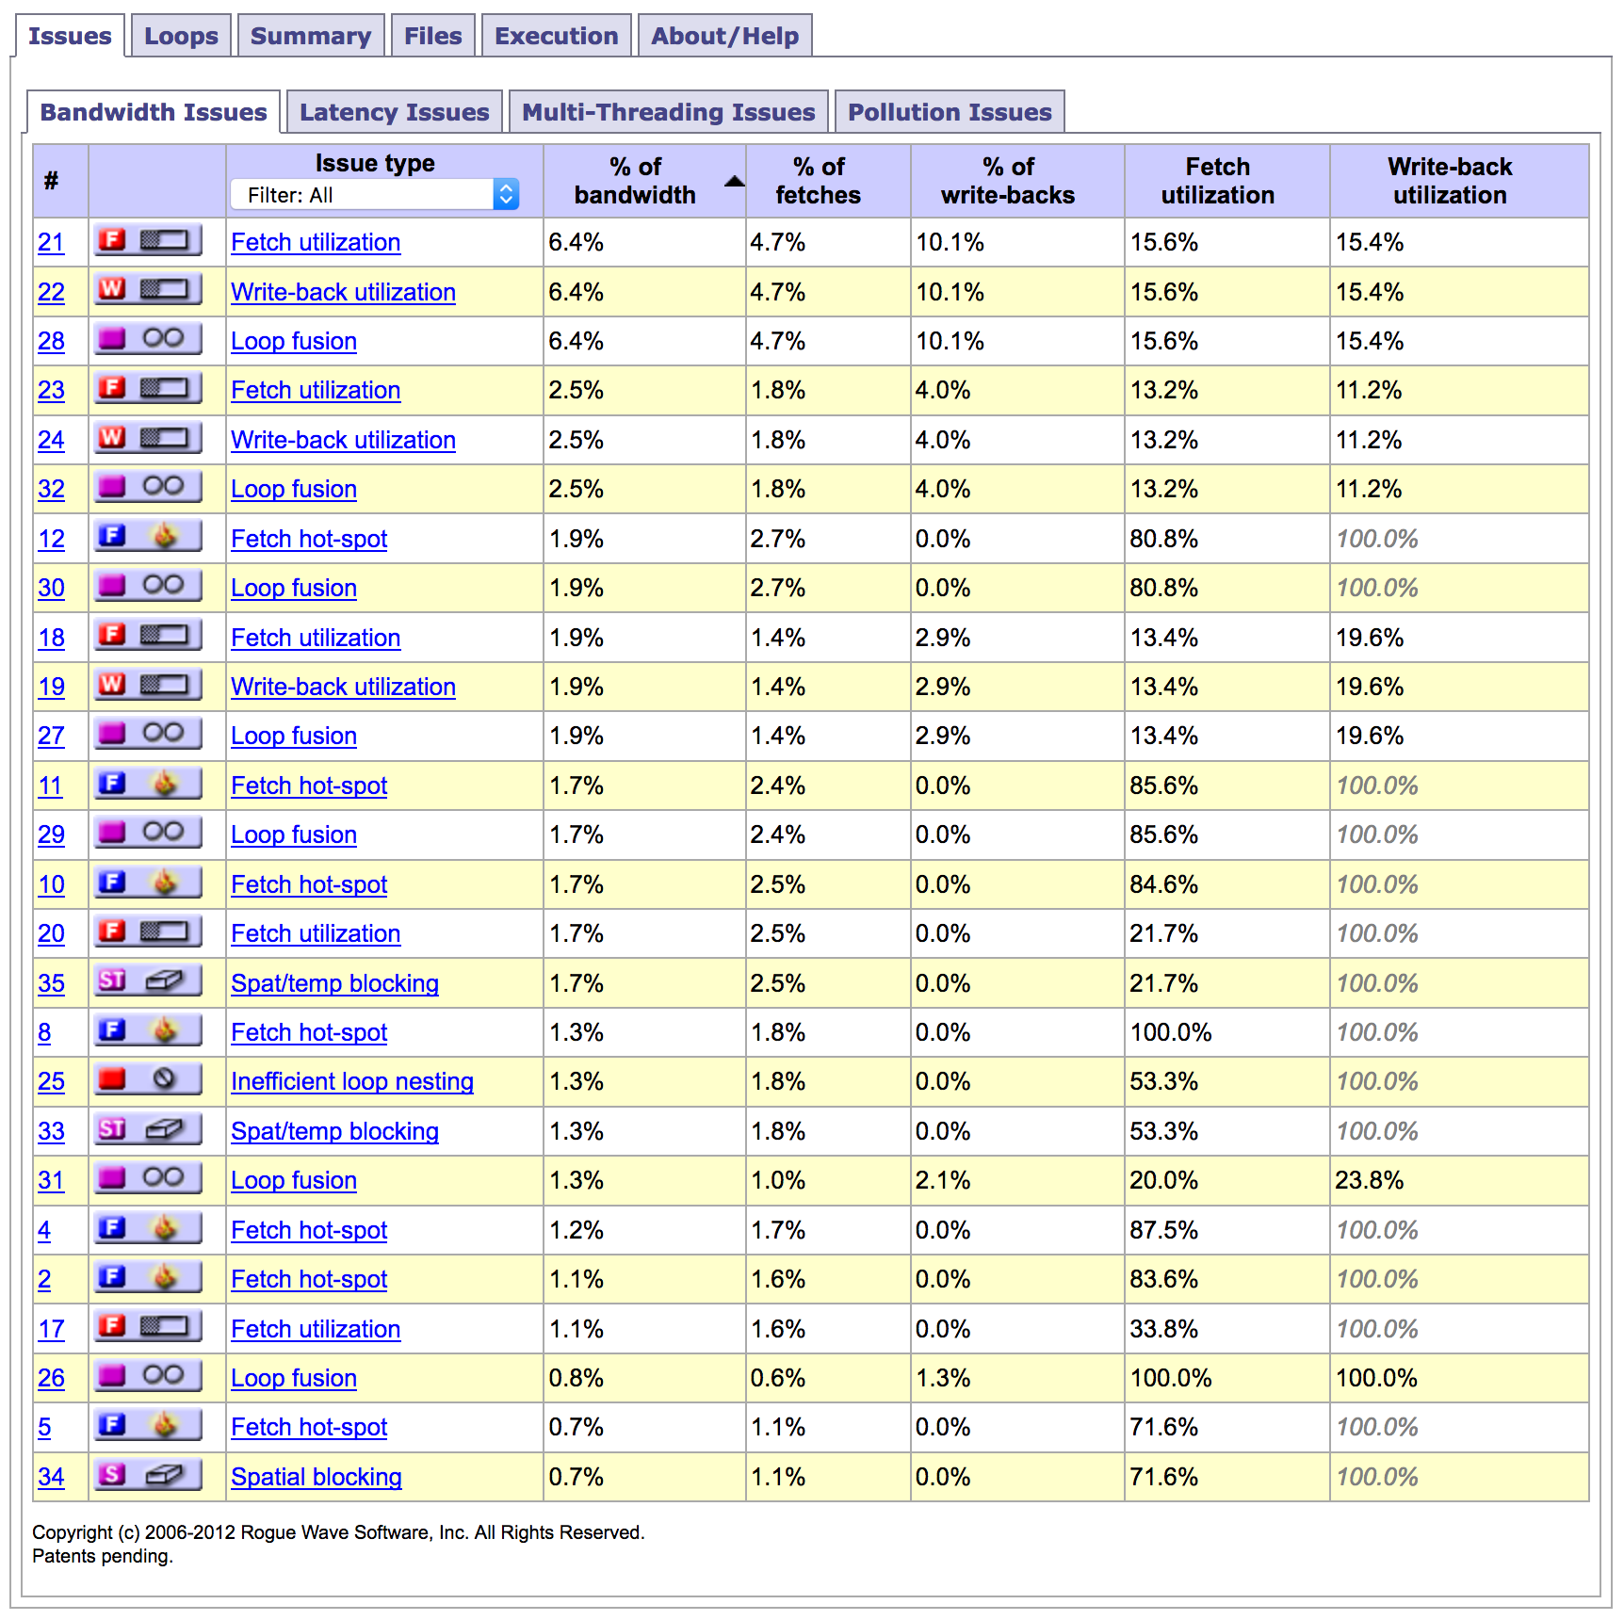
ThreadSpotter and Rotorcraft Optimization
CREATE-AV Helios
http://threadspotter.paratools.com/create-av-helios-tutorial/

Slide 8
ThreadSpotter Reports
ParaTools, Inc.

Slide 9
Report Index for 2040 MPI Ranks

Slide 10
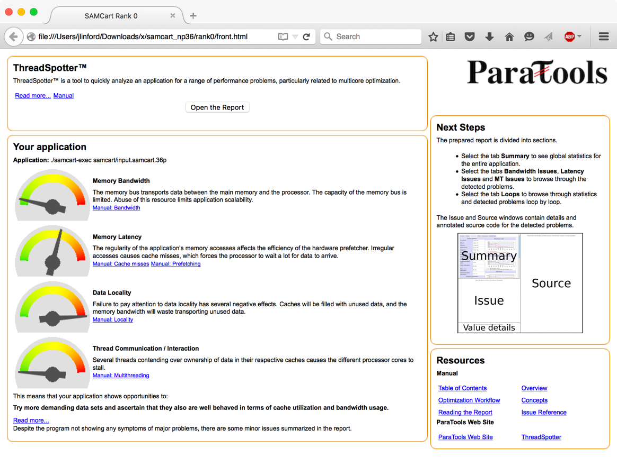
Report Cover page
No memory bandwidth issues
Data locality issues identified

Slide 11
Global statistics

Slide 12
ThreadSpotter Concepts
Issue
A problem or opportunity to improve performance
Presented with backing statistics and source navigation
Online help to explain details
Loop
An instruction cycle usually corresponding to a code loop
Instruction group
A collection of instructions touching related data

Slide 13
ParaTools ThreadSpotter report: Issues

Slide 14
ParaTools ThreadSpotter report: Loops

Slide 15
ParaTools ThreadSpotter report: Details

Slide 16
Metrics as a function of cache size
Fetch ratio
Memory operations that cause a data transfer to/from RAM
Miss ratio
Memory operations that stall due to cache misses.
Fetch utilization
Fraction of the data loaded into the cache that are actually used

Slide 17
ParaTools ThreadSpotter report: Source annotation

Slide 18
Report Vocabulary
Miss ratio: What is the likelihood that a memory access will miss in a cache?
Miss rate: Misses per unit, e.g. per-second or per-1000-instructions
Fetch ratio/rate: What is the likelihood that a memory access will cause a fetch to the cache (including HW prefetching)
Fetch utilization: What fraction of a cacheline was used before it got evicted
Writeback utilization: What fraction of a cacheline written back to memory contains dirty data
Communication utilization: What fraction of a communicated cacheline is ever used?

Slide 19
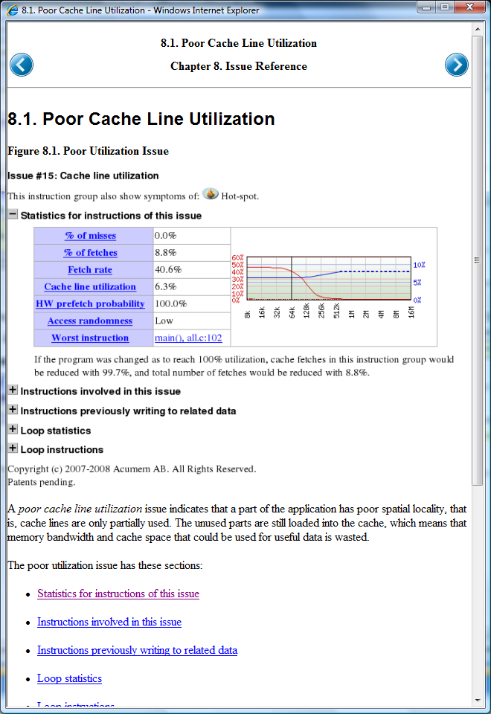
ParaTools ThreadSpotter report: help

Slide 20
Example: Temporal Blocking
ParaTools, Inc.
Gaussian Elimination with Pivoting

Slide 21
Overview of the forward elimination stage
for i=1 to n-1
find pivotPos in column i
if pivotPos ≠ i
exchange rows(pivotPos,i)
end if
for j=i+1 to n
A(i,j) = A(i,j)/A(i,i)
end for j
for j=i+1 to n+1
for k=i+1 to n
A(k,j)=A(k,j)-A(k,i)×A(i,j)
end for k
end for j
end for i
!$omp parallel do private ( i ,j )

Slide 22
First approach speed up
nThreads
ParaTools ThreadSpotter report

Slide 25
What went wrong!
For each prepared pivot, the whole matrix is accessed. The algorithm requires pivots to be calculated in order.
Repeated eviction of the matrix’ cache lines.

Slide 26
What went wrong!
For each prepared pivot, the whole matrix is accessed. The algorithm requires pivots to be calculated in order.
Repeated eviction of the matrix’ cache lines.

Slide 27
What went wrong!
For each prepared pivot, the whole matrix is accessed. The algorithm requires pivots to be calculated in order.
Repeated eviction of the matrix’ cache lines.
Observation: Each column is an accumulation of eliminations using previous columns!
Temporal Blocking Advice says:
Use each column many times before it gets evicted
→ Arrange code to make more pivots available!

Slide 28
Blocking GE
for k=1 to n-1, step C
BlockEnd=min(k+C-1,n)
GE on A(k:n,k:BlockEnd) &
Store C pivots’ positions
for each column j after BlockEnd
for i=k to BlockEnd
swap using pivots(i)
elimination i on j
end for i
end for each j
End for k
The row exchange turned into a two- element swap before column elimination
1
Pivots array
!$omp parallel do private ( i ,j )
2
C
Rest of columns
C
Rest of columns

Slide 29
Speed up vs. Block size C
ParaTools ThreadSpotter report

Slide 30
Speed up w.r.t sequential time
6.22x
nThreads

Slide 31
Command Line Usage
ParaTools, Inc.

Slide 32
PTTS Integration with TAU
tau_exec --ptts
Sampling (sample_ts)
Generates sample files named ptts/sample.#.smp
Issue Identification (report_ts)
Generates report files named ptts/report.#.tsr
Reporting (view-static_ts )
Generates node_# directories with html reports
Each rank produces log files for each step
sample_ts.#.log, report_ts.#.log, and view-static_ts.#.log

Slide 33
PTTS Integration with TAU
Flag | Description
-ptts | Use PTTS to generate performance data.
-ptts-post | Skip application sampling and post-process existing sample files. Useful for analyzing performance at each cache layer, or predicting performance on other architectures.
-ptts-num=<N> | Indicate number of MPI ranks if the size of the MPI communicator cannot be automatically detected, e.g. on Cray.
-ptts-sample-flags=<flags> | Additional flags to pass to the sample_ts command. Can also be specified in the TAU_TS_SAMPLE_FLAGS environment variable.
-ptts-report-flags=<flags> | Additional flags to pass to the report_ts command. Can also be specified in the TAU_TS_REPORT_FLAGS environment variable.

Slide 34
Sampler settings: Start & Stop
Controlling when to start and stop sampling
Start conditions
delay, -d <seconds>
--start-at-function <function name>
--start-at-address <0x1234123>
--start-at-ignore <pass count>
Stop conditions
Duration, -t <seconds>
--stop-at-function <function name>
--stop-at-address <0x123123>
--stop-at-ignore <pass count>

Slide 35
Report settings: Issue selection
depth
How long call stack to consider while differentiating instructions
--depth 0 – just consider the PC
--depth 1 – consider the PC and the site which called this function
percentage
cutoff. Suppress uninteresting issues
--percentage 3 (% of fetches)

Slide 36
Report settings: Source/debug
source directory – look for source in other places
Useful if the directories are not recorded in the debug information
-s directory
binary – look for binaries (containing debug information in other places)
Useful if the binary has moved since sampling
-b path-to-actual-binary
debug directory (for debug information stored external to the elf file)
-D directory
debug level (varying degree of information)
--debug-level 0-3

