Slide 1
Profiling OpenSHMEM with TAU Commander
ParaTools, Inc.
8 September 2017
Baltimore, MD

Slide 2
On Talapas
ssh studentXX@talapas-ln1.uoregon.edu
40 accounts available, please pick up a card
module load prl
module load workshops/09-08-17
Benchmarks:
/usr/local/packages/workshops/09-08-17

Slide 3
Installing TAU Commander
taucommander.com/downloads
Do you have network access?
Yes
No
Use the web-based installer
Use an all-in-one package
Lightweight package (324k) downloads software as needed.
Inclusive packages (700+MB) that do not require network access and will not download software.

Slide 4
Installing TAU Commaner
tar xvzf taucmdr-<options>.tar.gz
cd taucmdr-<version>
make install [INSTALLDIR=/path/to/install/to]
Bash (nearly everyone):
export PATH=INSTALLDIR/bin:$PATH
C-shell (nearly everyone else):
set path=(INSTALLDIR/bin $path)

Slide 5
Getting Started with TAU Commander
tau initialize
tau oshf90 *.f90 -o foo
tau srun -n 64 ./foo
tau show
This works on any supported system, even if TAU is not installed or has not been configured appropriately.
TAU and all its dependencies will be downloaded and installed if required.
Just put `tau` in front of everything and see what happens.

Slide 6
TAU Commander Online Help: tau --help

Slide 7
Commands have Subcommands
tau [subcmd] [subsubcmd] [subsubsubcmd] …
Commands are tree-like and become more specific as you move to the right:
tau application edit dfft --new-name my_dfft
Common command strings:
tau initialize
tau select [target] [application] [measurement] [experiment]
tau target create <name> [options]
tau application edit <name> [options]
tau measurement copy <name> <new_name> [options]

Slide 8
Command Line Hacks
All commands and flags support abbreviation:
tau initialize
tau initial
tau init
Boolean flags are flexible:
tau init --mpi=True
tau init --mpi=yes
tau init --mpi=1
tau init --mpi
Use --help at any point to get help.

Slide 9
Dashboard

Slide 10
T-A-M Model for Performance Engineering
Target
Installed software
Available compilers
Host architecture/OS
Application
MPI, OpenMP, CUDA, OpenACC, etc.
Measurement
Profile, trace, or both
Sample, source inst…
Measurement
Application
Target
Experiment = (Target, Application, Measurement)

Slide 11
All T-A-M Objects Have a Subcommand
Configuration Subcommands:
application Create and manage application configurations.
experiment Create and manage experiments.
measurement Create and manage measurement configurations.
project Create and manage project configurations.
target Create and manage target configurations.
trial Create and manage experiment trials.
$ tau application --help
usage: tau application <subcommand> [arguments]
Create and manage application configurations.
Positional Arguments:
<subcommand> See 'subcommands' below.
[arguments] Arguments to be passed to <subcommand>.
Optional Arguments:
-h, --help Show this help message and exit.
Subcommands:
copy Copy and modify application configurations.
create Create application configurations.
delete Delete application configurations.
edit Modify application configurations.
list Show application configuration data.
See 'tau application <subcommand> --help' for more information on <subcommand>.

Slide 12
Use the long listing format
$ tau app list --long
== Application Configurations (/storage/users/jlinford/gpu_suite.1.1.0/.tau/project.json) ==================
== gpu_suite.1.1.0 =========================================================================================
Attribute | Value | Command Flag | Description
==========+=================+==============+===============================================
cuda | True | --cuda | Application uses NVIDIA CUDA.
linkage | dynamic | --linkage | Application linkage.
mpc | False | --mpc | Application uses MPC.
mpi | False | --mpi | Application uses MPI.
opencl | False | --opencl | Application uses OpenCL.
openmp | False | --openmp | Application uses OpenMP.
projects | gpu_suite.1.1.0 | N/A | Projects using this application.
pthreads | False | --pthreads | Application uses pthreads.
shmem | False | --shmem | Application uses SHMEM.
tbb | False | --tbb | Application uses Thread Building Blocks (TBB).

Slide 13
Compiling with TAU Commander
tau <compiler> [options]
tau gcc *.c -o foo
tau oshfort -c foo.f90
tau oshfort foo.o -o foo
tau <compiler> is just a shortcut:
Expands to tau build <compiler>
Use tau build --help to show all known compilers.
NOTE: Compilation isn’t always necessary. Use sampling to gather data on uninstrumented executables.

Slide 14
Autotools
Initialize before running configure:
tau initialize --shmem
If the project is already initialized, be sure you don’t have an “expensive” experiment selected, e.g. tracing or profiling with lots of options.
./configure CC=“tau oshcc”
Recommend --disable-dependency-tracking to avoid problems with source-based instrumentation. No worries if only sampling.
make && make install
If you change your experiment you do not have to reconfigure, just recompile:
make clean
make && make install

Slide 15
CMAKE
This should work:
cmake -DCMAKE_C_COMPILER=“tau oshcc”
If it doesn’t, use the wrapper scripts:
export PATH=$PWD/.tau/bin/<target_name>
cmake -DCMAKE_C_COMPILER=“tau_oshcc”
Wrapper scripts are automatically generated for all compilers supported by the target.
Wrapper for <compiler> is “tau_<compiler>”
E.g. tau_gcc, tau_mpicc, tau_oshcc, etc.
Wrappers can be used for any build system that doesn’t like spaces in the compiler name.

Slide 16
Running with TAU Commander
tau <command>
tau srun -n 4 ./a.out
tau mpirun -np 4 ./a.out
tau ./a.out
tau <command> is just a shortcut:
Expands to tau trial create <command>

Slide 17
Running with custom launchers
tau trial create \
--launcher mylauncher -np 4 -- \
./a.out bar baz
Use the --launcher flag to indicate the launcher command and arguments.
Use “--” to mark the beginning of the application command line.
tau mpirun -np 4 ./a.out 20 is shorthand for: tau trial create --launcher mpirun –np 4 -- ./a.out 20

Slide 18
OpenSHMEM Examples
ParaTools, Inc.

Slide 19
Step 1: Initialize TAU Project
$ cd ISx
$ tau initialize --shmem
Creates a new project configuration using defaults
Project files exist in a directory named “.tau”
Like git, all directories below the directory containing the “.tau” directory can access the project
E.g. `tau dashboard` works in miniapp1/baseline

Slide 20
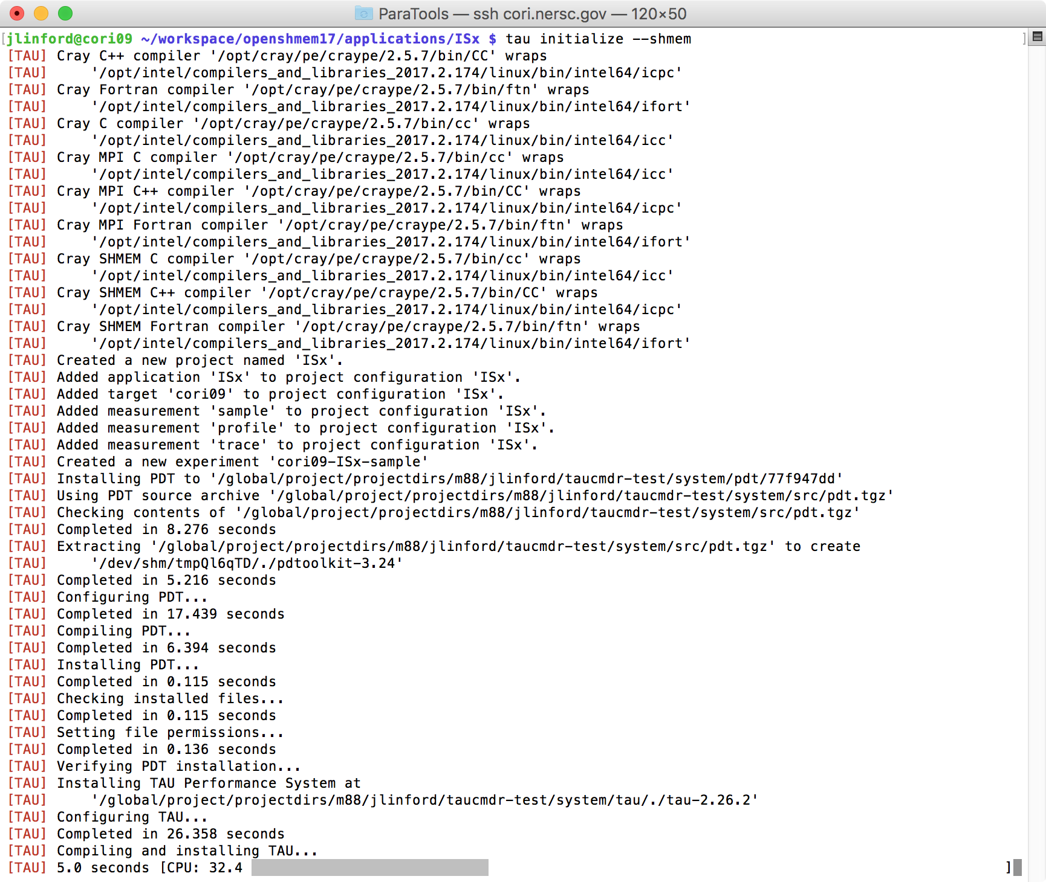
Initializing ISx Project on Cori
Compiler detection
Project initialization
Download and install PDT
TAU installation progress

Slide 21
TAU ISx Project Dashboard

Slide 22
Step 2: Use `tau` to compile
Prepend `tau` command to compiler command
Compile as normal
TAU Commander constructs a new compilation command line.
May replace compiler commands with TAU’s compiler wrapper scripts.
May set environment variables, parse configuration files, etc.
If no changes are required then nothing is changed.

Slide 23
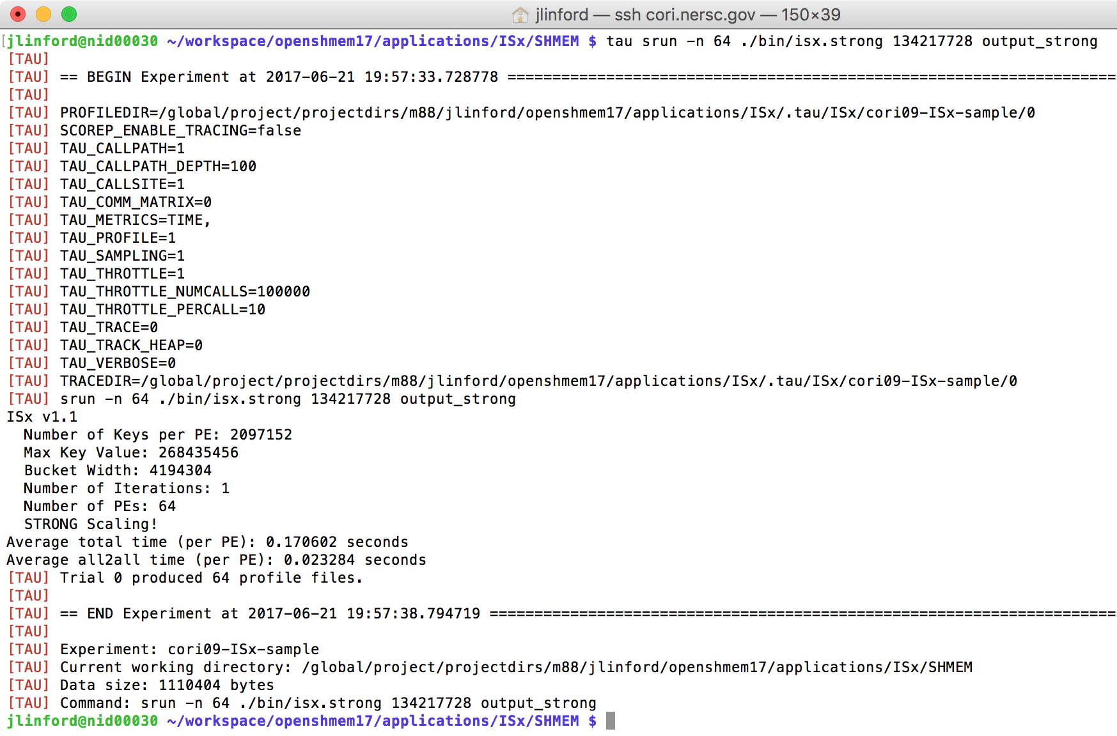
Step 3: Use `tau` to run
Prepend `tau` command to command line
TAU Commander sets environment variables
Application executes, possibly with tau_exec
New data is added to the performance database

Slide 24
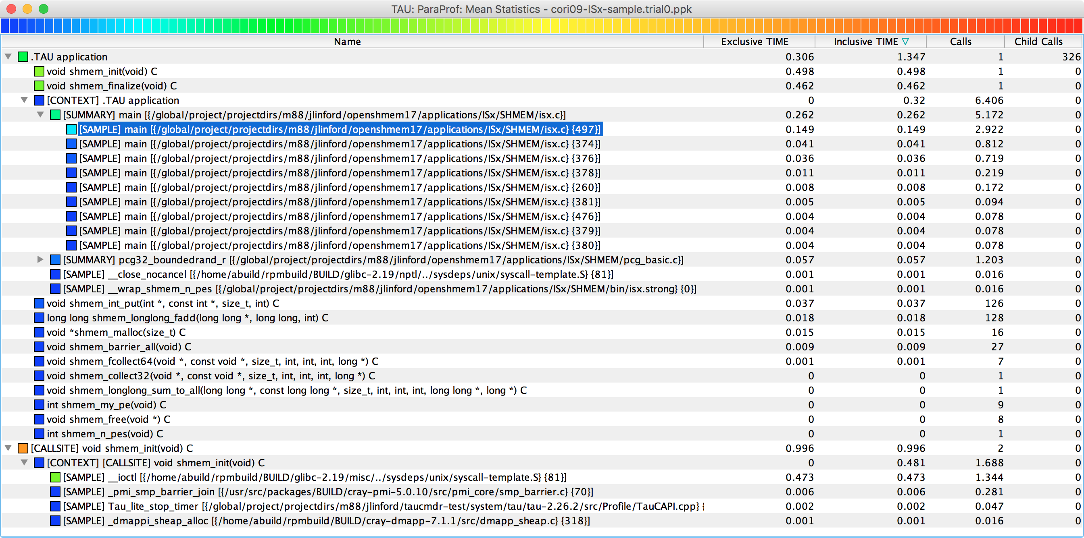
Step 4: Use `tau` to view data
$ tau show
Note: ISx was sampled with callsites, OpenSHMEM measured directly via wrapper library

Slide 25
Performance Data Analysis
OpenSHMEM’17

Slide 26
New: Callsites in Profiles and Traces

Slide 27
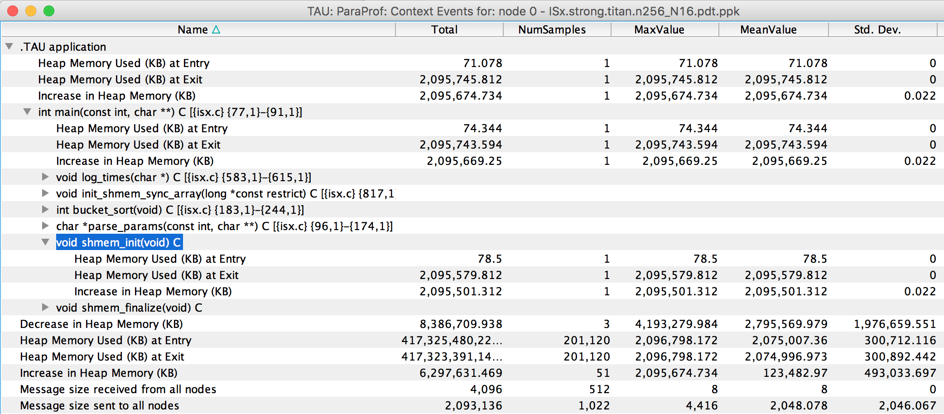
Memory Allocation/Deallocation
% paraprof (Right-click label [e.g “node 0”] → Show Context Event Window)
Notes:
Heap memory usage reported by the mallinfo() call is not 64-bit clean.
32 bit counters in Linux roll over when > 4GB memory is used
We keep track of heap memory usage in 64 bit counters inside TAU
Compensation of perturbation introduced by tool
Only show what application uses
Create guards for TAU calls to not track I/O and memory allocations/de-allocations performed inside TAU
Provide broad POSIX I/O and memory coverage

Slide 28
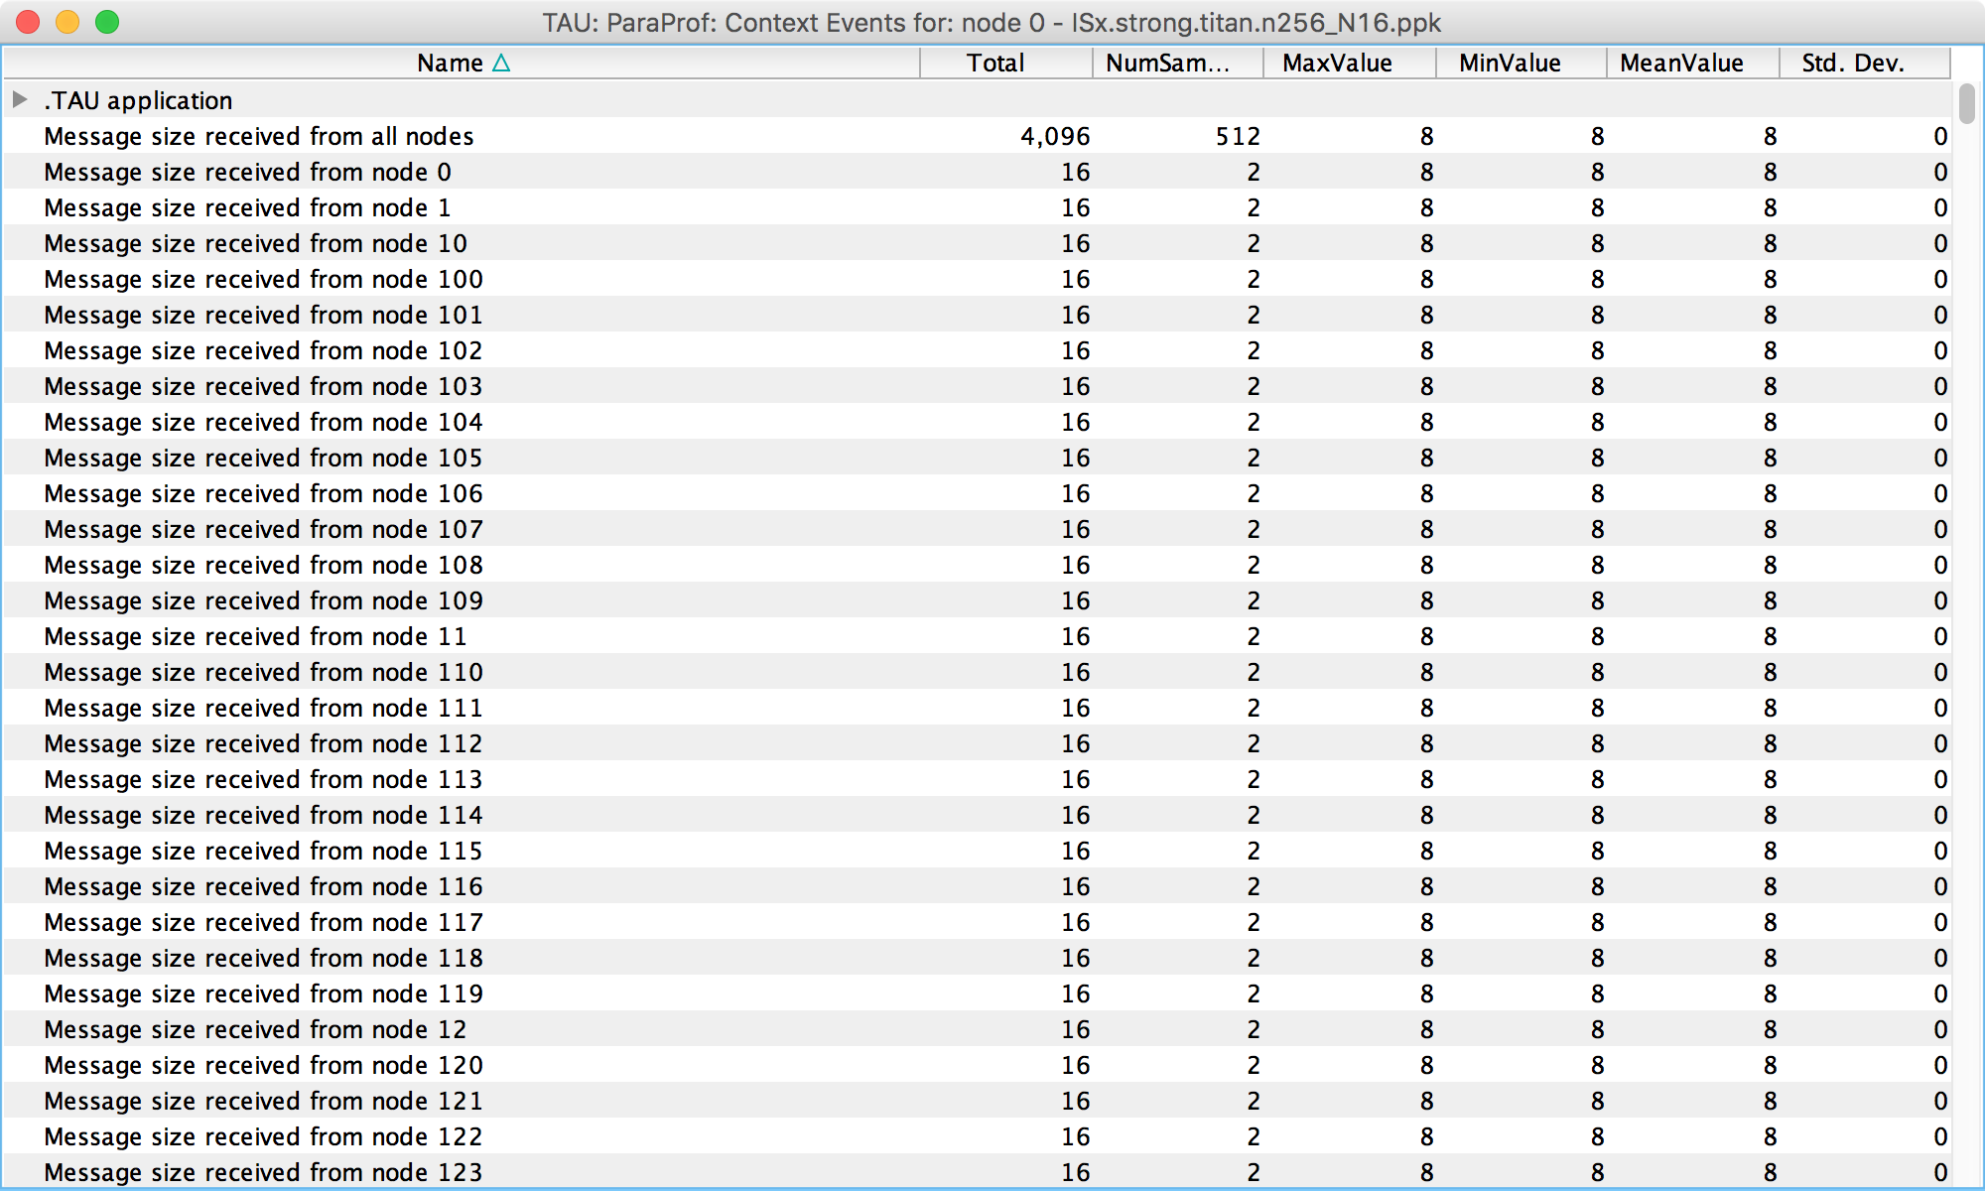
Message Statistics
% paraprof (Right-click label [e.g “node 0”] → Show Context Event Window)
Notes:
Heap memory usage reported by the mallinfo() call is not 64-bit clean.
32 bit counters in Linux roll over when > 4GB memory is used
We keep track of heap memory usage in 64 bit counters inside TAU
Compensation of perturbation introduced by tool
Only show what application uses
Create guards for TAU calls to not track I/O and memory allocations/de-allocations performed inside TAU
Provide broad POSIX I/O and memory coverage

Slide 29
Communication Matrix

Slide 30
3D Profile Visualization
% paraprof (Windows → 3D Visualization)

Slide 31
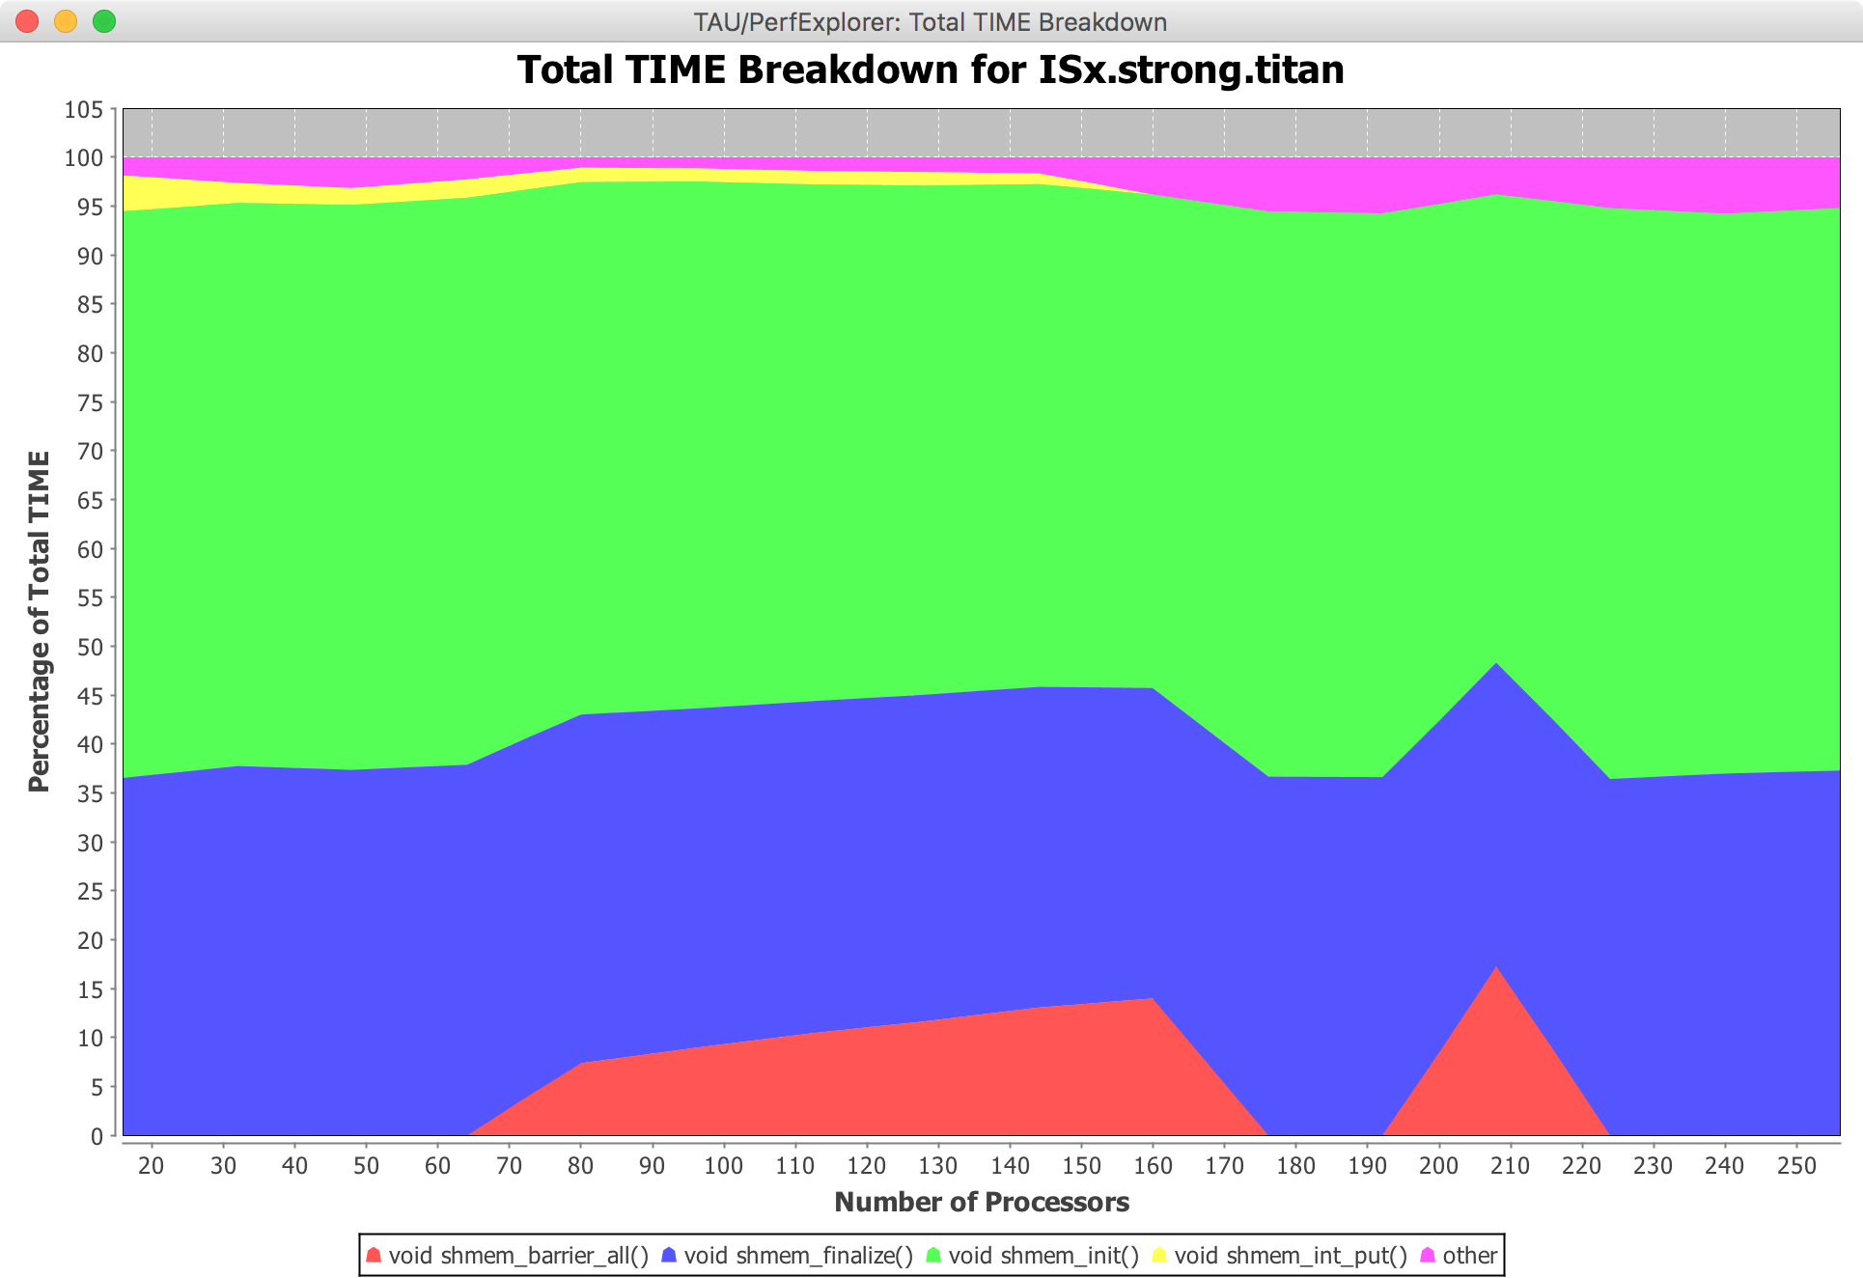
How Does Each Routine Scale?
% perfexplorer (Charts → Runtime Breakdown)

Slide 32
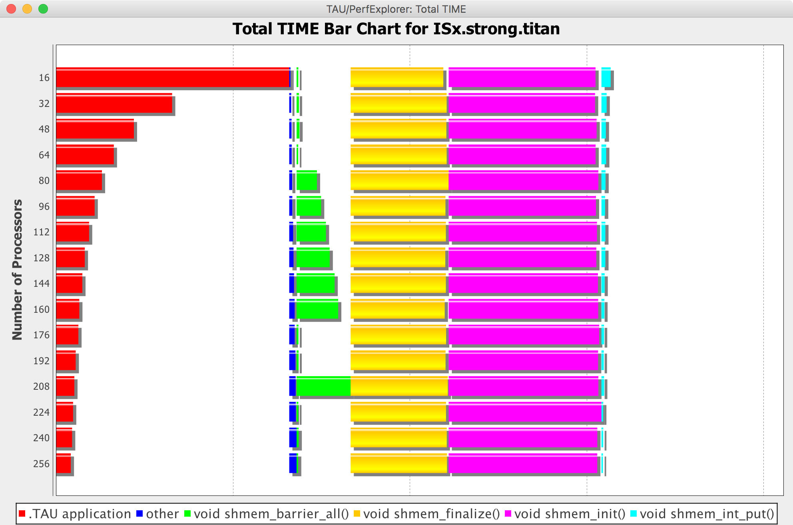
How Does Each Routine Scale?
% perfexplorer (Charts → Stacked Bar Chart)

Slide 33
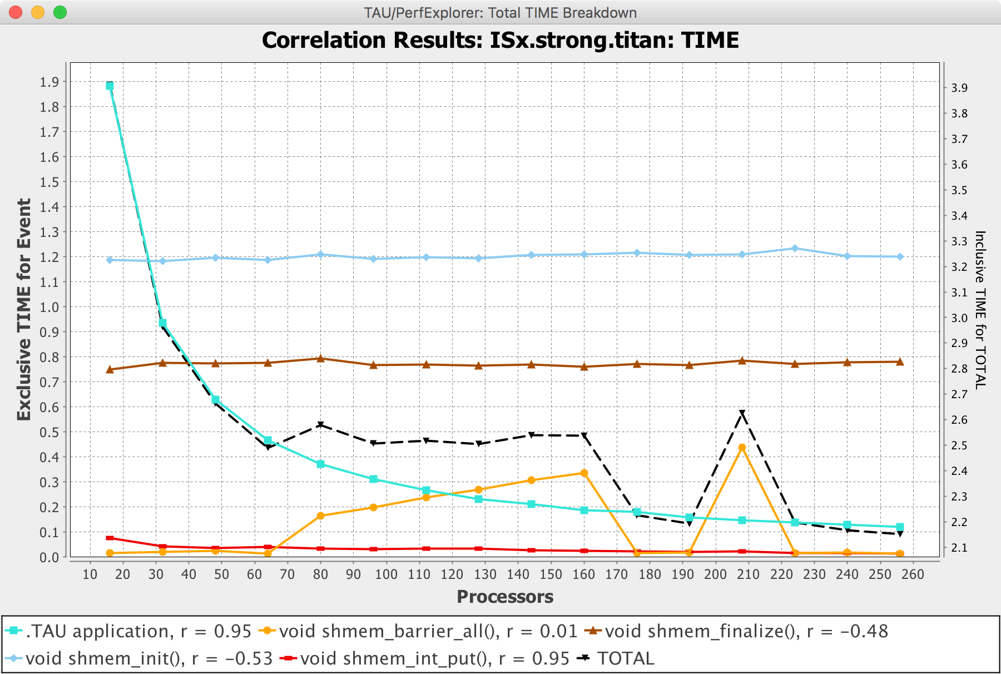
Which Events Correlate with Runtime?
% perfexplorer (Charts → Correlate Events with Total Runtime)

Slide 34
Source-based Instrumentation
OpenSHMEM’17

Slide 35
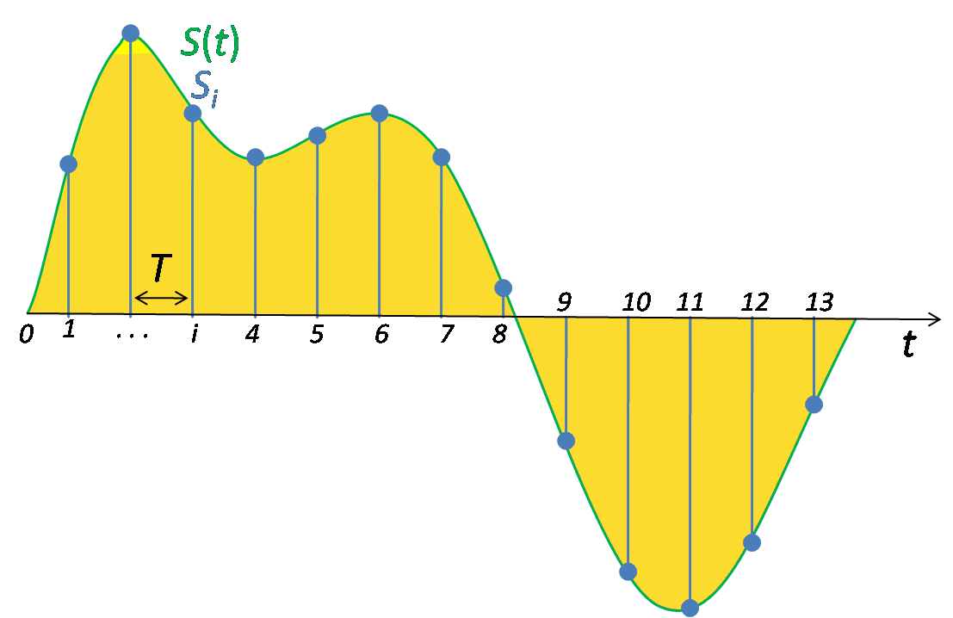
Source-based vs. Sampling
Direct via Probes
Indirect via Sampling
call TAU_START(‘potential’)
// code
call TAU_STOP(‘potential’)
Exact measurement
Fine-grain control
Calls inserted into code
No code modification
Minimal effort
Relies on debug symbols (-g option)

Slide 36
What are the performance characteristics of my application?
One target
Many measurements
One application
…
Measurement 0
Measurement N
Application
Target

Slide 37
Create a New Experiment
Select a new measurement to create a new experiment
TAU Performance System® automatically reconfigured and recompiled.
User advised that an application rebuild is required to use source-based instrumentation.

Slide 38
Automatic TAU Configuration
./configure -tag=dea32fb3 -arch=craycnl -cc=icc -c++=icpc -fortran=intel -shmem -shmeminc=/opt/cray/pe/mpt/7.4.4/gni/sma/include -shmemlib=/opt/cray/pe/mpt/7.4.4/gni/sma/lib64 -shmemlibrary=-L/opt/cray/pe/libsci/16.09.1/INTEL/15.0/x86_64/lib#-L/opt/cray/dmapp/default/lib64#-L/opt/cray/pe/mpt/7.4.4/gni/mpich-intel/16.0/lib#-L/opt/cray/rca/2.1.6_g2c60fbf-2.265/lib64#-L/opt/cray/alps/6.3.4-2.21/lib64#-L/opt/cray/xpmem/2.1.1_gf9c9084-2.38/lib64#-L/opt/cray/dmapp/7.1.1-39.37/lib64#-L/opt/cray/pe/pmi/5.0.10-1.0000.11050.0.0.ari/lib64#-L/opt/cray/ugni/6.0.15-2.2/lib64#-L/opt/cray/udreg/2.3.2-7.54/lib64#-L/opt/cray/pe/atp/2.1.0/libApp#-L/opt/cray/wlm_detect/1.2.1-3.10/lib64#-lpthread#-lsma#-lpmi#-ldmapp#-lsci_intel_mpi#-lsci_intel#-lm#-ldl#-lmpich_intel#-lrt#-lugni#-lalpslli#-lwlm_detect#-lalpsutil#-lrca#-lxpmem#-ludreg#-lmpichcxx_intel#-lmpichf90_intel -pdt=/global/project/projectdirs/m88/jlinford/taucmdr-test/system/pdt/77f947dd -pdt_c++=icpc -useropt=-O2#-g

Slide 39
Source-based Instrumentation Data

Slide 40
Tracing OpenSHMEM with TAU Commander
OpenSHMEM’17

Slide 41
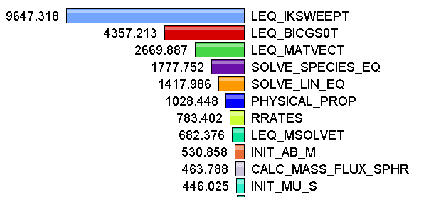
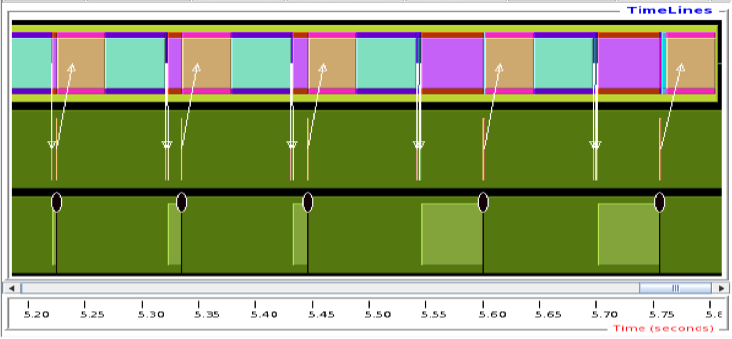
Measurement Approaches
Profiling
Tracing
Shows how much time was spent in each routine
Shows when events take place on a timeline

Slide 42
New: OTF2 Now the Default Trace Format
OTF2 dramatically improves on SLOG2:
Smaller trace files
Richer trace data, e.g. RMA events
Better trace visualization (Vampir, Ravel)
TAU can now generate OTF2 files natively:
No Score-P required!

Slide 43
TAU Commander with OpenSHMEM+OTF2
TAU_TRACE_FORMAT=otf2
OTF2 is 143MB vs. SLOG2 514MB

Slide 44
ISx in Vampir

Slide 45
Different Nodes, Different Timelines

Slide 46
Get/Put Recorded as RMA Events

Slide 47
TAU Commander with SOS
OpenSHMEM’17

Slide 48
Create a New Target for SOS

Slide 49
Select the SOS Target

Slide 50
TAU Commander and KNL
OpenSHMEM’17

Slide 51
Create a new Target for KNL

Slide 52
KNL Performance Data

Slide 53
Final Dashboard

Slide 54
TAU Commander and CUDA/OpenCL
OpenSHMEM’17

Slide 55
tau init --cuda

Slide 56
Run with `tau` as usual

Slide 57
GPUs are shown as “Threads”

Slide 58
Open the GPU “Thread” to see kernel time

Slide 59
Non-GPU threads show CUDA calls

Slide 60
Compiler-based Instrumentation

Slide 61
OpenCL
OpenCL is pretty much the same:
tau init --opencl
tau gcc *.c
tau ./a.out

