Slide 1
Thanks for attending the ParaTools TAU Webex!
ParaTools, Inc.
28 September 2017
Webex from Baltimore, MD

Slide 2
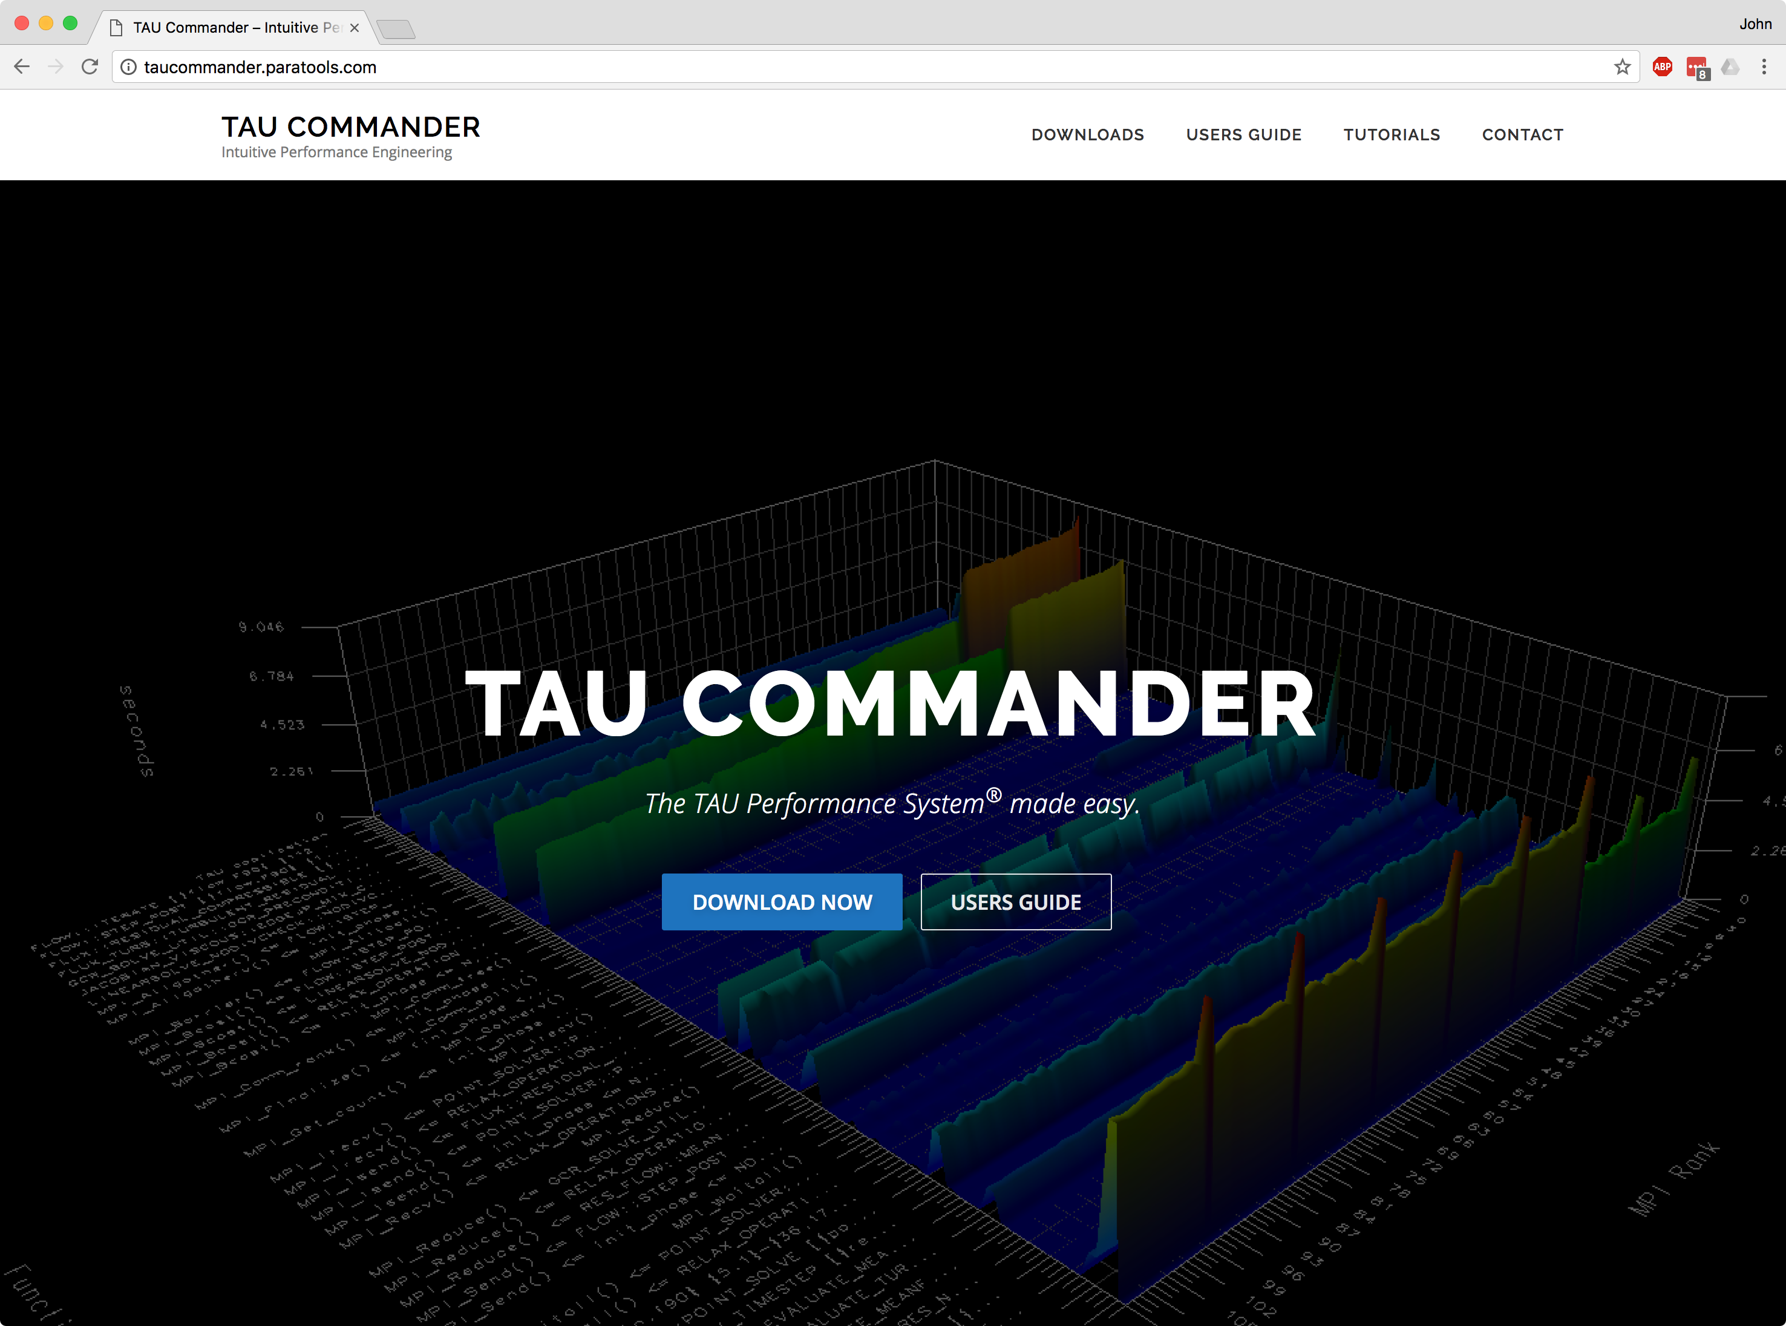
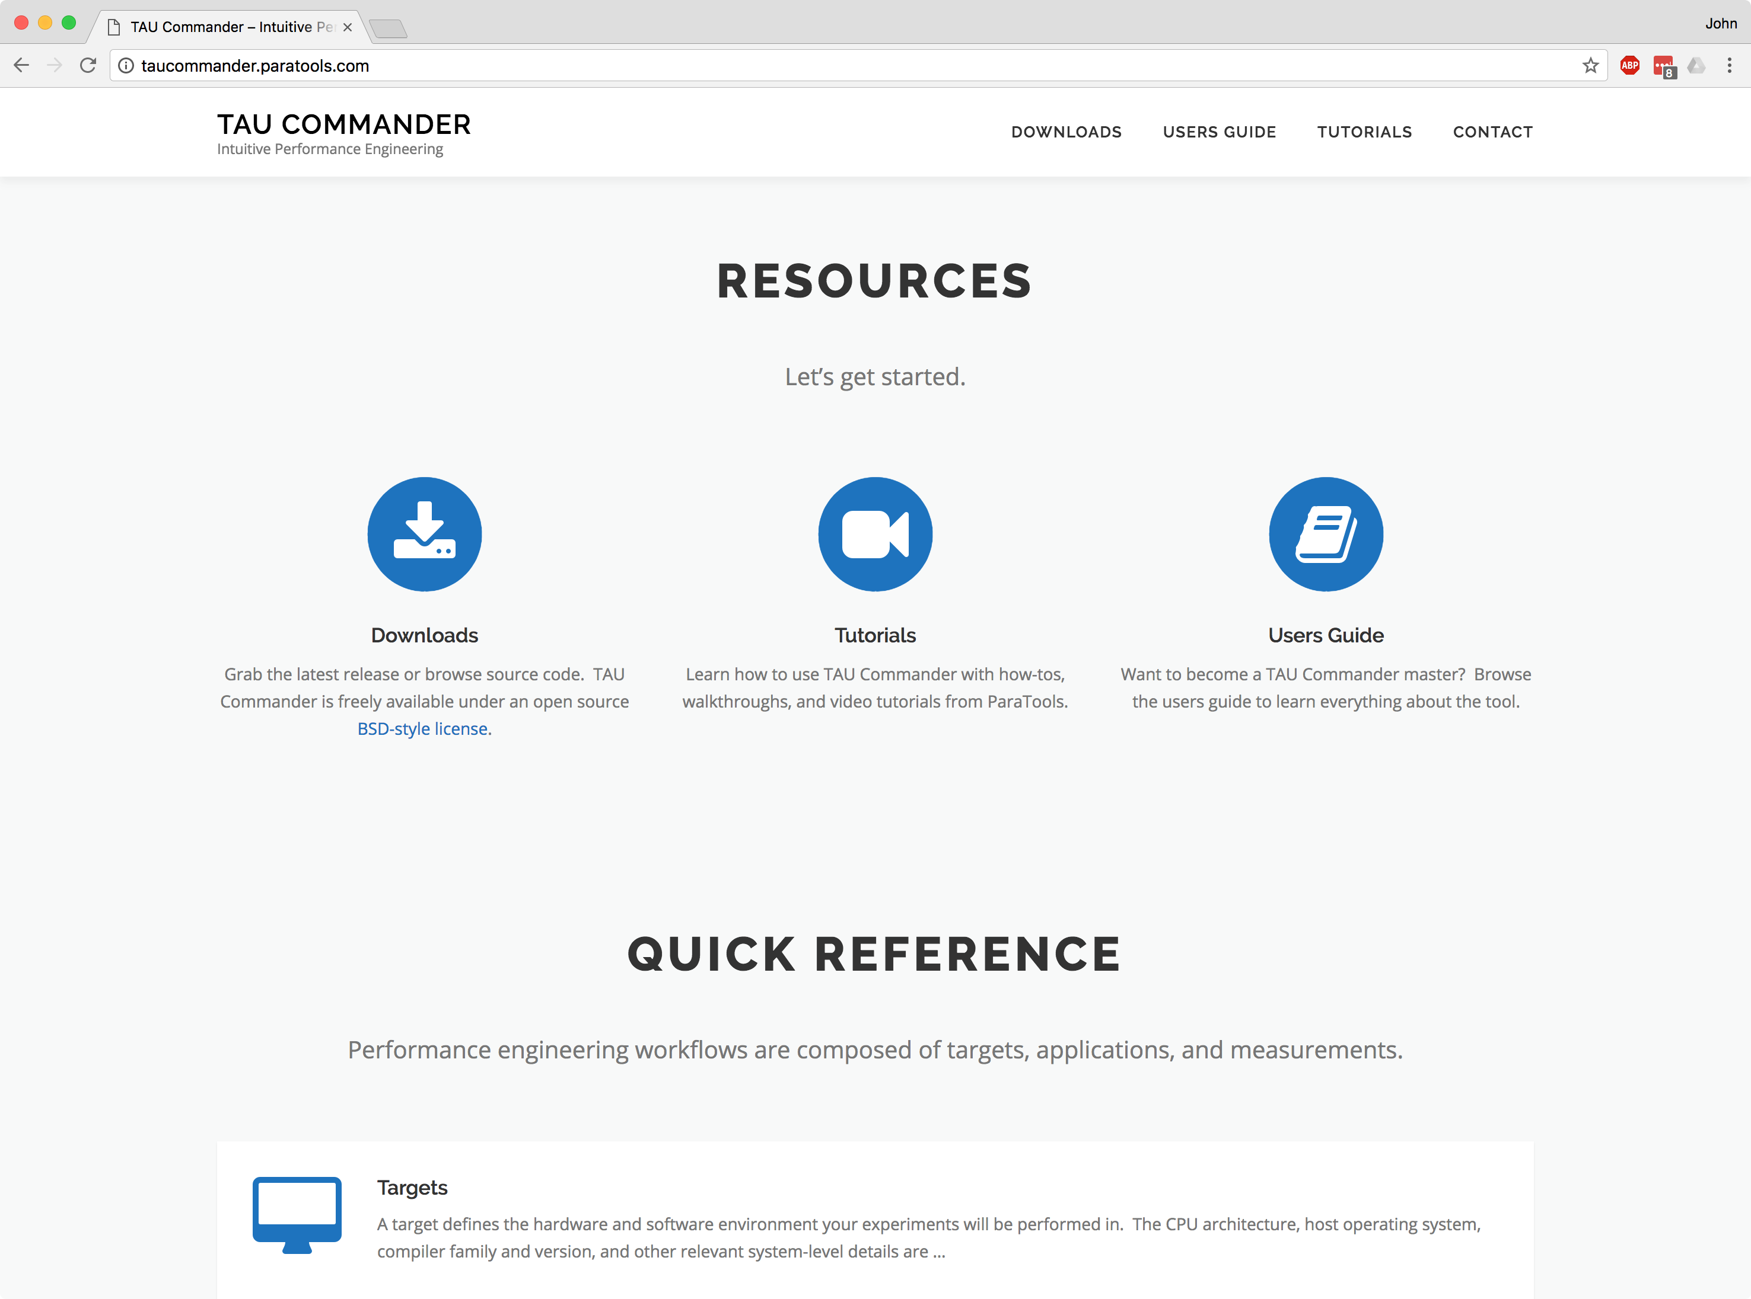
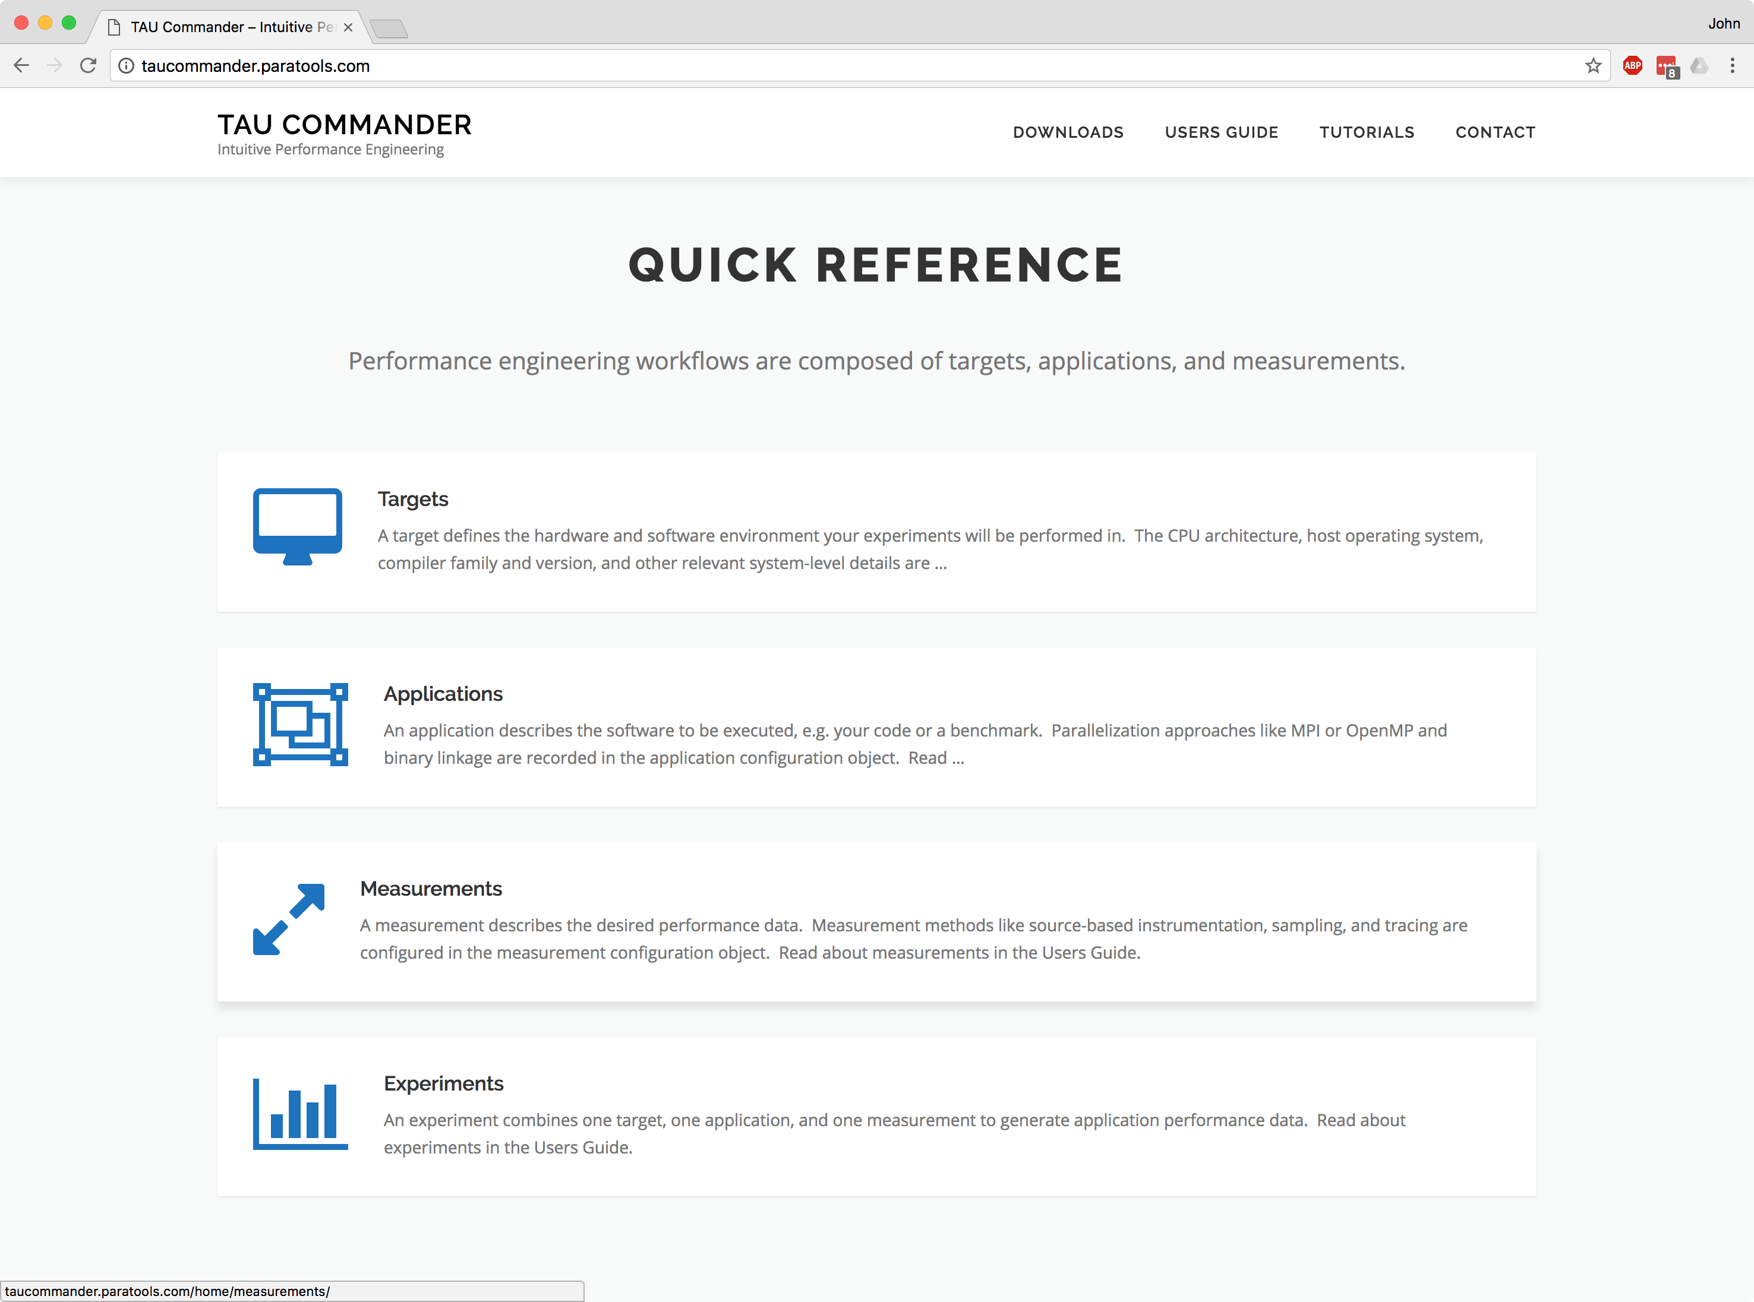
Download TAU Commander
www.taucommander.com
Free, open source, BSD license

Slide 3
Contact Info
Phone: 541-913-8797
Fax: 541-343-6086
info@paratools.com
ParaTools, Inc. 2836 Kincaid St. Eugene, OR 97405, USA

Slide 4
Acknowledgements
Department of Energy
Office of Science
Argonne National Laboratory
Oak Ridge National Laboratory
NNSA/ASC Trilabs (SNL, LLNL, LANL)
HPCMP DoD PETTT Program
National Science Foundation
Glassbox, SI-2
University of Tennessee
University of New Hampshire
Jean Perez, Benjamin Chandran
University of Oregon
Allen D. Malony, Sameer Shende
Kevin Huck, Wyatt Spear
TU Dresden
Holger Brunst, Andreas Knupfer
Wolfgang Nagel
Research Centre Jülich
Bernd Mohr
Felix Wolf

