Slide 1
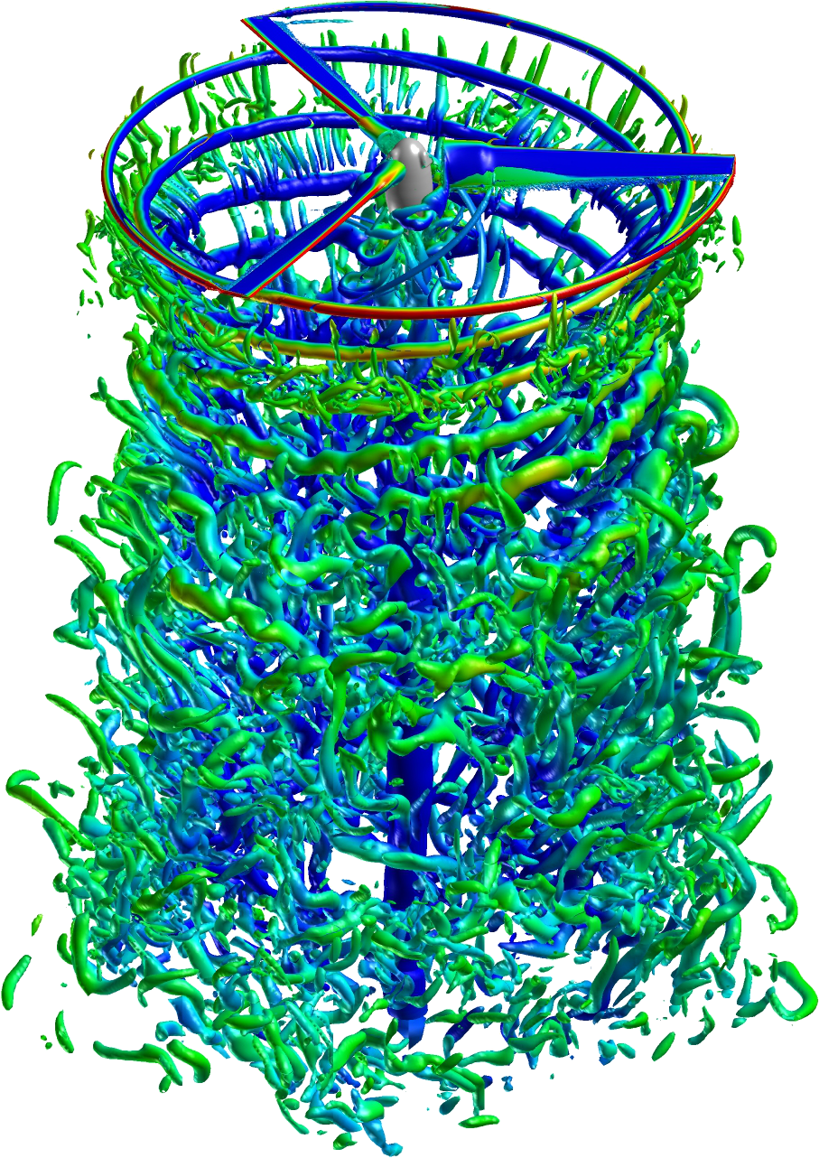
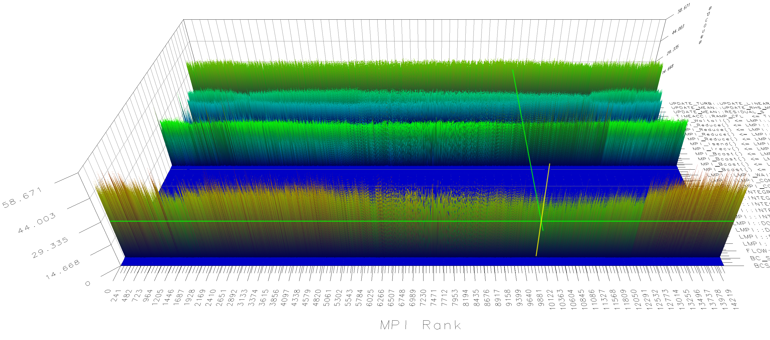
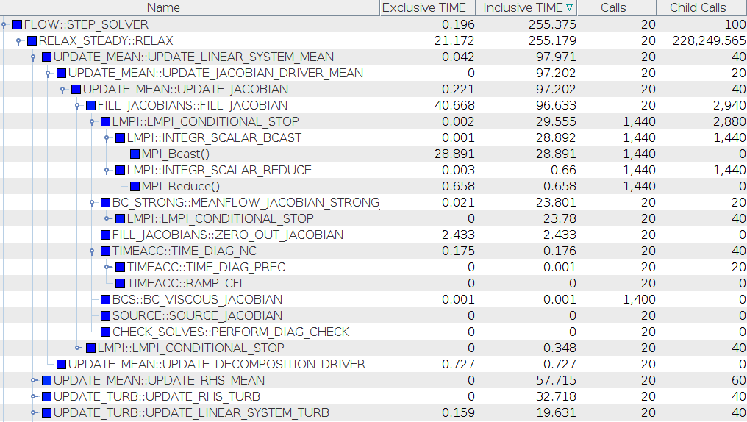
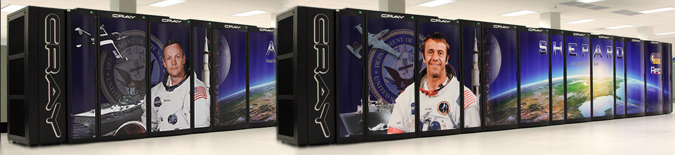
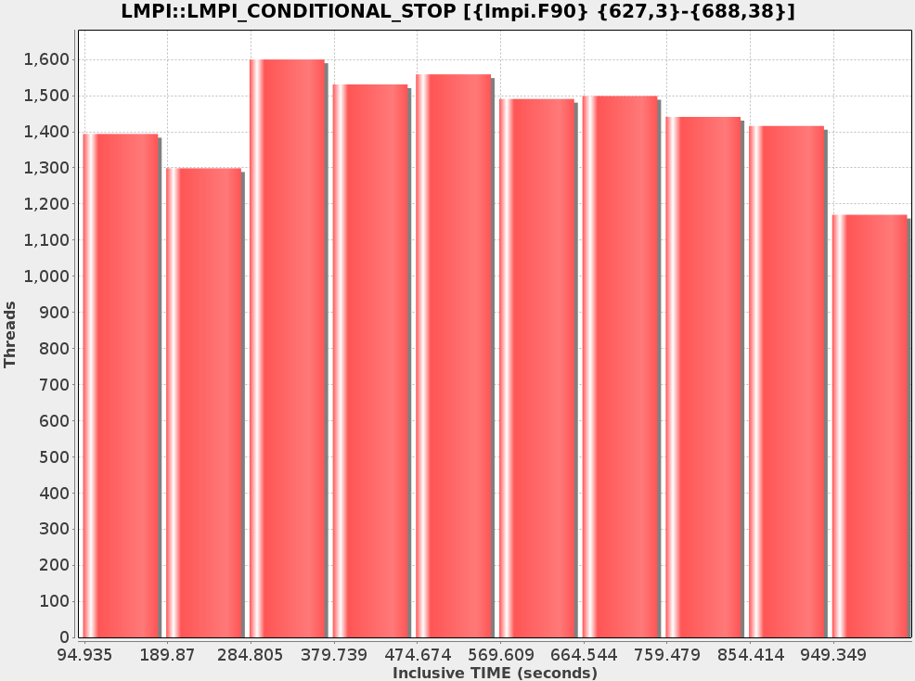
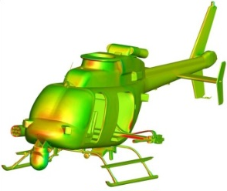
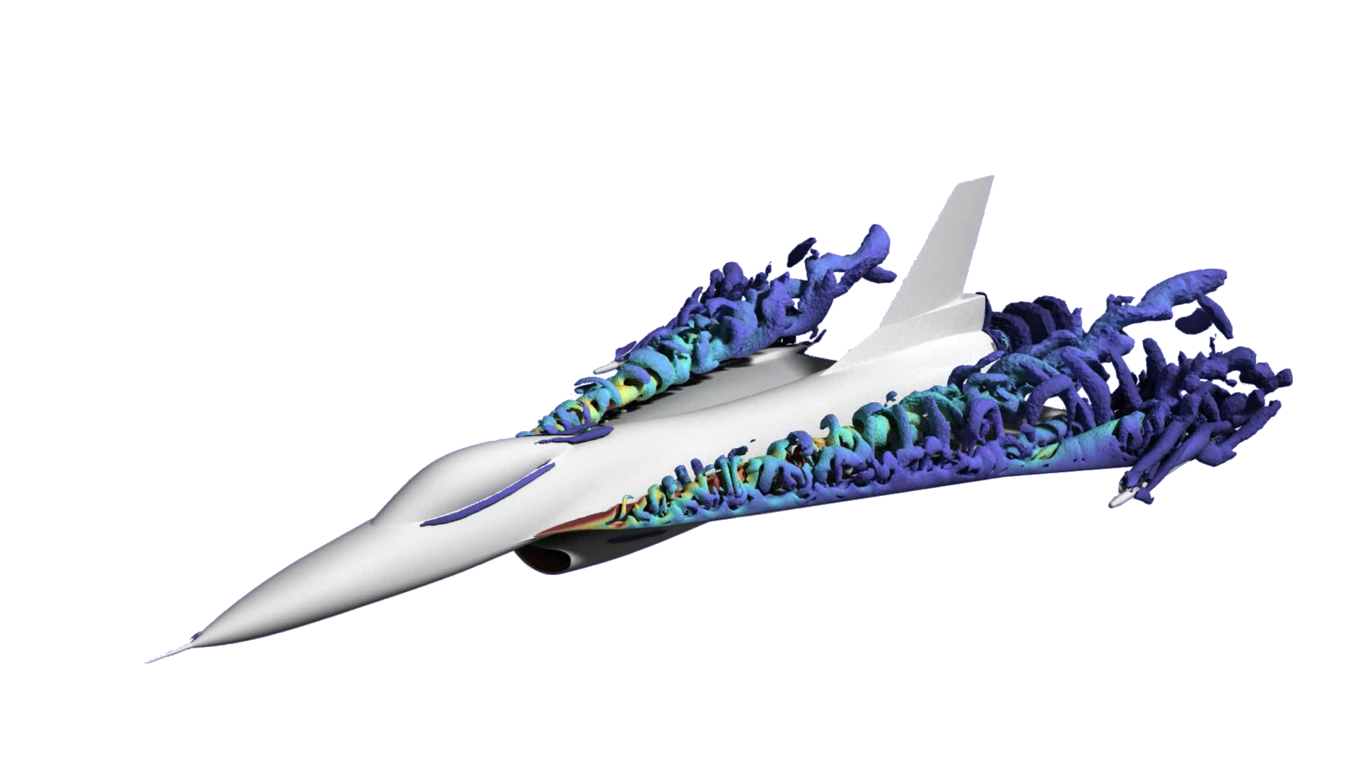
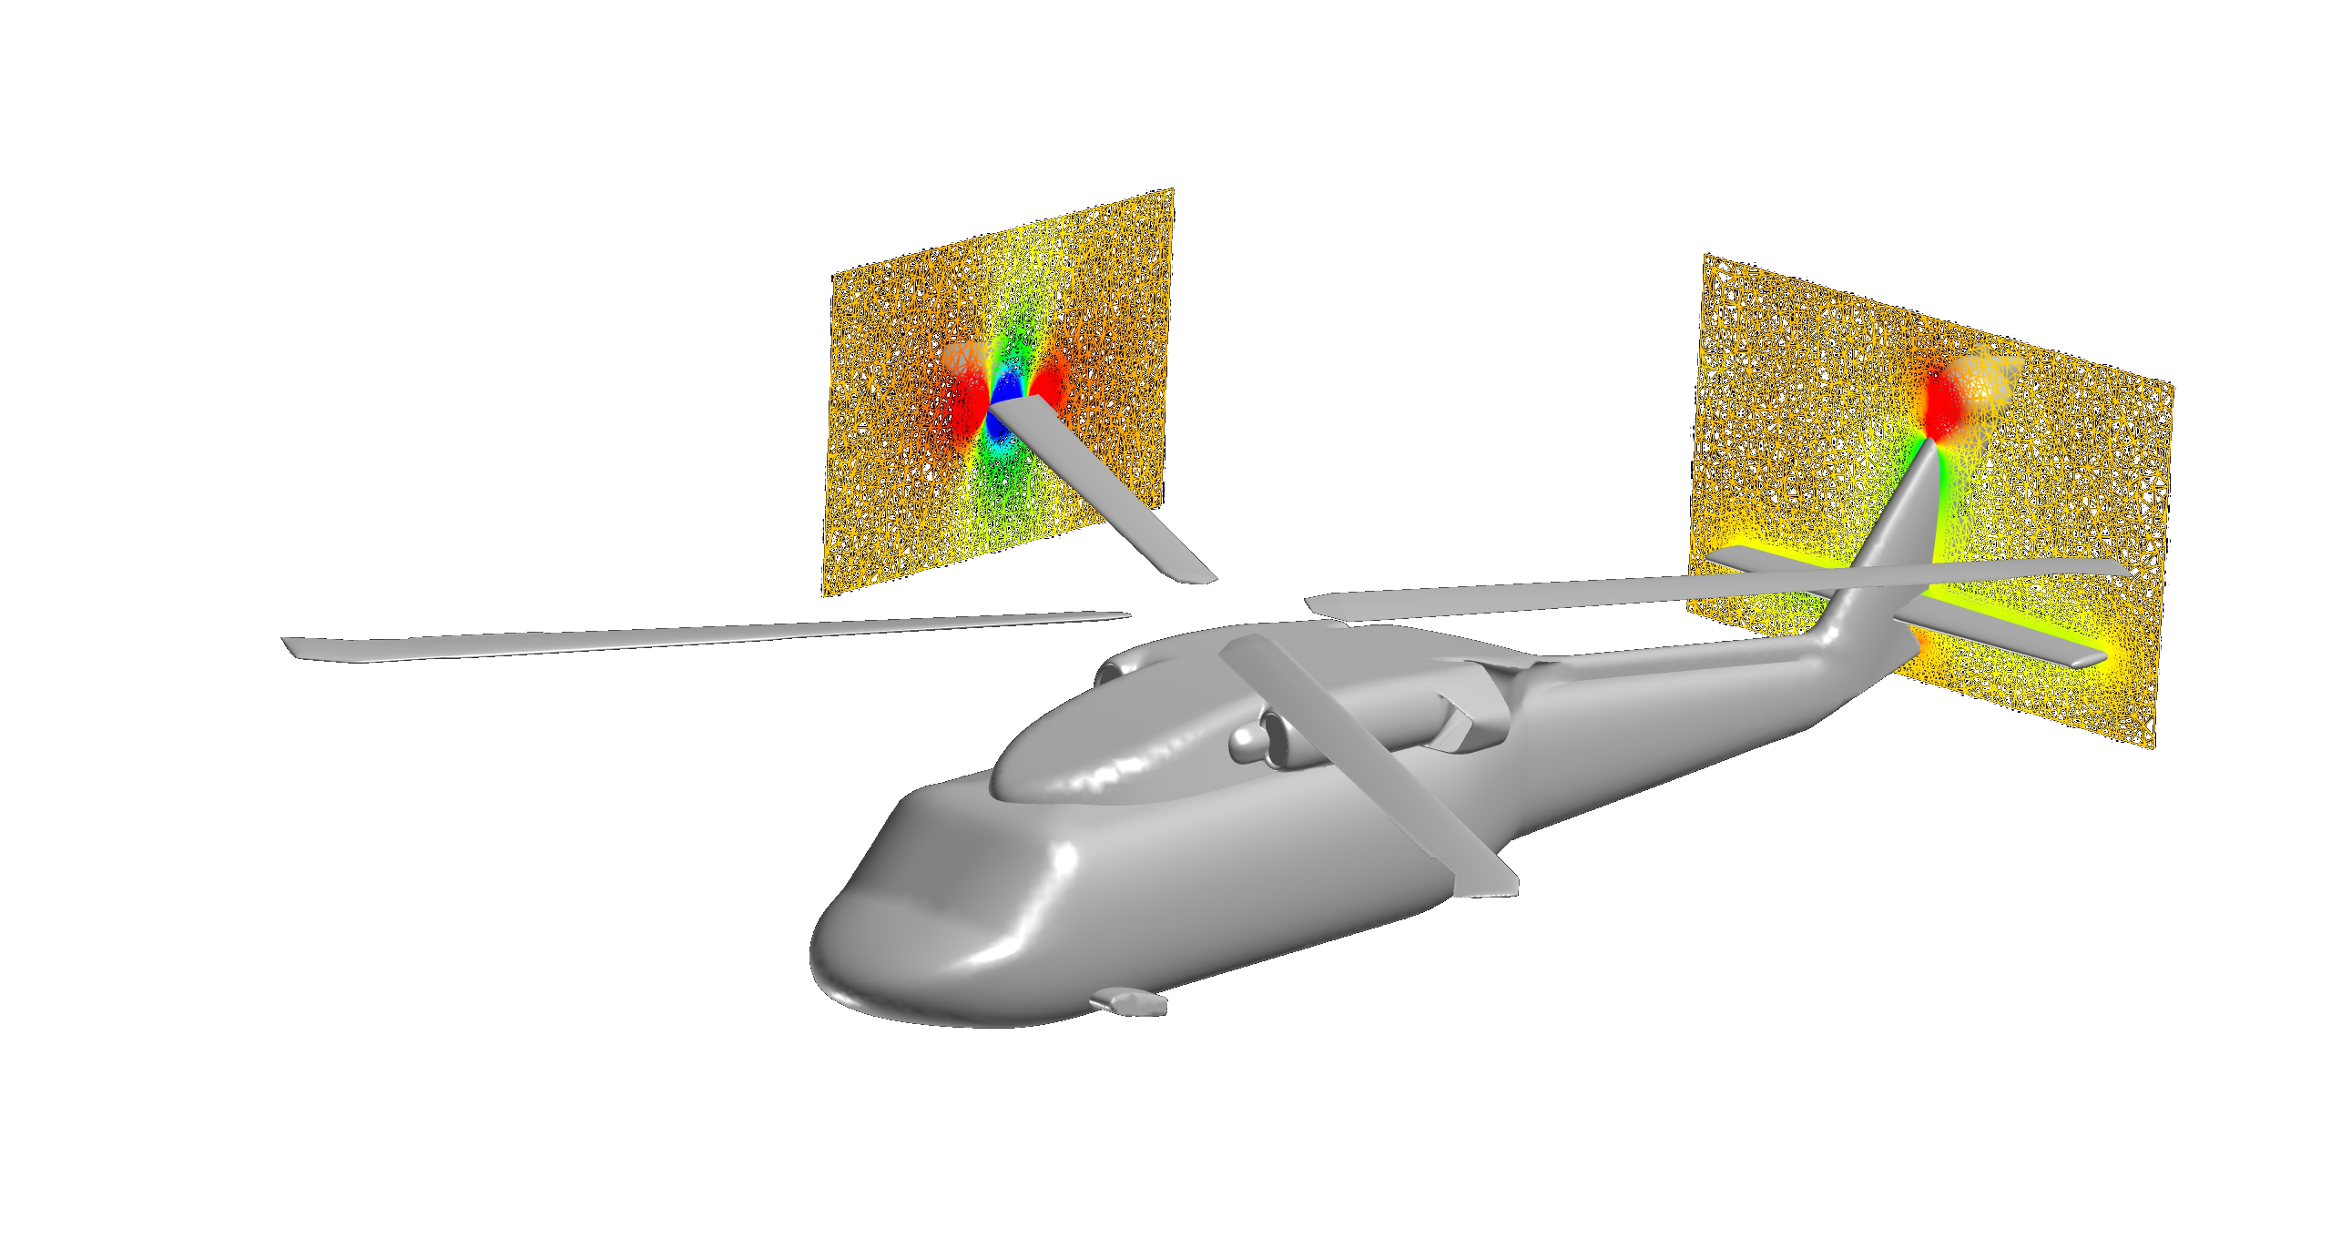
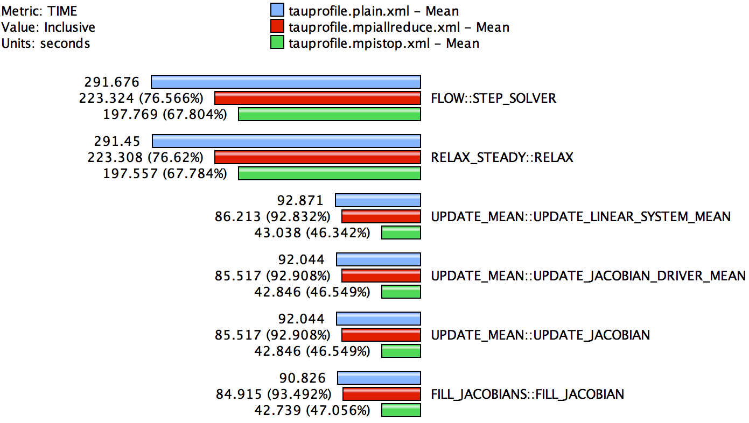
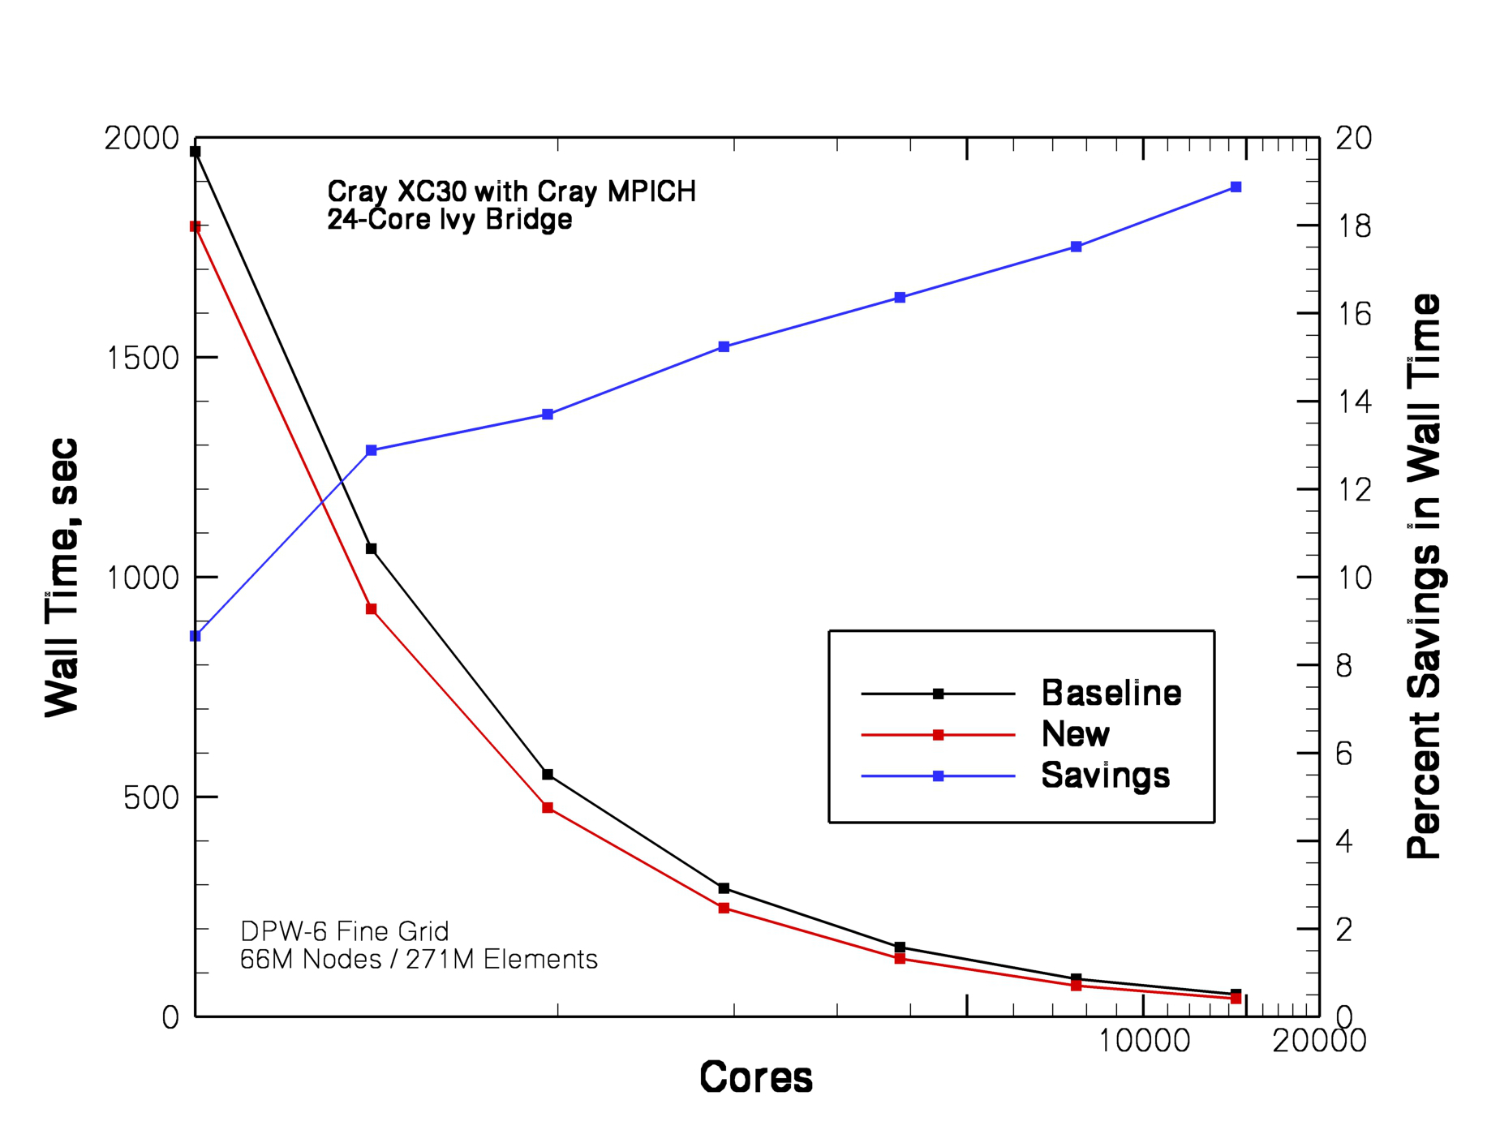
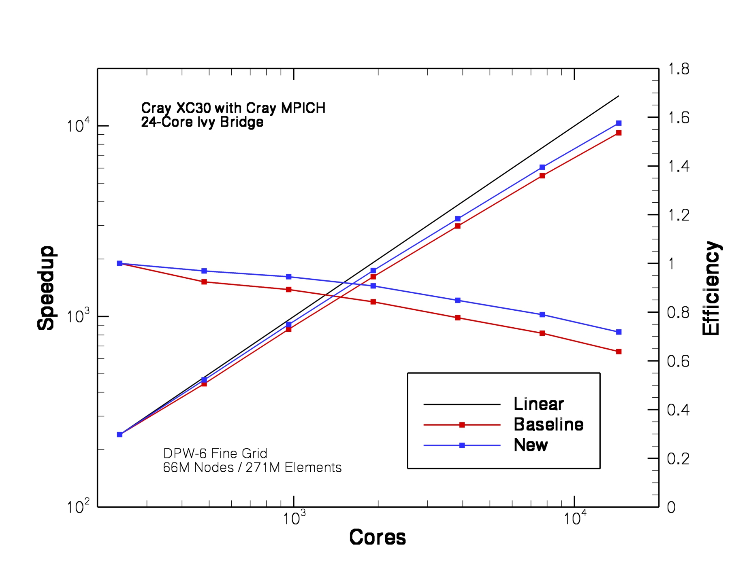
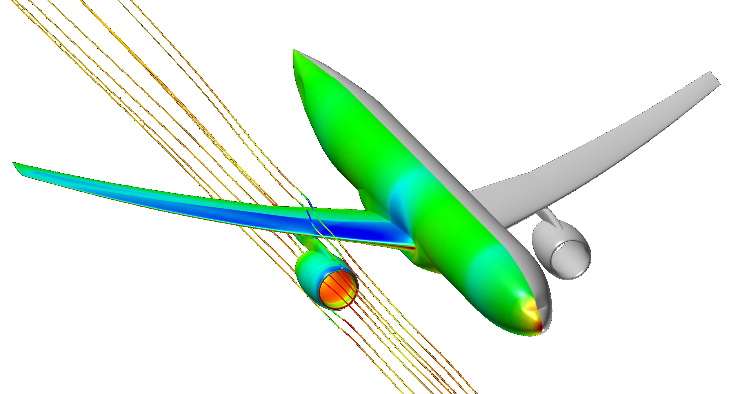
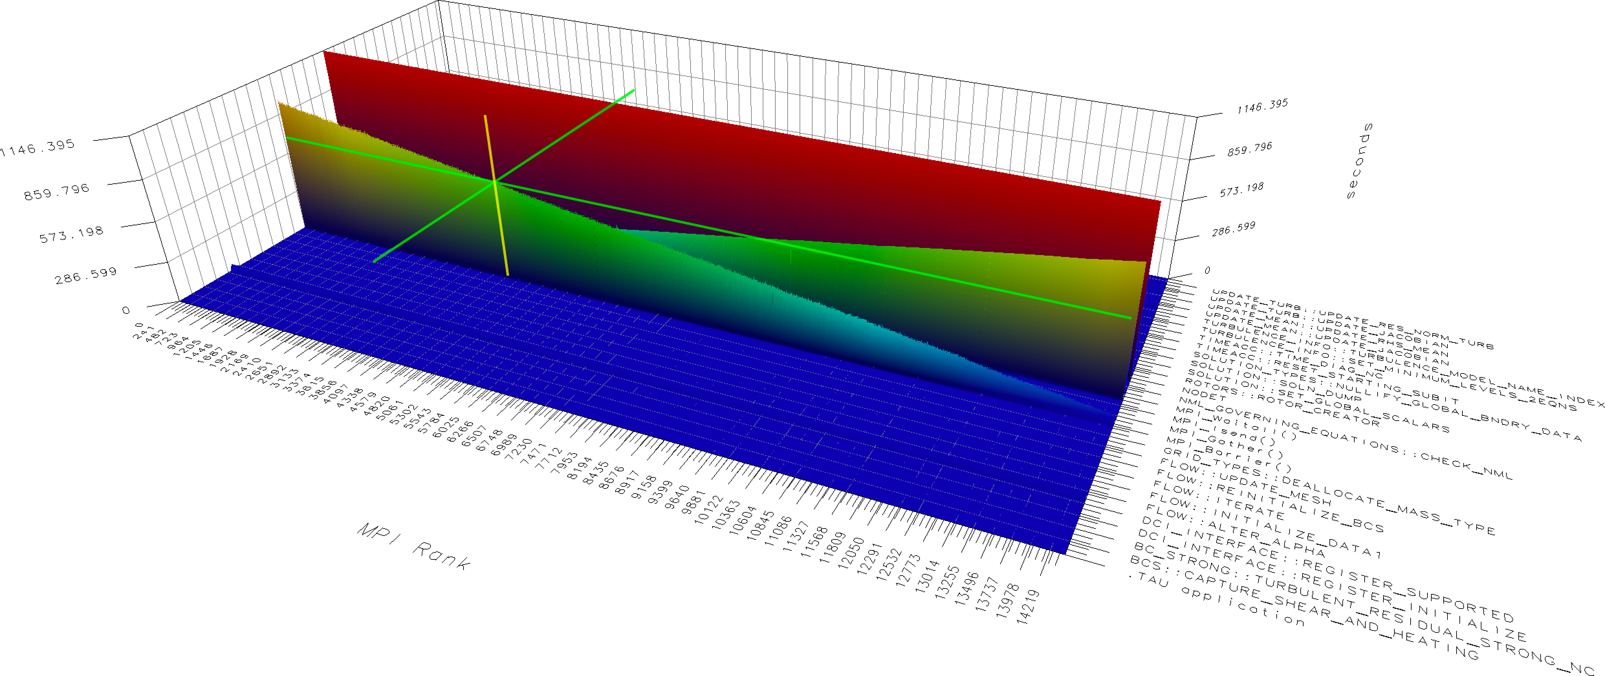
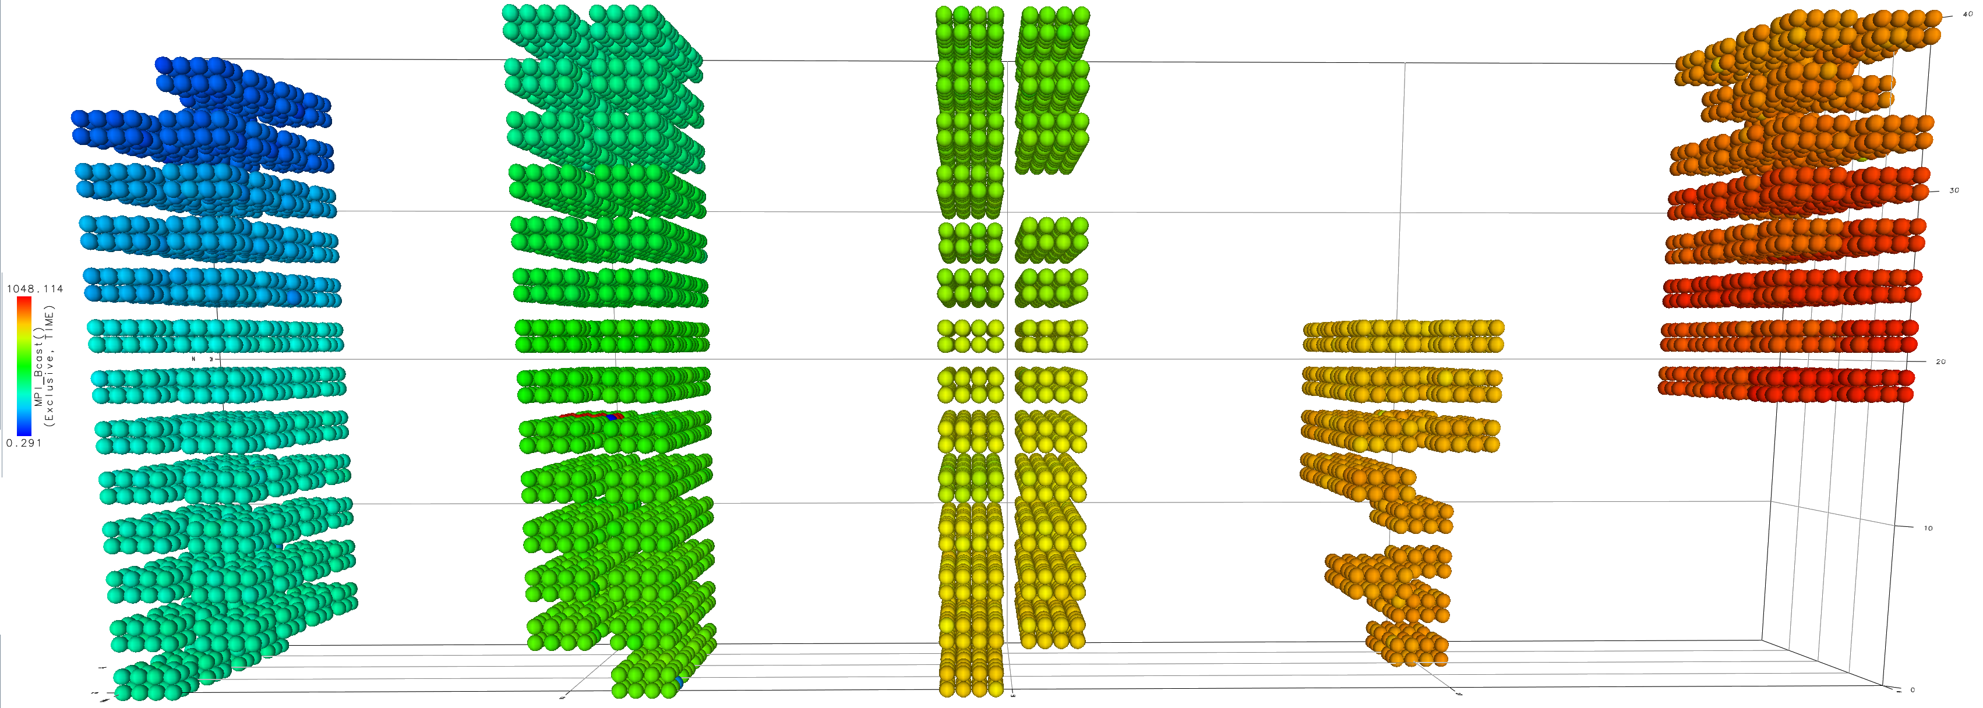
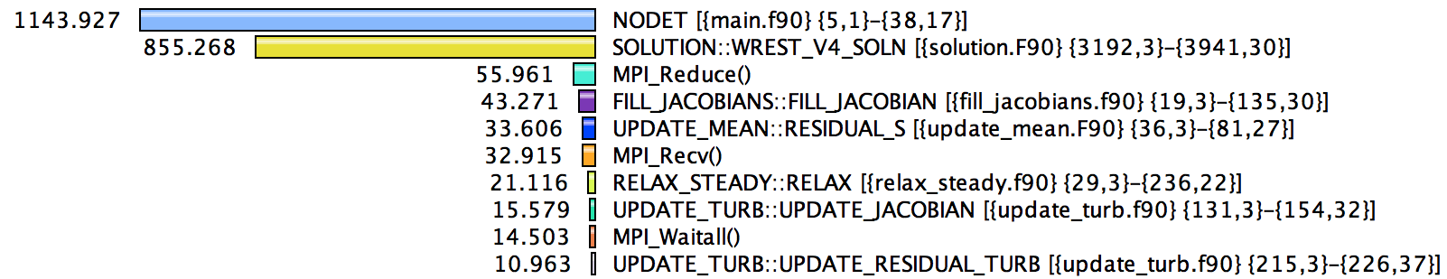
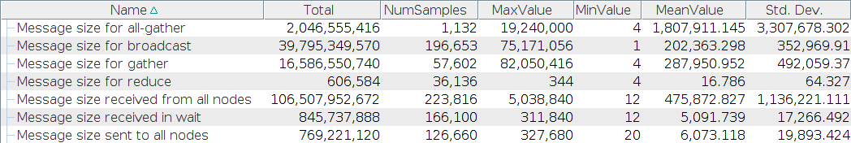
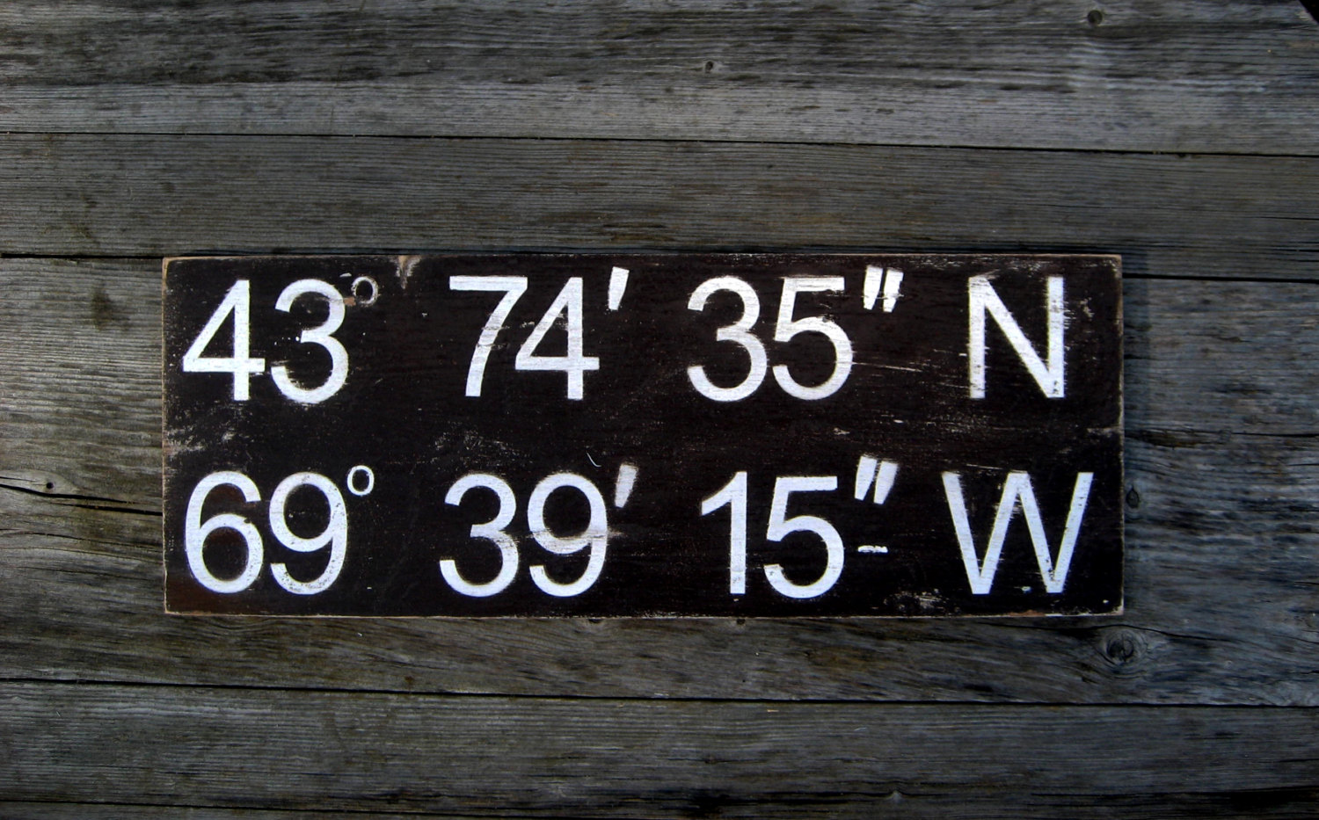
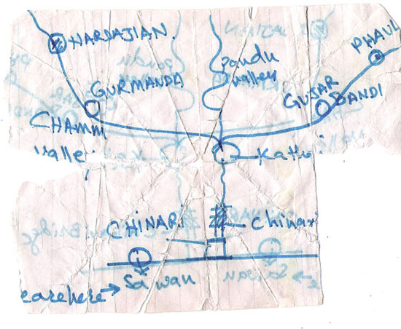
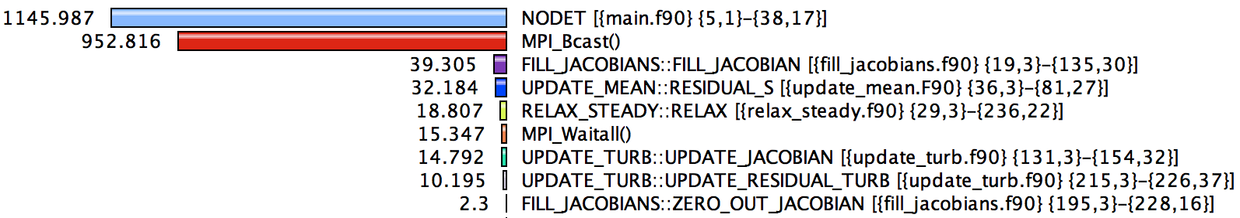
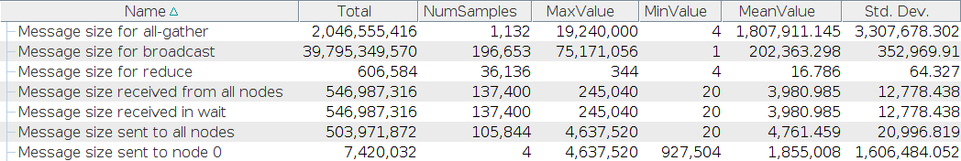
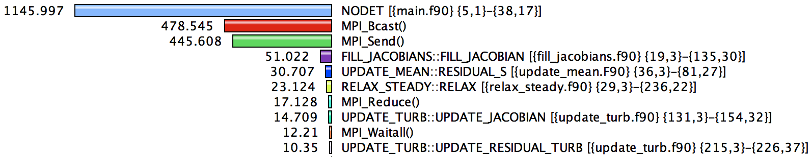
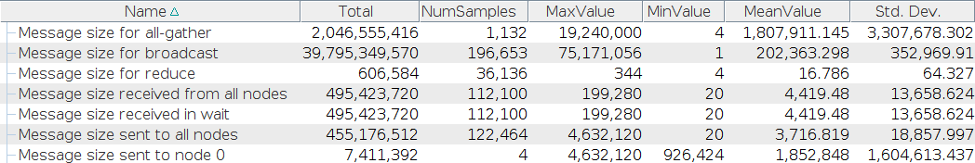
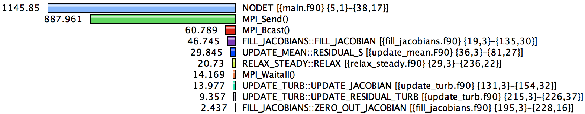





Performance Engineering FUN3D at Scale with TAU Commander
John C. Linford^{*1}, Srinath Vadlamani¹, Sameer Shende¹, Allen D. Malony¹, William Jones², William Kyle Anderson², and Eric Nielsen²
¹ParaTools, Inc. Eugene, OR 97405, U.S.A.
²NASA Langley Research Center, Hampton, VA 23681, U.S.A.
The FUN3D Solver
FUN3D at the Department of Defense
Performance Analysis
NASA Langley Research Center's FUN3D software is an unstructured-grid computational fluid dynamics suite used to tackle complex aerodynamics problems. The toolset enables multidisciplinary capabilities through coupling to variable fidelity models encompassing structural effects, multi-body dynamics, acoustics, radiation, optics, propulsion, and ablation. FUN3D provides the world's foremost adjoint-based design capability, enabling formal optimization of time-dependent moving-body simulations involving turbulent flows. The adjoint formulation is also used to perform mathematically-rigorous mesh adaptation and error estimation.
FUN3D is being applied to a broad spectrum of analysis and design problems across all the major service branches at the Department of Defense (DoD). These applications span the speed range from subsonic to hypersonic flows and include both fixed- and rotary-wing configurations as well as a diverse array of weapons systems.
Load imbalance in FILL_JACOBIAN is easily visible by comparing against the lowest time in this routine and viewing the function histogram. On average, the routine took 96.6 seconds, of which 28.8 seconds are spent in MPI_Bcast. The broadcast operation takes place in LMPI_CONDITIONAL_STOP, which has dramatically different times across all MPI ranks.
Coupled Helios-FUN3D Simulation Courtesy Rohit Jain, US Army Aviation Development Directorate - AFDD
FUN3D is in routine use across the various DoD Supercomputing Resource Centers (DSRCs). To accommodate an ever-increasing demand for larger and more complex simulations, the FUN3D development team is partnered with computational experts from ParaTools, Inc. through the DoD/Engility Productivity Enhancement, Technology Transfer and Training Project (PETTT). Through this collaboration, the team is effectively identifying and addressing computational barriers encountered at scale.
Credit: US Army
Analyzing data from the 14.4k core run revealed a communication bottleneck in LMPI_CONDITIONAL_STOP. Rank 0 performs a data reduction on behalf of all other ranks, so all other ranks remain idle until Rank 0 finishes the calculation. The severity of the problem grew linearly in the number of MPI ranks.
FUN3D is widely used to support major national research and engineering efforts at NASA and among groups across U.S. industry, other government agencies, and academia. A past collaboration with the Department of Energy received the prestigious Gordon Bell Prize, which recognizes outstanding achievements in high-performance computing.
TAU Commander
Project Goal
TAU Commander simplifies the TAU Performance System® by using a structured workflow approach that gives context to a TAU user’s actions. This eliminates the troubleshooting step inherent in the traditional TAU workflow and avoids invalid TAU configurations.
The team is using TAU commander and related tools on the DoD DSRC systems to study FUN3D computational performance and to guide optimization efforts. TAU Commander highlights source code regions that limit scalability through profiling, tracing, and aggregate summary statistics with respect to computational time, memory allocation, and memory access patterns. The analysis approach is being carefully documented to assist other DoD groups in similar performance evaluation activities.
The team implemented a new approach that did not require the data reduction operation. This improvement reduced runtime by up to 33% in core solver routines and is included in the FUN3D 13.0 release.
Add TAU to PATH
Setup
Need to Parse Code?
Yes
Download PDT
Setup
No
Configure PDT
Configure TAU
Compile/Install PDT
Create or Select Experiment
Yes
Compile TAU
When writing the solution file to disk, there is a strong correlation between MPI rank and time spent in MPI_Bcast and MPI_Send. This operation occurs only once every few hours in production. Further optimization should focus on load balance in the PDE solution.
Instrument
Compilation
Error?
Use TAU to compile
No
Instrument
1,651,089,924 grid points
5,902,801,476 tetrahedral elements
1,310,290,264 prismatic elements
14,400 Ivy Bridge cores
Setup Environment
No
Instrument
Source Code?
Launch Application
Yes
Yes
No
Yes
Use TAU to Compile
Troubleshoot
Measure
Incorrect TAU Config
Compiler Env Vars
Correct?
Compilation
Error?
No
No
Desired Metrics
Measured?
Yes
No
Required tau_exec
Tags Available?
Yes
Setup Environment
tau_exec
Required?
Measure
Yes
No
To establish a baseline database of FUN3D performance metrics, the team used TAU Commander to profile a high Reynolds number simulation of the flow over a wing-body-pylon-nacelle geometry. The computation was performed using 600 nodes (14,400 Intel® Xeon® Ivy Bridge cores) on Shepard, a Cray XC30 system located at the Navy DSRC.
MPI_Bcast is called the same number of times with the same message size for all ranks, yet time spent in MPI_Bcast varies dramatically by rank. Rank 0 receives data from all others and writes it to disk, hence N-1 ranks spend the majority of their time in this operation waiting for I/O on Rank 0. This suggests implementing parallel I/O and distributed checkpoints.
Analyze
No
Launch with tau_exec
Launch Application
TAU Commander Workflow
Yes
Runtime Env Vars
Correct?
No
Desired Metrics
Measured?
Yes
Analyze
Traditional TAU Workflow
A study of 124 workflows demonstrated that using TAU Commander reduces the number of unique steps in the performance workflow by approximately 50% and reduces the number of commands a user must know from approximately eight to exactly one. TAU Commander is installed on several DoD DSRC systems.
MPI Rank 0
MPI Rank 0
The majority of MPI ranks are physically co-located with their immediate neighbors to optimize communication performance. Five cabinets of Shepard are visible.
MPI Rank 1
MPI Rank 1
Improve productivity by specifying the
desired result, not step-by-step directions.
vs
All MPI ranks on one node in this slot perform below average.
All nodes in this slot perform slightly above average.
MPI Rank 7260
MPI Rank 14399
Acknowledgments
MPI Rank 14399
This work was developed in part by the User Productivity Enhancement, Technology Transfer and Training (PETTT) Project No. PETA-KY07-001 and by DoE SBIR Grant No. DE-SC0009593. The authors would like to acknowledge the computational resources and PETTT software support from the DoD High Performance Computing Modernization office under Contract No. GS04T09DBC0017.
Additional information, visualizations, and slides.
Topology plot showing physical locations of all MPI ranks.
* Corresponding author: jlinford@paratools.com
DISTRIBUTION STATEMENT A. Approved for public release; distribution is unlimited.

