Slide 1

Drs. Allen Malony, Sameer Shende, John C. Linford, et al.
{malony, sameer, jlinford}@paratools.com
2 February 2017
Northrop Grumman
Woodlawn, MD

Slide 2
Contact Info
Dr. John Linford: 540-808-9250
Phone: 541-913-8797
Fax: 541-343-6086
info@paratools.com
ParaTools, Inc.
2836 Kincaid St.
Eugene, OR 97405, USA
Today’s Goal: Make Contact!

Slide 3
Outline
Introduction to ParaTools Inc.
The TAU Performance System®
ParaTools ThreadSpotter
Success Stories
Q&A

Slide 4
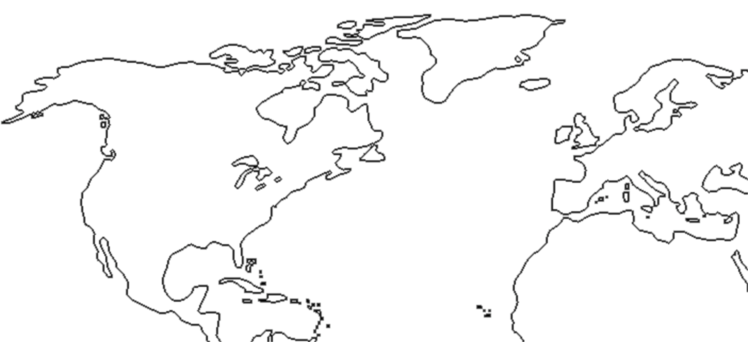
ParaTools
Allen Malony (CEO)
Sameer Shende (President)
John Linford
Jean-Baptiste Besnard
Srinath Vadlamani
Wyatt Spear
Kevin Huck
Oregon
United Kingdom
France
Colorado
Maryland

Slide 5
ParaTools Accelerates Software
Policy
National Security
Time-to-market
Cyber security
Quality
Research
Simulation
Weapons research
Intelligence
Analysis
Testing
Energy
Environment
Emergency
Engineering & Manufacturing
Contingency

Slide 6

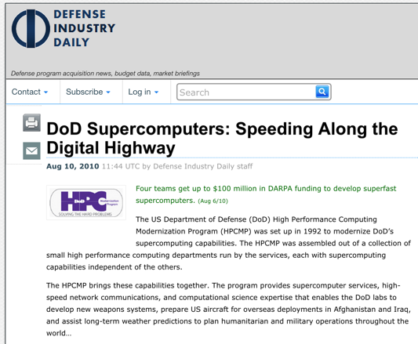

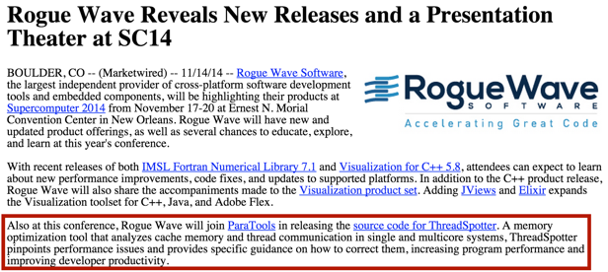
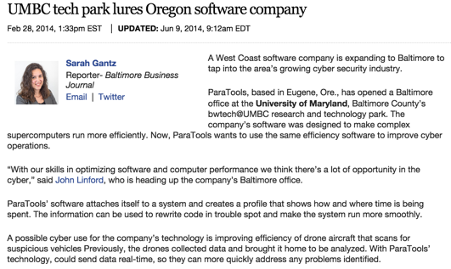
In the Press
http://tau.uoregon.edu/success/irmhd.pdf
http://www.defenseindustrydaily.com/Up-to-1471M-to-HPTi-for-DoD-High-Performance-Computing-Work-05688/
http://java.sys-con.com/node/3228954
http://www.bizjournals.com/baltimore/blog/cyberbizblog/2014/02/umbc-tech-park-lures-oregon-software.html

Slide 7










Partnerships

Slide 8
Products and Services
The TAU Performance System®
Kppa
RotCFD
ParaTools ThreadSpotter
HPC Linux
PToolsRTE
PToolsWin
IQB
Vampir
TAU Commander / TAU Enterprise
Performance Engineering
Software Development
Algorithm Development
Software Porting
Hosting
Data Analytics
ParaTools® and IQB® are registered trademarks of ParaTools, Inc.
ParaTools is the sole licensee of the TAU Performance System® trademark owned by the State of Oregon acting by and through the State Board of Higher Education on behalf of the University of Oregon.

Slide 9
Products and Services
The TAU Performance System®
Kppa
RotCFD
ParaTools ThreadSpotter
HPC Linux
PToolsRTE
PToolsWin
IQB
Vampir
TAU Commander / TAU Enterprise
Performance Engineering
Software Development
Algorithm Development
Software Porting
Hosting
Data Analytics
ParaTools® and IQB® are registered trademarks of ParaTools, Inc.
ParaTools is the sole licensee of the TAU Performance System® trademark owned by the State of Oregon acting by and through the State Board of Higher Education on behalf of the University of Oregon.

Slide 10
The Tau Performance System
Keeping Up With Technology

Slide 11
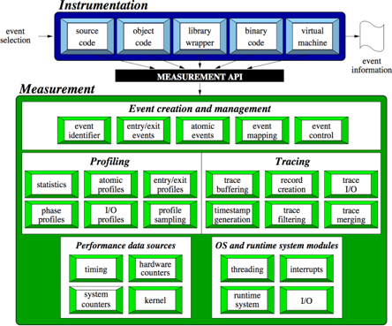
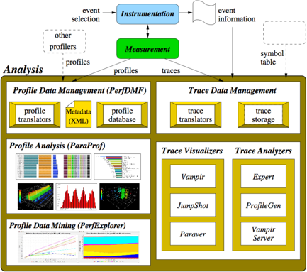
The TAU Performance System®
TAU Architecture
Toolkit for performance problem solving and software situational awareness
  Instrumentation, measurement, analysis, visualization
  Portable profiling and tracing
  Performance data management and data mining
Free, open source, BSD license
http://tau.uoregon.edu/

Slide 12
Questions TAU Can Answer
How much time is spent in each application routine and outer loops? Within loops, what is the contribution of each statement?
How many instructions are executed in these code regions?
Floating point, Level 1 and 2 data cache misses, hits, branches taken, vector instructions?
What is the memory usage of the code? When and where is memory allocated/de-allocated? Are there any memory leaks?
What are the I/O characteristics of the code? What is the peak read and write bandwidth of individual calls, total volume?
What is the time spent waiting for collectives (e.g. reduce)?
How does the application scale?

Slide 13
Use Cases
Code Modernization and Hardening
  CREATE-AV HELIOS / KESTREL
    Army, Navy, Air Force, NASA, Boeing…
  FraPPE: Framework for Parallel Program Engineering
    Army, NASA
Performance Provenance
  Protection (like ClearCase for performance)
Performance Optimization
  Load balancing
  “Hot spot” identification
  Improvement quantification
Performance Regression Testing

Slide 14
Apples to Apples Across Platforms
C/C++
CUDA
UPC
Python
GPI
Fortran
OpenACC
MPI
Java
pthreads
Intel MIC
OpenMP
Intel
GNU
PGI
Sun
LLVM
Cray
MinGW
AIX
Linux
Windows
Insert yours
here
BlueGene
Fujitsu
ARM
Android
MPC
OS X

Slide 15
Measurement at Every Layer
(But not Cray only!)
Copyright © Cray Inc.

Slide 16
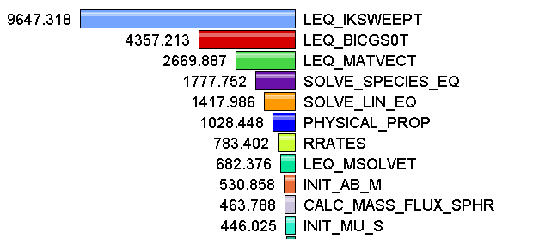
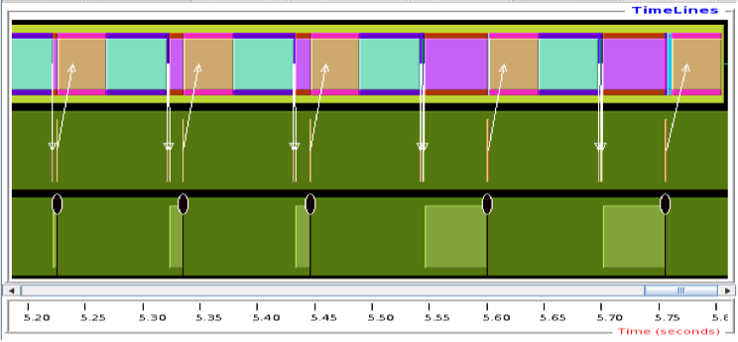
Measurement Approaches
Profiling
Tracing
Shows
how much time was spent in each routine
Shows
when events take place on a timeline

Slide 17
How Much Data do you Want?
Limited
Profile
Loop
Profile
Callpath
Profile
O(KB)
O(TB)
Flat
Profile
Phase
Profile
Trace
All levels support multiple metrics/counters

Slide 18
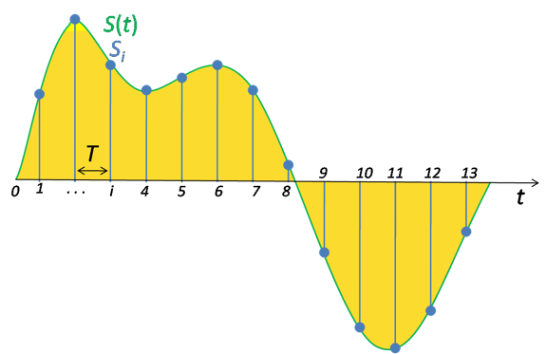
Performance Data Measurement
Direct via Probes
Indirect via Sampling
call TAU_START(‘potential’)
// code
call TAU_STOP(‘potential’)
Exact measurement
Fine-grain control
Code region granularity
Calls inserted into code
No code modification
Minimal effort
Code line granularity
Uses debug symbols

Slide 19


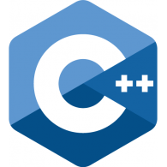
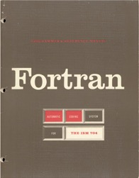
Multi-Language Debugging
Identify the source location of a crash by unwinding the system callstack
Identify memory errors (off-by-one, etc.) across language boundaries
double * x =
new double[5];
A = x(1:10) + 5

Slide 20
Data Analysis with TAU
Keeping Up With Technology

Slide 21
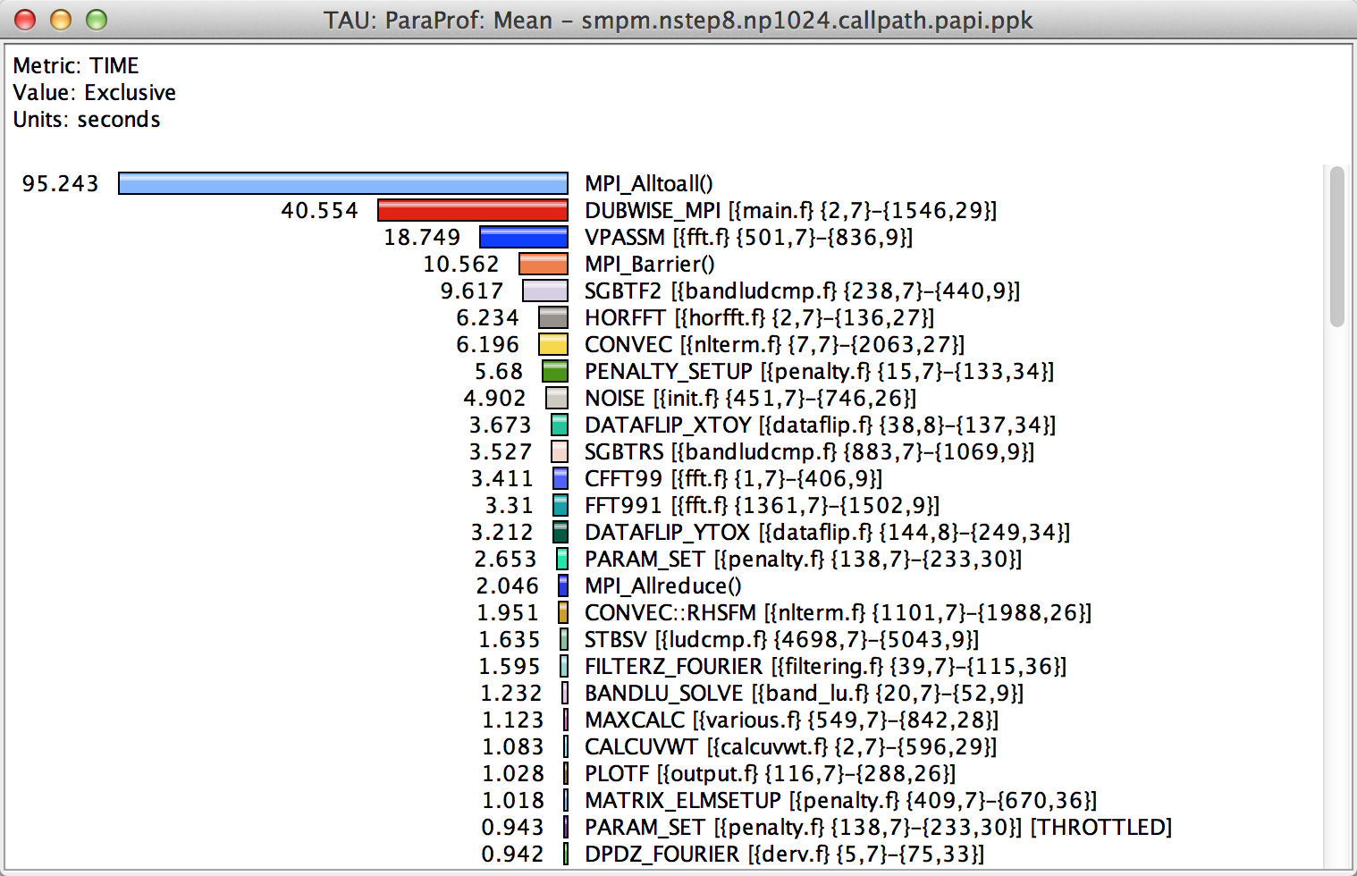
How Much Time per Code Region?
Notes:
How much time per code region?
How many instructions per code region?
What is the cost of each code statement?
L1 or L2 cache misses?

Slide 22
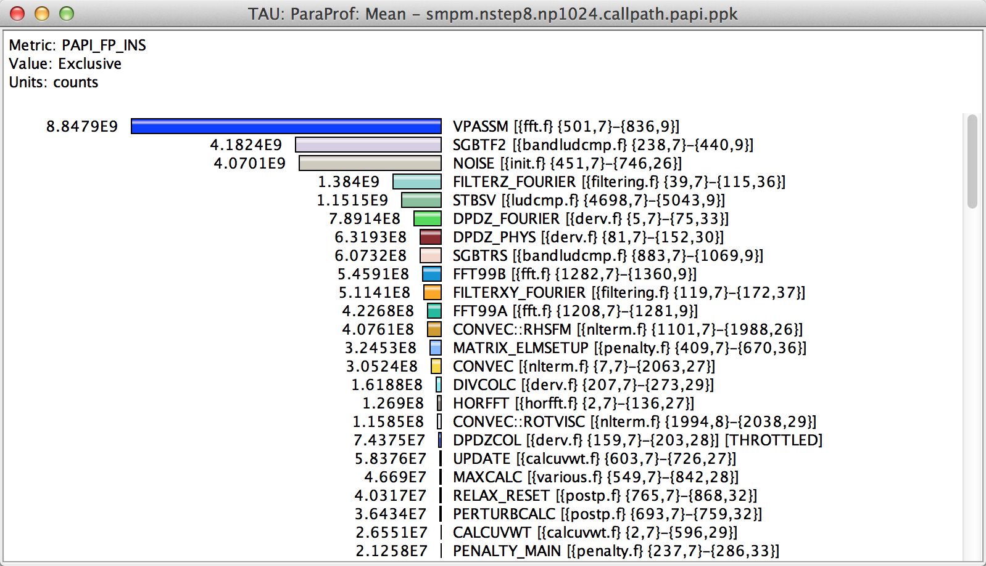
How Many Instructions per Code Region?
Notes:
How much time per code region?
How many instructions per code region?
What is the cost of each code statement?
L1 or L2 cache misses?

Slide 23
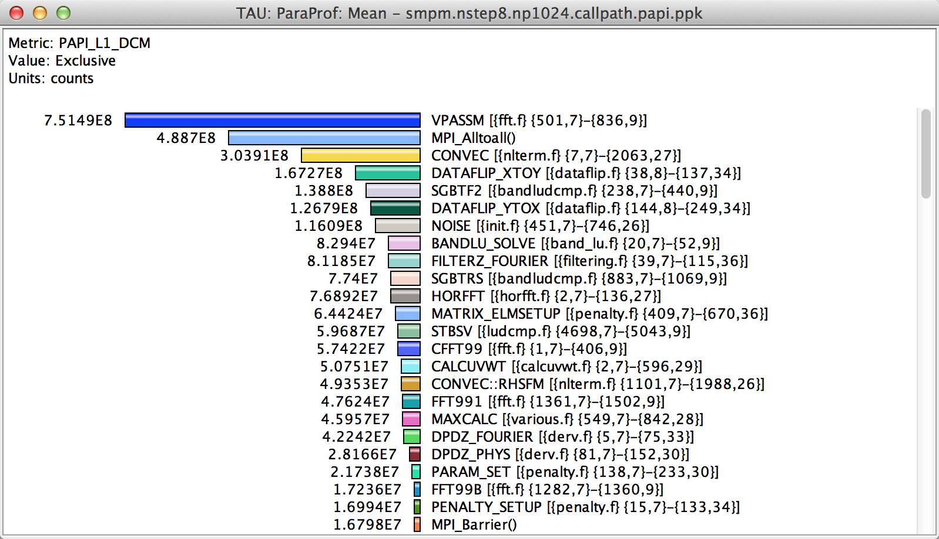
How Many L1/L2/L3 Cache Misses?
Notes:
How much time per code region?
How many instructions per code region?
What is the cost of each code statement?
L1 or L2 cache misses?

Slide 24
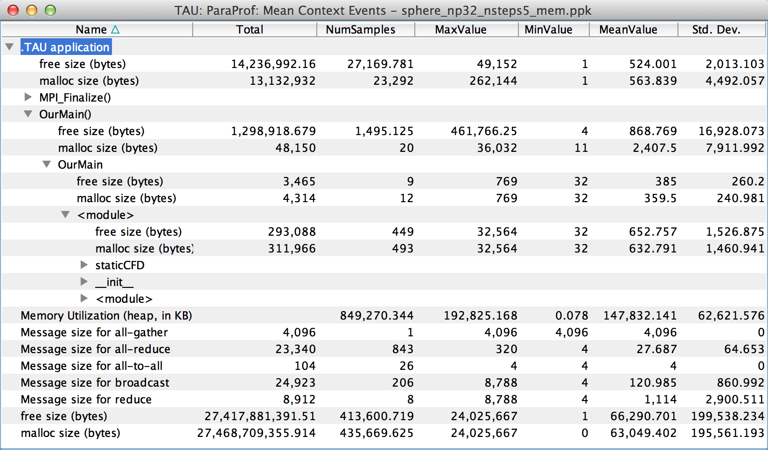
How Much Memory Does the Code Use?
High-water mark
Notes:
Heap memory usage reported by the mallinfo() call is not 64-bit clean.
32 bit counters in Linux roll over when > 4GB memory is used
We keep track of heap memory usage in 64 bit counters inside TAU
Compensation of perturbation introduced by tool
Only show what application uses
Create guards for TAU calls to not track I/O and memory allocations/de-allocations performed inside TAU
Provide broad POSIX I/O and memory coverage

Slide 25
How Much Memory Does the Code Use?
Total allocated/deallocated
Notes:
What is the memory usage of the code?
When/where is memory allocated?
Are there any memory leaks?
What are the I/O characteristics?

Slide 26
Where is Memory Allocated / Deallocated?
Allocation / Deallocation Events
Notes:
What is the memory usage of the code?
When/where is memory allocated?
Are there any memory leaks?
What are the I/O characteristics?

Slide 27
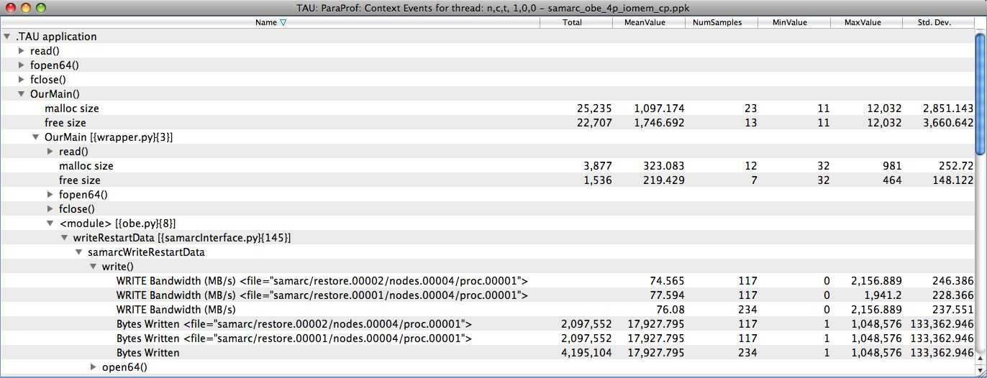
What are the I/O Characteristics?
Write bandwidth per file
Bytes written to each file
Notes:
What is the memory usage of the code?
When/where is memory allocated?
Are there any memory leaks?
What are the I/O characteristics?

Slide 28
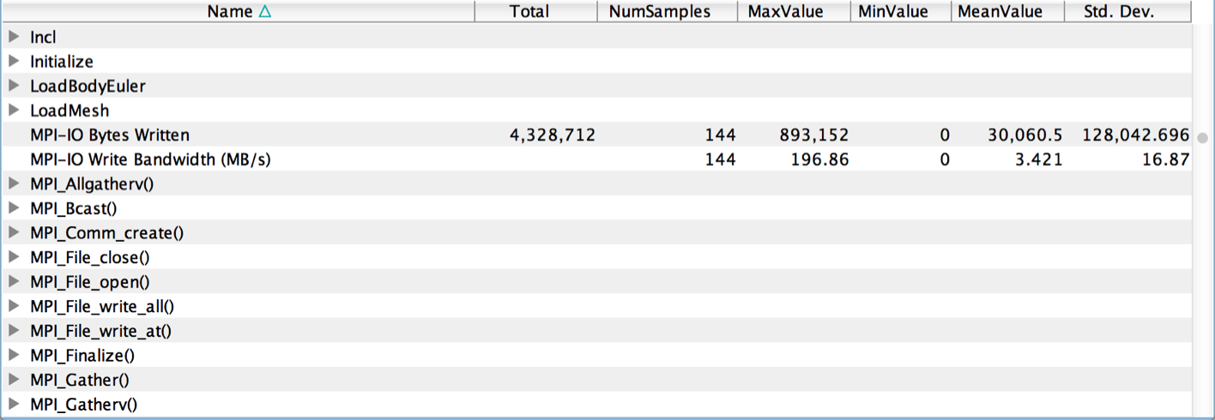
What are the I/O Characteristics?
Peak Parallel I/O Write Bandwidth
Notes:
What is the memory usage of the code?
When/where is memory allocated?
Are there any memory leaks?
What are the I/O characteristics?

Slide 29
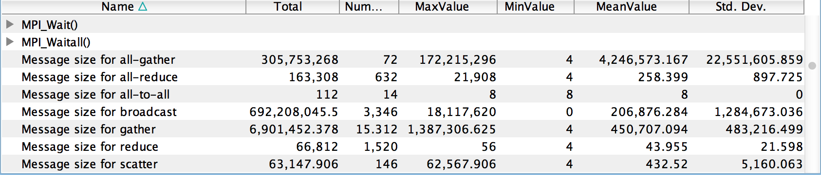
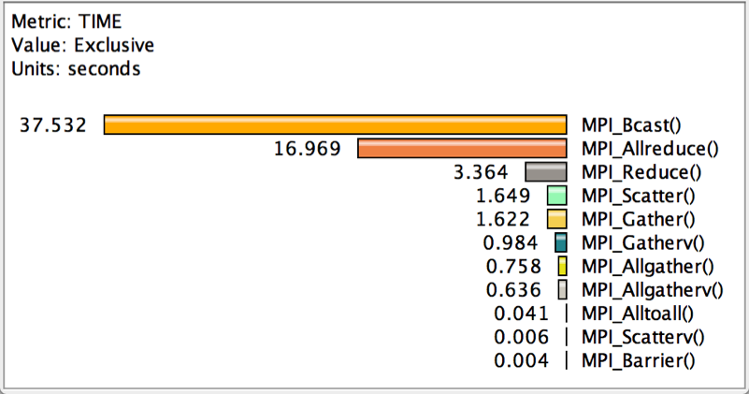
How Much Time is Spent in Collectives?
Message sizes
Time spent in collectives
Notes:
What is the memory usage of the code?
When/where is memory allocated?
Are there any memory leaks?
What are the I/O characteristics?

Slide 30
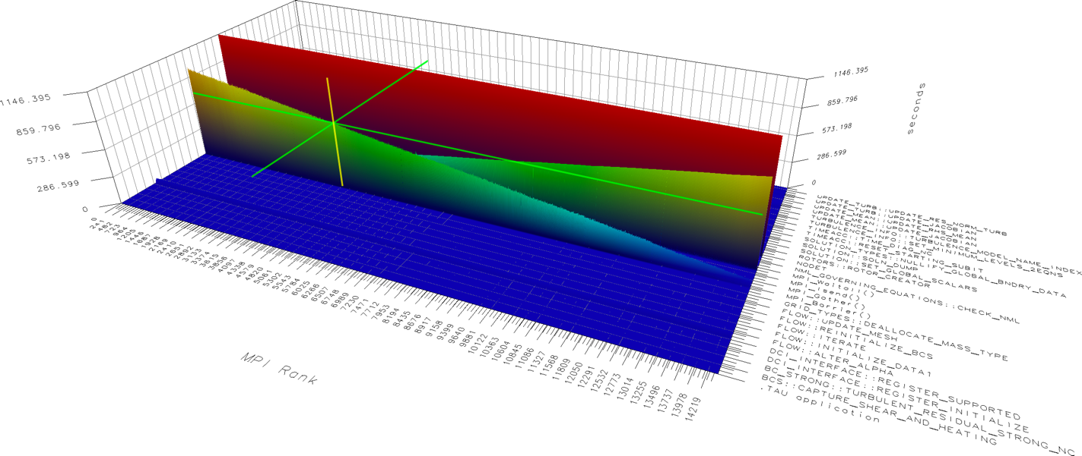
Are there relationships or patterns?

Slide 31
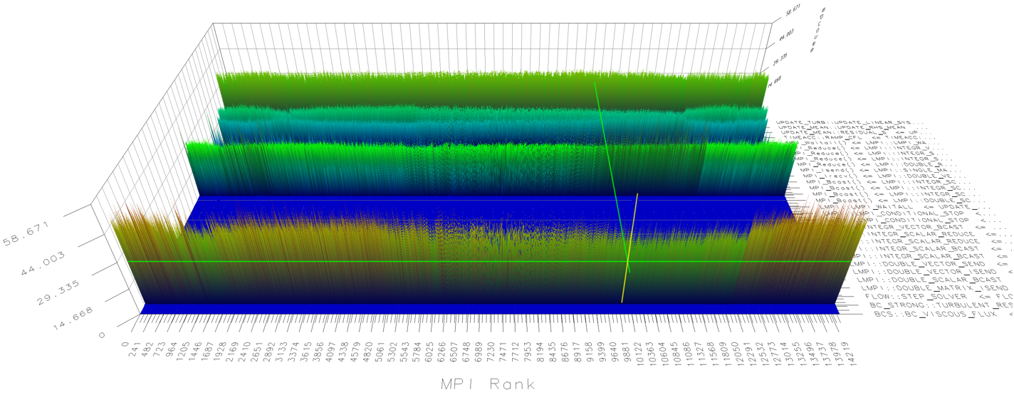
Are there load imbalances?

Slide 32
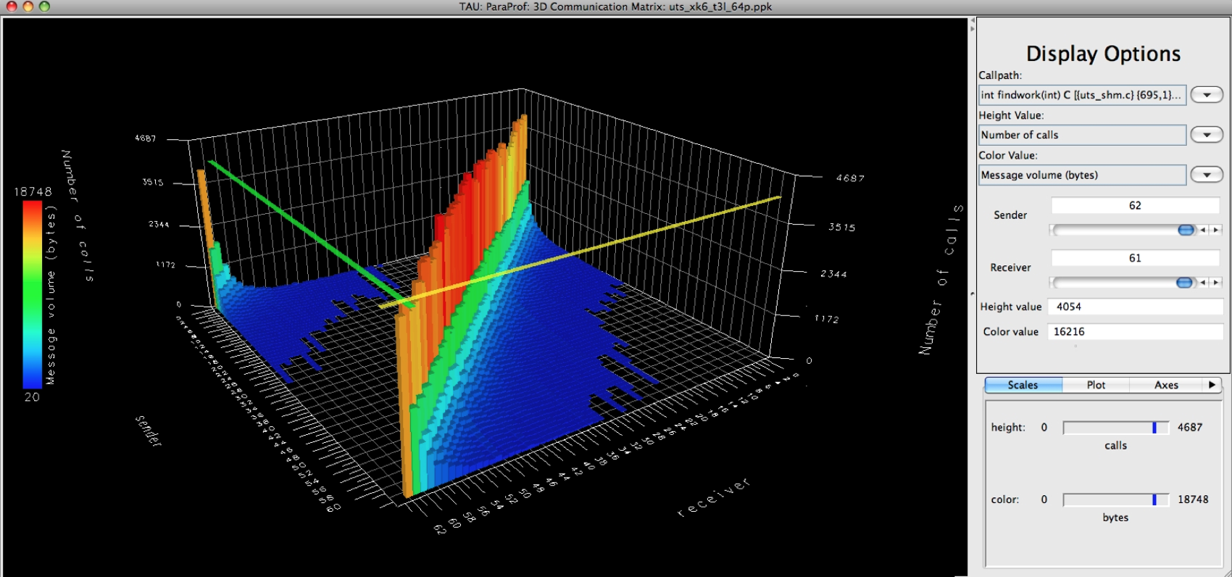
What is the communication profile?

Slide 33
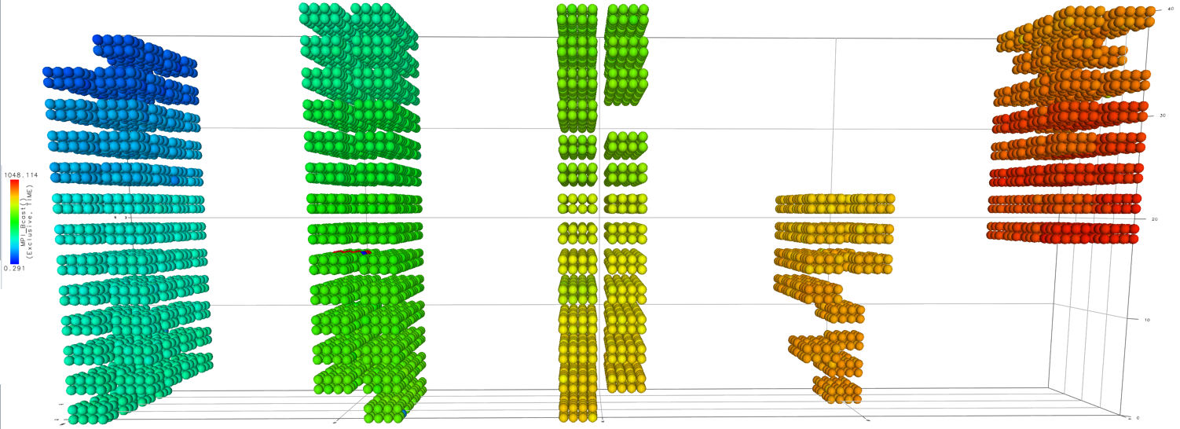
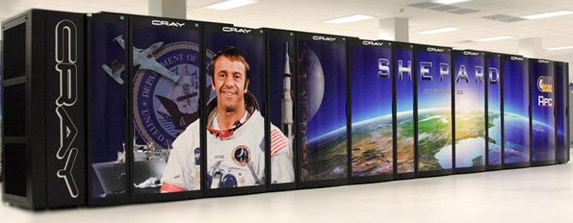
Where is the computation performed?
Note: Virtual, physical, and user-defined topologies are supported.
Notes:
MPI_Send on BG/Q

Slide 34
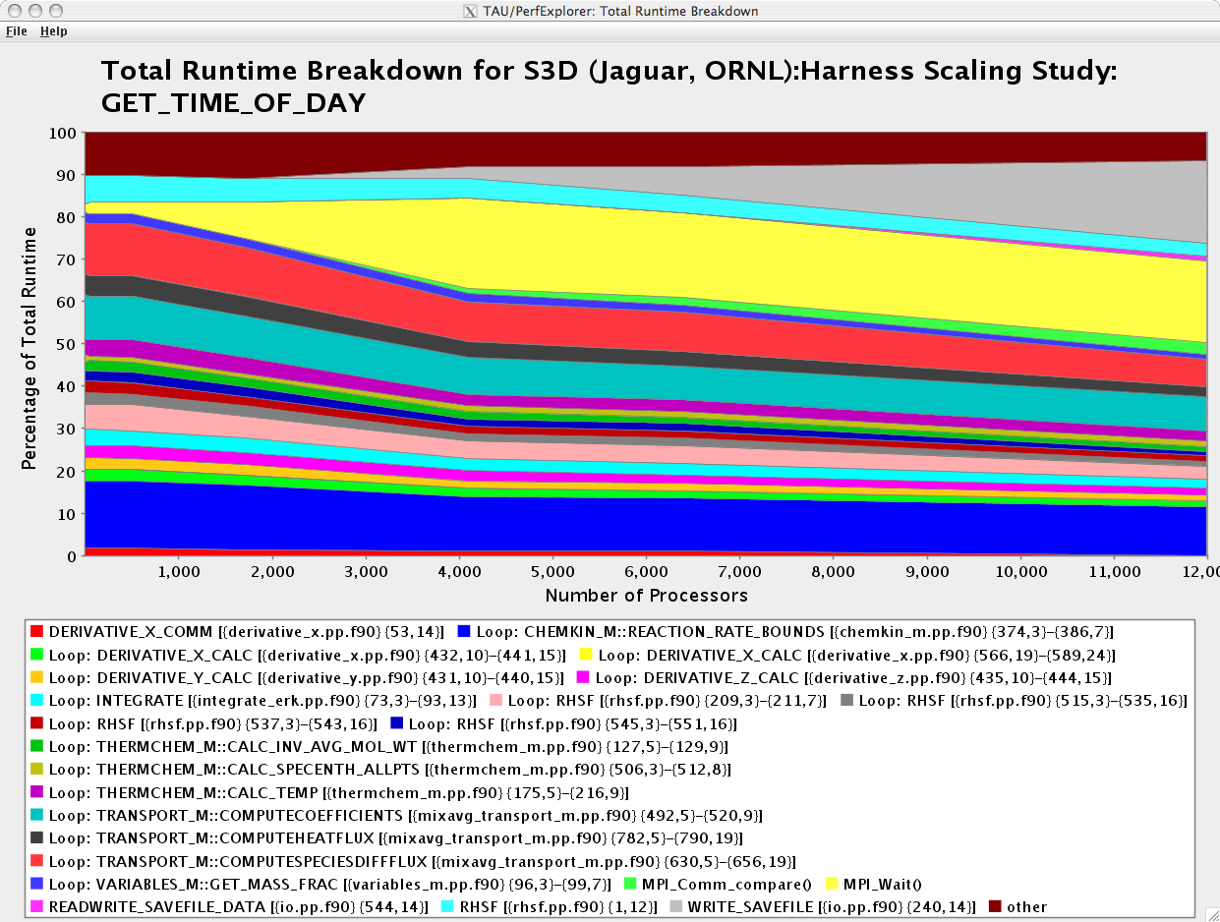
How does the application scale?
WRITE_SAVEFILE
MPI_Waitall
% perfexplorer (Charts → Runtime Breakdown)

Slide 35
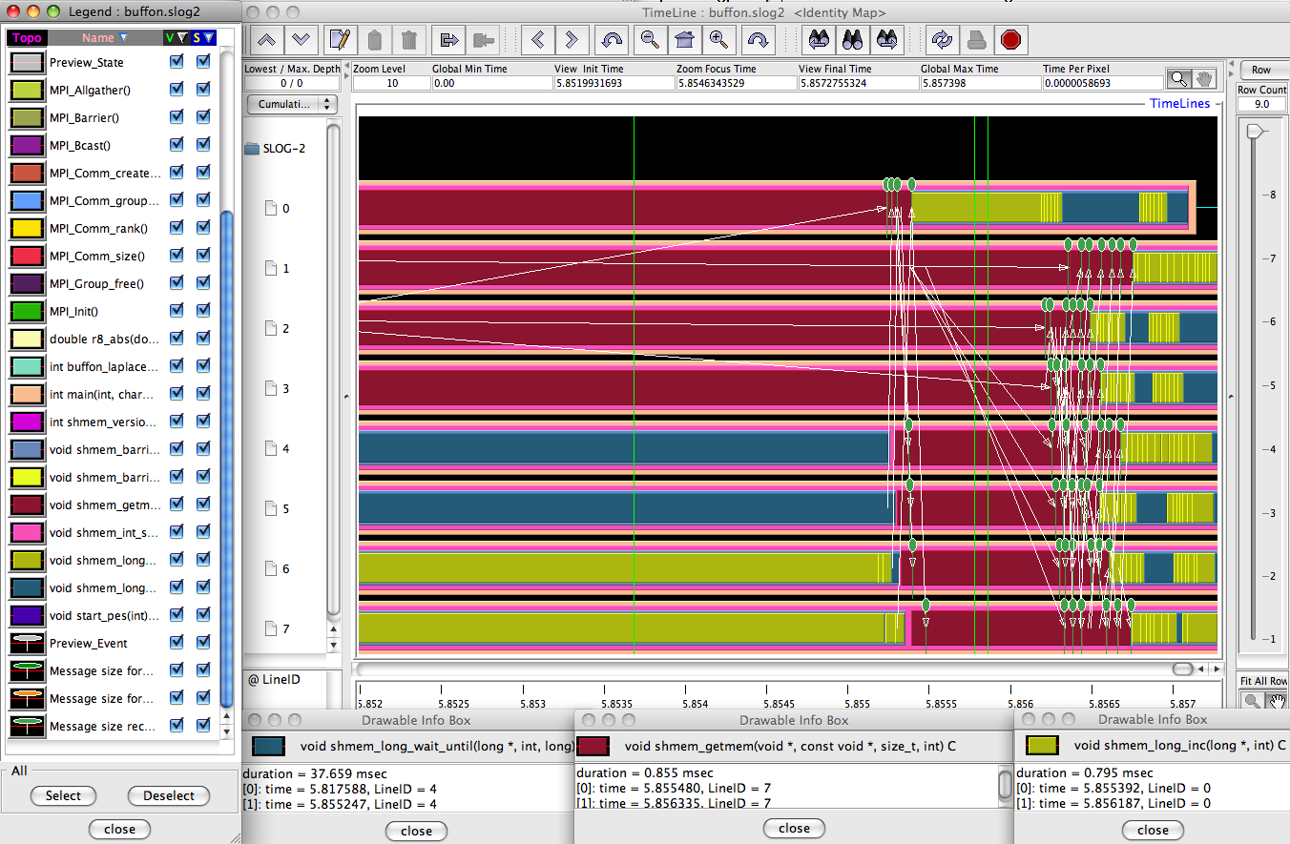
When do Events Occur?

Slide 36
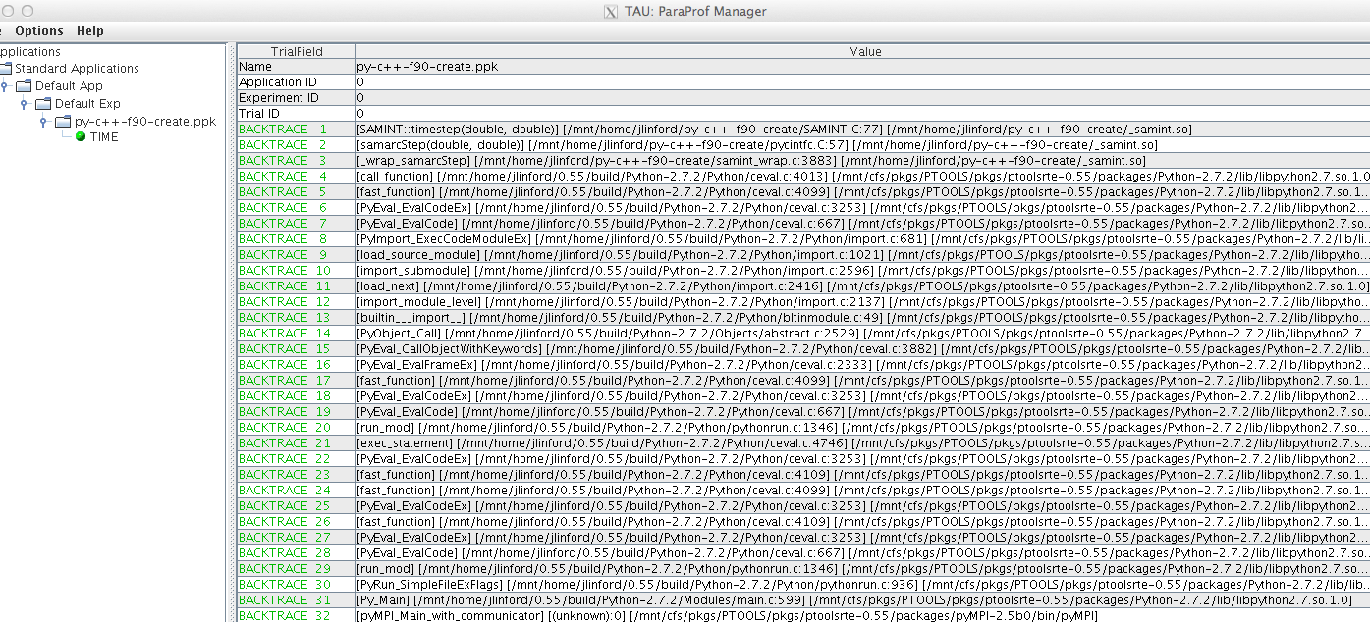
What Caused My Application to Crash?
% qsub –env TAU_TRACK_SIGNALS=1 …
% paraprof
Notes:
What caused the segfault?
What were the performance characteristics up to failure?
Which routines were or were not called?
Were there any memory errors?

Slide 37
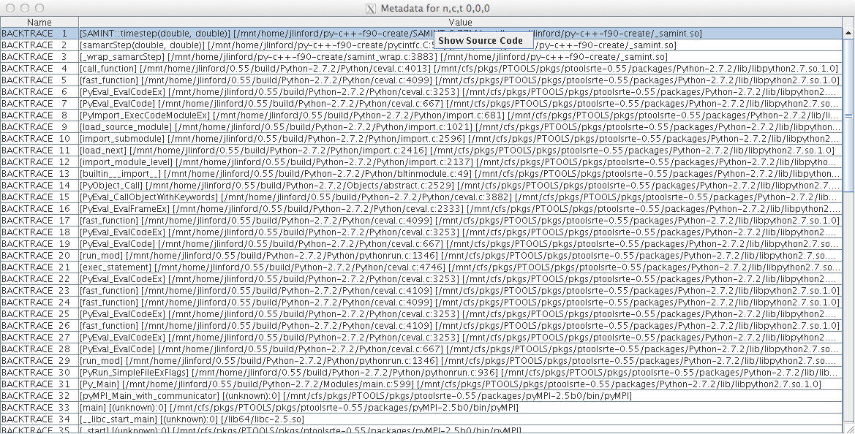
What Caused My Application to Crash?
Right-click to see source code

Slide 38
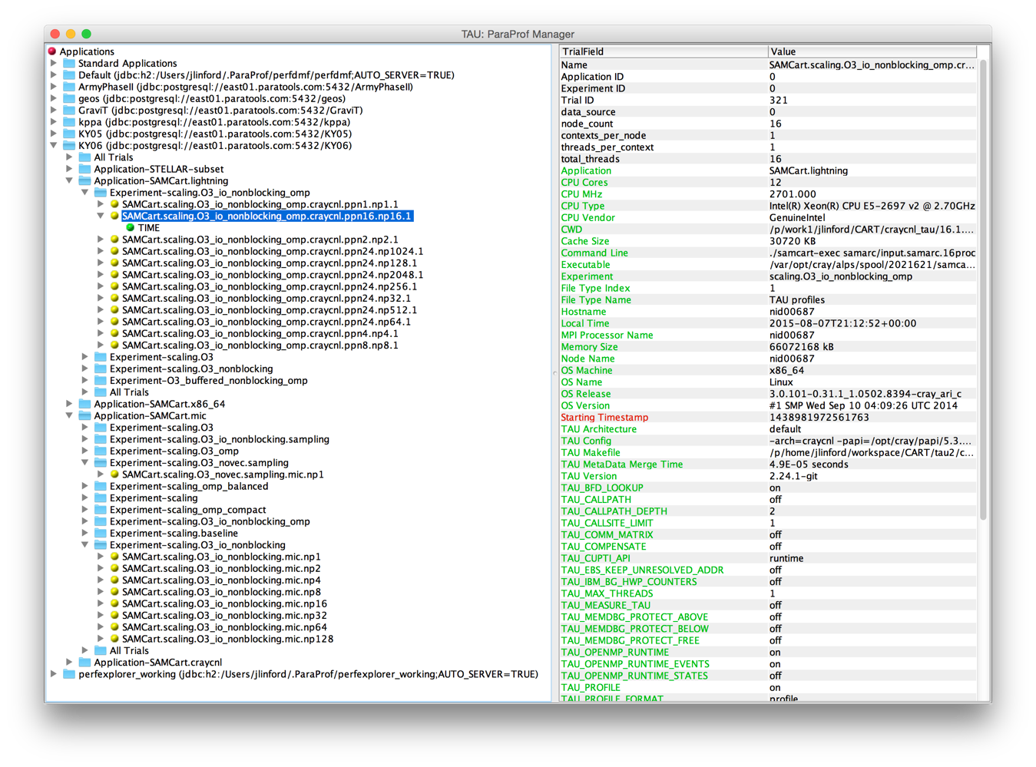
Performance Provenance

Slide 39
ParaTools ThreadSpotter
Keeping Up With Technology

Slide 40
ParaTools ThreadSpotter
A cache and memory optimization tool integrated with TAU
  Analyzes memory bandwidth and latency, data locality and thread communication
  Identifies specific issues and pinpoints troublesome areas in source code
  Provides guidance towards a resolution
Provides qualitative measurement:
  Data is not dependent on the hardware
  Can predict performance for other memory systems
    E.g. Intel Xeon Phi “Knights Landing” MCDRAM vs. DDR

Slide 41
Questions ThreadSpotter can Answer
Miss ratio: What is the likelihood that a memory access will miss in a cache?
Miss rate: D:o per time unit, e.g. per-second, per-1000-instructions
Fetch ratio/rate*: What is the likelihood that a memory access will cause a fetch to the cache [including HW prefetching]
Fetch utilization*: What fraction of a cacheline was used before it got evicted
Writeback utilization*: What fraction of a cacheline written back to memory contains dirty data
Communication utilization*: What fraction of a communicated cacheline is ever used?
*Terms used in ParaTools ThreadSpotter reports.

Slide 42
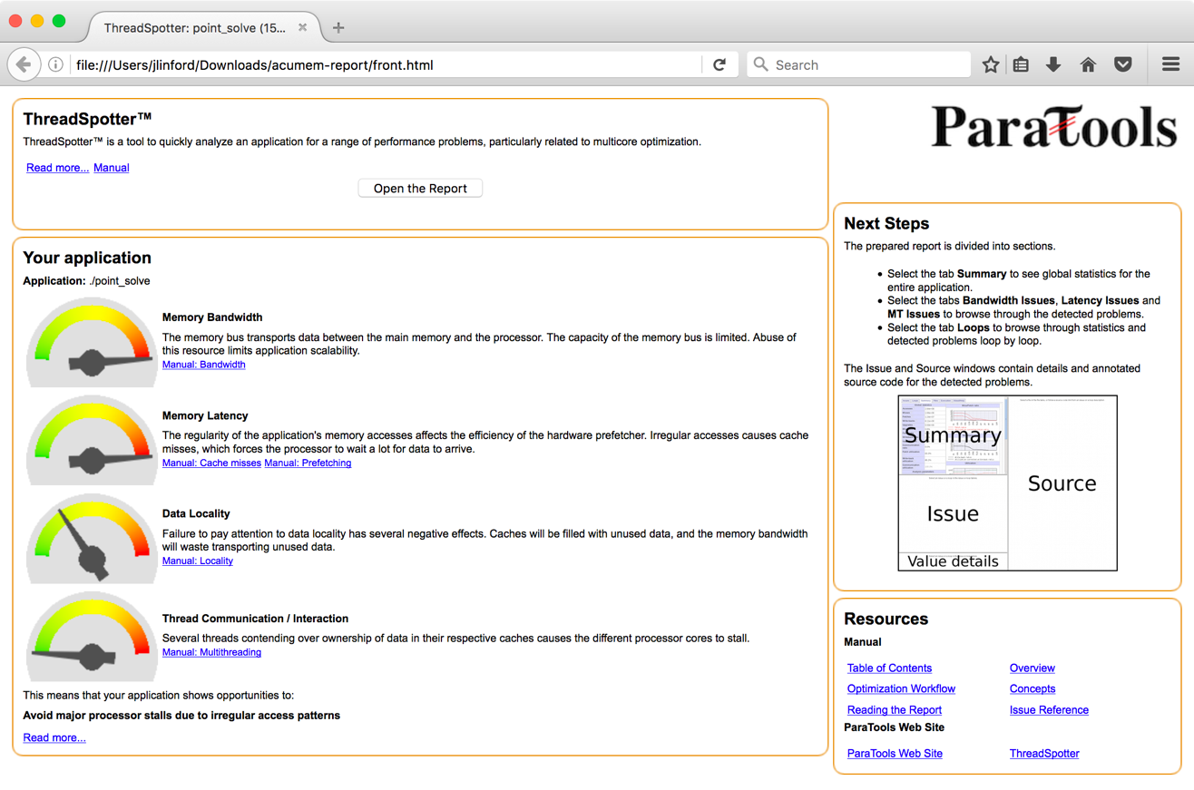
ThreadSpotter Report Front Page

Slide 43
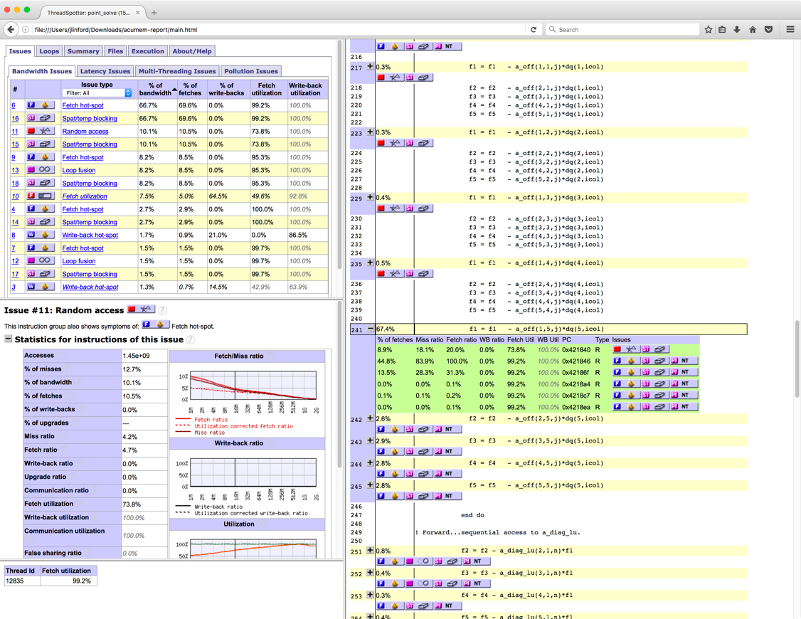
ThreadSpotter Report

Slide 44
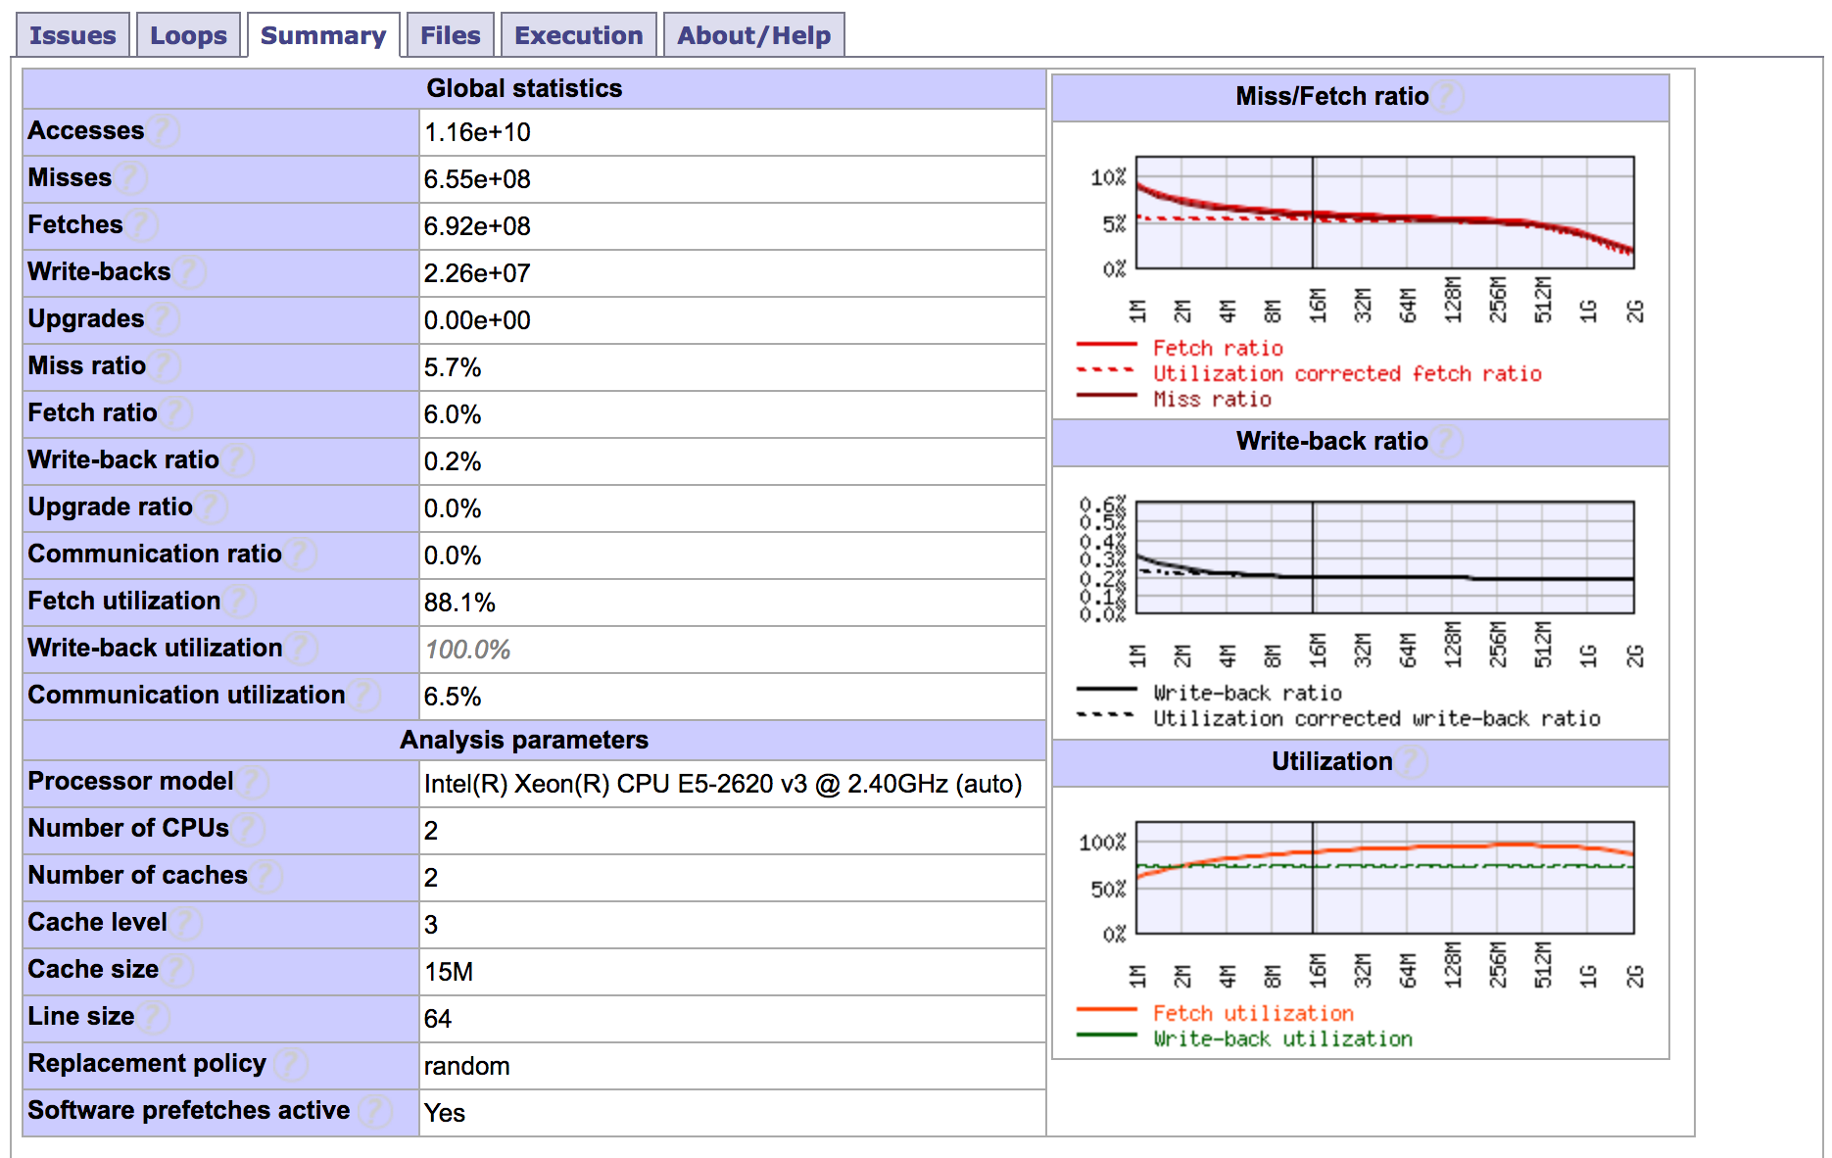
Application Performance Summary

Slide 45
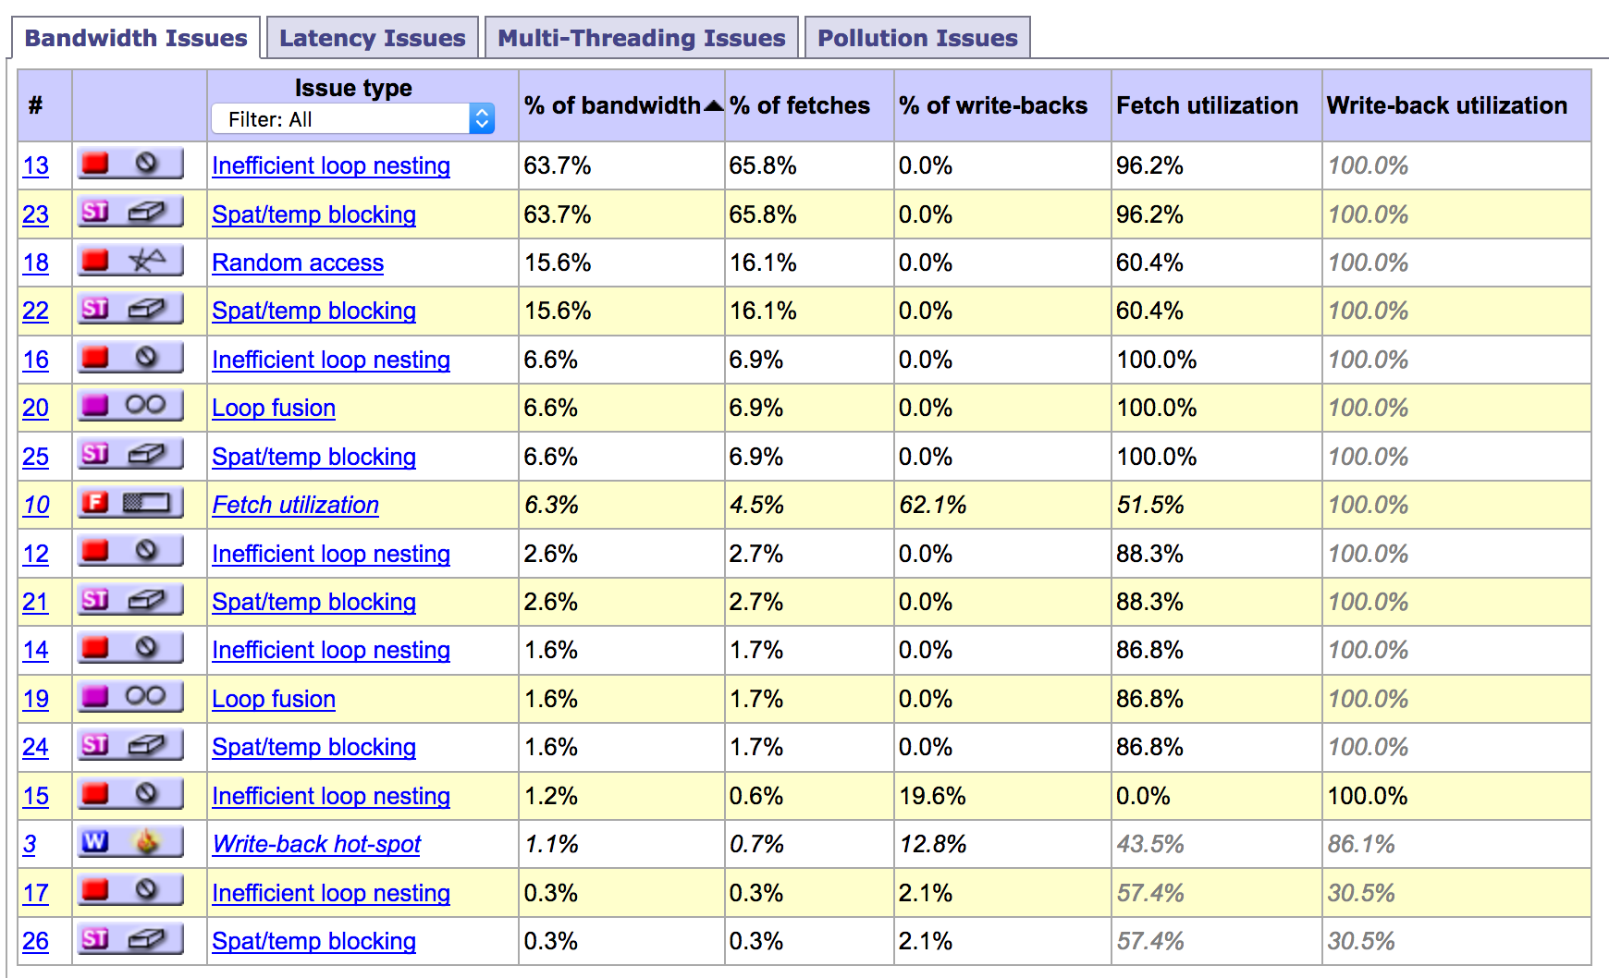
Performance Issues

Slide 46
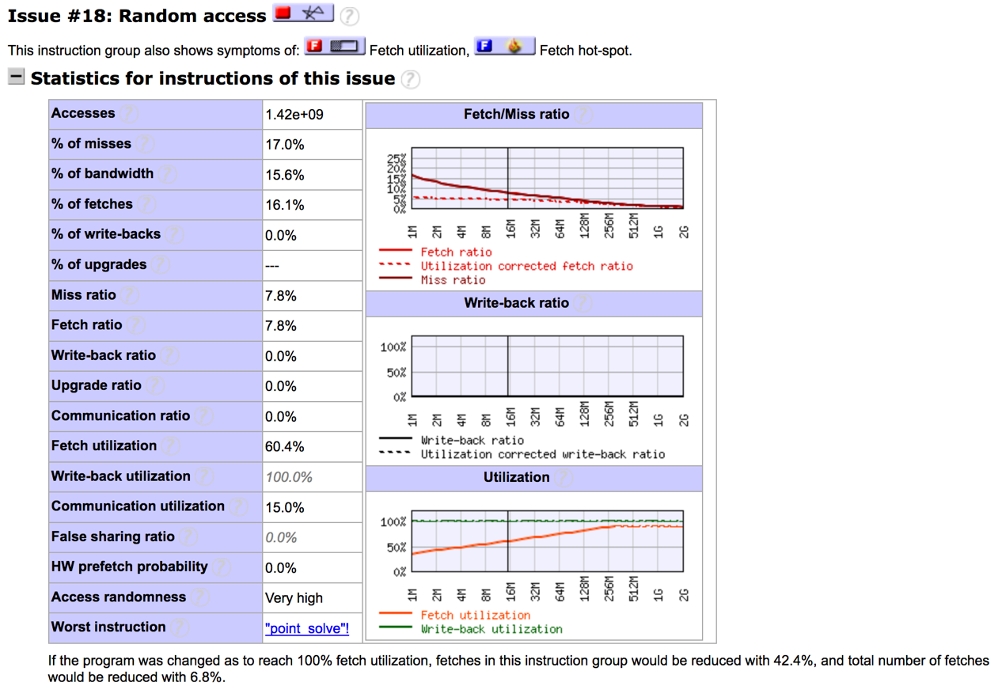
Random Access Issue Detail

Slide 47
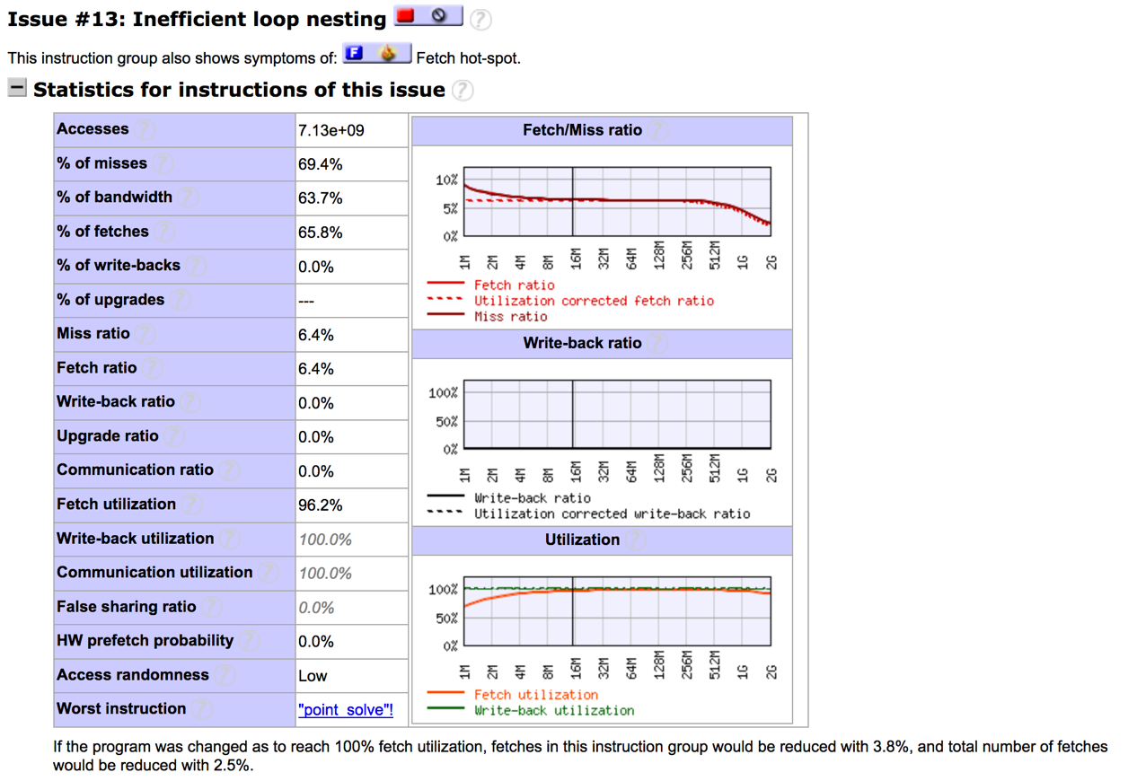
Inefficient Loop Nesting Issue Detail

Slide 48
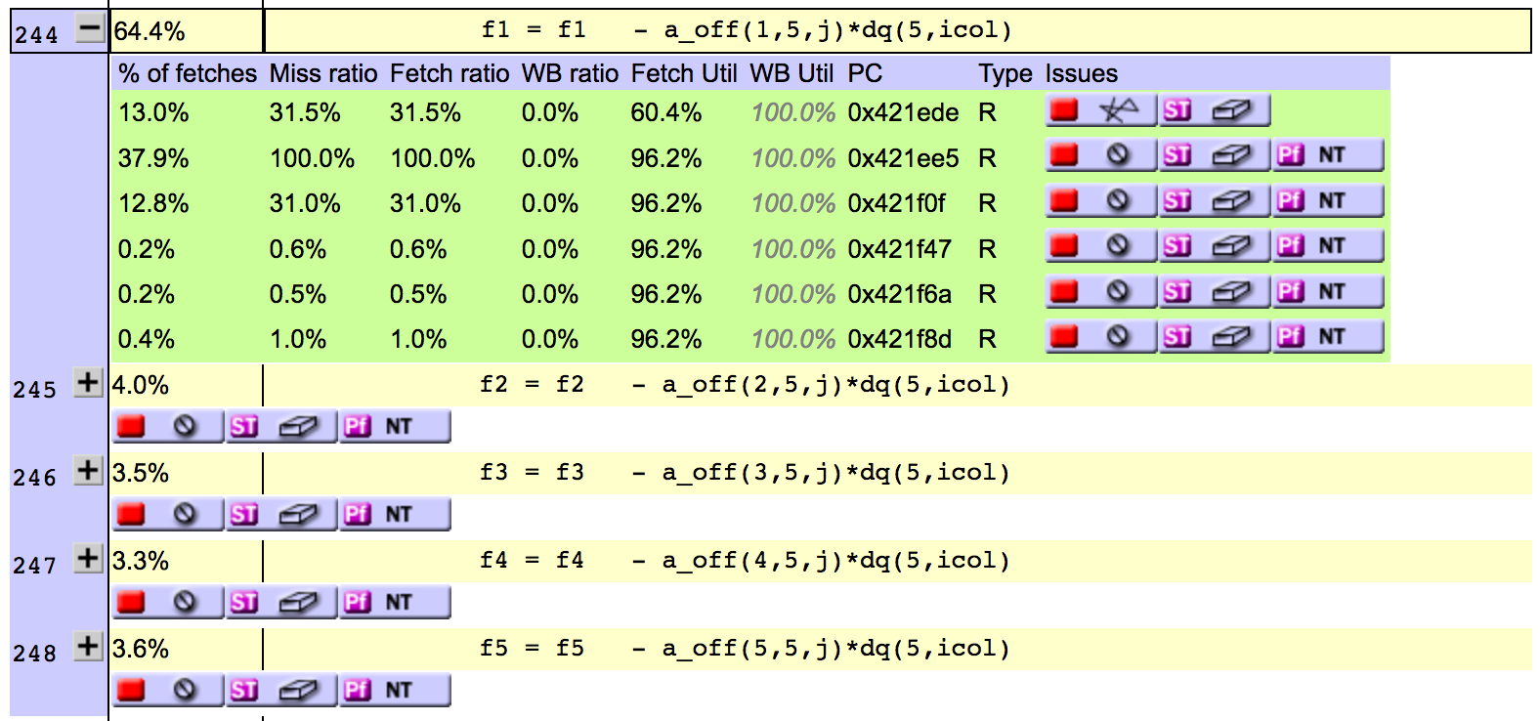
Source Code / Issue Mapping

Slide 49
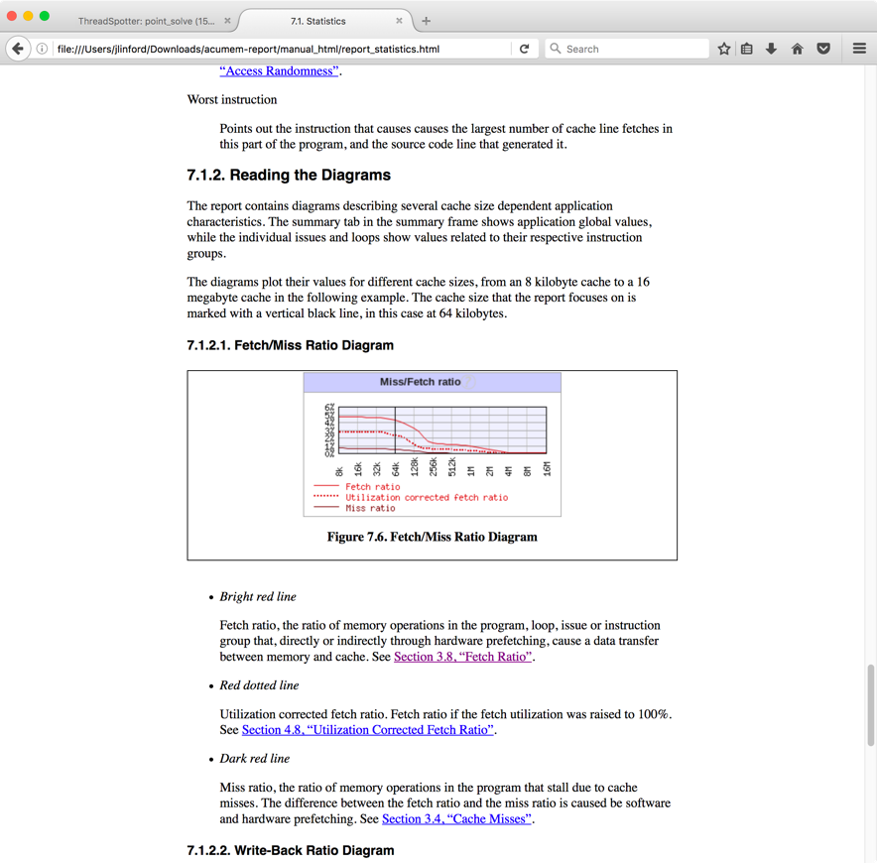
ThreadSpotter Online Help

Slide 50
Success Stories
Keeping Up With Technology

Slide 51
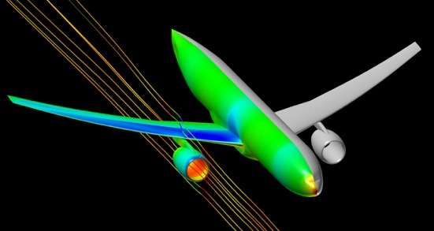
NASA FUN3D
“These days I get excited about 1-2% speedups that I find....quite unusual to find something of this magnitude these days, especially with just a 2-line fix in the code! :)”
1,651,089,924 grid points
5,902,801,476 tetrahedral elements
1,310,290,264 prismatic elements
14,400 Ivy Bridge cores
One of the largest and most accurate
wing-body-nacelle simulations of 2016.
33% runtime improvement

Slide 52
DOD CREATE-AV

Slide 53
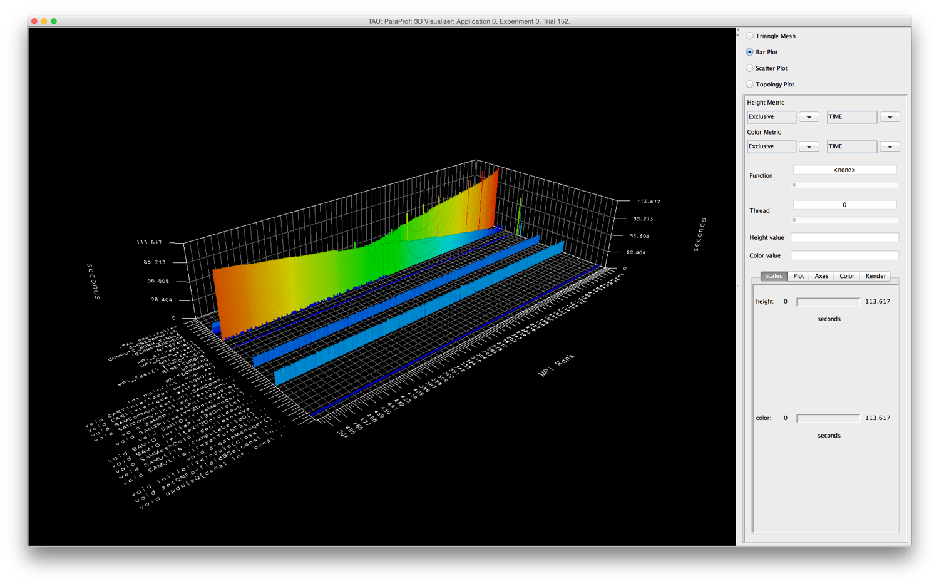
Initial Profile
MPI_Barrier
MPI_Send
File I/O
Useful Work!

Slide 54
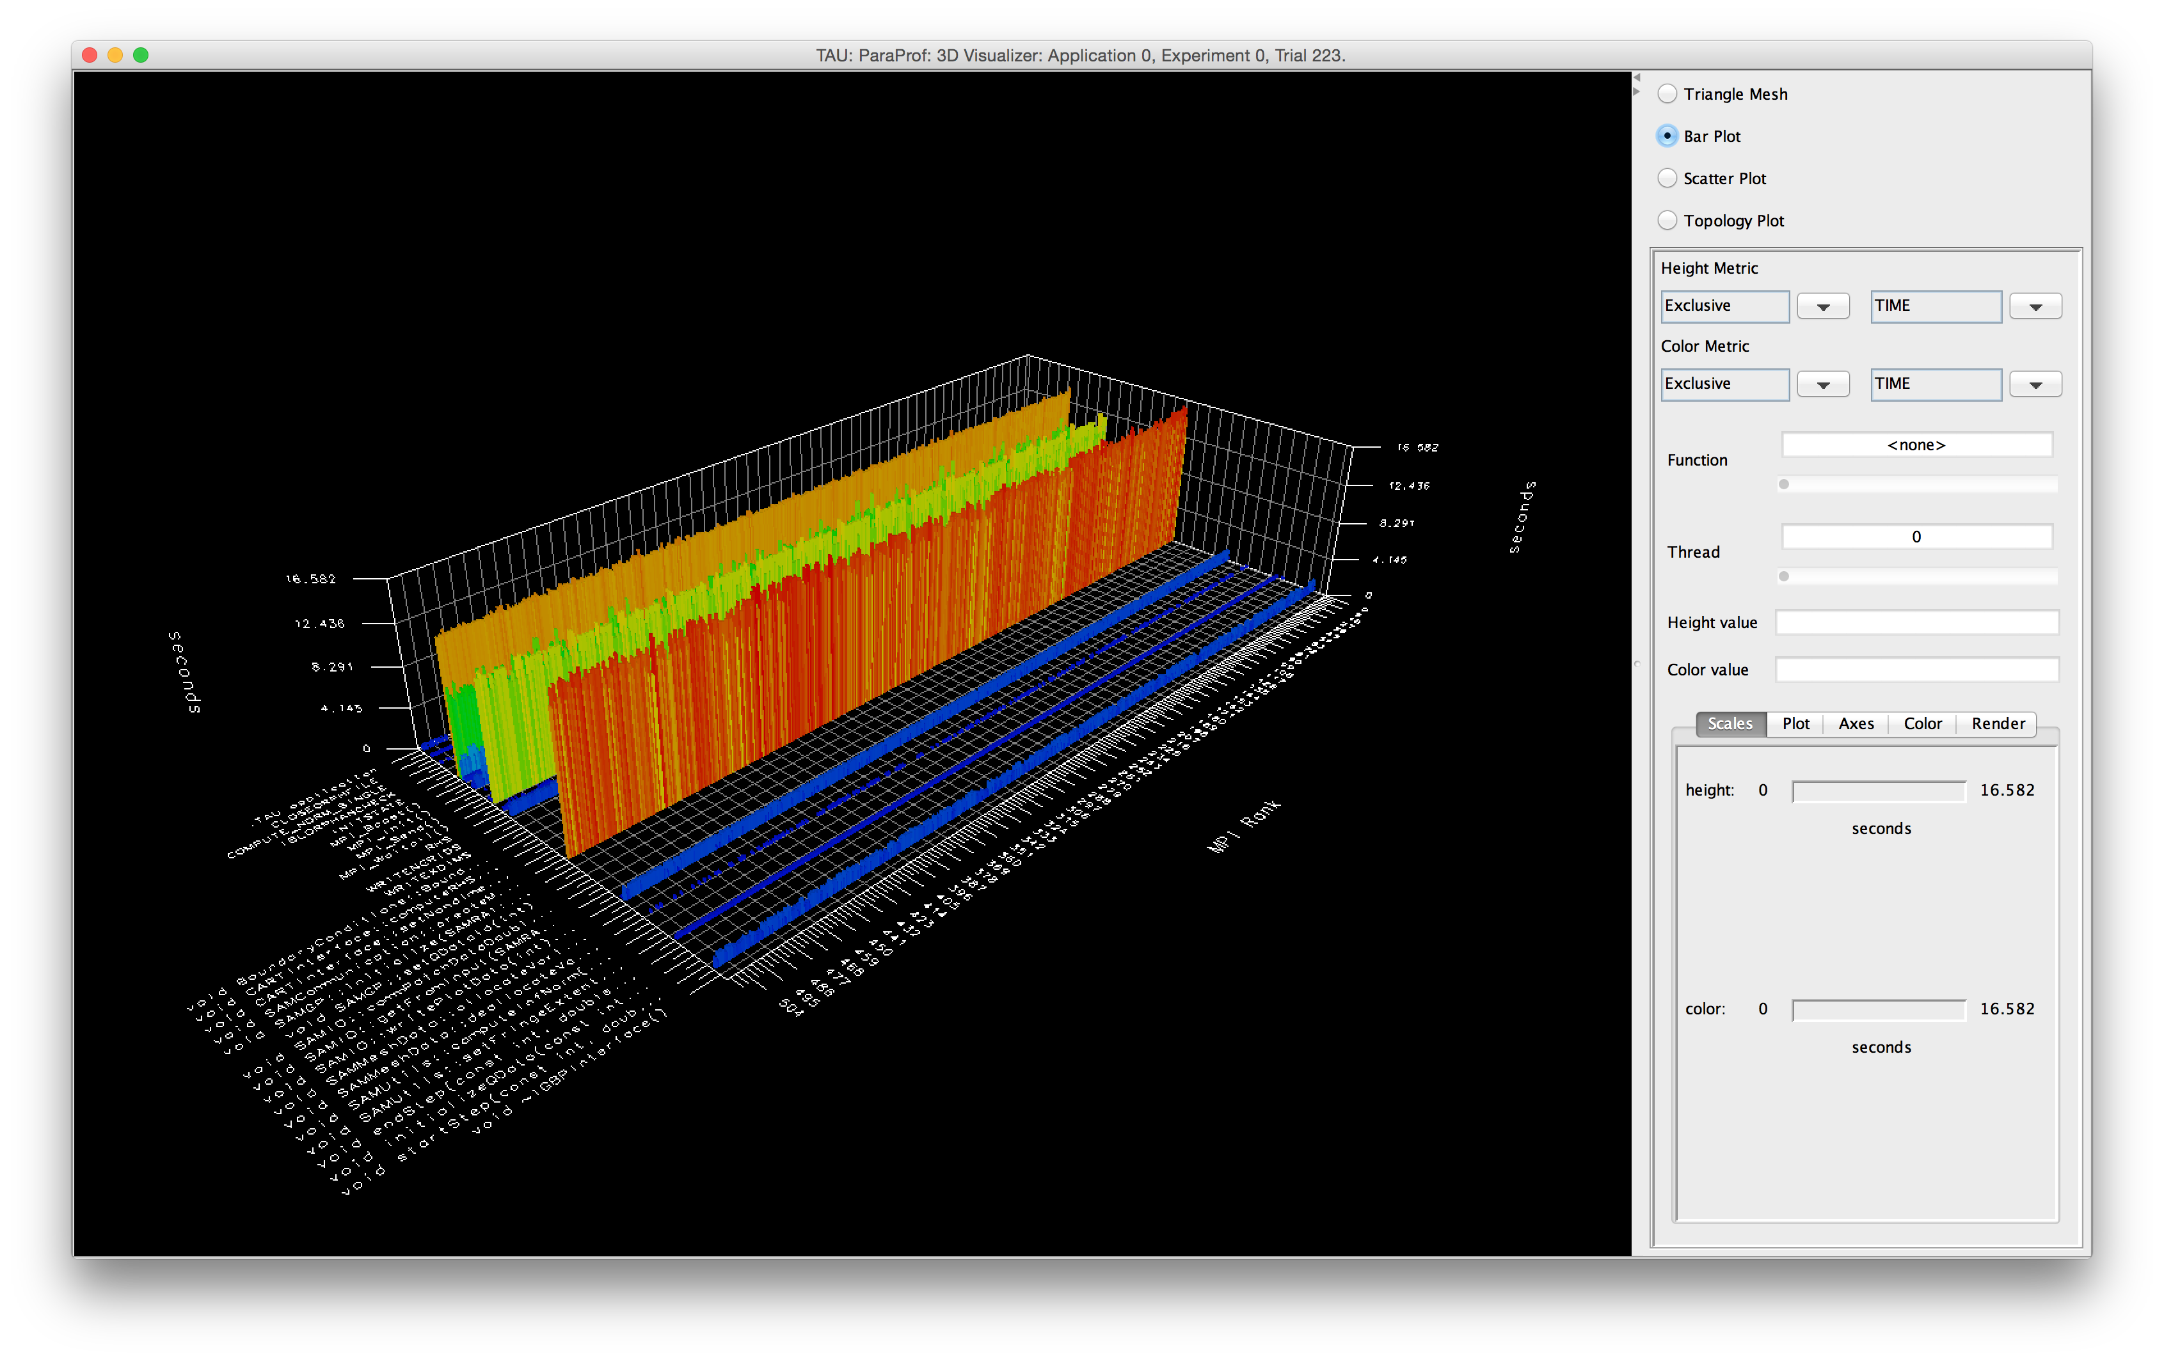
After Hot Spot Optimization
MPI_Waitall
Useful work!
Useful work
File I/O

Slide 55
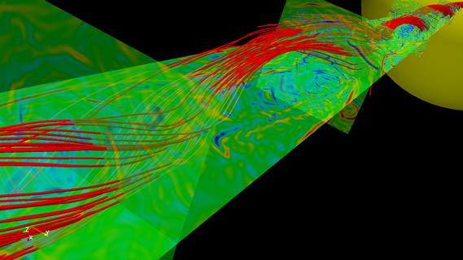

DOE IRMHD
INCITE magnetohydrodynamcis simulation to understand solar winds and coronal heating
  First direct numerical simulations
  of Alfvén wave (AW) turbulence in
  extended solar atmosphere
  accounting for inhomogeneities
  Team
    University of New Hampshire
    (Jean Perez and Benjamin Chandran)
    ALCF (Tim Williams)
    University of Oregon (Sameer Shende)
IRMHD (Inhomogeneous Reduced Magnetohydrodynamics)
  Fortran 90 and MPI
  Excellent weak and strong scaling properties
  Tested and benchmarked on Intrepid and Mira
HPC Source article and ALCF news
https://www.alcf.anl.gov/articles/furthering-understanding-coronal-heating-and-solar-wind-origin

Slide 56
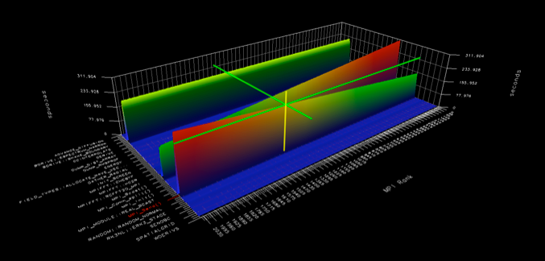
IRMHD Communication Analysis
Source-based (direct) instrumentation
MPI instrumentation and volume measurement
IRMHD exhibited significant synchronous communication bottlenecks
On 2,408 cores:
  MPI_Send and MPI_Bcast
  take significant time
  Opportunities for
  communication/
  computation overlap
  Identified possible targets
  for computation improvements
MPI_Barrier
MPI_Send

Slide 57
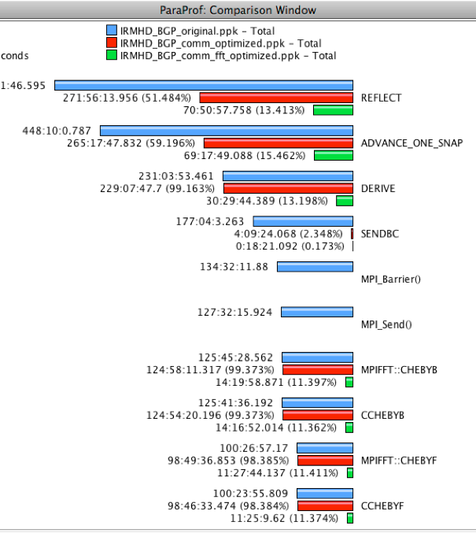
IRMHD Optimization
On 2,408 cores, overall execution time reduced from 528.18 core hours to 70.8 core hours
(>7x improvement)
Non-blocking communication substrate
More efficient implementation of underlying FFT

Slide 58
Conclusion
Python Performance Evaluation

Slide 59
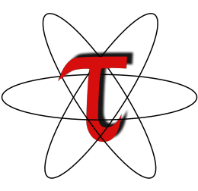
Try it out!
http://www.paratools.com/TAU
http://www.paratools.com/ThreadSpotter
Free download, open source, BSD license
jlinford@paratools.com
(540) 808-9250

Slide 60
















Acknowledgements
Department of Energy
  Office of Science
  Argonne National Laboratory
  Oak Ridge National Laboratory
  NNSA/ASC Trilabs (SNL, LLNL, LANL)
HPCMP DoD PETTT Program
National Science Foundation
  Glassbox, SI-2
University of Tennessee
    University of New Hampshire
      Jean Perez, Benjamin Chandran
University of Oregon
  Allen D. Malony, Sameer Shende
  Kevin Huck, Wyatt Spear
TU Dresden
  Holger Brunst, Andreas Knupfer
  Wolfgang Nagel
Research Centre Jülich
  Bernd Mohr
  Felix Wolf

