Slide 1

Drs. John C. Linford, Sameer Shende, Allen Malony
{jlinford, sameer, malony}@paratools.com
29 June 2017
Northrop Grumman Lunch-N-Learn
McLean, VA

Slide 2
Contact Info
Phone: 541-913-8797
Fax: 541-343-6086
info@paratools.com
ParaTools, Inc.
2836 Kincaid St.
Eugene, OR 97405, USA

Slide 3


Northrop Grumman Cync Program
A partnership between
Northrop Grumman and
the Cyber Incubator@bwtech
Innovative, technology-driven startup companies addressing critical market needs in:
  Cyber
  Data Sciences
  Big Data
  Secure Mobility
  Cyber Physical Systems
  Critical Infrastructure Protection

Slide 4
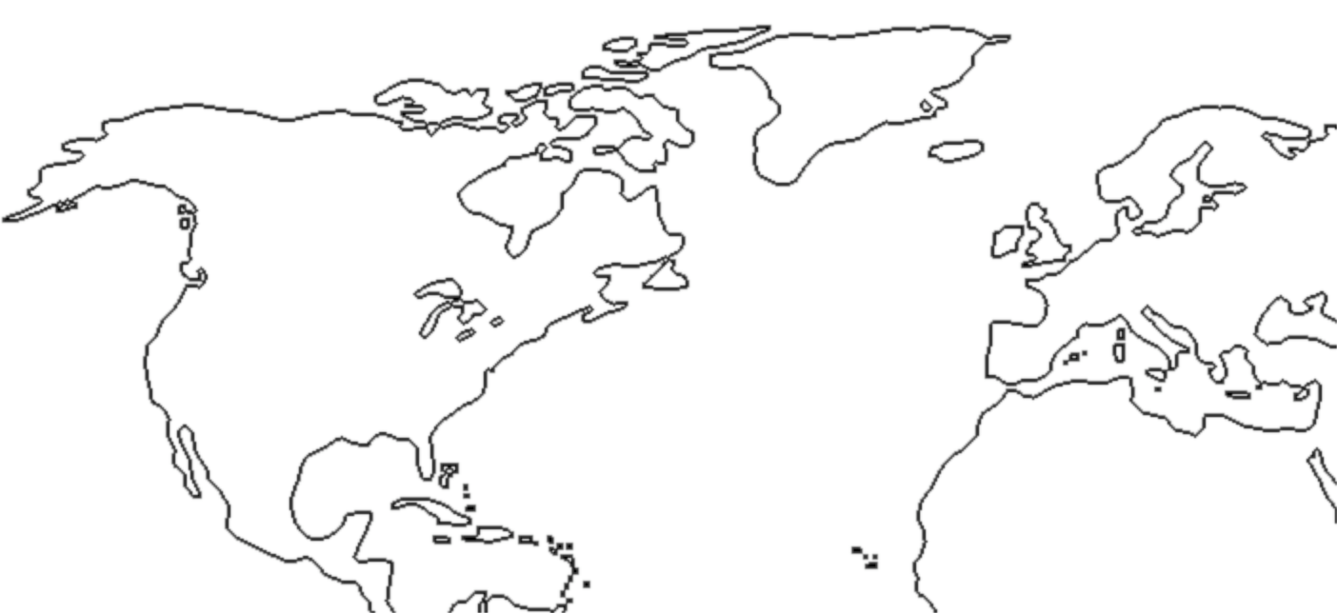
ParaTools
Dr. Allen Malony (CEO)
Dr. Sameer Shende (President)
Dr. John Linford
Dr. Jean-Baptiste Besnard
Dr. Nick Chaimov
Dr. David Mackay
Dr. Sam Khuvis
Daresbury, UK
Beaverton, OR
HQ @ Eugene, OR
Paris, France
Baltimore, MD

Slide 5
ParaTools Accelerates Software
Policy
National Security
Time-to-market
Cyber security
Quality
Research
Simulation
Weapons research
Intelligence
Analysis
Testing
Energy
Environment
Emergency
Engineering & Manufacturing
Contingency

Slide 6
Products and Services
The TAU Performance System®
Kppa
RotCFD
ThreadSpotter
HPC Linux
PToolsRTE
PToolsWin
IQB
Vampir
TAU Commander / Enterprise
Performance Engineering
Software Development
Algorithm Development
Software Porting
Hosting
Data Analytics
ParaTools® and IQB® are registered trademarks of ParaTools, Inc.
ParaTools is the sole licensee of the TAU Performance System® trademark owned by the State of Oregon acting by and through the State Board of Higher Education on behalf of the University of Oregon.

Slide 7

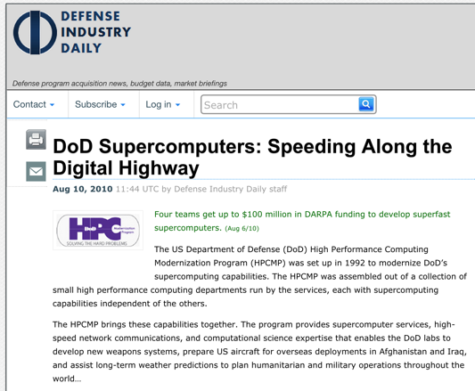

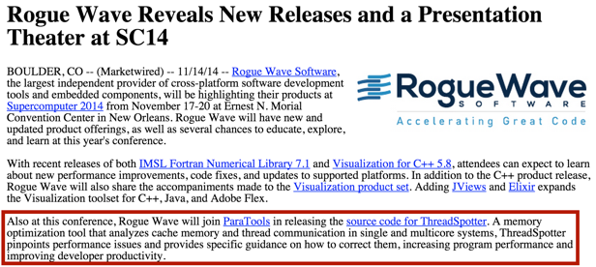
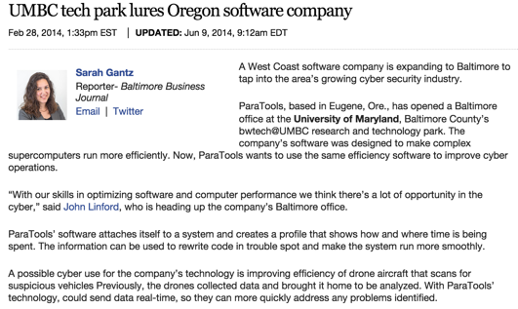
In the Press
http://tau.uoregon.edu/success/irmhd.pdf
http://www.defenseindustrydaily.com/Up-to-1471M-to-HPTi-for-DoD-High-Performance-Computing-Work-05688/
http://java.sys-con.com/node/3228954
http://www.bizjournals.com/baltimore/blog/cyberbizblog/2014/02/umbc-tech-park-lures-oregon-software.html

Slide 8










Partnerships

Slide 9
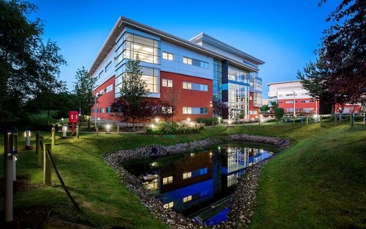
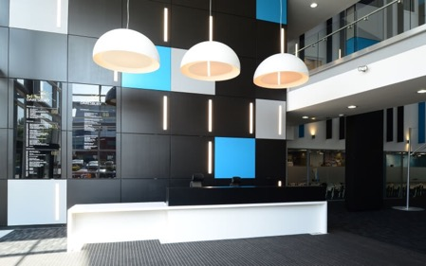
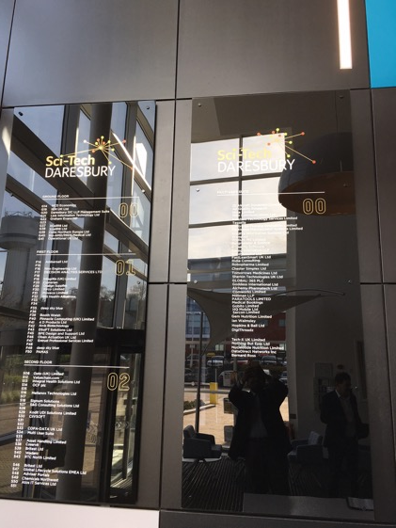
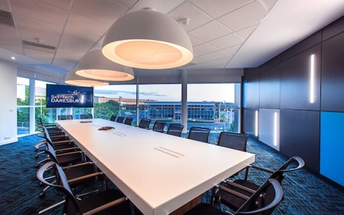
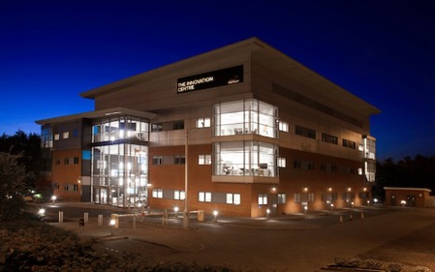
ParaTools LTD in Daresburry UK
Located in the Sci-Tech Daresburry Innovation Centre
In partnership with STFC Daresbury Laboratory
  Luke Mason co-PI

Slide 10
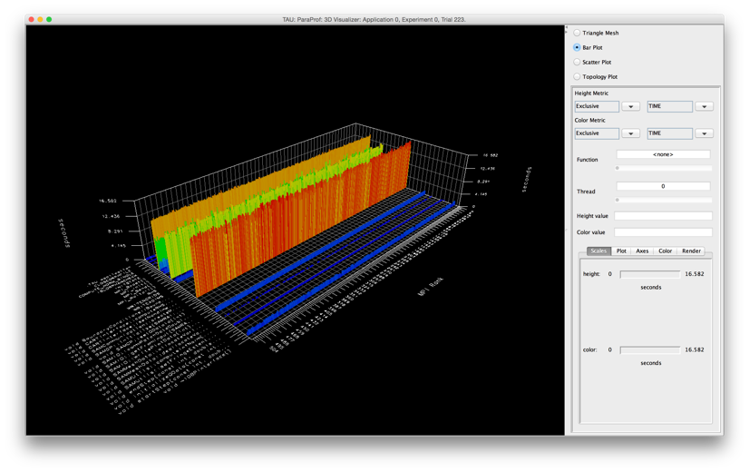
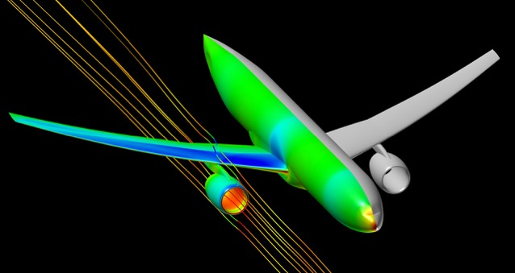
NASA, DOD, DOE, Industry
“These days I get excited about 1-2% speedups that I find....quite unusual to find something of this magnitude these days, especially with just a 2-line fix in the code! :)”
14,400 Processes
512 Processes
3x capability
23hrs ➔ 8hrs
33% Faster

Slide 11
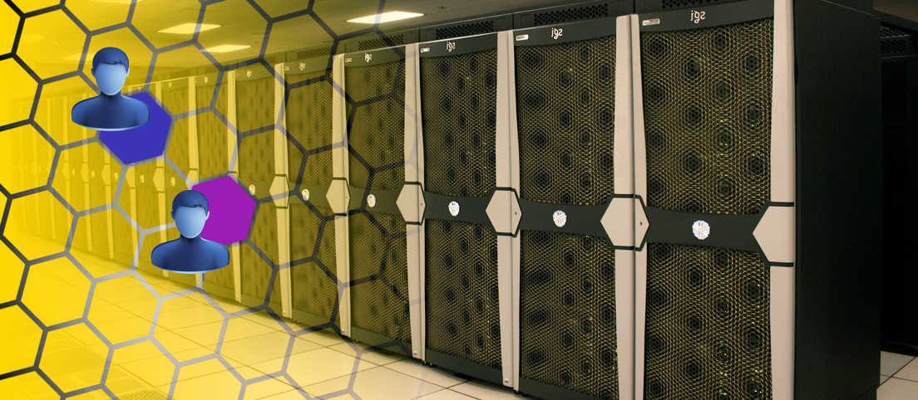
High Performance Cybersecurity
Risk from inexperienced users, COTS, BYOD, and community/user-installable software packages.¹
Performance impact of existing solutions is too high.
1. M. Garnaeva et al. Kaspersky Security Bulletin 2015. Kaspersky Labs, Dec. 2015.

Slide 12
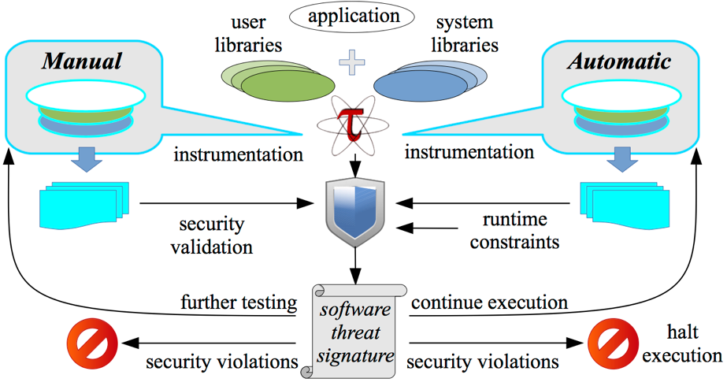
Secure Intelligent Runtime Environment (SIREN)
Profile-driven threat quantification and isolation:
  Safely test and analyze untrusted software.
  Dynamically react to suspicious shifts in behavior.
  Extremely low overhead, no virtualization.

Slide 13

Low Overhead Application Isolation
Monitor the application’s threat signature to isolate software that attempts to violate system integrity.
Complements existing security measures:
  Firewalls.
  VM-based isolation frameworks.
  Container-based isolation.
No VM required!

Slide 14
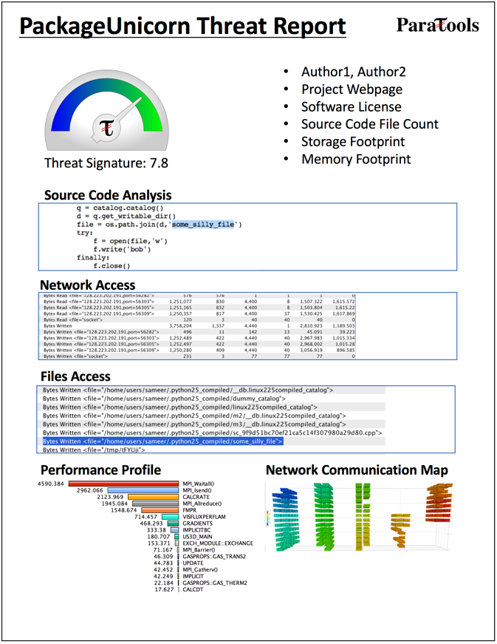
User-space Threat Quantification
Quantify the potential risk of using a package.
Automatically filter by software behavior.
Make system-level assertions about package characteristics:
  “Only FIPS-compliant Python packages.”

Slide 15
The Tau Performance System
NGC Lunch and Learn

Slide 16
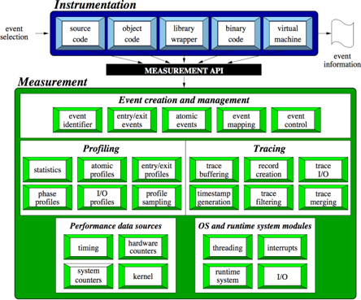
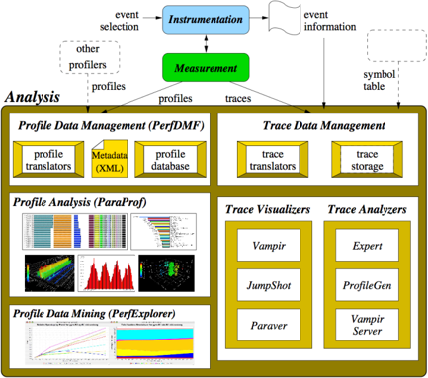

The TAU Performance System®
TAU Architecture
Integrated toolkit for performance problem solving
  Instrumentation, measurement, analysis, visualization
  Portable profiling and tracing
  Performance data management and data mining
Developed for over 20 years
Direct and indirect measurement
Free, open source, BSD license
Available on all HPC platforms (and some non-HPC)
http://tau.uoregon.edu/

Slide 17
Use Cases
Cybersecurity
  Profile-driven threat quantification and isolation
Code Modernization
  FraPPE: the Framework for Parallel Program Engineering (US ARMY)
Software Optimization
  Load balancing
  “Hot spot” identification
  Improvement quantification
Performance Regression Testing

Slide 18
TAU Supports All Platforms
C/C++
CUDA
UPC
Python
GPI
Fortran
OpenACC
MPI
Java
pthreads
Intel MIC
OpenMP
Intel
GNU
PGI
Sun
LLVM
Cray
MinGW
AIX
Linux
Windows
Insert yours
here
BlueGene
Fujitsu
ARM
Android
MPC
OS X

Slide 19
Instrumentation at Every System Layer
Copyright © Cray Inc.

Slide 20
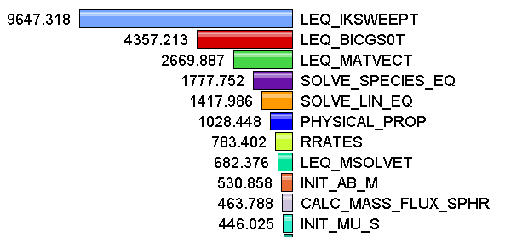
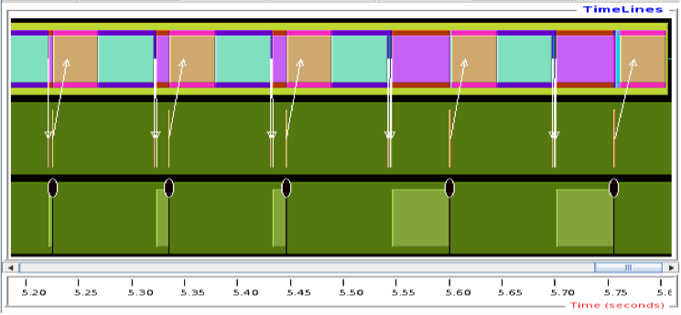
Types of Event Data
Profiling
Tracing
Shows
how much time was spent in each routine
Shows
when events take place on a timeline

Slide 21
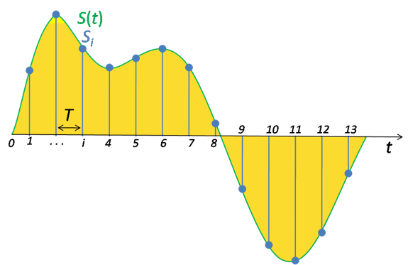
Event Measurement
Direct via Probes
Indirect via Sampling
call TAU_START(‘potential’)
// code
call TAU_STOP(‘potential’)
Exact measurement
Fine-grain control
Calls inserted into code
No code modification
Minimal effort
Relies on debug symbols (-g option)

Slide 22
Inclusive vs. Exclusive Measurements
Exclusive measurements for region only
Inclusive measurements includes child regions
int foo()
{
int a;
a =a + 1;
bar();
a =a + 1;
return a;
}
Inclusive
duration
Exclusive
duration

Slide 23
How Much Data do you Want?
Limited
Profile
Loop
Profile
Callpath
Profile
O(KB)
O(TB)
Flat
Profile
Phase
Profile
Trace
All levels support multiple metrics/counters

Slide 24


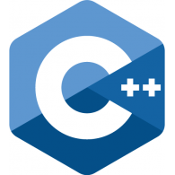
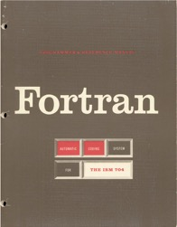
Multi-Language Debugging
Identify the source location of a crash by unwinding the system callstack
Identify memory errors (off-by-one, etc.) across language boundaries
double * x =
new double[5];
A = x(1:10) + 5

Slide 25
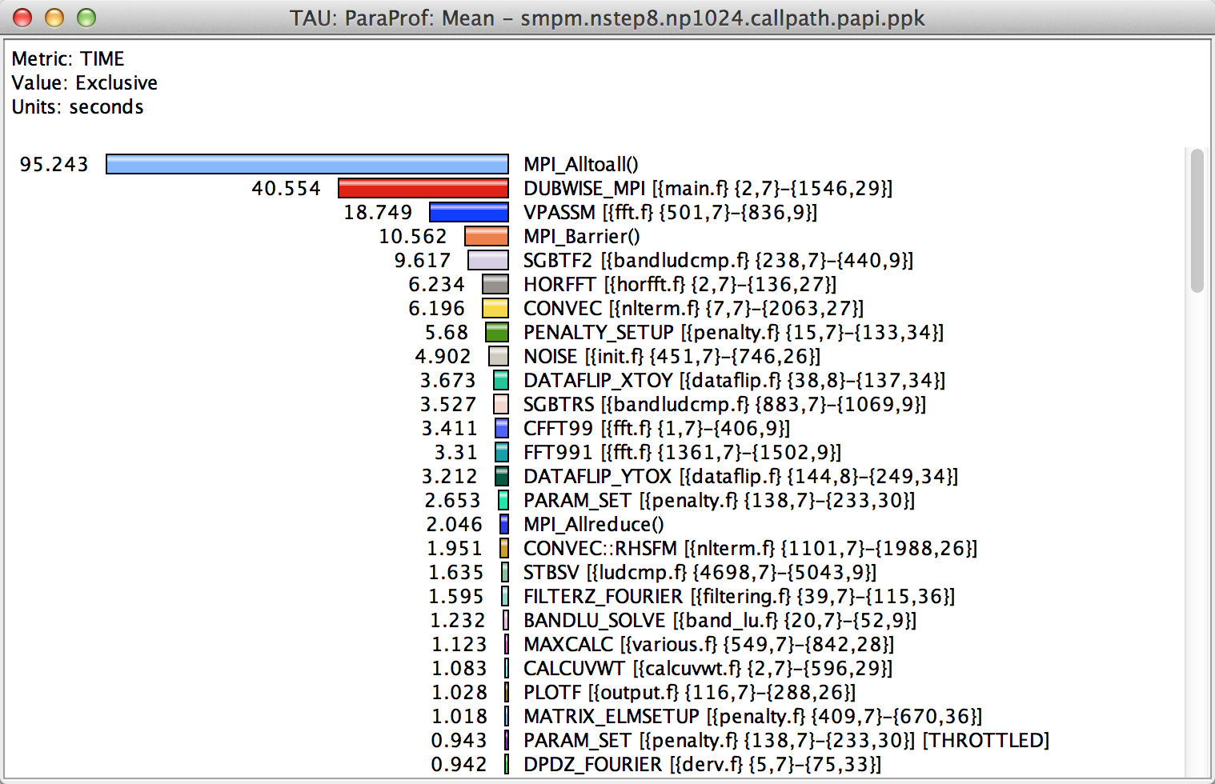
How Much Time per Code Region?
% paraprof (Click on label, e.g. “Mean” or “node 0”)
Notes:
How much time per code region?
How many instructions per code region?
What is the cost of each code statement?
L1 or L2 cache misses?

Slide 26
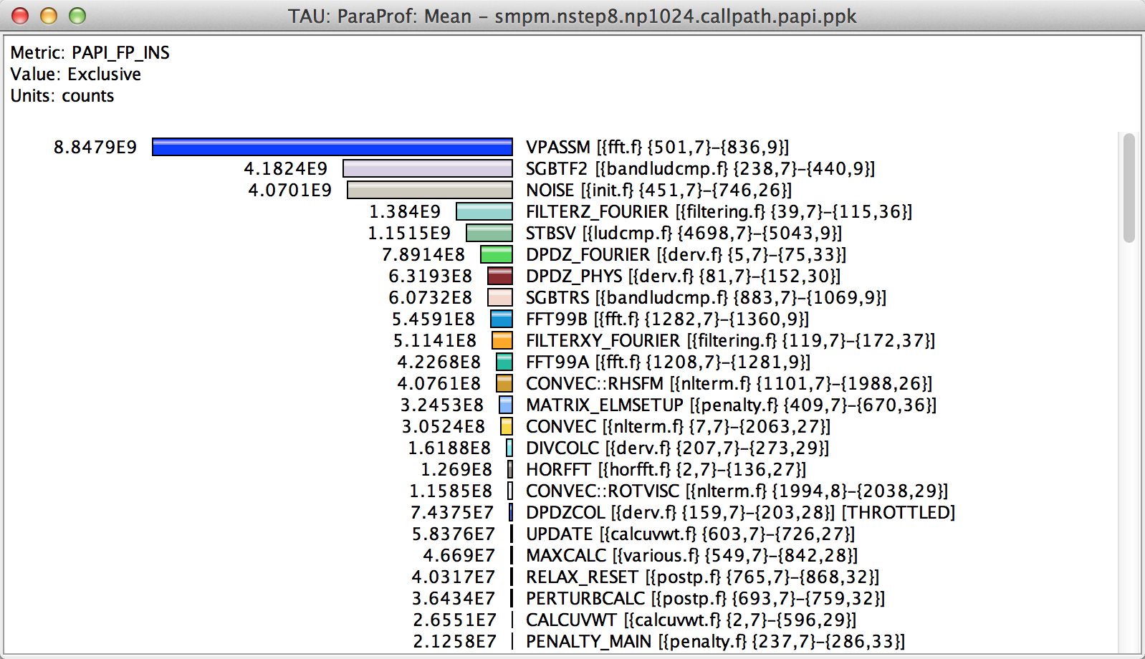
How Many Instructions per Code Region?
% paraprof (Options → Select Metric... → Exclusive… → PAPI_FP_INS)
Notes:
How much time per code region?
How many instructions per code region?
What is the cost of each code statement?
L1 or L2 cache misses?

Slide 27
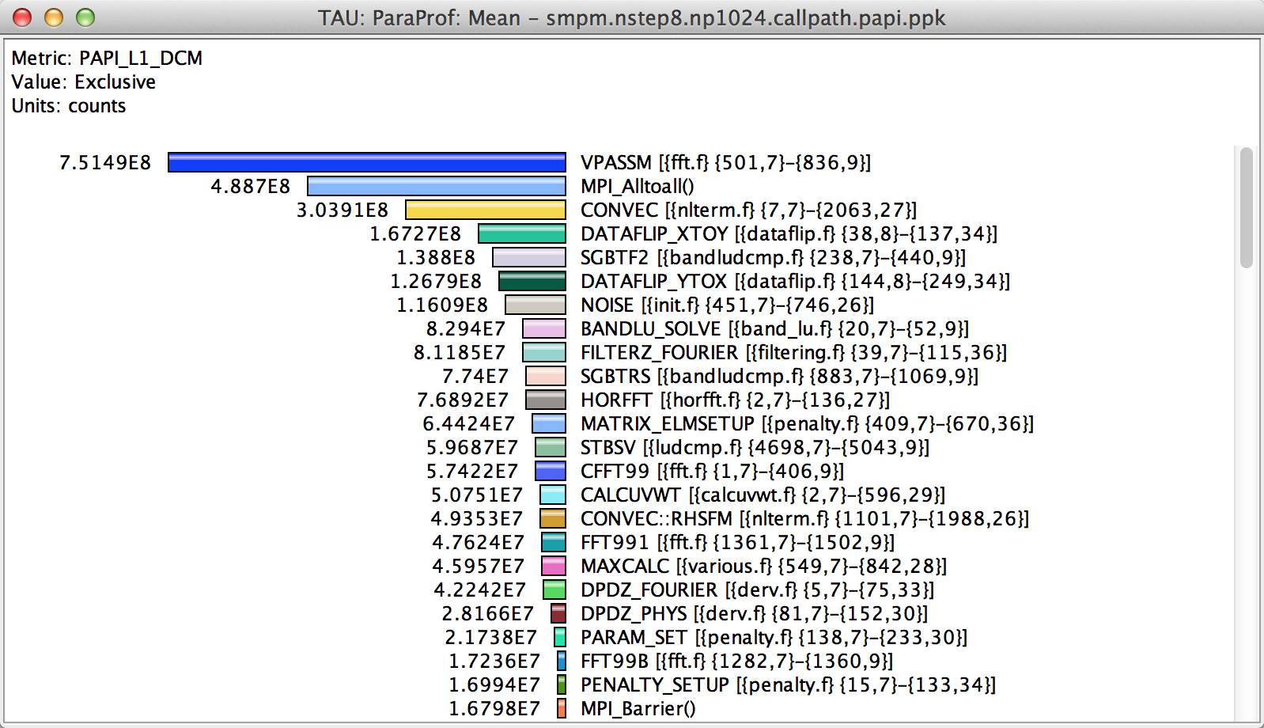
How Many L1/L2/L3 Cache Misses?
% paraprof (Options → Select Metric... → Exclusive… → PAPI_L1_DCM)
Notes:
How much time per code region?
How many instructions per code region?
What is the cost of each code statement?
L1 or L2 cache misses?

Slide 28
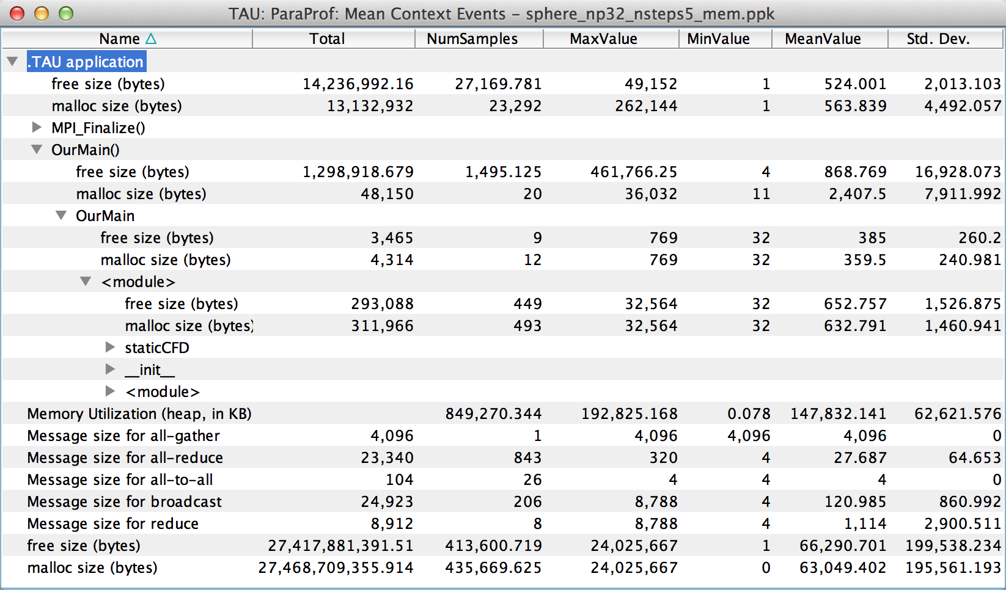
How Much Memory Does the Code Use?
High-water mark
% paraprof (Right-click label [e.g “node 0”] → Show Context Event Window)
Notes:
Heap memory usage reported by the mallinfo() call is not 64-bit clean.
32 bit counters in Linux roll over when > 4GB memory is used
We keep track of heap memory usage in 64 bit counters inside TAU
Compensation of perturbation introduced by tool
Only show what application uses
Create guards for TAU calls to not track I/O and memory allocations/de-allocations performed inside TAU
Provide broad POSIX I/O and memory coverage

Slide 29
How Much Memory Does the Code Use?
Total allocated/deallocated
% paraprof (Right-click label [e.g “node 0”] → Show Context Event Window)
Notes:
What is the memory usage of the code?
When/where is memory allocated?
Are there any memory leaks?
What are the I/O characteristics?

Slide 30
Where is Memory Allocated / Deallocated?
Allocation / Deallocation Events
% paraprof (Right-click label [e.g “node 0”] → Show Context Event Window)
Notes:
What is the memory usage of the code?
When/where is memory allocated?
Are there any memory leaks?
What are the I/O characteristics?

Slide 31
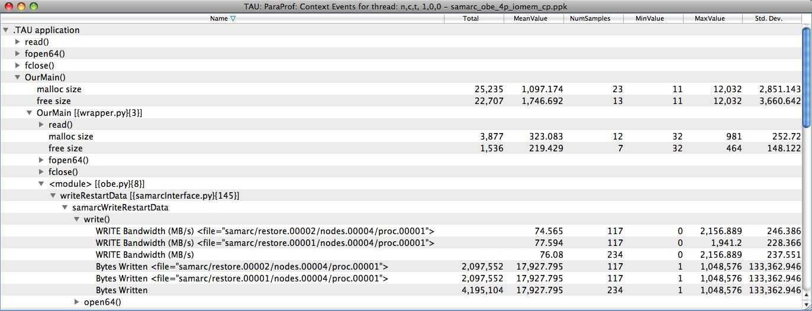
What are the I/O Characteristics?
Write bandwidth per file
Bytes written to each file
% paraprof (Right-click label [e.g “node 0”] → Show Context Event Window)
Notes:
What is the memory usage of the code?
When/where is memory allocated?
Are there any memory leaks?
What are the I/O characteristics?

Slide 32
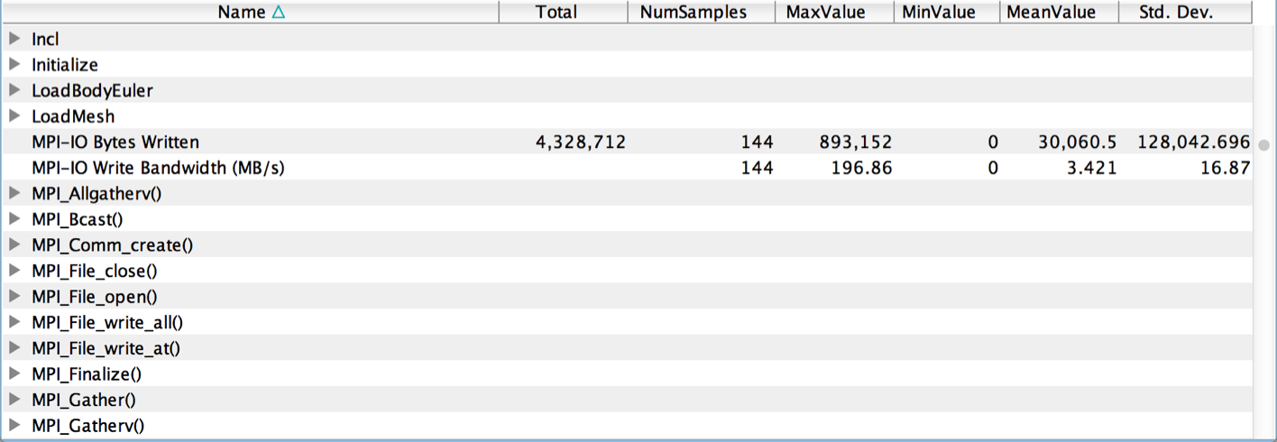
What are the I/O Characteristics?
Peak MPI-IO Write Bandwidth
% paraprof (Right-click label [e.g “node 0”] → Show Context Event Window)
Notes:
What is the memory usage of the code?
When/where is memory allocated?
Are there any memory leaks?
What are the I/O characteristics?

Slide 33
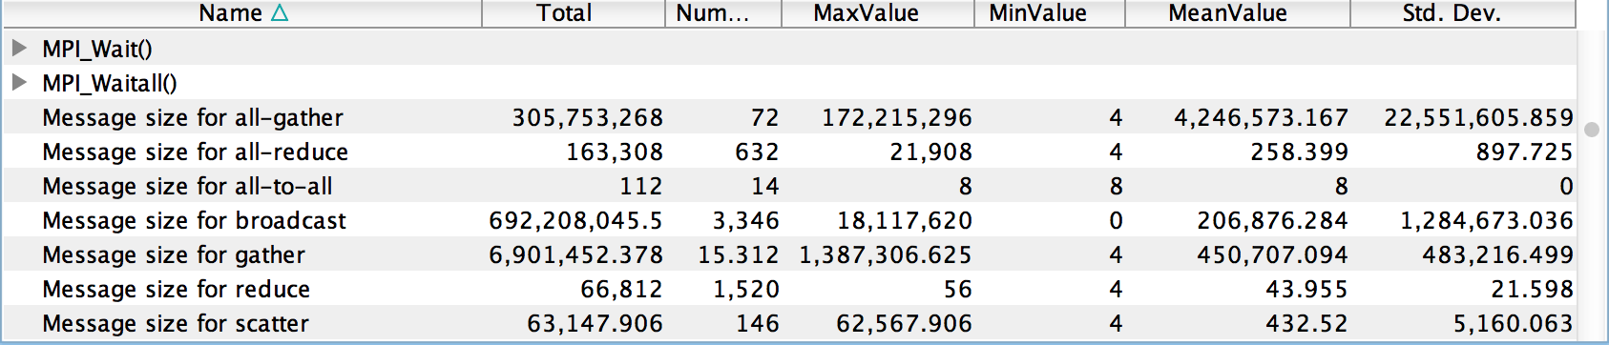
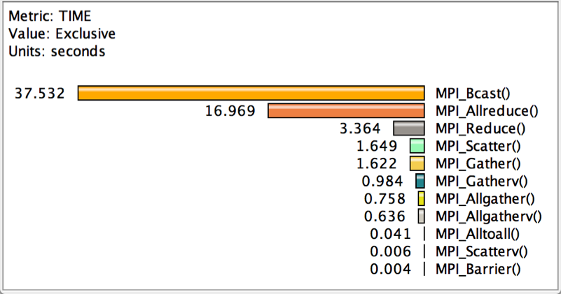
How Much Time is Spent in Collectives?
Message sizes
Time spent in collectives
Notes:
What is the memory usage of the code?
When/where is memory allocated?
Are there any memory leaks?
What are the I/O characteristics?

Slide 34
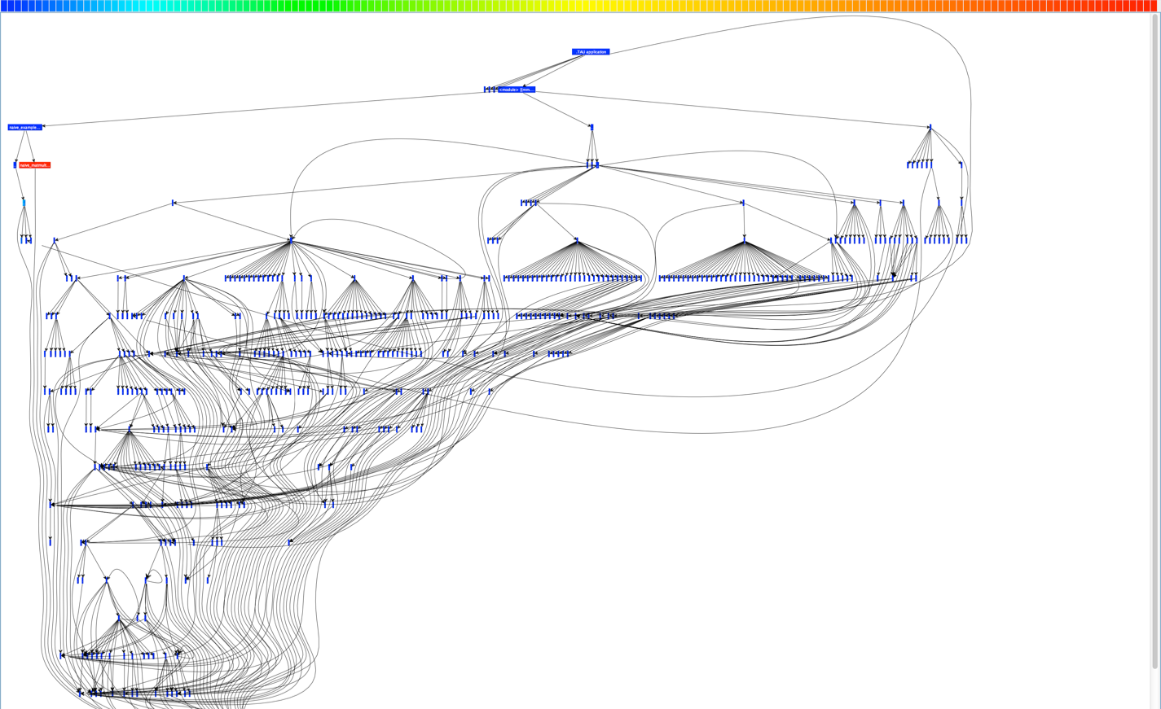
What is the Application Structure?

Slide 35
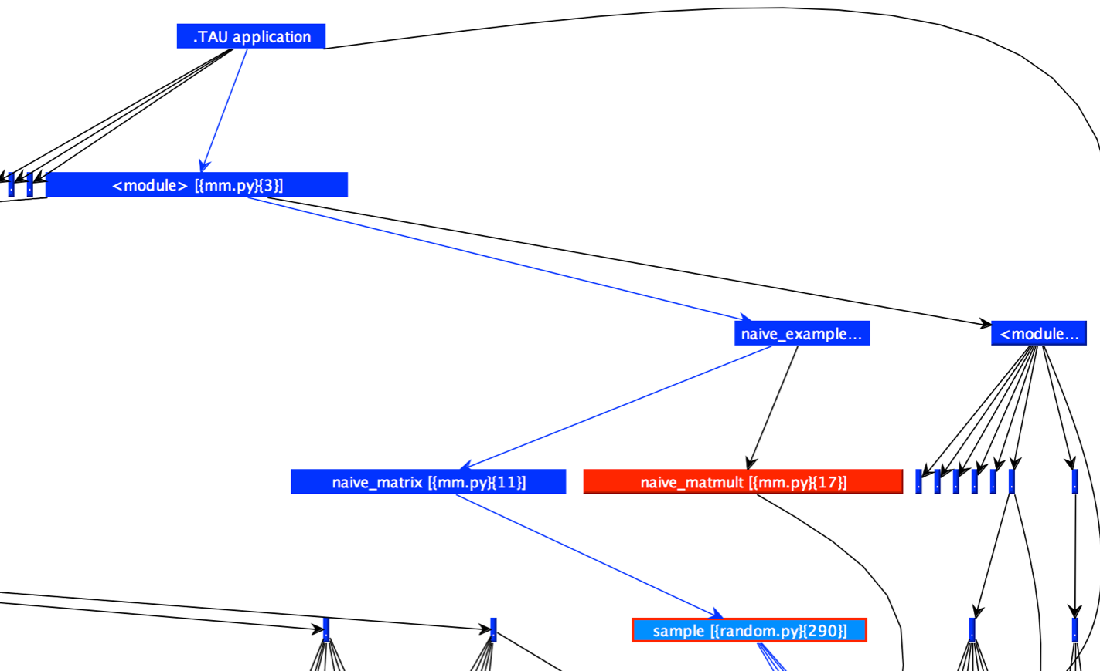
Application Callgraph Navigation

Slide 36
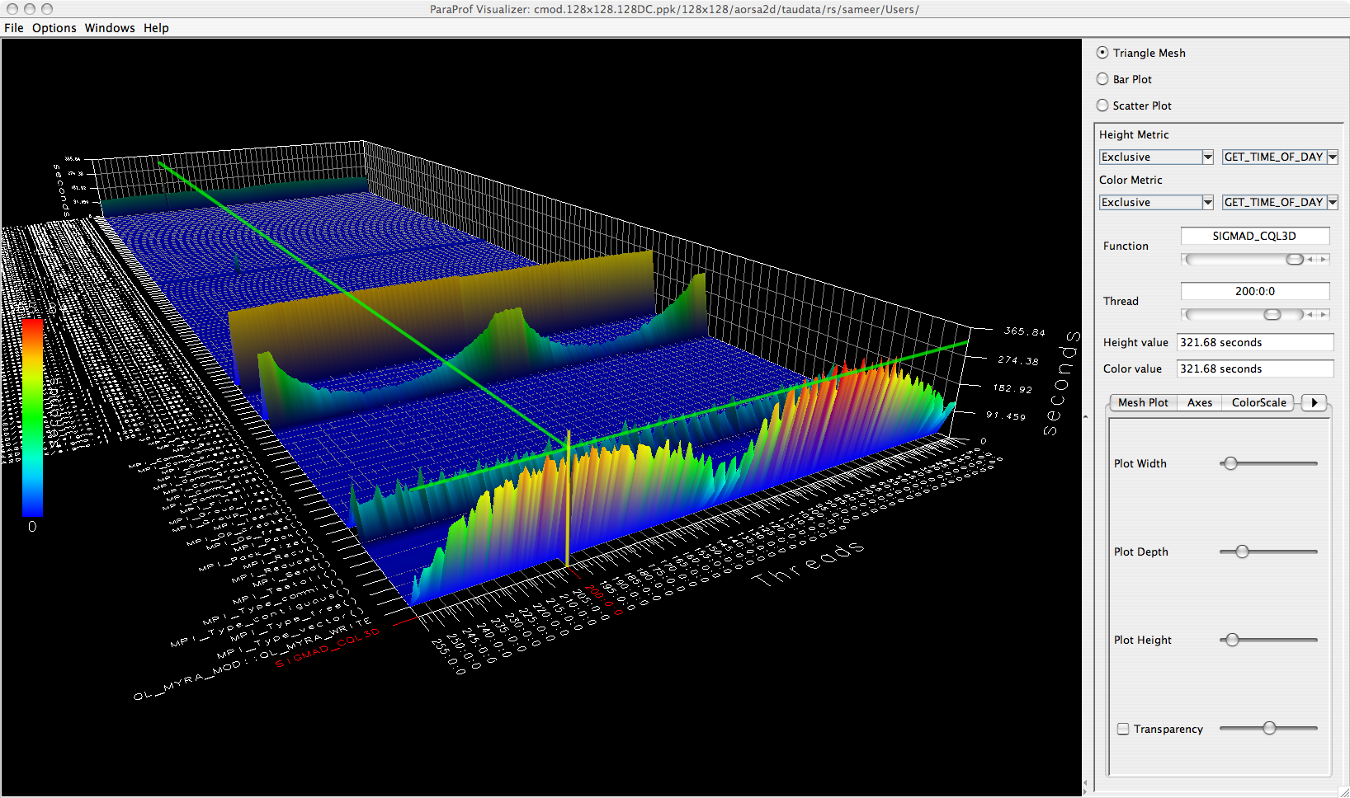
3D Profile Visualization
% paraprof (Windows → 3D Visualization)

Slide 37
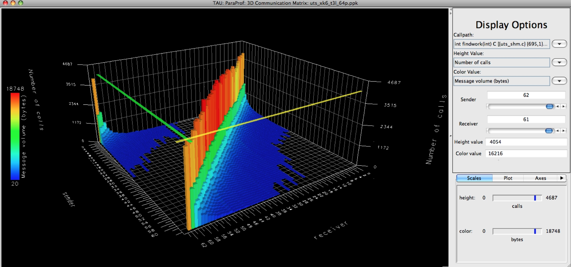
3D Communication Visualization
% qsub –env TAU_COMM_MATRIX=1 …
% paraprof (Windows → 3D Communication Matrix)

Slide 38
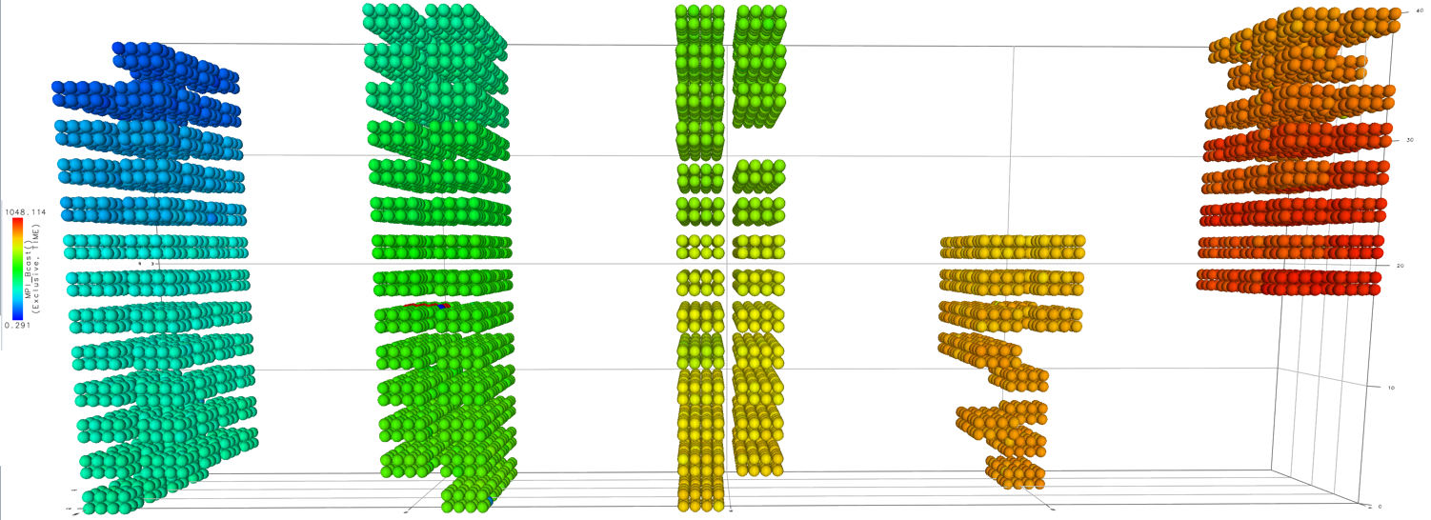
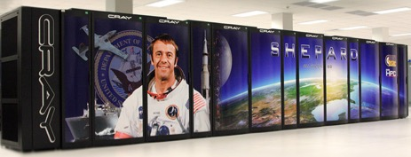
3D Topology Visualization
Notes:
MPI_Send on BG/Q

Slide 39
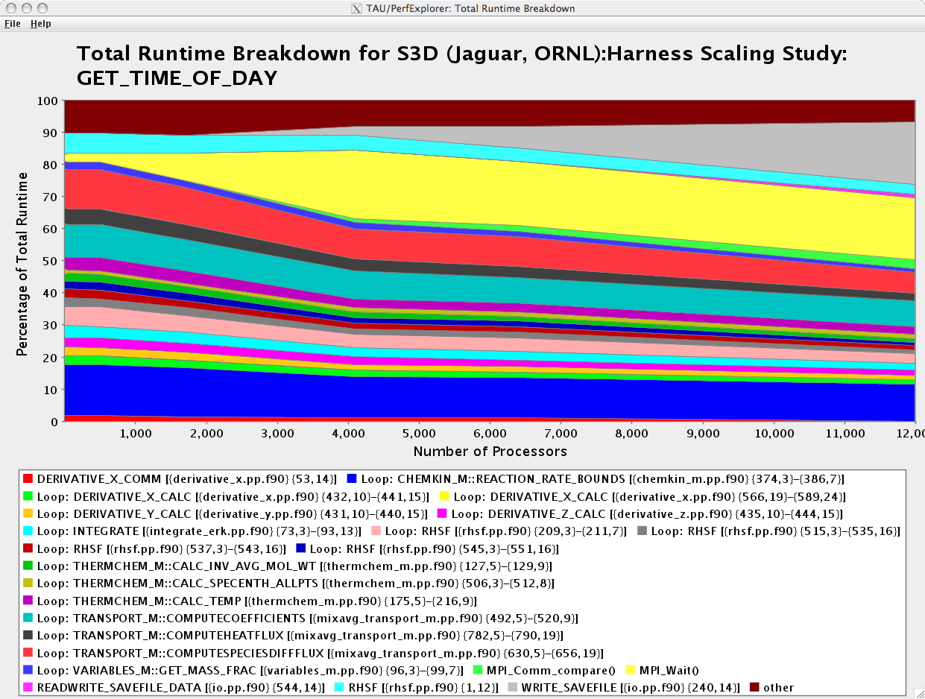
How Well Does Each Routine Scale?
WRITE_SAVEFILE
MPI_Waitall
% perfexplorer (Charts → Runtime Breakdown)

Slide 40
Which Events Correlate with Runtime?
% perfexplorer (Charts → Correlate Events with Total Runtime)

Slide 41
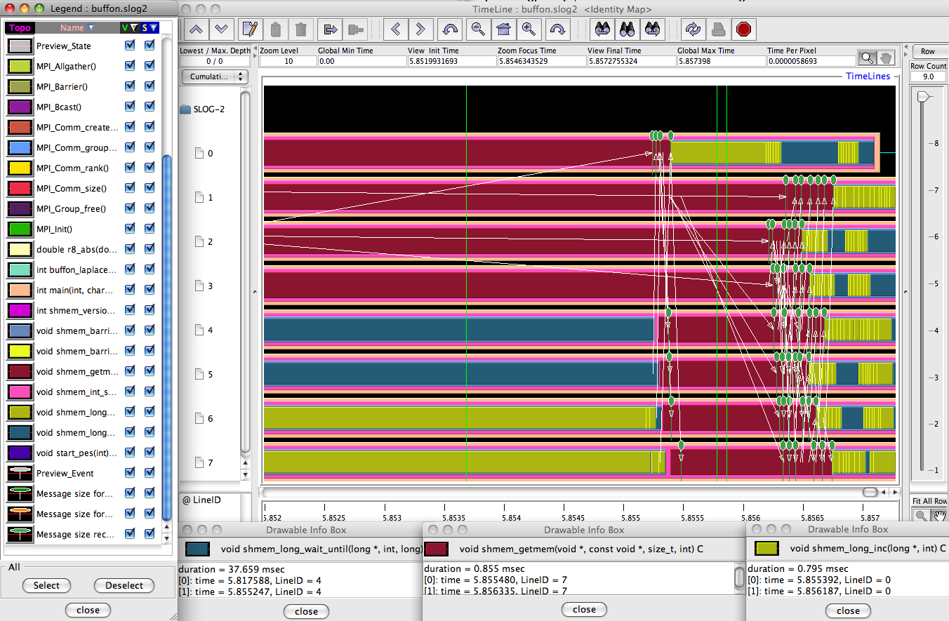
When do Events Occur?

Slide 42
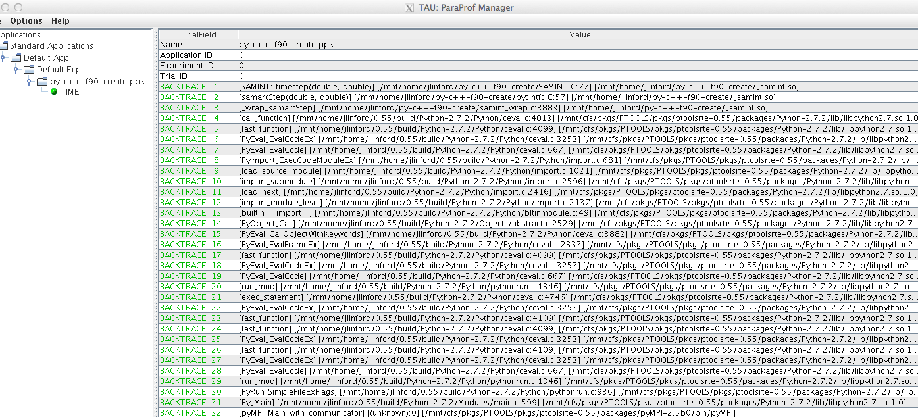
What Caused My Application to Crash?
% qsub –env TAU_TRACK_SIGNALS=1 …
% paraprof
Notes:
What caused the segfault?
What were the performance characteristics up to failure?
Which routines were or were not called?
Were there any memory errors?

Slide 43
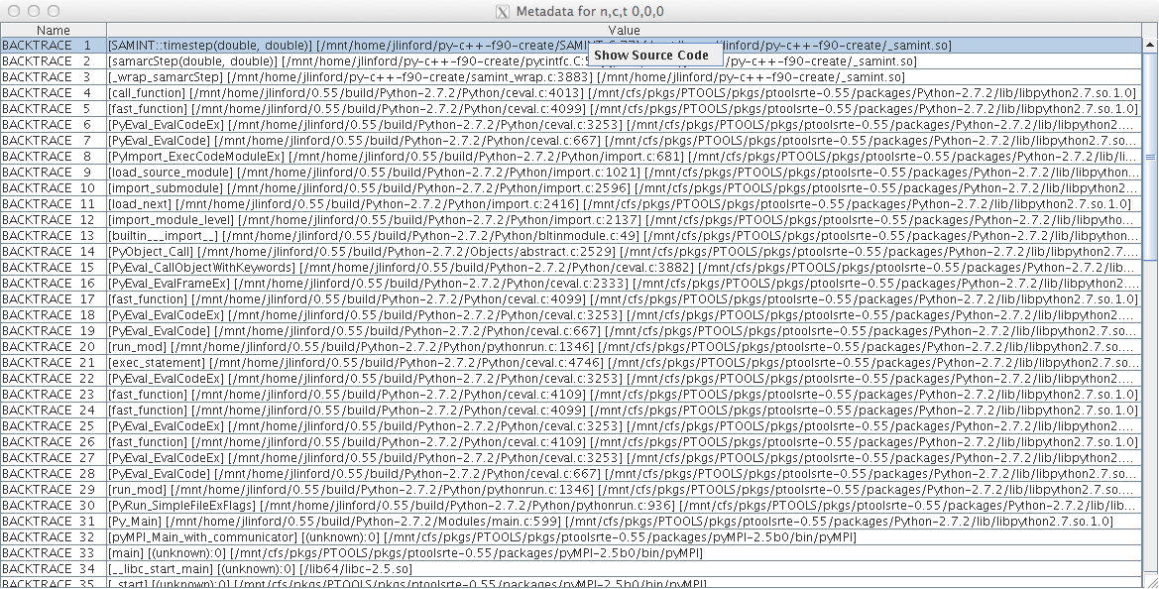
What Caused My Application to Crash?
Right-click to see source code

Slide 44
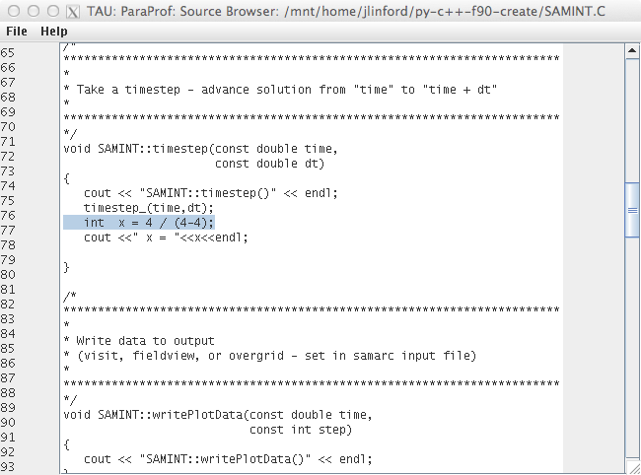
What Caused My Application to Crash?
Error shown in ParaProf Source Browser

Slide 45
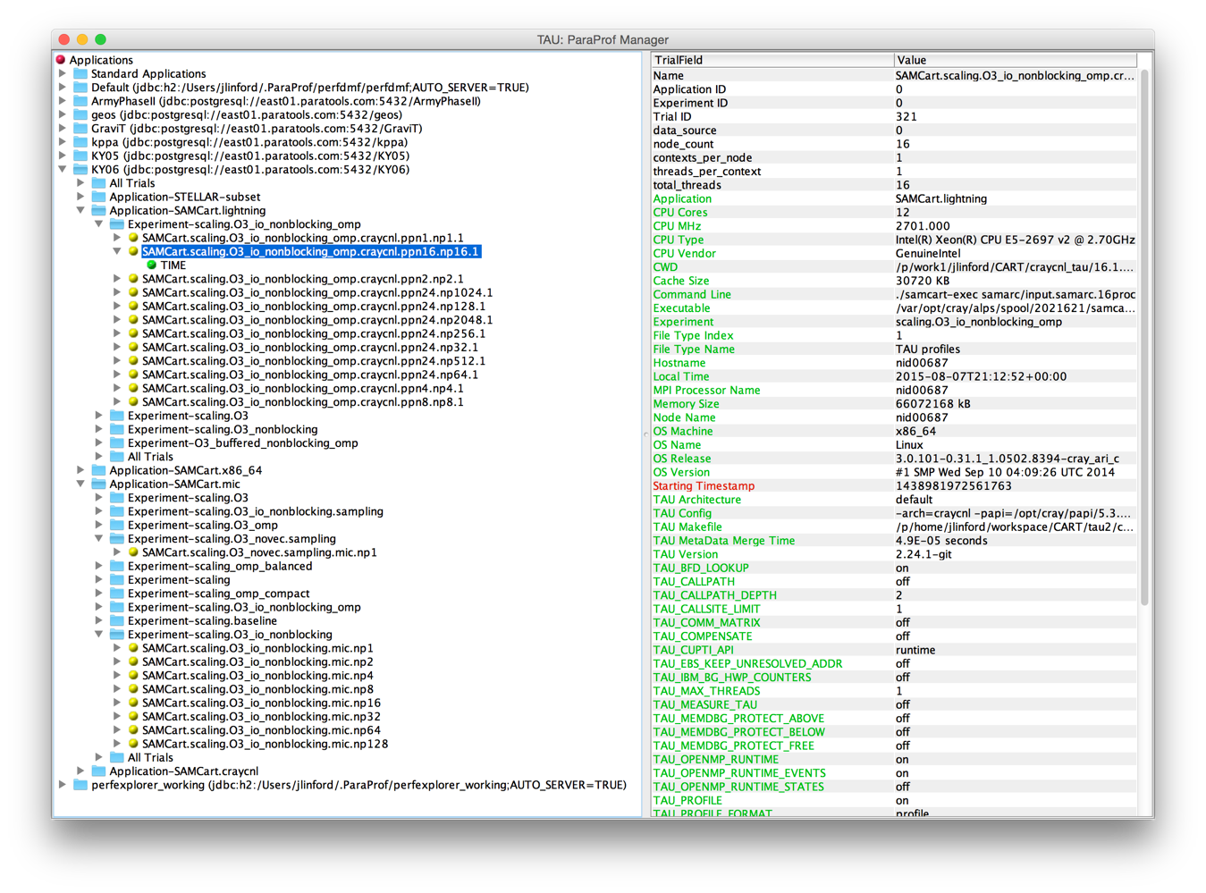
Performance Provenance

Slide 46
Case Study: Strand Solver
NGC Lunch and Learn

Slide 47
DoD CFD Applications

Slide 48
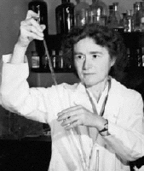
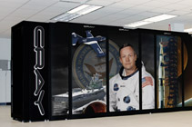
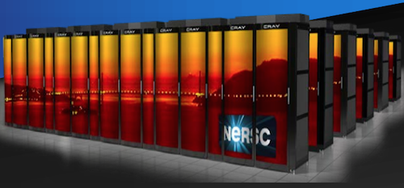

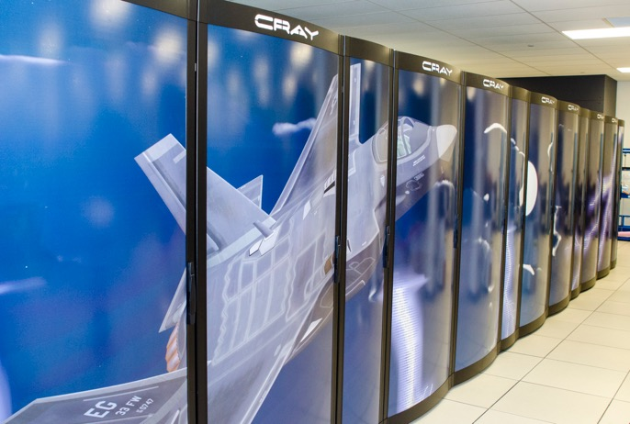

Target Platform: x86_64 + Xeon Phi
Armstrong [XC30]
Cori
Haise [iDataPlex]
Lightning [XC30]
Kilrain [iDataPlex]

Slide 49
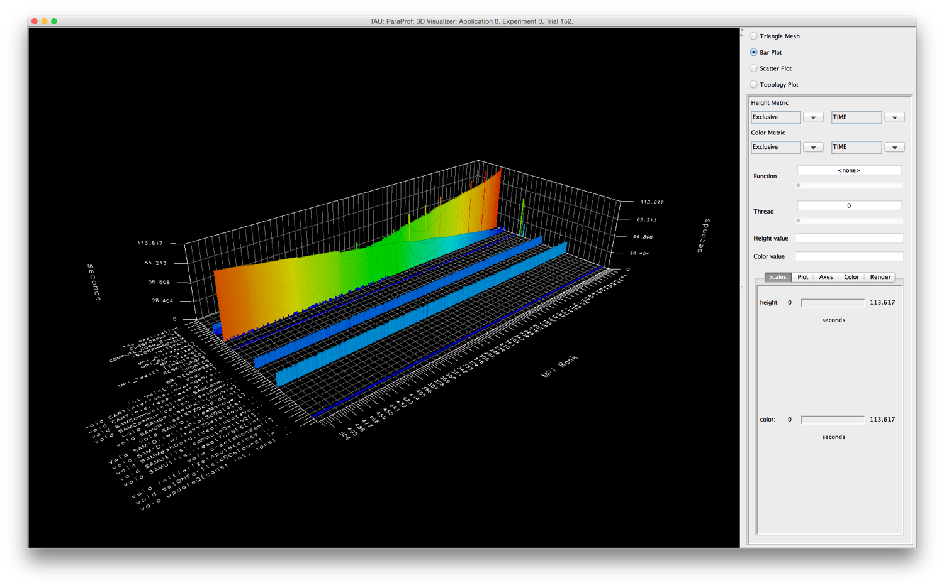
Initial Profile
MPI_Barrier
MPI_Send
File I/O
Useful Work!

Slide 50
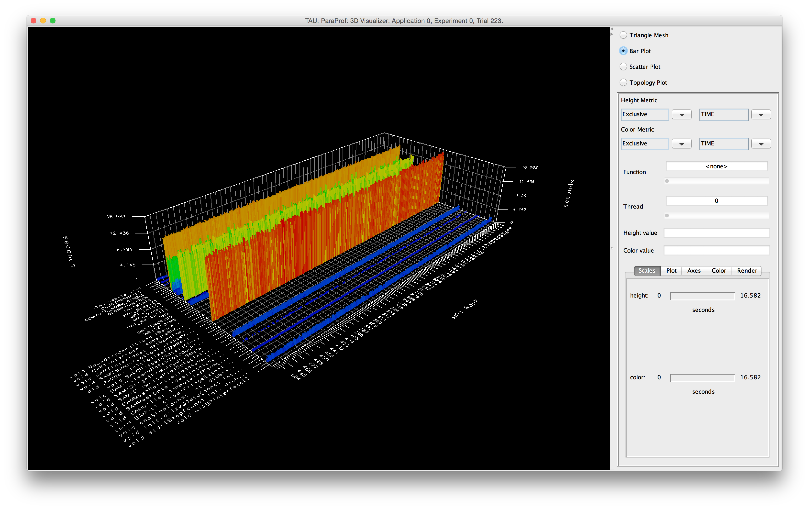
Nonblocking MPI and Optimized I/O
MPI_Waitall
Useful work!
Useful work!
File I/O

Slide 51
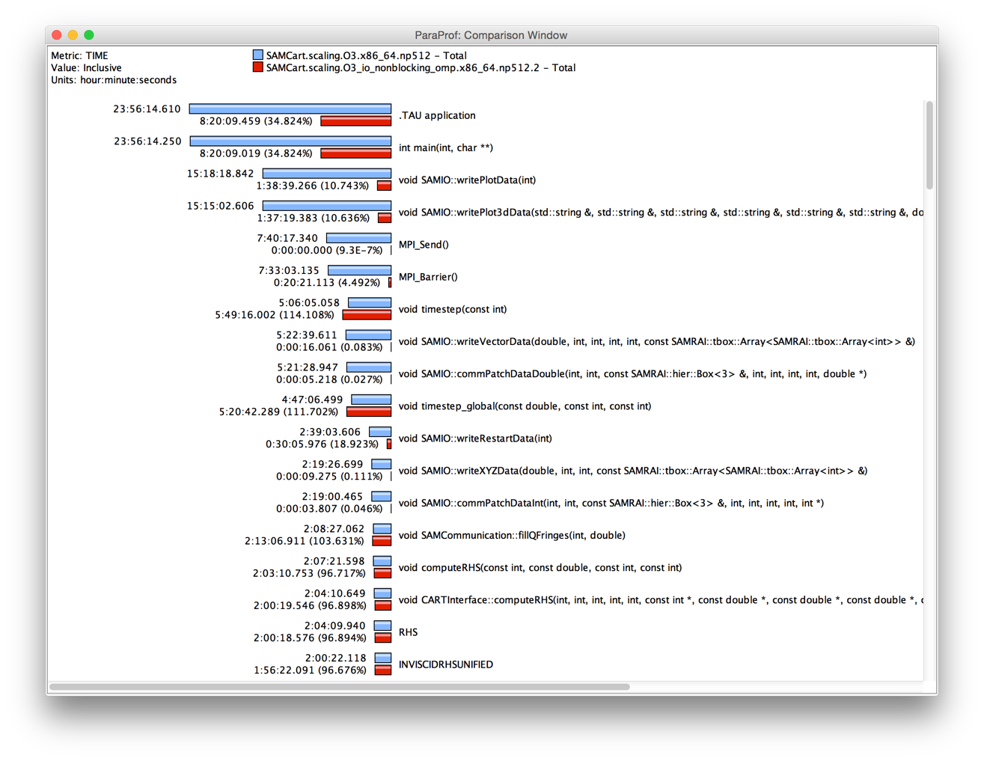
65% Runtime Reduction (~2x faster)

Slide 52
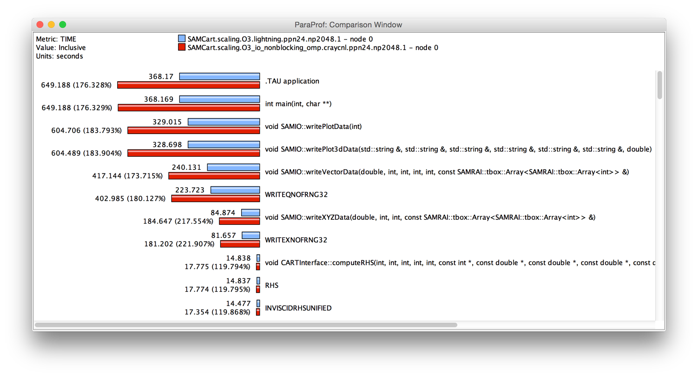
Cray XC30
Slower! What happened???

Slide 53
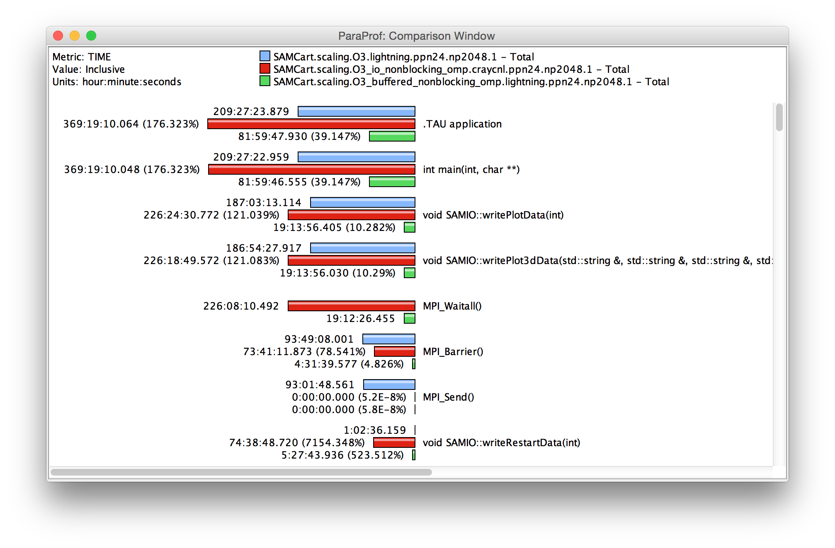
Use Appropriate Stripe & Buffered I/O

Slide 54
Case Study: NASA FUN3D
NGC Lunch and Learn

Slide 55



FUN3D Wing-Body-Nacelle
1,651,089,924 grid points
5,902,801,476 tetrahedral elements
1,310,290,264 prismatic elements
14,400 Ivy Bridge cores

Slide 56

FUN3D Profile shows a hot spot

Slide 57

MPI_Bcast in Unstacked Bar Chart

Slide 58

Callpath Profile

Slide 59

Broad histogram indicates bottleneck.

Slide 60
What’s going on here?
All non-zero ranks send a status code to Rank 0.
Rank 0 broadcasts global status code to all ranks.
Rank 1
Rank 1
Rank 2
Rank 2
Rank 3
Rank 3
Rank 4
Rank 0 checks for any invalid status codes.
Rank 4
Rank 5
Rank 5
Rank 6
Rank 6
Rank 7
Rank 0
Rank 7
Rank 8
Rank 8
Rank 9
Rank 9
Rank 10
Rank 10
…
…
Rank 14,470
Rank 14,470

Slide 61

Two Solutions
MPI_Allreduce()
MPI_Abort()
O(log₂ N) vs. O(N)
O(1) vs. O(N)
33% runtime improvement

Slide 62


FUN3D Wing-Body-Nacelle
“These days I get excited about 1-2% speedups that I find....quite unusual to find something of this magnitude these days, especially with just a 2-line fix in the code! :)”

Slide 63
Case Study: IRMHD
NGC Lunch and Learn

Slide 64


IRMHD on Intrepid and Mira
INCITE magnetohydrodynamcis simulation to understand solar winds and coronal heating
  First direct numerical simulations
  of Alfvén wave (AW) turbulence in
  extended solar atmosphere
  accounting for inhomogeneities
  Team
    University of New Hampshire
    (Jean Perez and Benjamin Chandran)
    ALCF (Tim Williams)
    University of Oregon (Sameer Shende)
IRMHD (Inhomogeneous Reduced Magnetohydrodynamics)
  Fortran 90 and MPI
  Excellent weak and strong scaling properties
  Tested and benchmarked on Intrepid and Mira
HPC Source article and ALCF news
https://www.alcf.anl.gov/articles/furthering-understanding-coronal-heating-and-solar-wind-origin

Slide 65

IRMHD Communication Analysis
Source-based (direct) instrumentation
MPI instrumentation and volume measurement
IRMHD exhibited significant synchronous communication bottlenecks
On 2,408 cores of BG/P:
  MPI_Send and MPI_Bcast
  take significant time
  Opportunities for
  communication/
  computation overlap
  Identified possible targets
  for computation improvements
MPI_Barrier
MPI_Send

Slide 66

IRMHD Optimization on Intrepid (BG/P)
On 2,408 cores, overall execution time reduced from 528.18 core hours to 70.8 core hours
(>7x improvement)
Non-blocking communication substrate
More efficient implementation of underlying FFT

Slide 67

IRMHD Optimization on MIRA (BG/Q)
Oversubscribe nodes: 32k ranks vs. 16k per node
Overall time improvement: 71.23% of original

Slide 68
Conclusion
NGC Lunch and Learn

Slide 69

Try it out!
http://www.taucommander.com
http://www.hpclinux.com [LiveDVD]
Free download, open source, BSD license

Slide 70
















Acknowledgements
Department of Energy
  Office of Science
  Argonne National Laboratory
  Oak Ridge National Laboratory
  NNSA/ASC Trilabs (SNL, LLNL, LANL)
HPCMP DoD PETTT Program
National Science Foundation
  Glassbox, SI-2
University of Tennessee
    University of New Hampshire
      Jean Perez, Benjamin Chandran
University of Oregon
  Allen D. Malony, Sameer Shende
  Kevin Huck, Wyatt Spear
TU Dresden
  Holger Brunst, Andreas Knupfer
  Wolfgang Nagel
Research Centre Jülich
  Bernd Mohr
  Felix Wolf

Slide 71
Reference
TAU Performance System

Slide 72
Online References
PAPI:
  PAPI documentation is available from the PAPI website:
  http://icl.cs.utk.edu/papi/
TAU:
  TAU Users Guide and papers available from the TAU website: http://tau.uoregon.edu/
VAMPIR:
  VAMPIR website:
  http://www.vampir.eu/
Scalasca:
  Scalasca documentation page:
  http://www.scalasca.org/
Eclipse PTP:
  Documentation available from the Eclipse PTP website:
  http://www.eclipse.org/ptp/

Slide 73
Compiling Fortran Codes with TAU
If your Fortran code uses free format in .f files (fixed is default for .f):
% export TAU_OPTIONS='-optPdtF95Opts="-R free" -optVerbose'
To use the compiler based instrumentation instead of PDT (source-based):
% export TAU_OPTIONS='-optCompInst -optVerbose'
If your Fortran code uses C preprocessor directives (#include, #ifdef, #endif):
% export TAU_OPTIONS='-optPreProcess –optVerbose'
To use an instrumentation specification file:
% export TAU_OPTIONS=
'-optTauSelectFile=select.tau -optVerbose -optPreProcess’
Example select.tau file
  BEGIN_INSTRUMENT_SECTION
  loops file="*" routine="#"
  memory file="foo.f90" routine=”#"
  io file="abc.f90" routine="FOO"
  END_INSTRUMENT_SECTION

Slide 74
Generate a PAPI profile with 2 or more counters
% export TAU_MAKEFILE=$TAU/Makefile.tau-papi-mpi-pdt
% export TAU_OPTIONS=‘-optTauSelectFile=select.tau –optVerbose’
% cat select.tau
BEGIN_INSTRUMENT_SECTION
loops routine=“#”
END_INSTRUMENT_SECTION
% export PATH=$TAU_ROOT/bin:$PATH
% make F90=tau_f90.sh
(Or edit Makefile and change F90=tau_f90.sh)
%
% export TAU_METRICS=TIME:PAPI_FP_INS:PAPI_L1_DCM
% mpirun -np 4 ./a.out
% paraprof -–pack app.ppk
Move the app.ppk file to your desktop.
% paraprof app.ppk
Choose Options -> Show Derived Metrics Panel -> “PAPI_FP_INS”, click “/”, “TIME”, click “Apply” and choose the derived metric.

Slide 75
Tracking I/O
% export TAU_MAKEFILE=$TAU/Makefile.tau-papi-mpi-pdt
% export PATH=$TAU_ROOT/bin:$PATH
% export TAU_OPTIONS=‘-optTrackIO –optVerbose’
% make CC=tau_cc.sh CXX=tau_cxx.sh F90=tau_f90.sh
% mpirun –n 4 ./a.out
% paraprof –pack ioprofile.ppk
% export TAU_TRACK_IO_PARAMS=1
% mpirun –n 4 ./a.out

Slide 76
Installing and Configuring TAU
Installing PDT:
  wget http://tau.uoregon.edu/pdt.tgz
  ./configure –prefix=<dir>; make ; make install
Installing TAU:
  wget http://tau.uoregon.edu/tau.tgz
  ./configure -bfd=download -pdt=<dir> -papi=<dir> ...
  make install
Using TAU:
  export TAU_MAKEFILE=<taudir>/<arch>/lib/Makefile.tau-<TAGS>
  make CC=tau_cc.sh CXX=tau_cxx.sh F90=tau_f90.sh

Slide 77
Compile-Time Options (TAU_OPTIONS)
% tau_compiler.sh
  -optVerbose Turn on verbose debugging messages
  -optCompInst Use compiler based instrumentation
  -optNoCompInst Do not revert to compiler instrumentation if source instrumentation fails.
  ﻿-optTrackIO Wrap POSIX I/O call and calculates vol/bw of I/O operations
  ﻿-optMemDbg Runtime bounds checking (see TAU_MEMDBG_* env vars)
  -optKeepFiles Does not remove intermediate .pdb and .inst.* files
  -optPreProcess Preprocess sources (OpenMP, Fortran) before instrumentation
  -optTauSelectFile=”<file>" Specify selective instrumentation file for tau_instrumentor
  -optTauWrapFile=”<file>" Specify path to link_options.tau generated by tau_gen_wrapper
  -optHeaderInst Enable Instrumentation of headers
  -optTrackUPCR Track UPC runtime layer routines (used with tau_upc.sh)
  -optPdtF95Opts="" Add options for Fortran parser in PDT (f95parse/gfparse) …

Slide 78
Runtime Environment Variables
Environment Variable | Default | Description
TAU_TRACE | 0 | Setting to 1 turns on tracing
TAU_CALLPATH | 0 | Setting to 1 turns on callpath profiling
TAU_TRACK_MEMORY_LEAKS | 0 | Setting to 1 turns on leak detection (for use with –optMemDbg or tau_exec)
TAU_MEMDBG_PROTECT_ABOVE | 0 | Setting to 1 turns on bounds checking for dynamically allocated arrays. (Use with –optMemDbg or tau_exec –memory_debug).
TAU_CALLPATH_DEPTH | 2 | Specifies depth of callpath. Setting to 0 generates no callpath or routine information, setting to 1 generates flat profile and context events have just parent information (e.g., Heap Entry: foo)
TAU_TRACK_IO_PARAMS | 0 | Setting to 1 with –optTrackIO or tau_exec –io captures arguments of I/O calls
TAU_TRACK_SIGNALS | 0 | Setting to 1 generate debugging callstack info when a program crashes
TAU_COMM_MATRIX | 0 | Setting to 1 generates communication matrix display using context events
TAU_THROTTLE | 1 | Setting to 0 turns off throttling. Enabled by default to remove instrumentation in lightweight routines that are called frequently
TAU_THROTTLE_NUMCALLS | 100000 | Specifies the number of calls before testing for throttling
TAU_THROTTLE_PERCALL | 10 | Specifies value in microseconds. Throttle a routine if it is called over 100000 times and takes less than 10 usec of inclusive time per call
TAU_COMPENSATE | 0 | Setting to 1 enables runtime compensation of instrumentation overhead
TAU_PROFILE_FORMAT | Profile | Setting to “merged” generates a single file. “snapshot” generates xml format
TAU_METRICS | TIME | Setting to a comma separated list generates other metrics. (e.g., TIME:P_VIRTUAL_TIME:PAPI_FP_INS:PAPI_NATIVE_<event>\\:<subevent>)

