Slide 1
Performance Engineering with TAU and TAU Commander
John C. Linford
ParaTools, Inc.
NASA Langley Research Center
25 May 2017

Slide 2
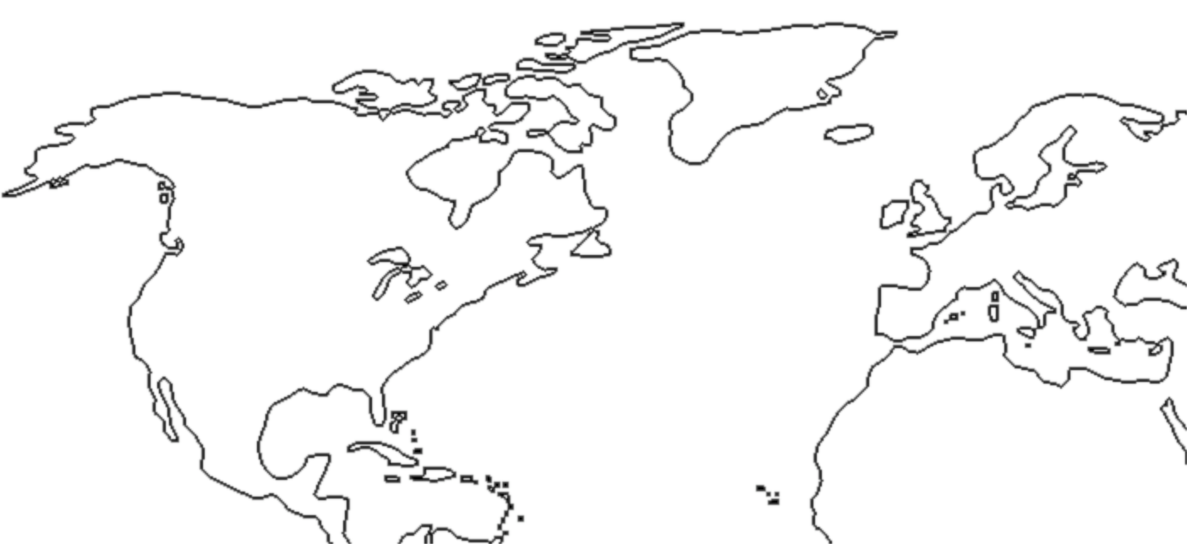
ParaTools
Dr. Allen Malony (CEO)
Dr. Sameer Shende (President)
Dr. John Linford
Dr. Jean-Baptiste Besnard
Mr. Izaak Beekman
Dr. David Mackay
Dr. Sam Khuvis
Daresbury, UK
Beaverton, OR
HQ @ Eugene, OR
Paris, France
Baltimore, MD

Slide 3
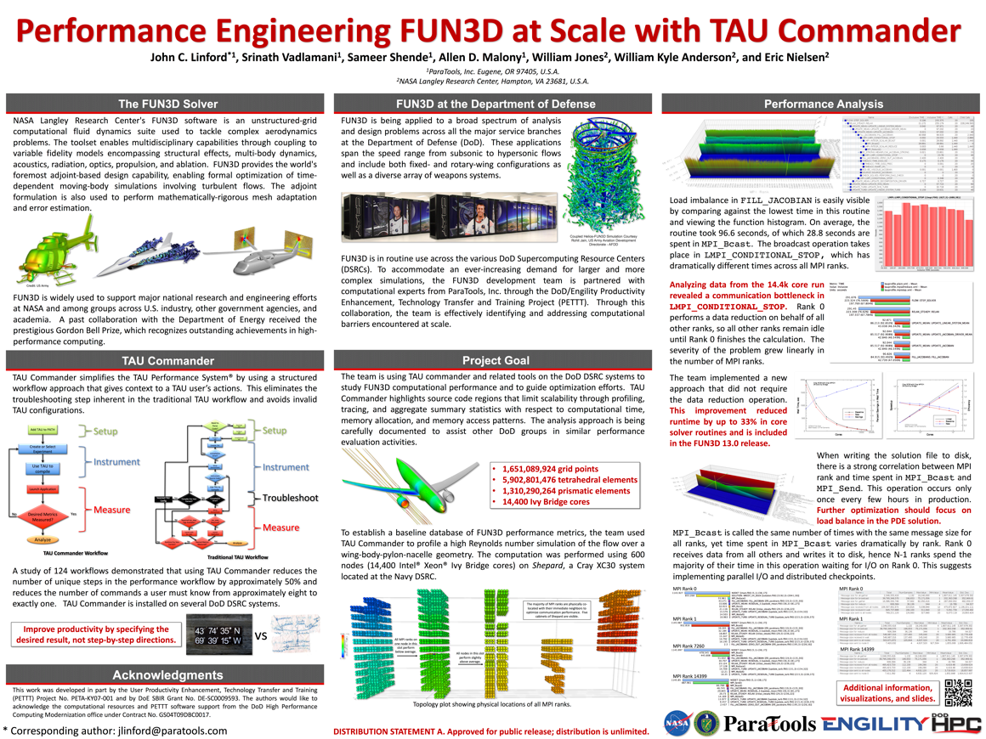
FUN3D work at SC’16

Slide 4
Overview
Why Tools?
TAU Overview
TAU Commander
Case Studies
5
30
10
10

Slide 5
Motivation
Intuitive Performance Engineering

Slide 6
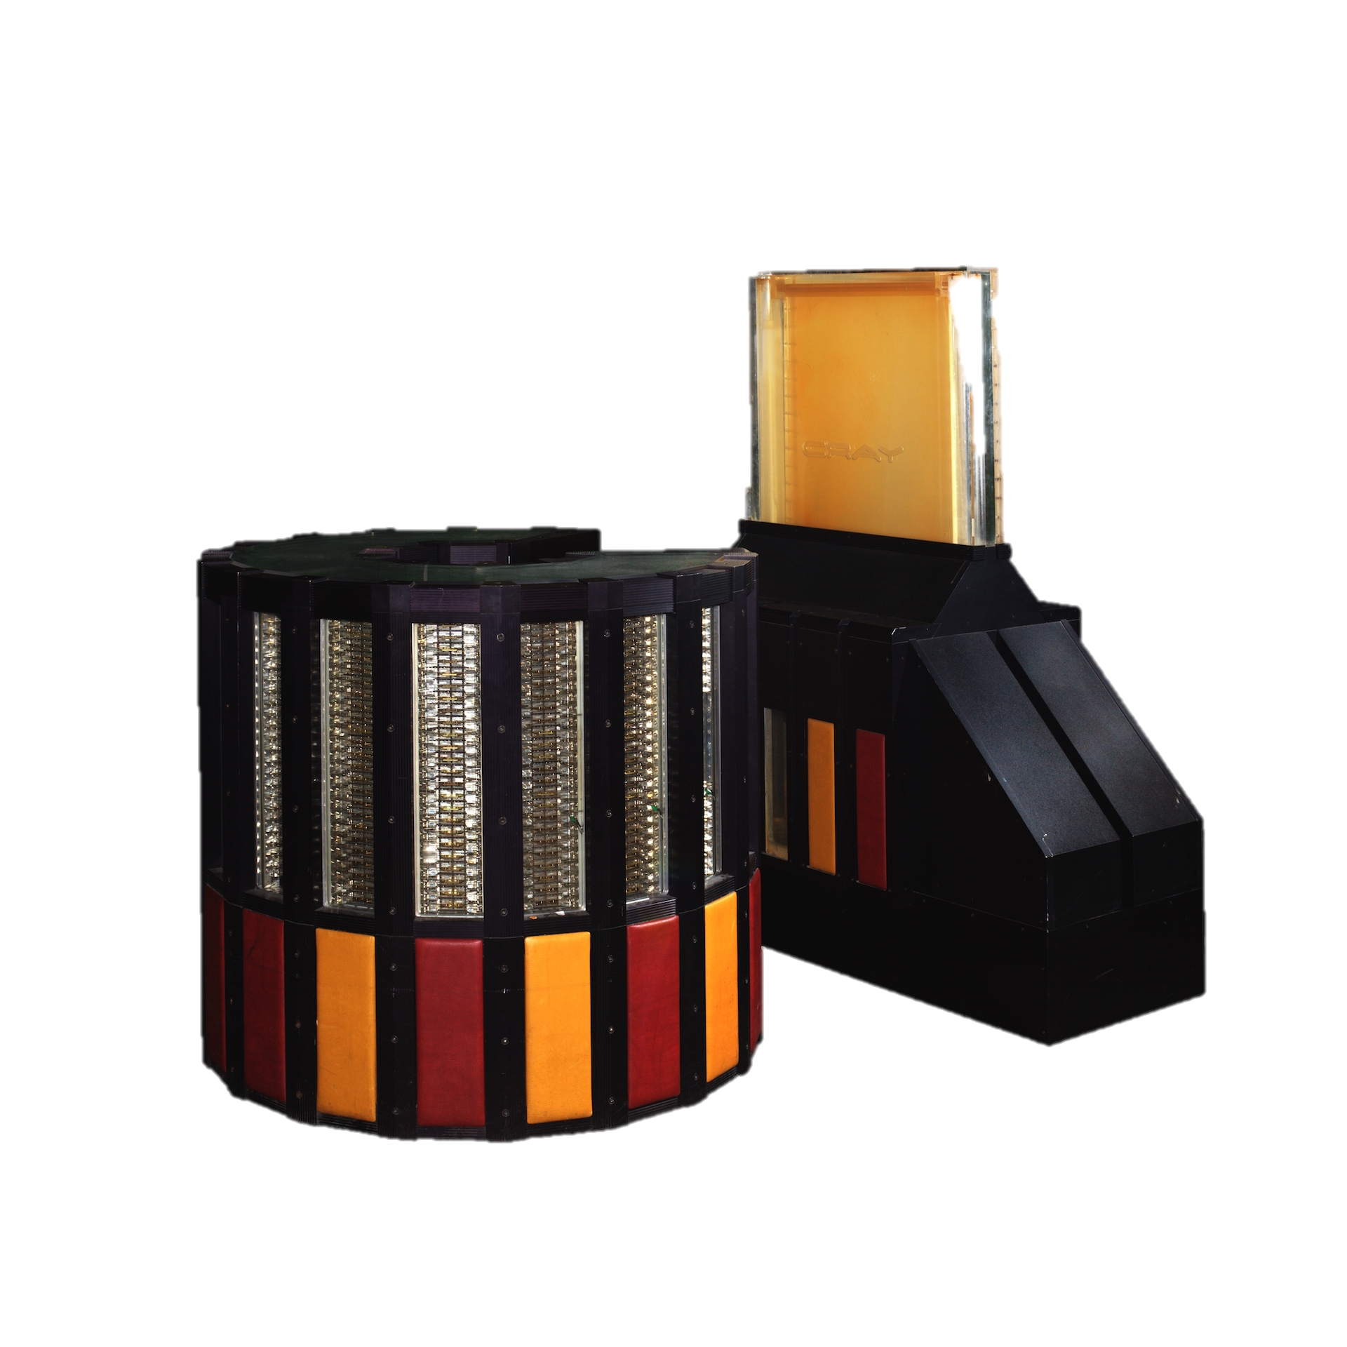
1985: Cray-2
4 vector processors
1.9 gigaflops (0.0095 gigaflops/Watt)
237.5 million abacuses

Slide 7
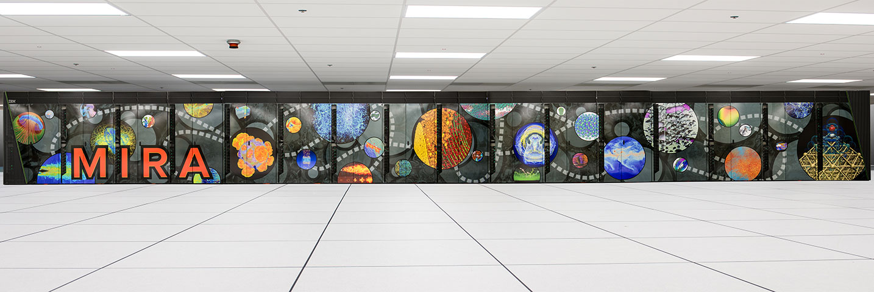
2013: IBM “Mira” BlueGene/Q
784,432 cores
10 petaflops (2.08 gigaflops/Watt)
1.25 quadrillion abacuses
Notes:
1.25 quadrillion abacuses
172,413 abacuses per person

Slide 8
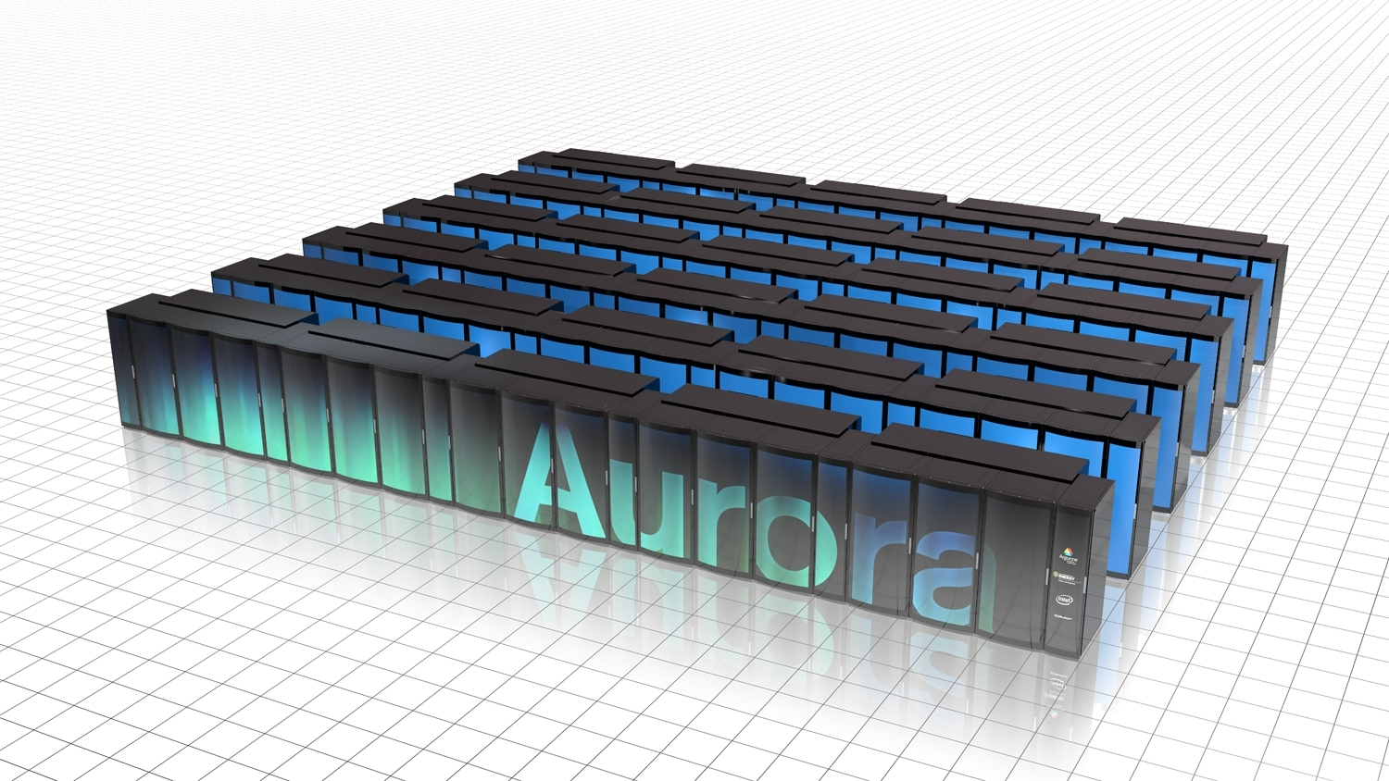
2019: Aurora
>3,200,000 cores
180 petaflops (5.62 gigaflops/Watt)
22.5 quadrillion abacuses

Slide 9
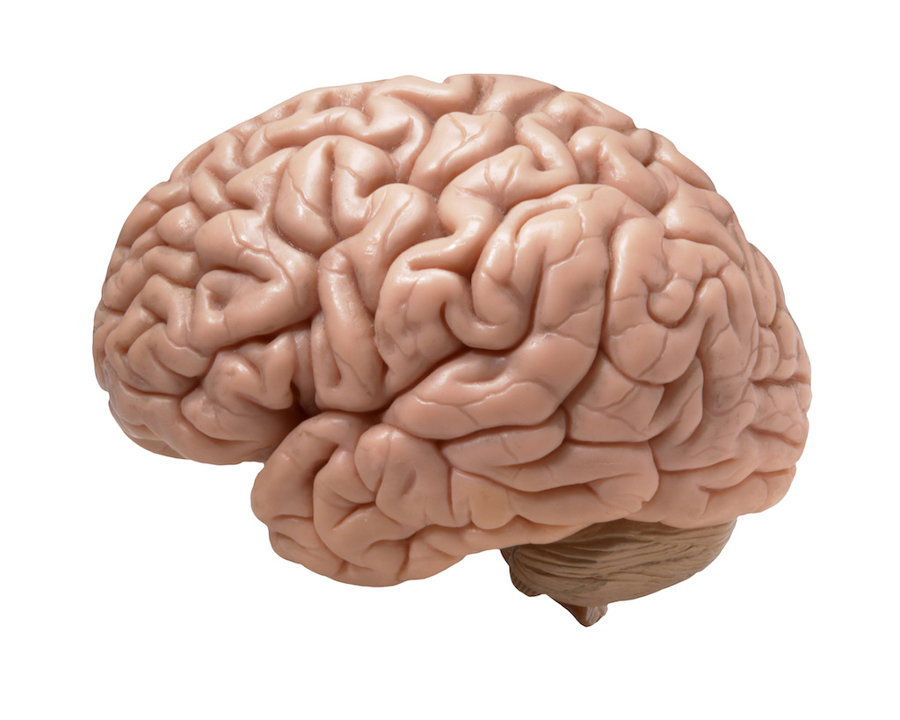
Your brain is not enough
Supercomputers are incomprehensibly complex.
Naïve optimization may harm performance.
Performance engineering tools are essential for realizing performance at scale.
<
<

Slide 10
Naïve GE Optimization
for i=1 to n-1
find pivotPos in column i
if pivotPos ≠ i
exchange rows(pivotPos,i)
end if
for j=i+1 to n
A(i,j) = A(i,j)/A(i,i)
end for j
for j=i+1 to n+1
for k=i+1 to n
A(k,j)=A(k,j)-A(k,i)×A(i,j)
end for k
end for j
end for i
!$omp parallel do private ( i ,j )

Slide 11
First approach speed up
nThreads

Slide 12
The Tau Performance System
Intuitive Performance Engineering

Slide 13
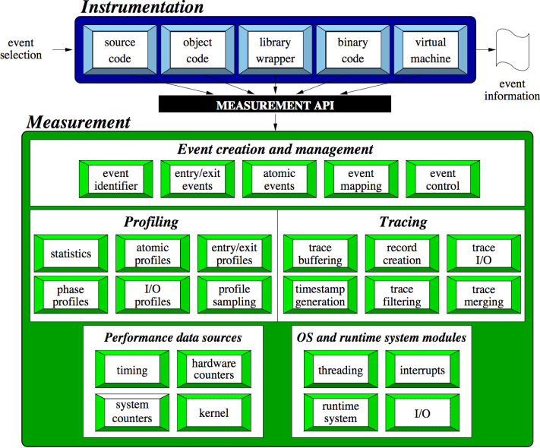
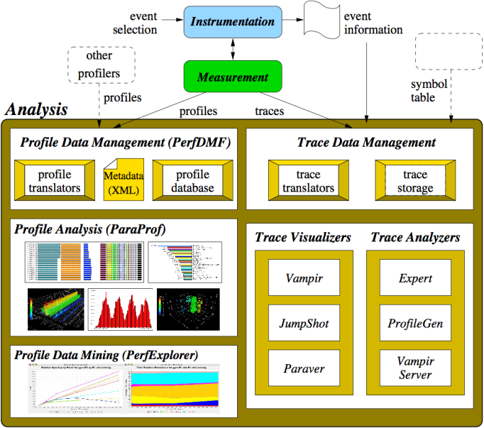
The TAU Performance System®
TAU Architecture
Integrated toolkit for performance problem solving
  Instrumentation, measurement, analysis, visualization
  Portable profiling and tracing
  Performance data management and data mining
Direct and indirect measurement
Free, open source, BSD license
Available on all HPC platforms (and some non-HPC)
http://tau.uoregon.edu/

Slide 14
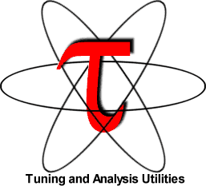
The TAU Performance System®
Tuning and Analysis Utilities (20+ year project)
Comprehensive performance profiling and tracing
  Integrated, scalable, flexible, portable
  Targets all parallel programming/execution paradigms
Integrated performance toolkit
  Instrumentation, measurement, analysis, visualization
  Widely-ported performance profiling / tracing system
  Performance data management and data mining
  Open source (BSD-style license)
Integrates with application frameworks

Slide 15
TAU Supports All HPC Platforms
C/C++
CUDA
UPC
Python
GPI
Fortran
OpenACC
MPI
Java
pthreads
Intel MIC
OpenMP
Intel
GNU
PGI
Sun
LLVM
Cray
MinGW
AIX
Linux
Windows
Insert yours
here
BlueGene
Fujitsu
ARM
Android
MPC
OS X

Slide 16
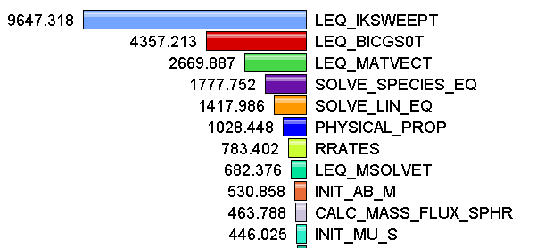
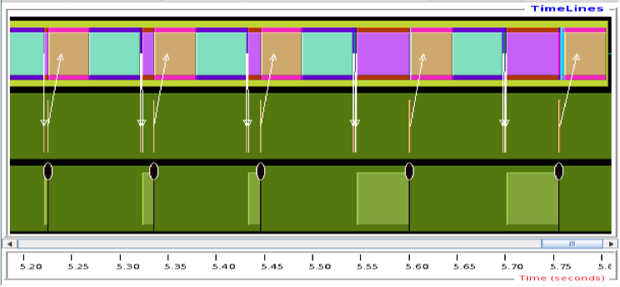
Measurement Approaches
Profiling
Tracing
Shows
how much time was spent in each routine
Shows
when events take place on a timeline

Slide 17
Types of Performance Profiles
Flat profiles
  Metric (e.g., time) spent in an event
  Exclusive/inclusive, # of calls, child calls, …
Callpath profiles
  Time spent along a calling path (edges in callgraph)
  “main=> f1 => f2 => MPI_Send”
  Set the TAU_CALLPATH_DEPTH environment variable
Phase profiles
  Flat profiles under a phase (nested phases allowed)
  Default “main” phase
  Supports static or dynamic (e.g. per-iteration) phases
Notes:
Collect basic routine-level timing profile to determine where most time is being spent
Collect routine-level hardware counter data to determine types of performance problems
Collect callpath profiles to determine sequence of events causing performance problems
Conduct finer-grained profiling and/or tracing to pinpoint performance bottlenecks
Loop-level profiling with hardware counters
Tracing of communication operations

Slide 18
How much data do you want?
Limited
Profile
Loop
Profile
Callpath
Profile
O(KB)
O(TB)
Flat
Profile
Phase
Profile
Trace
All levels support multiple metrics/counters

Slide 19
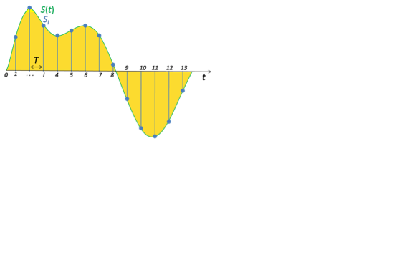
Performance Data Measurement
Direct via Probes
Indirect via Sampling
call TAU_START(‘potential’)
// code
call TAU_STOP(‘potential’)
Exact measurement
Fine-grain control
Calls inserted into code
No code modification
Minimal effort
Relies on debug symbols (-g option)

Slide 20
Insert TAU API Calls Automatically
Use TAU’s compiler wrappers
  Replace CXX with tau_cxx.sh, etc.
  Automatically instruments source code, links with TAU libraries.
Use tau_cc.sh for C, tau_f90.sh for Fortran, etc.
Makefile without TAU
Makefile with TAU
CXX = mpicxx
F90 = mpif90
CXXFLAGS =
LIBS = -lm
OBJS = f1.o f2.o f3.o … fn.o
app: $(OBJS)
$(CXX) $(LDFLAGS) $(OBJS) -o $@
$(LIBS)
.cpp.o:
$(CXX) $(CXXFLAGS) -c $<
CXX = tau_cxx.sh
F90 = tau_f90.sh
CXXFLAGS =
LIBS = -lm
OBJS = f1.o f2.o f3.o … fn.o
app: $(OBJS)
$(CXX) $(LDFLAGS) $(OBJS) -o $@ $(LIBS)
.cpp.o:
$(CXX) $(CXXFLAGS) -c $<

Slide 21
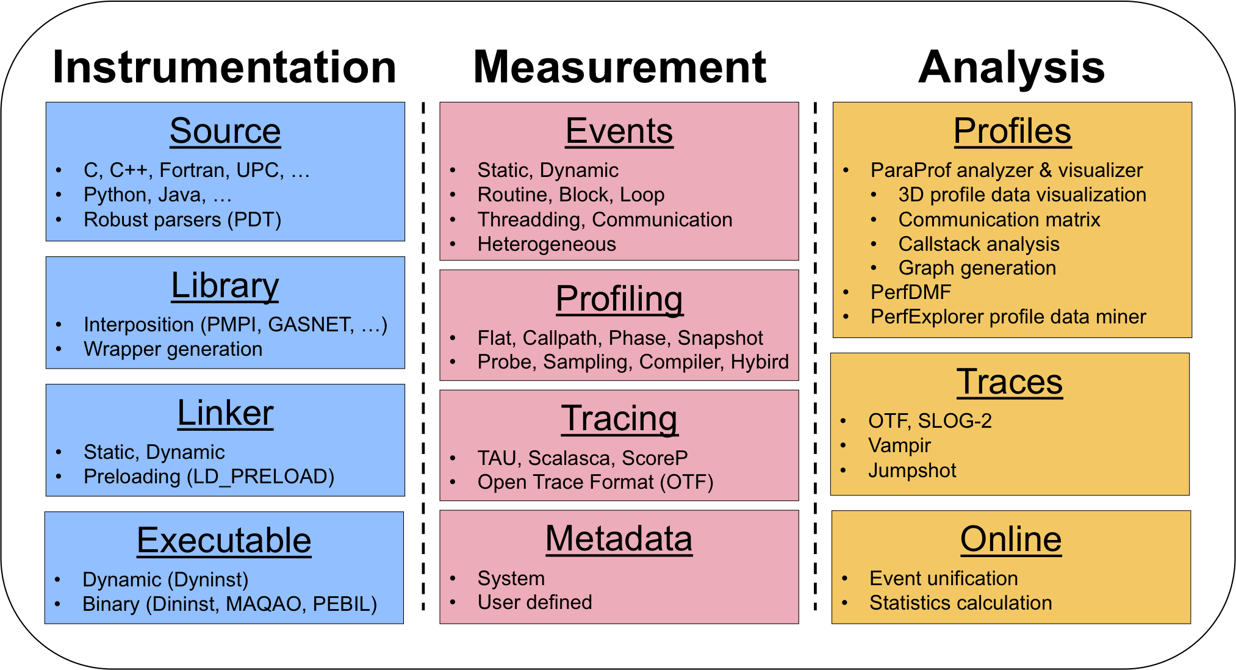
TAU Workflow

Slide 22
Instrument: Add Probes
  Source code instrumentation
    PDT parsers, pre-processors
  Wrap external libraries
    I/O, MPI, Memory, CUDA, OpenCL, pthread
  Rewrite the binary executable
    Dyninst, MAQAO

Slide 23
Measure: Gather Data
  Direct measurement via probes
  Indirect measurement via sampling
  Throttling and runtime control
  Interface with external packages (PAPI)

Slide 24
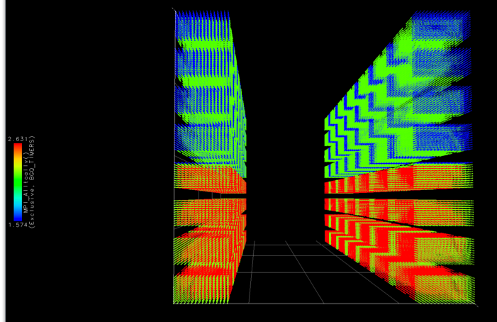
Analyze: Synthesize Knowledge
  Data visualization
  Data mining
  Statistical analysis
  Import/export performance data

Slide 25
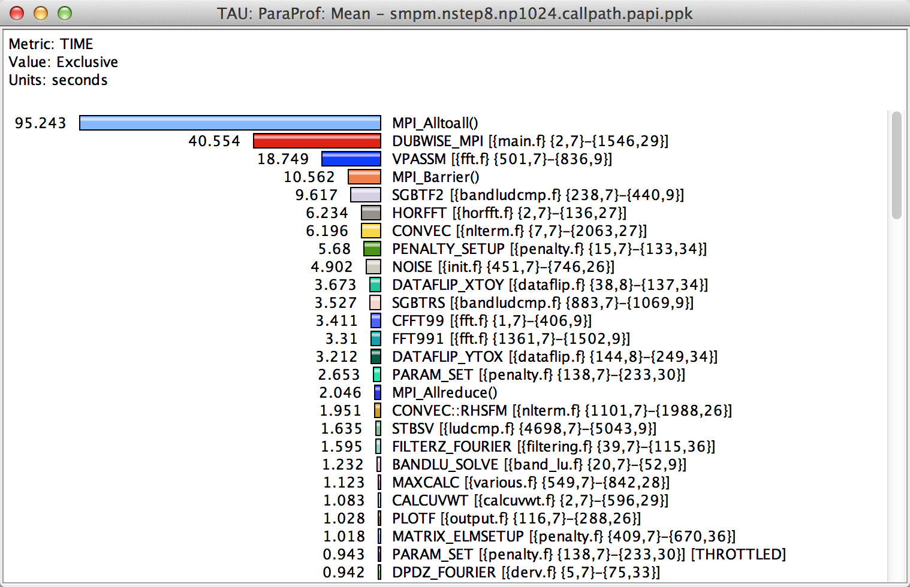
How Much Time per Code Region?
% paraprof (Click on label, e.g. “Mean” or “node 0”)
Notes:
How much time per code region?
How many instructions per code region?
What is the cost of each code statement?
L1 or L2 cache misses?

Slide 26
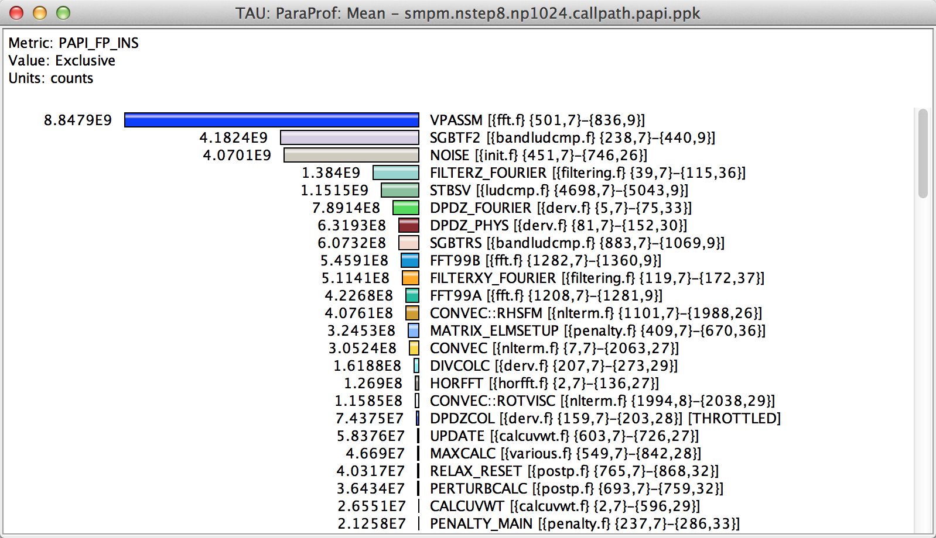
How Many Instructions per Code Region?
% paraprof (Options → Select Metric... → Exclusive… → PAPI_FP_INS)
Notes:
How much time per code region?
How many instructions per code region?
What is the cost of each code statement?
L1 or L2 cache misses?

Slide 27
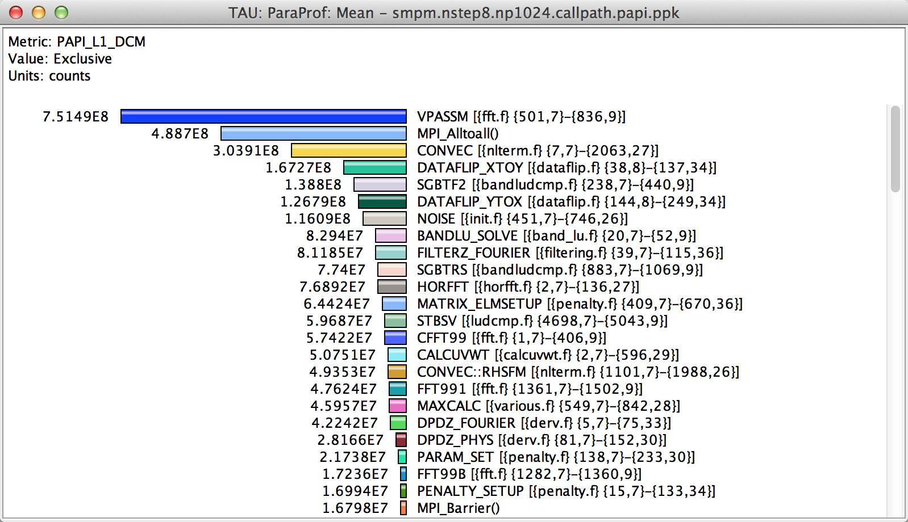
How Many L1 or L2 Cache Misses?
% paraprof (Options → Select Metric... → Exclusive… → PAPI_L1_DCM)
Notes:
How much time per code region?
How many instructions per code region?
What is the cost of each code statement?
L1 or L2 cache misses?

Slide 28
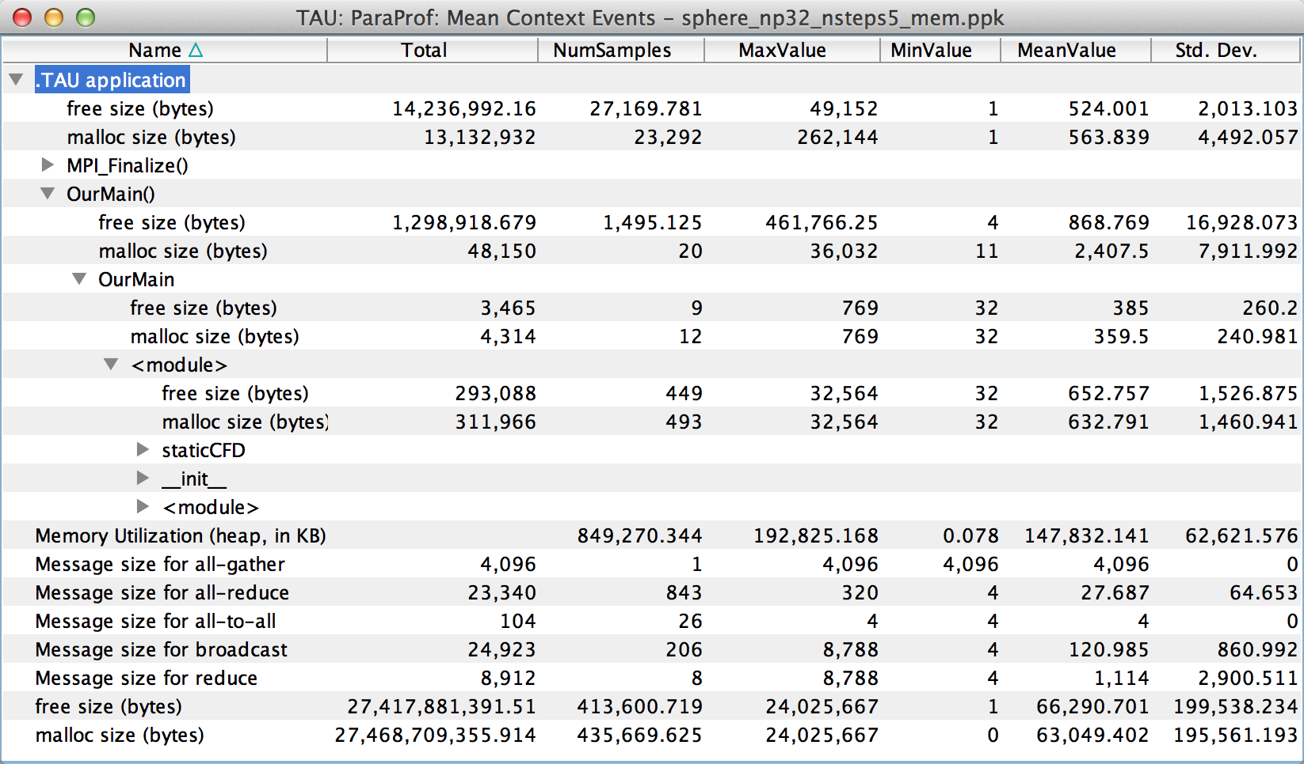
How Much Memory Does the Code Use?
High-water mark
% paraprof (Right-click label [e.g “node 0”] → Show Context Event Window)
Notes:
Heap memory usage reported by the mallinfo() call is not 64-bit clean.
32 bit counters in Linux roll over when > 4GB memory is used
We keep track of heap memory usage in 64 bit counters inside TAU
Compensation of perturbation introduced by tool
Only show what application uses
Create guards for TAU calls to not track I/O and memory allocations/de-allocations performed inside TAU
Provide broad POSIX I/O and memory coverage

Slide 29
How Much Memory Does the Code Use?
Total allocated/deallocated
% paraprof (Right-click label [e.g “node 0”] → Show Context Event Window)
Notes:
What is the memory usage of the code?
When/where is memory allocated?
Are there any memory leaks?
What are the I/O characteristics?

Slide 30
Where is Memory Allocated / Deallocated?
Allocation / Deallocation Events
% paraprof (Right-click label [e.g “node 0”] → Show Context Event Window)
Notes:
What is the memory usage of the code?
When/where is memory allocated?
Are there any memory leaks?
What are the I/O characteristics?

Slide 31
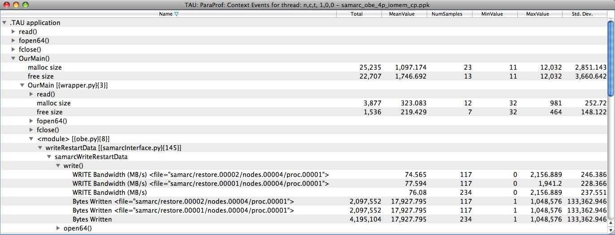
What are the I/O Characteristics?
Write bandwidth per file
Bytes written to each file
% paraprof (Right-click label [e.g “node 0”] → Show Context Event Window)
Notes:
What is the memory usage of the code?
When/where is memory allocated?
Are there any memory leaks?
What are the I/O characteristics?

Slide 32
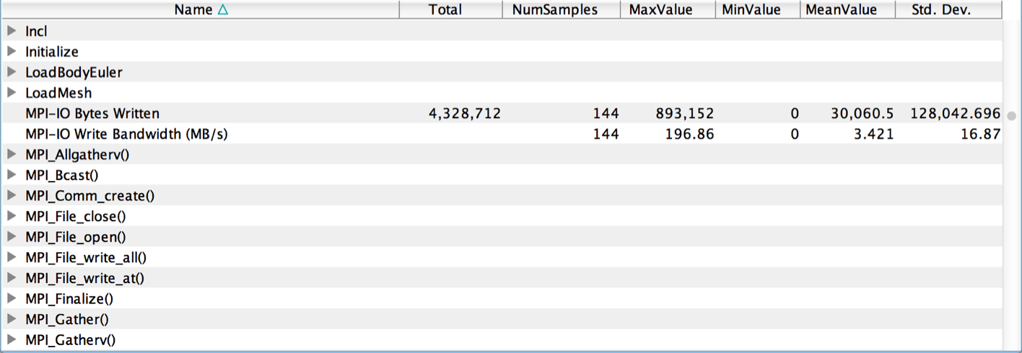
What are the I/O Characteristics?
Peak MPI-IO Write Bandwidth
% paraprof (Right-click label [e.g “node 0”] → Show Context Event Window)
Notes:
What is the memory usage of the code?
When/where is memory allocated?
Are there any memory leaks?
What are the I/O characteristics?

Slide 33
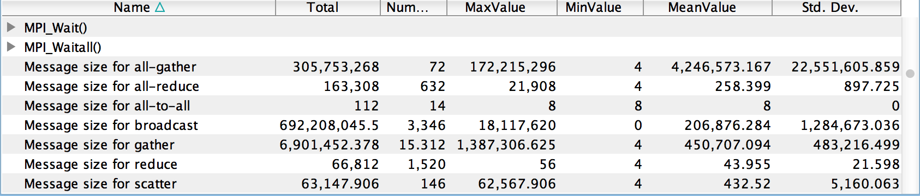
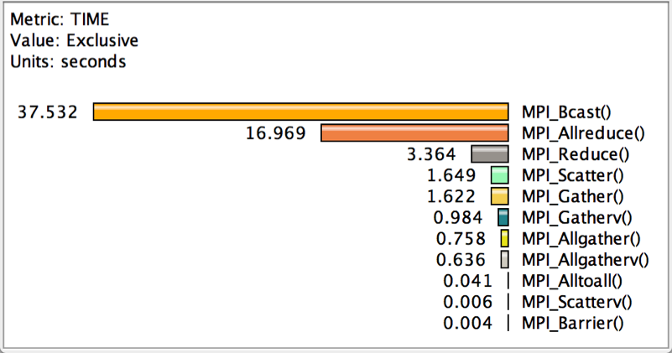
How Much Time is spent in Collectives?
Message sizes
Time spent in collectives
Notes:
What is the memory usage of the code?
When/where is memory allocated?
Are there any memory leaks?
What are the I/O characteristics?

Slide 34
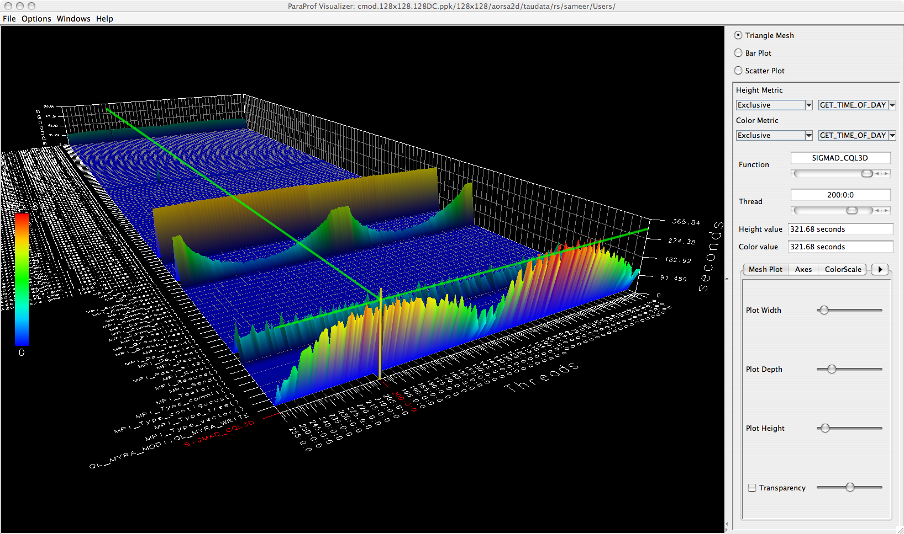
3D Profile Visualization
% paraprof (Windows → 3D Visualization)

Slide 35
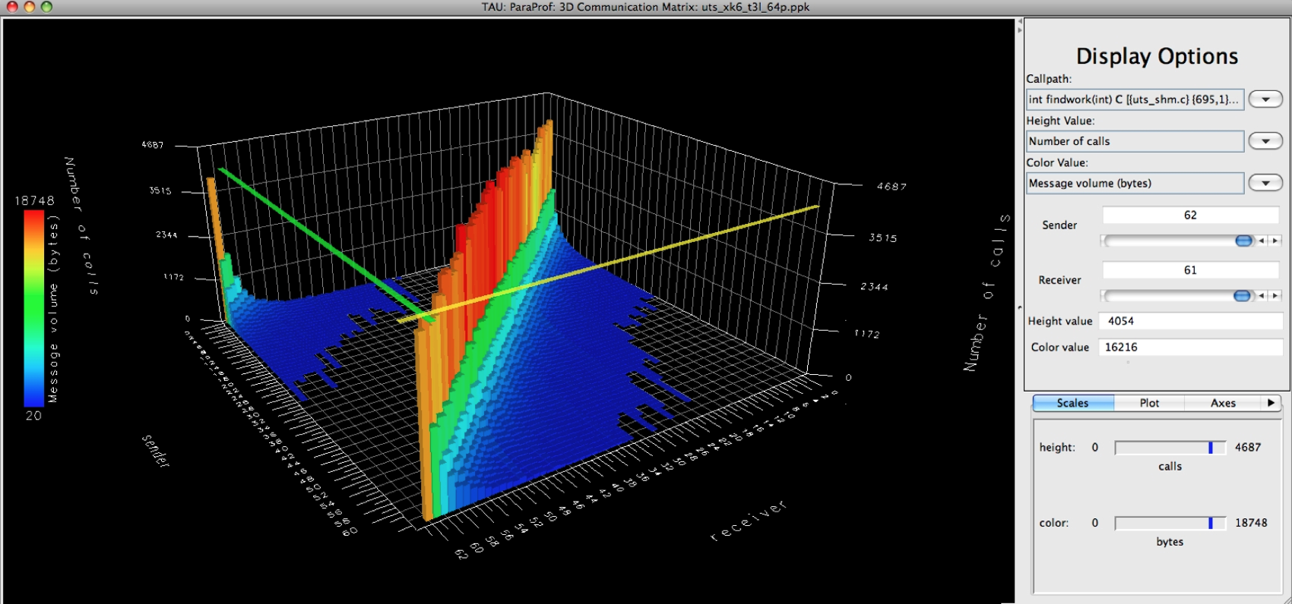
3D Communication Visualization
% qsub –env TAU_COMM_MATRIX=1 …
% paraprof (Windows → 3D Communication Matrix)

Slide 36
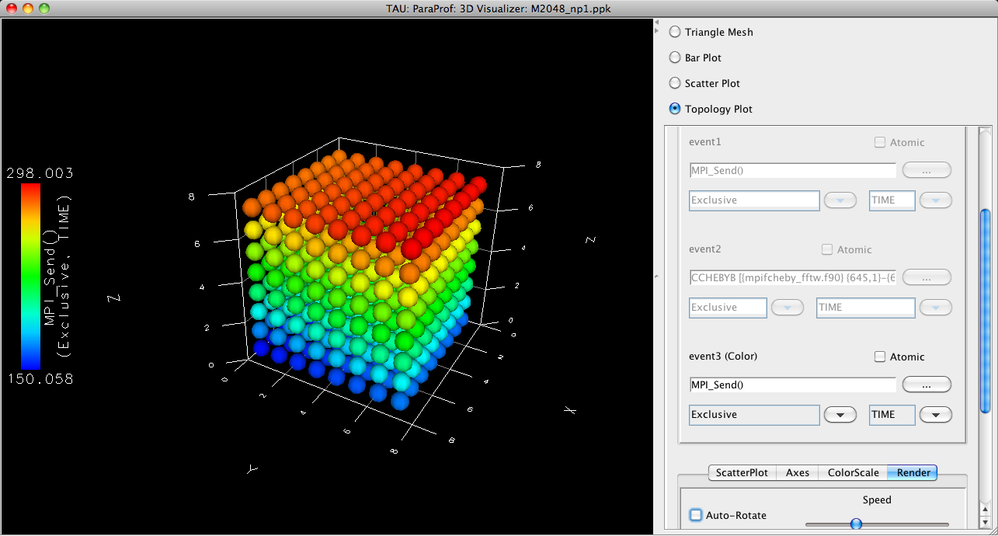
3D Topology Visualization
% paraprof (Windows → 3D Visualization → Topology Plot)
Notes:
MPI_Send on BG/Q

Slide 37
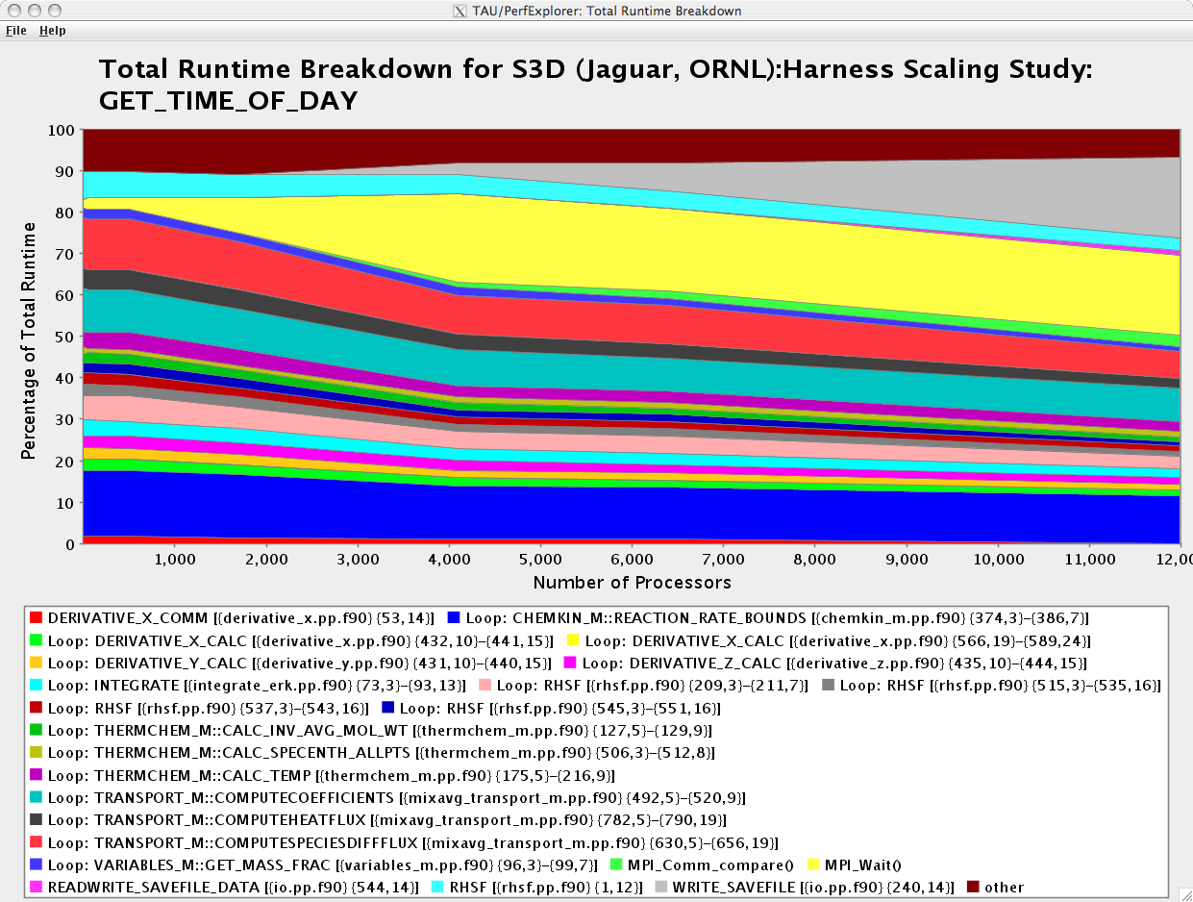
How Does Each Routine Scale?
WRITE_SAVEFILE
MPI_Waitall
% perfexplorer (Charts → Runtime Breakdown)

Slide 38
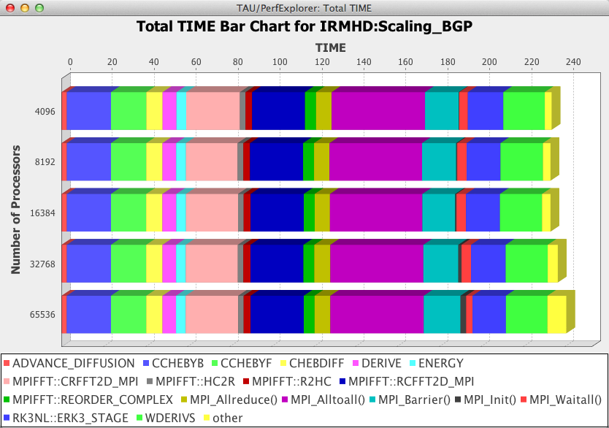
How Does Each Routine Scale?
% perfexplorer (Charts → Stacked Bar Chart)

Slide 39
Which Events Correlate with Runtime?
% perfexplorer (Charts → Correlate Events with Total Runtime)

Slide 40
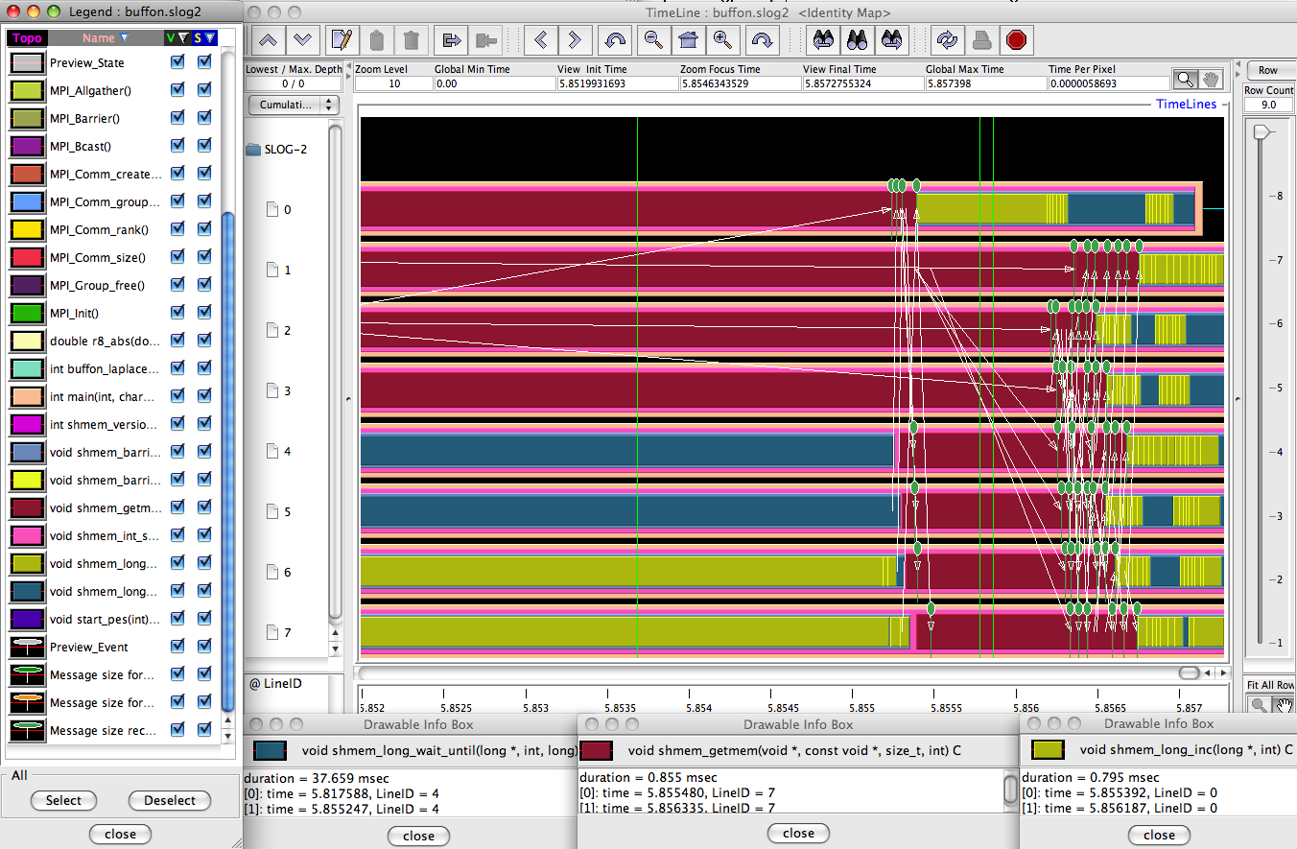
When do Events Occur?

Slide 41
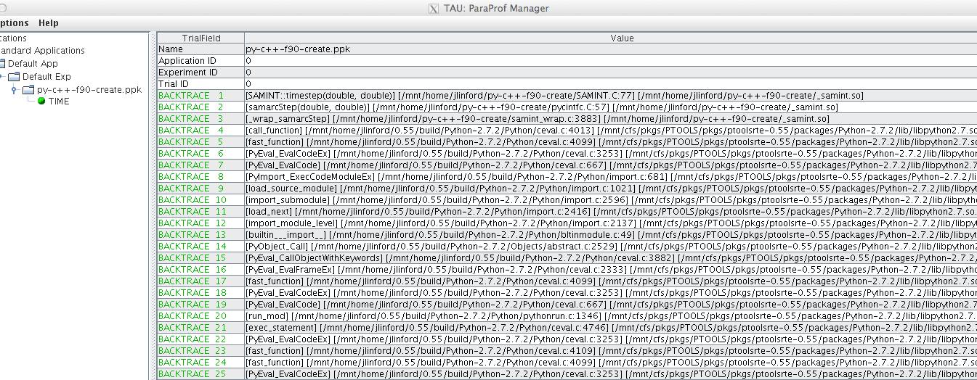
What Caused My Application to Crash?
% qsub –env TAU_TRACK_SIGNALS=1 …
% paraprof
Notes:
What caused the segfault?
What were the performance characteristics up to failure?
Which routines were or were not called?
Were there any memory errors?

Slide 42
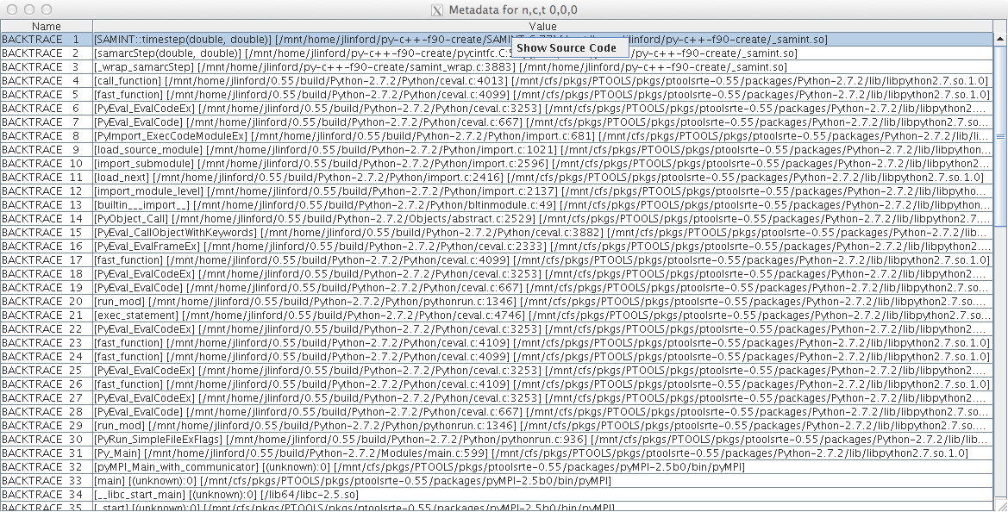
What Caused My Application to Crash?
Right-click to see source code

Slide 43
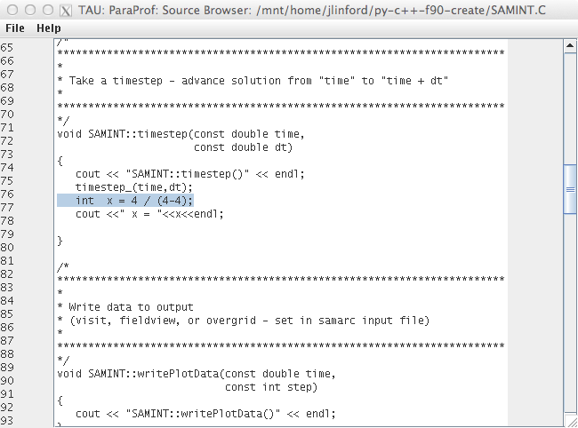
What Caused My Application to Crash?
Error shown in ParaProf Source Browser

Slide 44
Tau commander
Intuitive Performance Engineering

Slide 45
TAU Commander
Workflow manager and user interface for TAU.
Automatically installs and (re)configures TAU and dependencies.
Prevents invalid TAU configurations.
Maintains a performance narrative to facilitate data provenance.
TAU Commander
TAU
PDT
OMPT
Score-P
binutils
libunwind

Slide 46
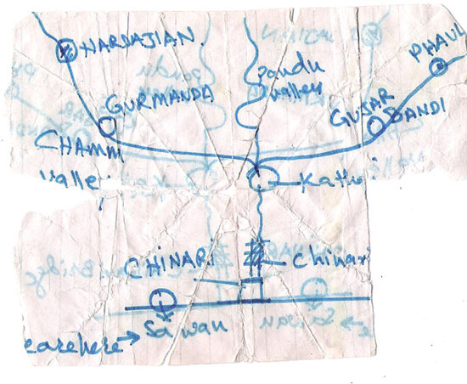
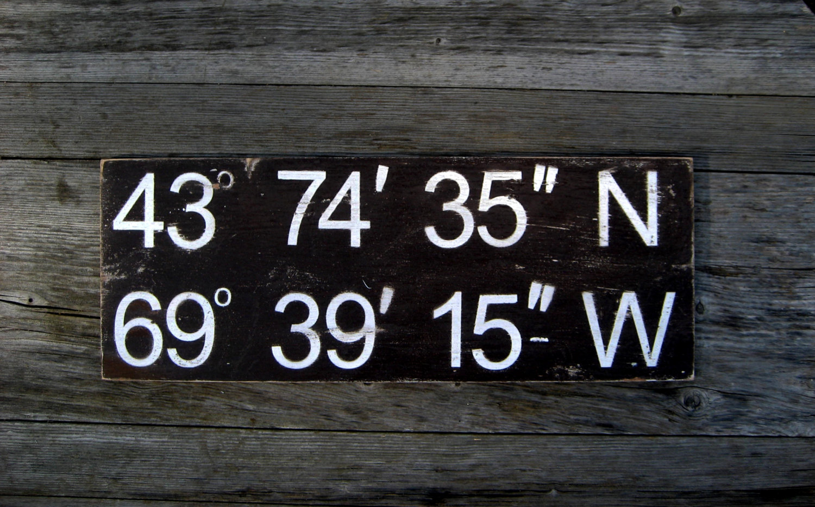
The TAU Commander Approach
Say where you’re going, not how to get there
TAU Projects give context to the user’s actions
  Defines desired metrics and measurement approach
  Defines operating environment
  Establishes a baseline for error checking
vs.

Slide 47
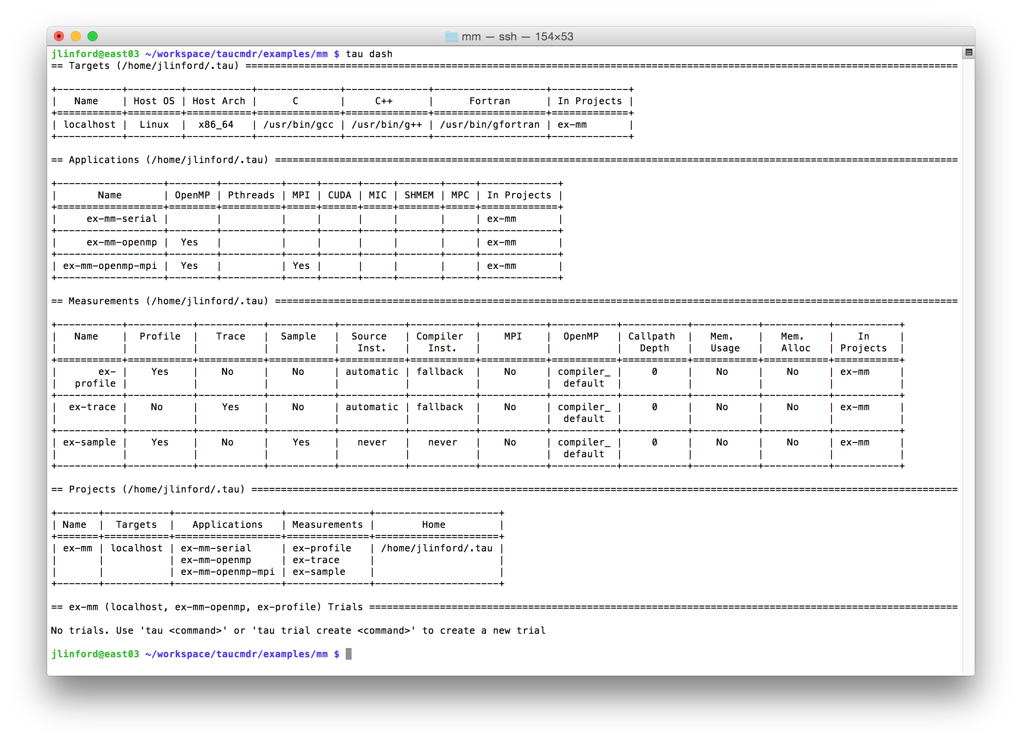
TAU Commander CLI Dashboard

Slide 48
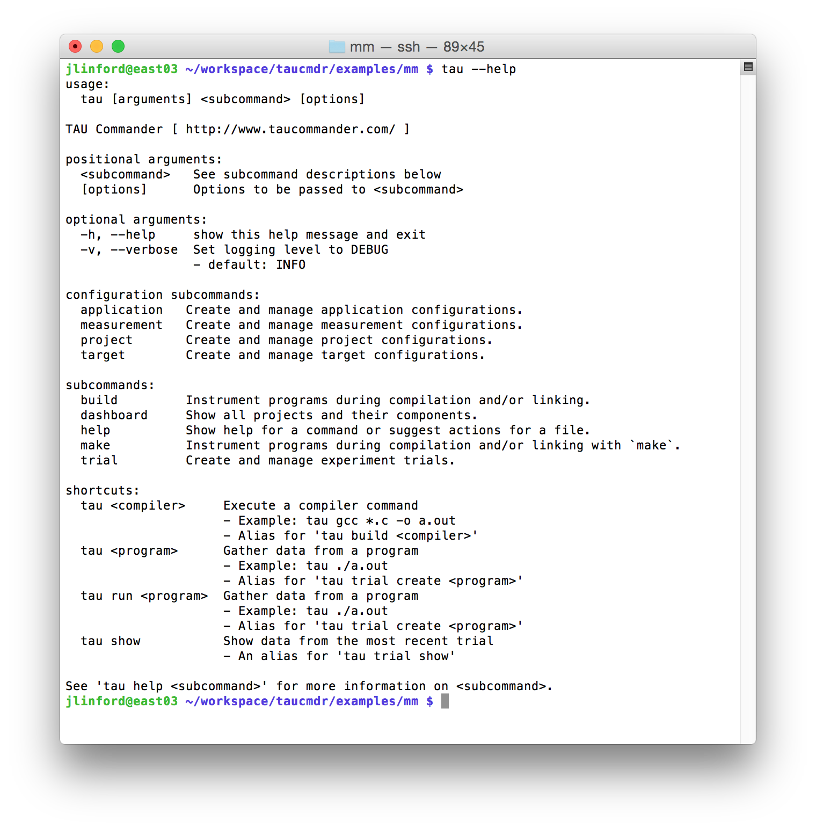
TAU Commander CLI
--help
This command’s usage
Subcommand usage
Shortcuts

Slide 49
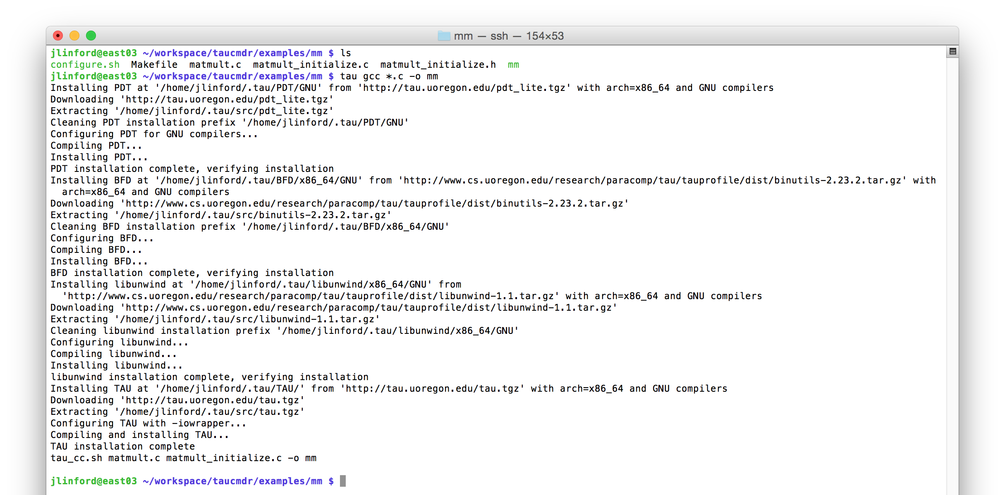
First use on a “vanilla” system
Put tau in front of every command
Detects, downloads, and installs required dependencies
Configures environment, wraps compiler

Slide 50
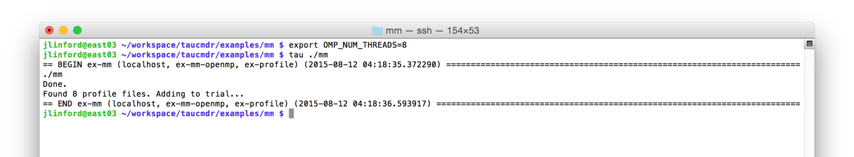
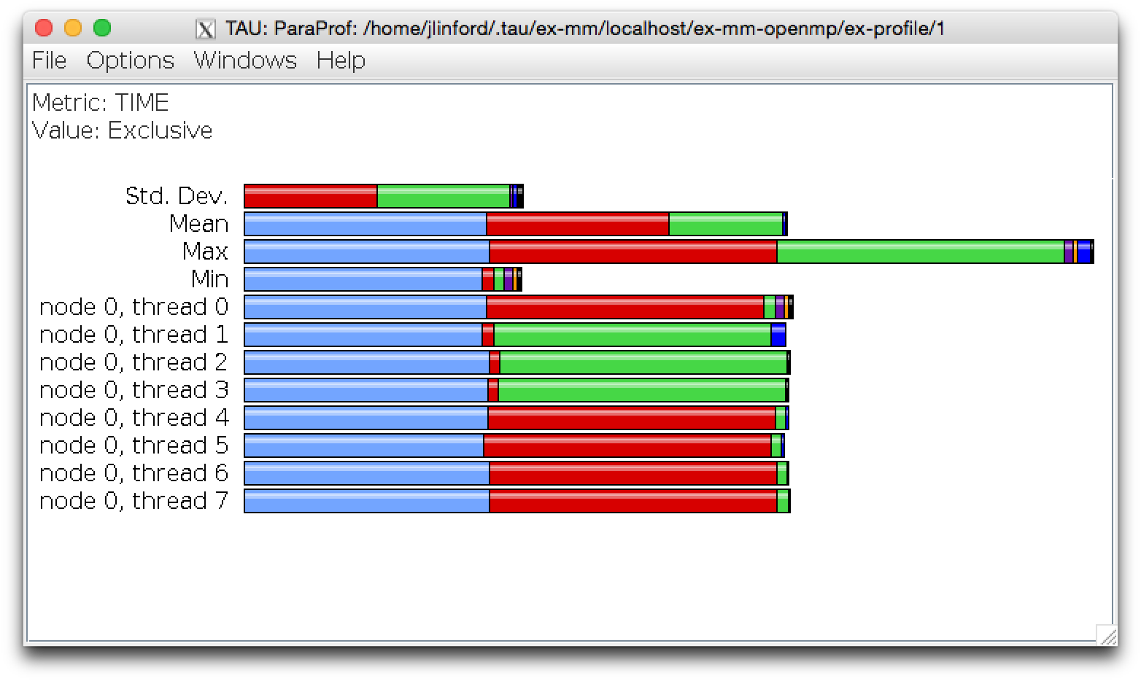
Executions create experiment trials
Put tau in front of every command
`tau show` to see data from last trial

Slide 51

Executions create experiment trials
Each execution is a new trial

Slide 52
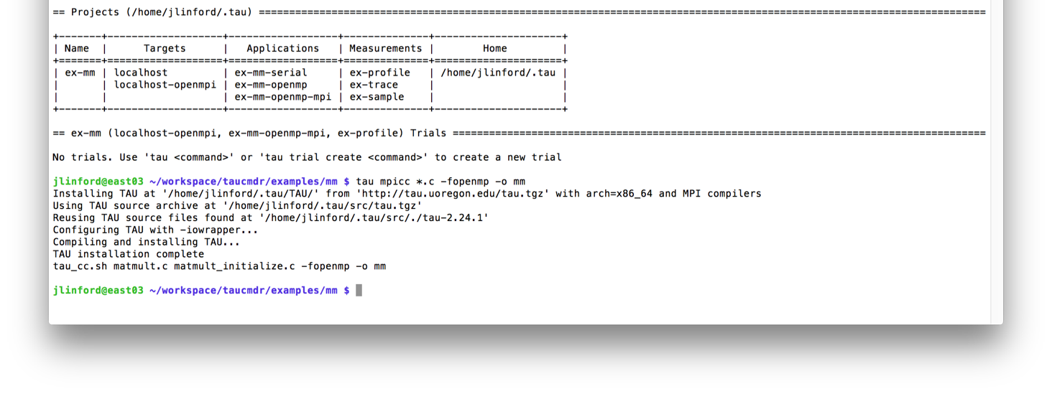
Changing from serial to MPI+OpenMP
Put tau in front of every command
Automatically reconfigures TAU for MPI+OpenMP

Slide 53
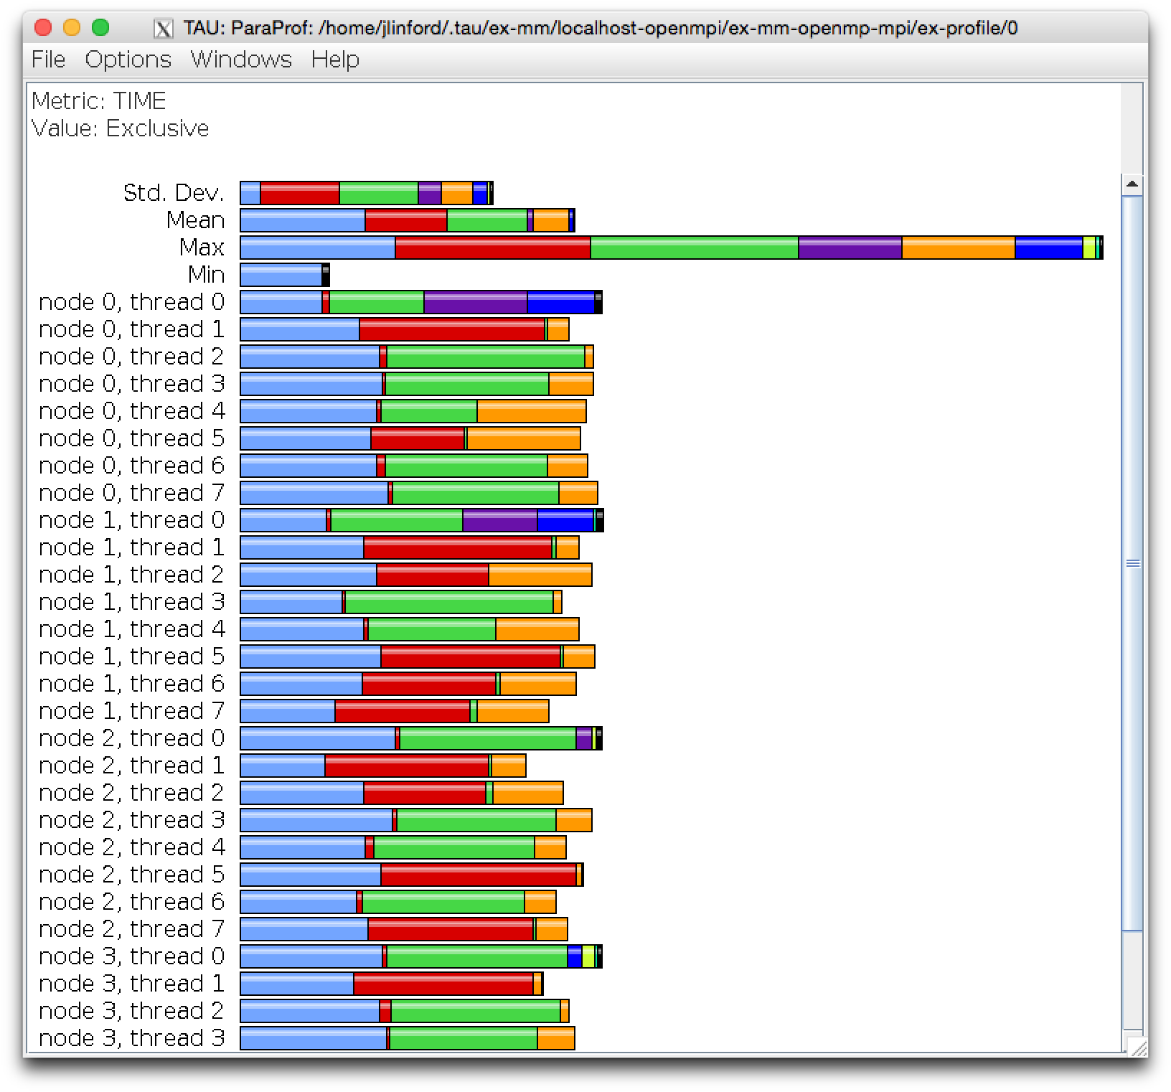
Workflow is unchanged
`tau show` to see data from last trial

Slide 54
Bottleneck Identification in FUN3D
Parallel I/O Tuning for Scientific Applications

Slide 55
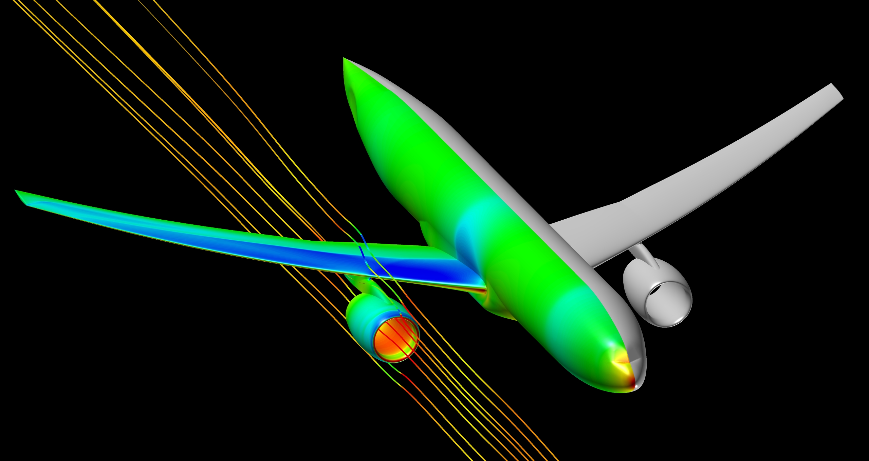
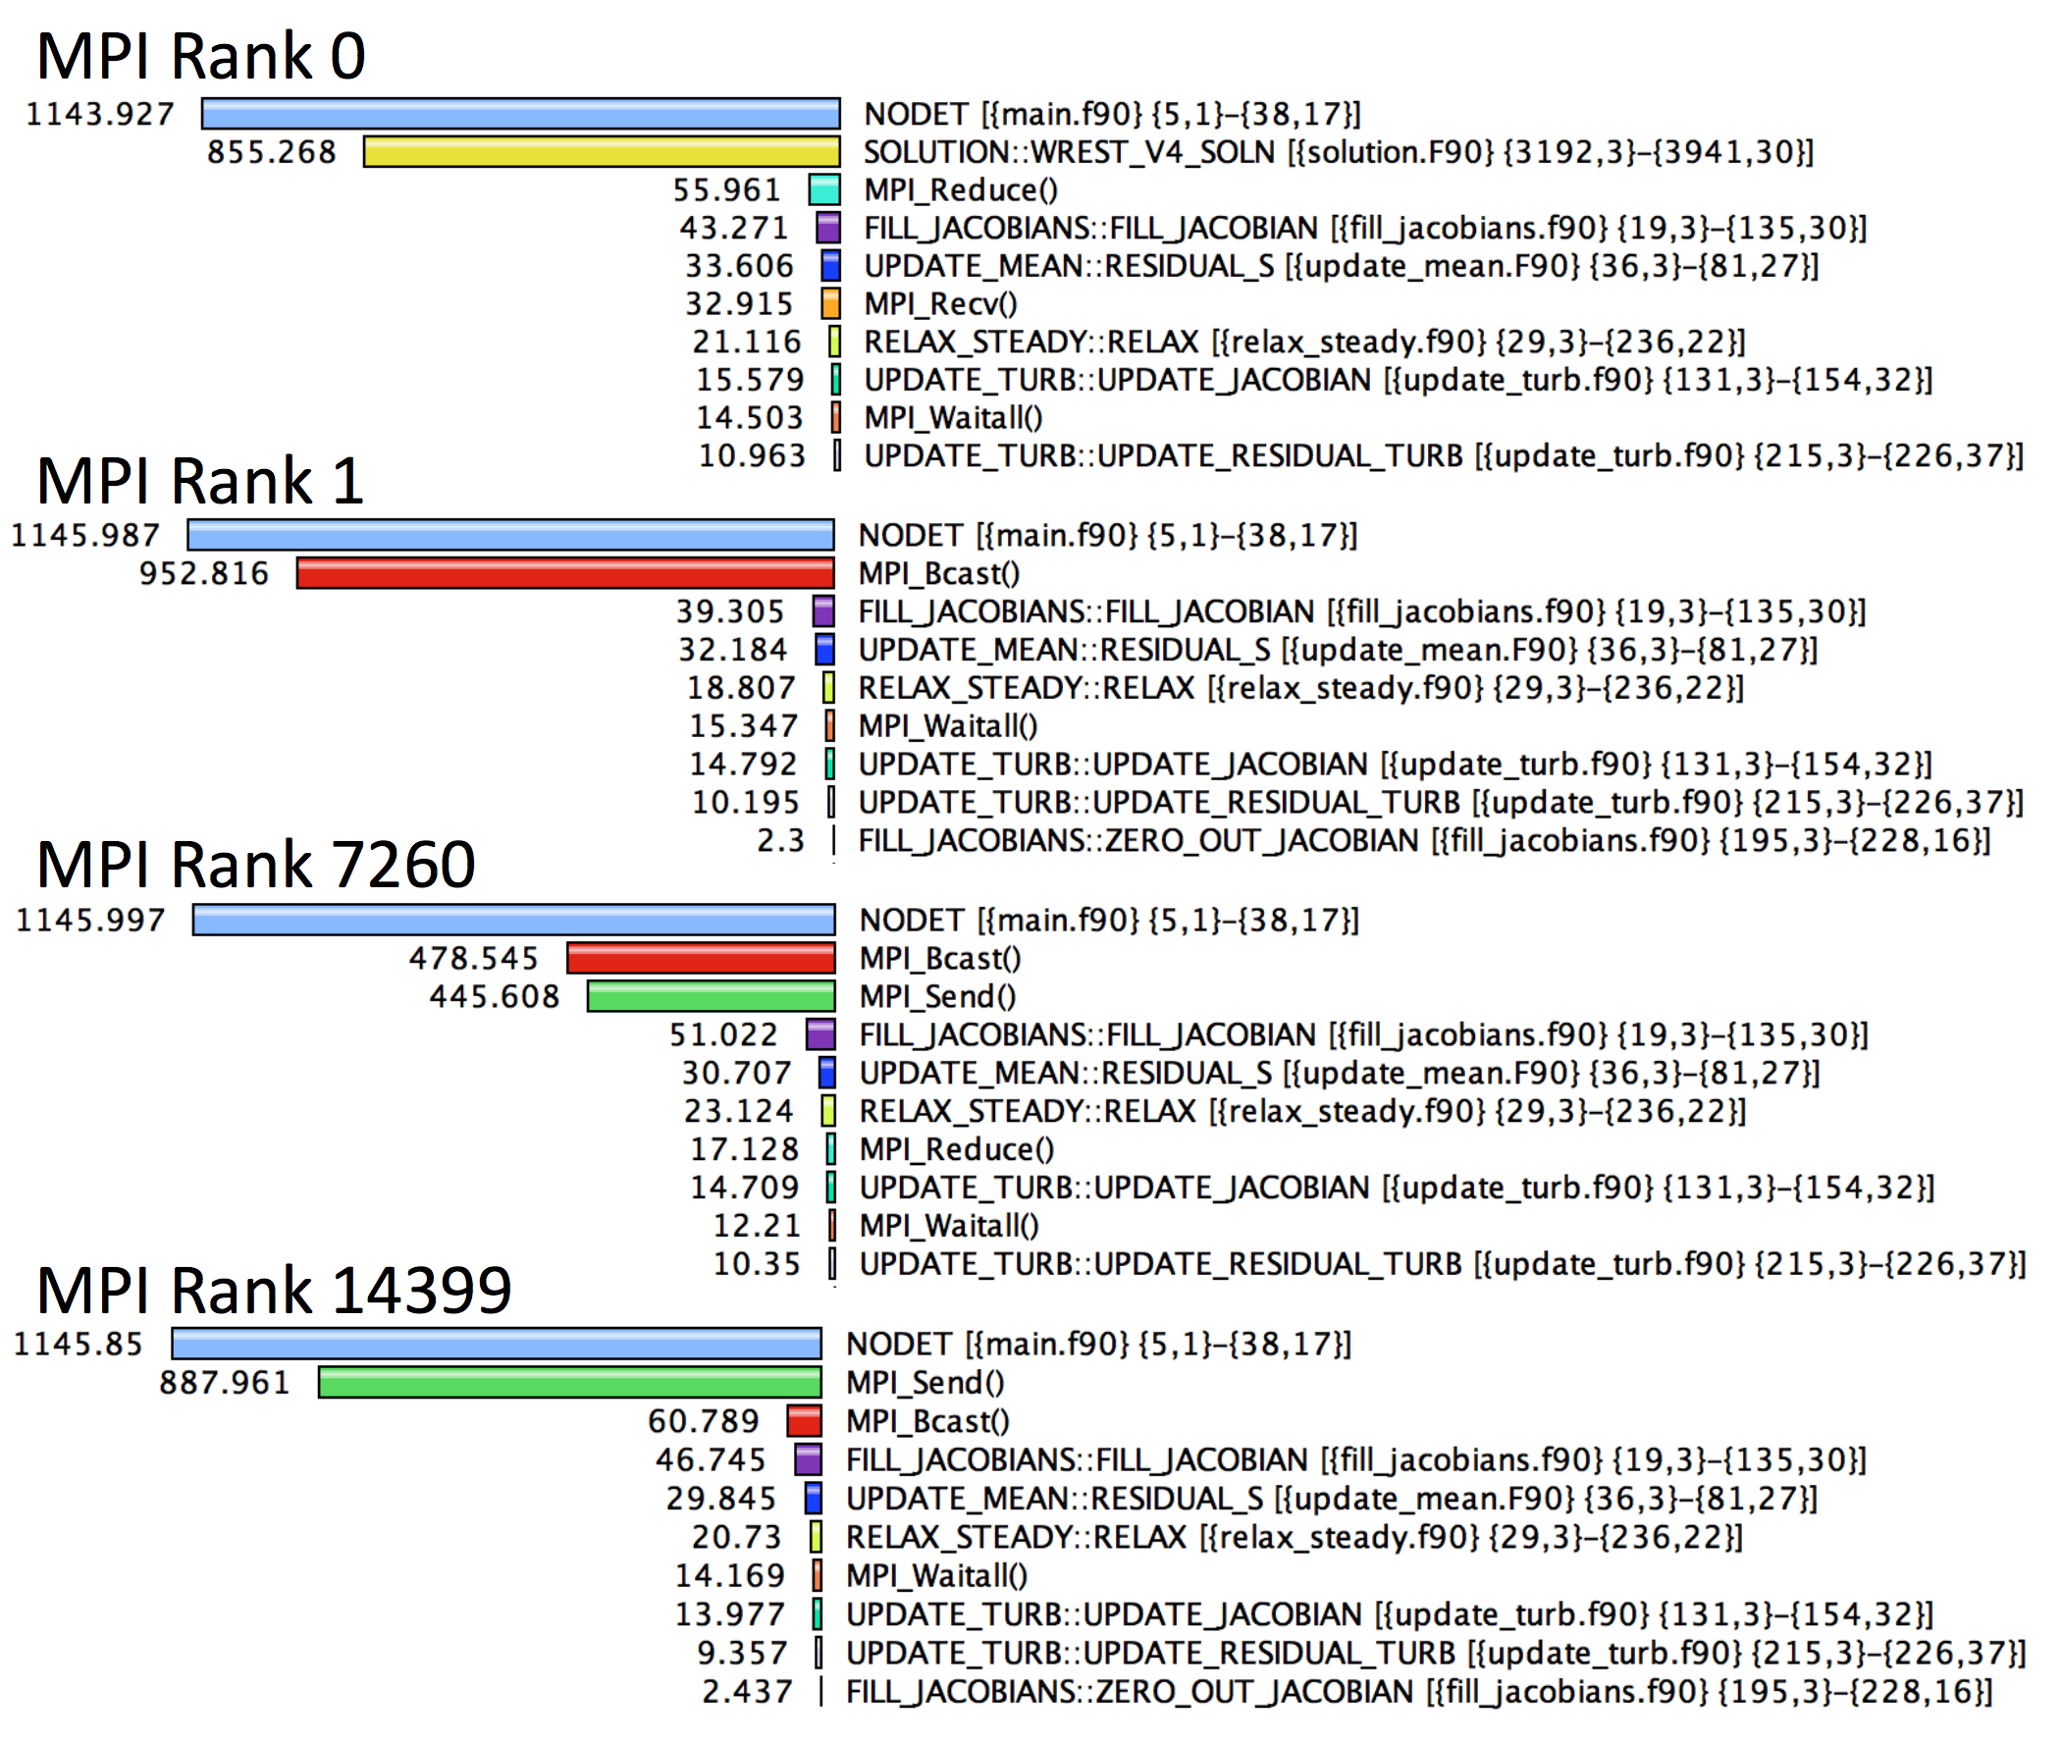
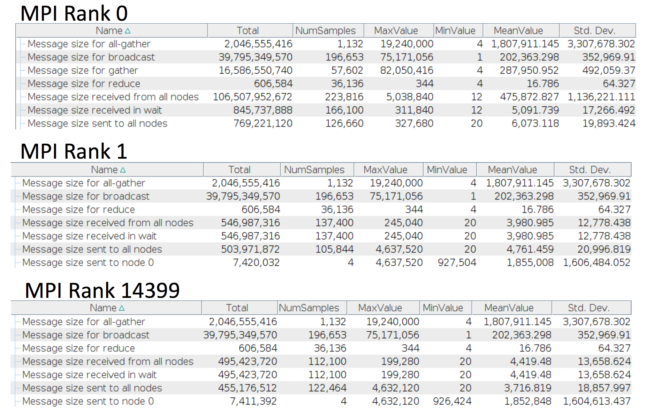
FUN3D Wing-Body-Nacelle
1,651,089,924 grid points
5,902,801,476 tetrahedral elements
1,310,290,264 prismatic elements
14,400 Ivy Bridge cores

Slide 56
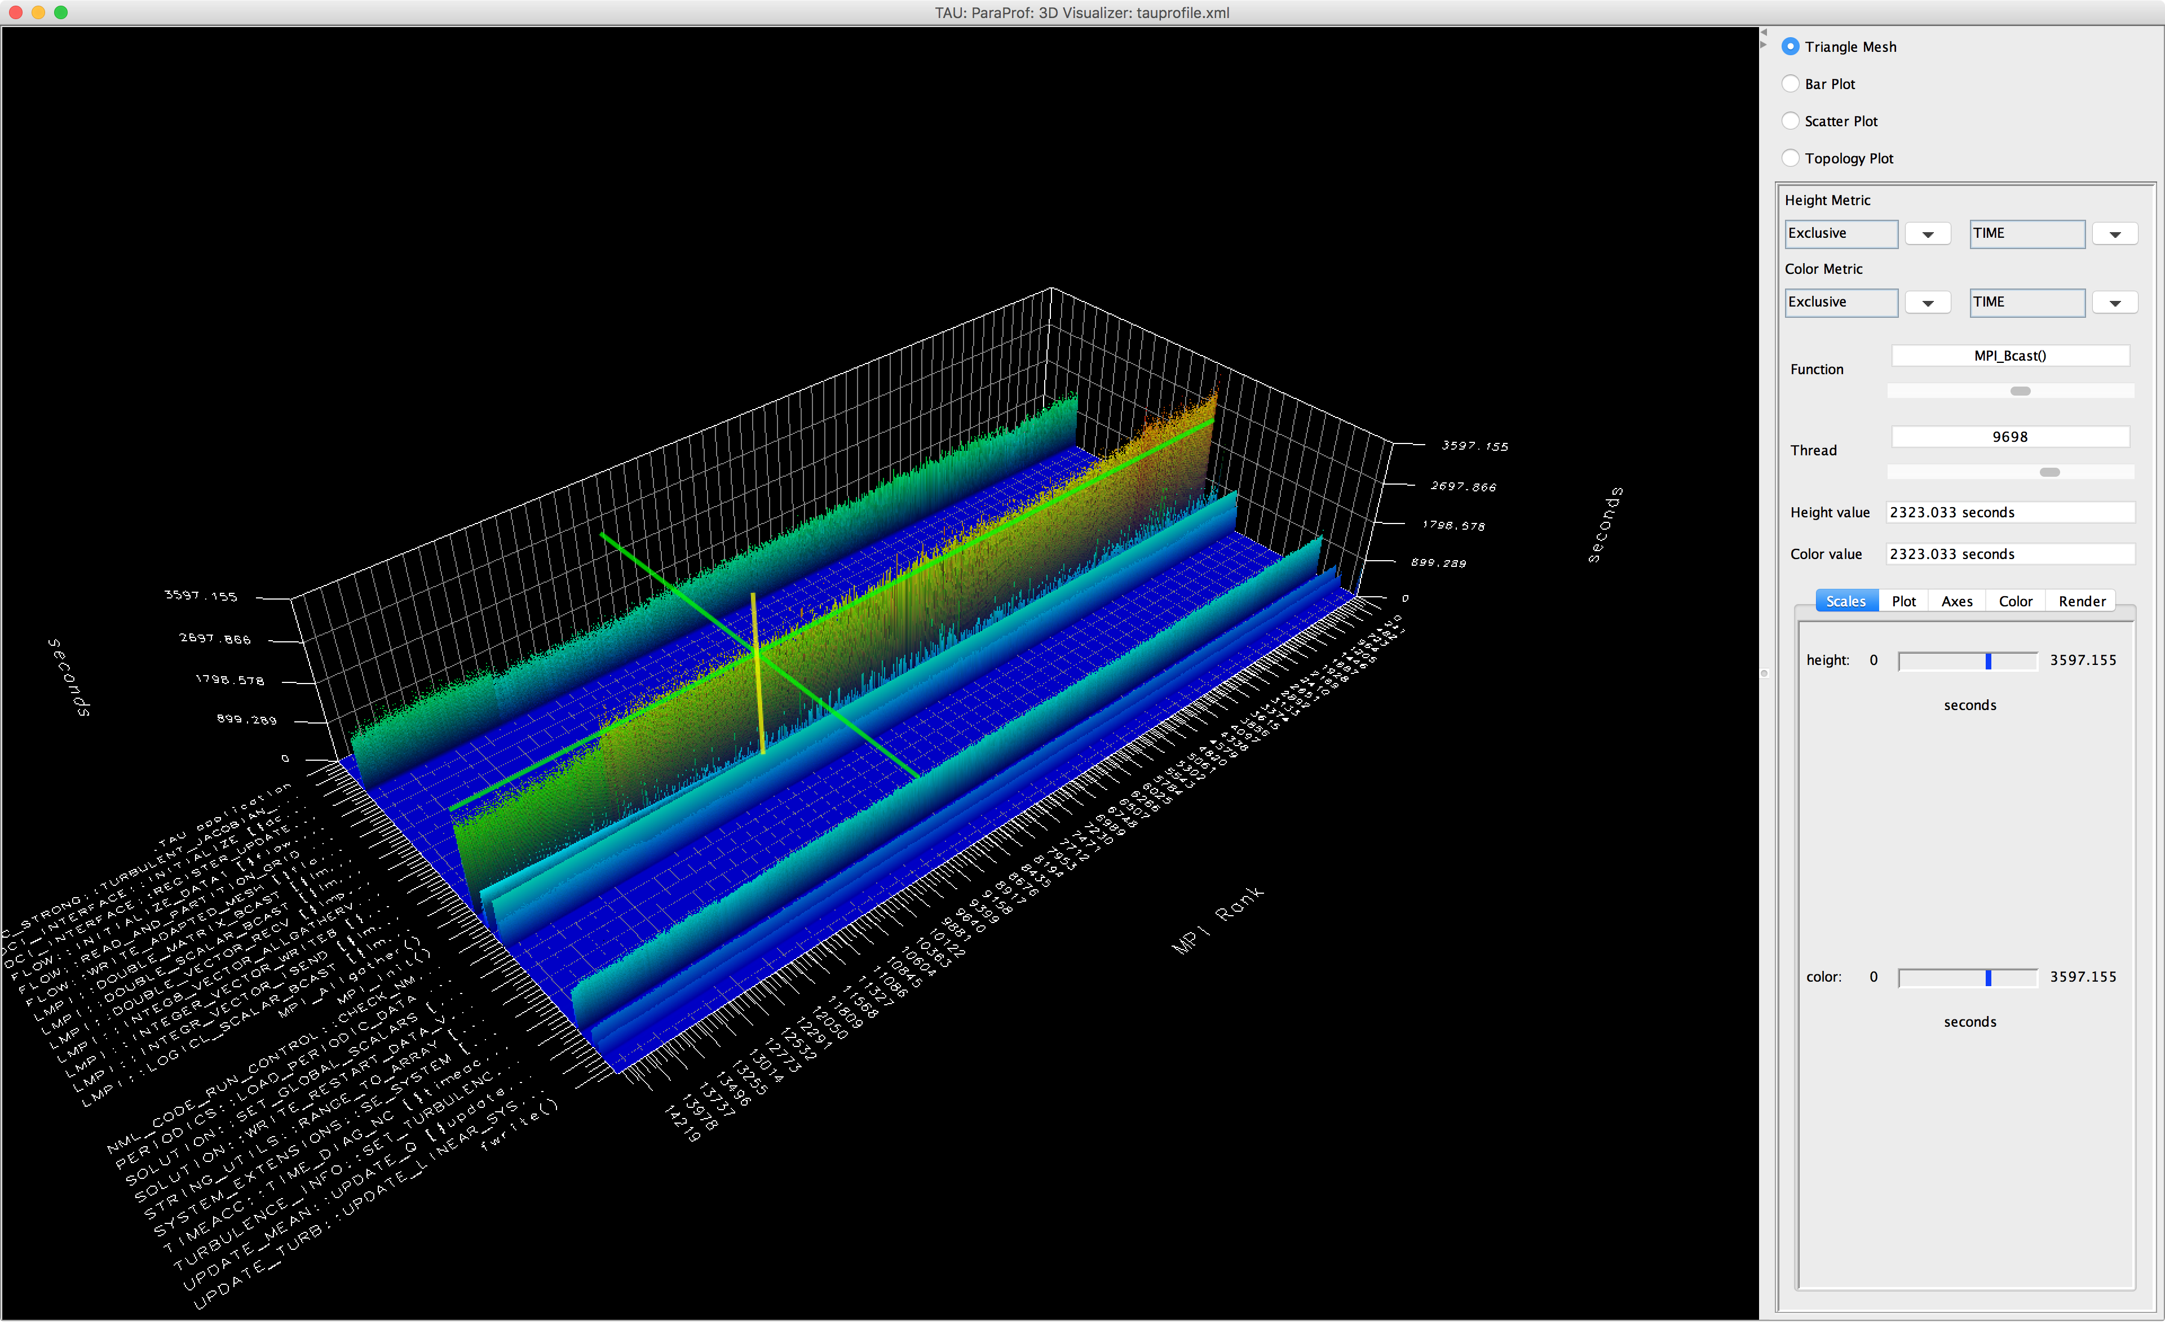
FUN3D Profile shows a hot spot

Slide 57
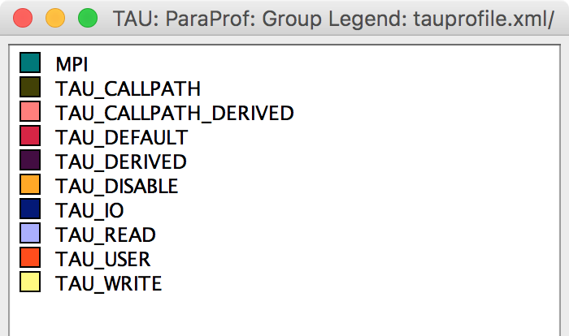
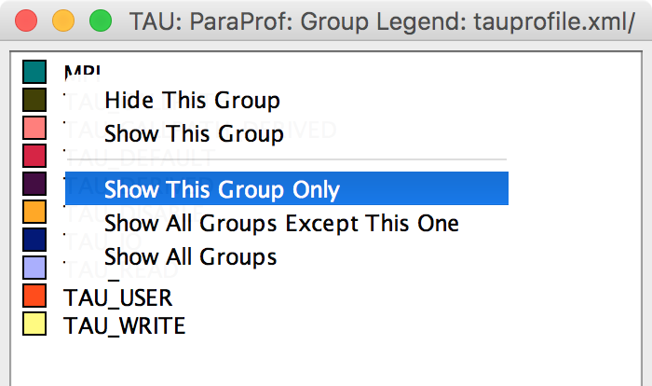
Windows | Group Legend
Right-click to show options

Slide 58
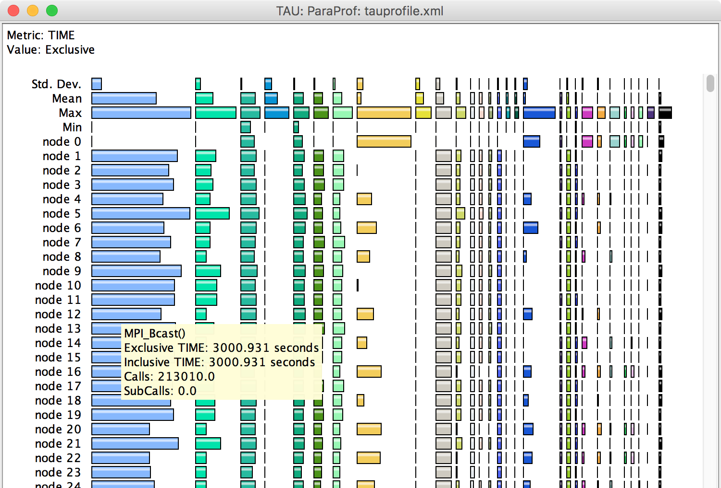
MPI_Bcast in Unstacked Bar Chart

Slide 59
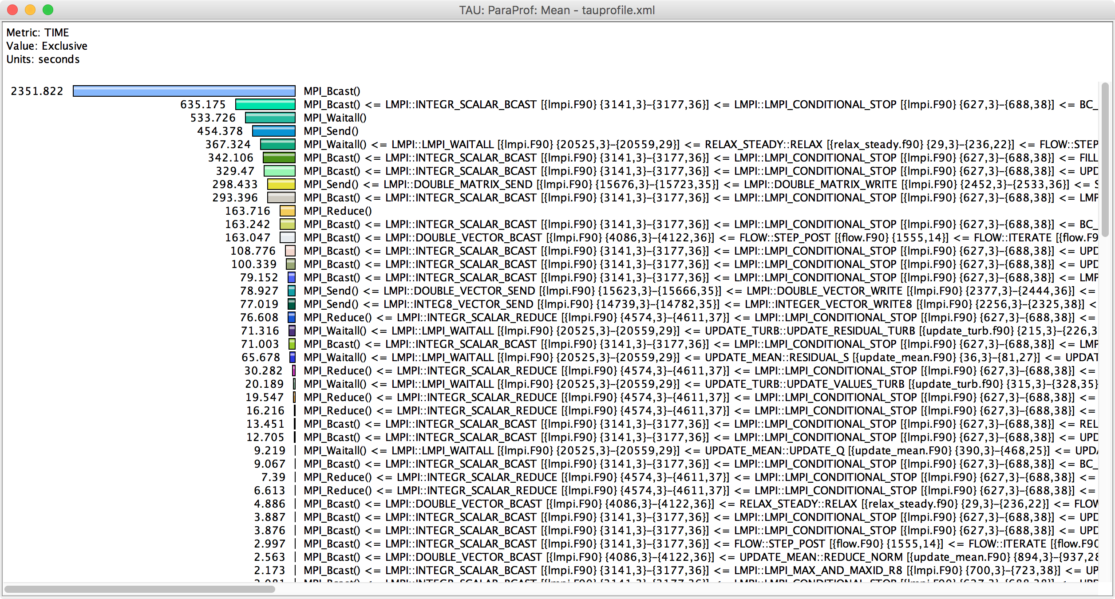
Callpath Profile

Slide 60
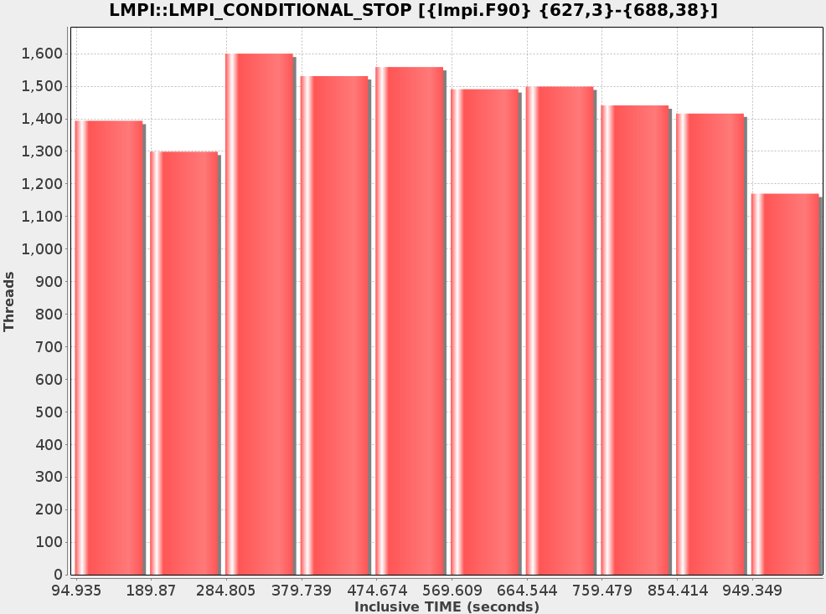
Broad histogram indicates bottleneck.

Slide 61
What’s going on here?
All non-zero ranks send a status code to Rank 0.
Rank 0 broadcasts global status code to all ranks.
Rank 1
Rank 1
Rank 2
Rank 2
Rank 3
Rank 3
Rank 4
Rank 0 checks for any invalid status codes.
Rank 4
Rank 5
Rank 5
Rank 6
Rank 6
Rank 7
Rank 0
Rank 7
Rank 8
Rank 8
Rank 9
Rank 9
Rank 10
Rank 10
…
…
Rank 14,470
Rank 14,470

Slide 62
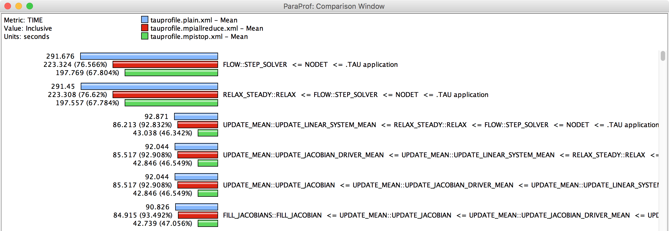
Two Solutions
MPI_Allreduce()
MPI_Abort()
O(log₂ N) vs. O(N)
O(1) vs. O(N)
33% runtime improvement

Slide 63


FUN3D Wing-Body-Nacelle
“These days I get excited about 1-2% speedups that I find....quite unusual to find something of this magnitude these days, especially with just a 2-line fix in the code! :)”

Slide 64

I/O Bottleneck on FUN3D Shutdown

Slide 65


Matrix and Vector I/O shows Bottleneck

Slide 66
Bottleneck Identification in CREATE-AV HELIOS / SAMCART
Parallel I/O Tuning for Scientific Applications

Slide 68






Target Platforms
Armstrong [XC30]
Cori
Haise [iDataPlex]
Lightning [XC30]
Kilrain [iDataPlex]

Slide 69

Initial Profile on Babbage
MPI_Barrier
MPI_Send
File I/O
Useful Work!

Slide 70

Implement Non-blocking Comm.
MPI_Waitall
Useful work!
Useful work!
File I/O

Slide 71

65% Runtime Reduction (~2x faster)

Slide 72

Lightning (a.k.a. watch your I/O)
Slower! What happened???

Slide 73

Buffered I/O, change stripe size

Slide 74
IRMHD on BlueGene/Q
Intuitive Performance Engineering

Slide 75


IRMHD on Intrepid and Mira
INCITE magnetohydrodynamcis simulation to understand solar winds and coronal heating
  First direct numerical simulations
  of Alfvén wave (AW) turbulence in
  extended solar atmosphere
  accounting for inhomogeneities
  Team
    University of New Hampshire
    (Jean Perez and Benjamin Chandran)
    ALCF (Tim Williams)
    University of Oregon (Sameer Shende)
IRMHD (Inhomogeneous Reduced Magnetohydrodynamics)
  Fortran 90 and MPI
  Excellent weak and strong scaling properties
  Tested and benchmarked on Intrepid and Mira
HPC Source article and ALCF news
https://www.alcf.anl.gov/articles/furthering-understanding-coronal-heating-and-solar-wind-origin

Slide 76

IRMHD Communication Analysis
Source-based (direct) instrumentation
MPI instrumentation and volume measurement
IRMHD exhibited significant synchronous communication bottlenecks
On 2,408 cores of BG/P:
  MPI_Send and MPI_Bcast
  take significant time
  Opportunities for
  communication/
  computation overlap
  Identified possible targets
  for computation improvements
MPI_Barrier
MPI_Send

Slide 77

IRMHD Optimization on Intrepid (BG/P)
On 2,408 cores, overall execution time reduced from 528.18 core hours to 70.8 core hours
(>7x improvement)
Non-blocking communication substrate
More efficient implementation of underlying FFT

Slide 78

IRMHD Optimization on MIRA (BG/Q)
Oversubscribe nodes: 32k ranks vs. 16k per node
Overall time improvement: 71.23% of original

Slide 79
Conclusion
Intuitive Performance Engineering

Slide 80

Downloads
http://taucommander.paratools.com
http://tau.uoregon.edu
http://www.hpclinux.com
Free download, open source, BSD license

Slide 81
















Acknowledgements
Department of Energy
  Office of Science
  Argonne National Laboratory
  Oak Ridge National Laboratory
  NNSA/ASC Trilabs (SNL, LLNL, LANL)
HPCMP DoD PETTT Program
National Science Foundation
  Glassbox, SI-2
University of Tennessee
    University of New Hampshire
      Jean Perez, Benjamin Chandran
University of Oregon
  Allen D. Malony, Sameer Shende
  Kevin Huck, Wyatt Spear
TU Dresden
  Holger Brunst, Andreas Knupfer
  Wolfgang Nagel
Research Centre Jülich
  Bernd Mohr
  Felix Wolf

