Slide 1
Intuitive Performance Engineering at the Exascale with TAU and TAU Commander
John C. Linford
ParaTools, Inc.
Argonne Extreme Scale Computing Training Program
10 August 2016, Pheasant Run “Resort”

Slide 2
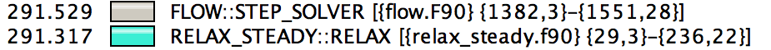
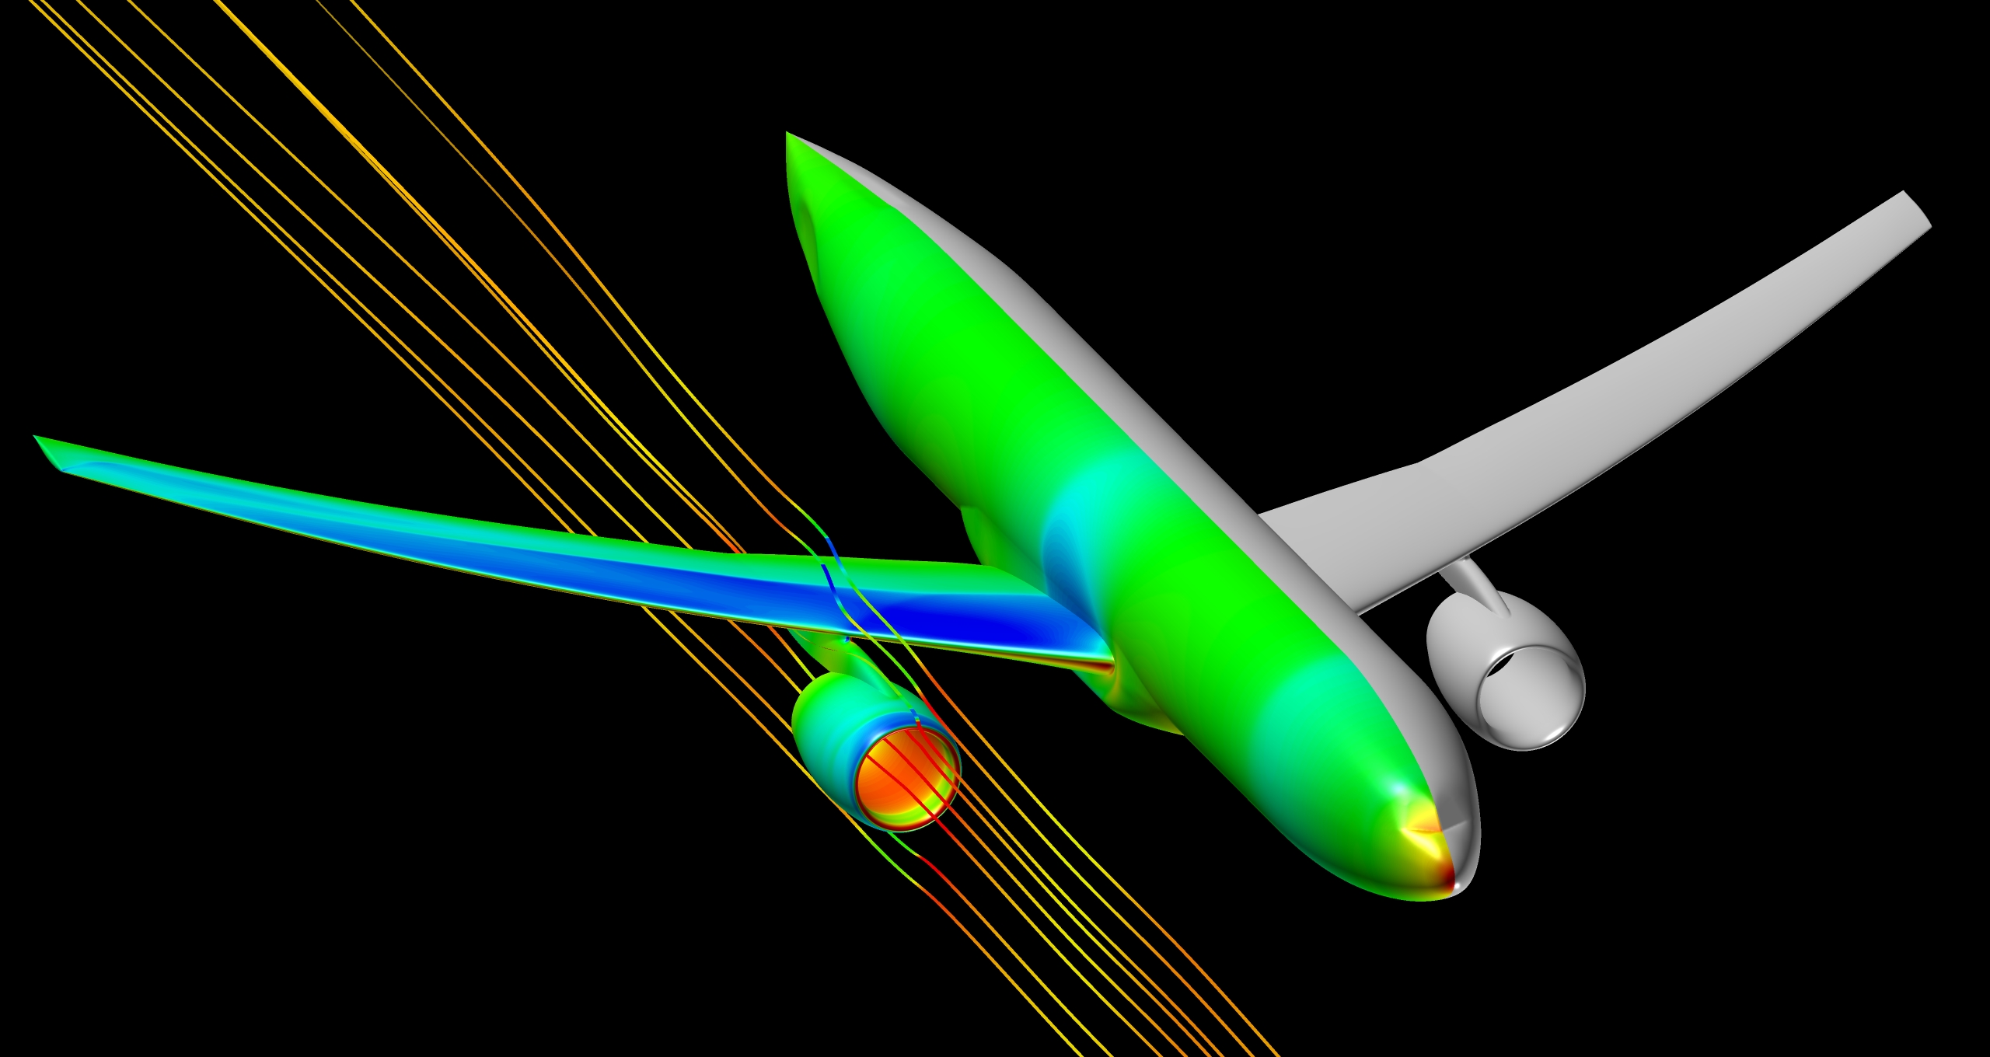
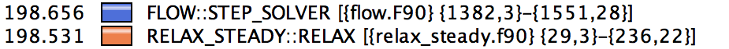
Late breaking news
“These days I get excited about 1-2% speedups that I find....quite unusual to find something of this magnitude these days, especially with just a 2-line fix in the code! :)”
1,651,089,924 grid points
5,902,801,476 tetrahedral elements
1,310,290,264 prismatic elements
14,400 Ivy Bridge cores
33% runtime improvement

Slide 3
A silly introduction
Intuitive Performance Engineering

Slide 4
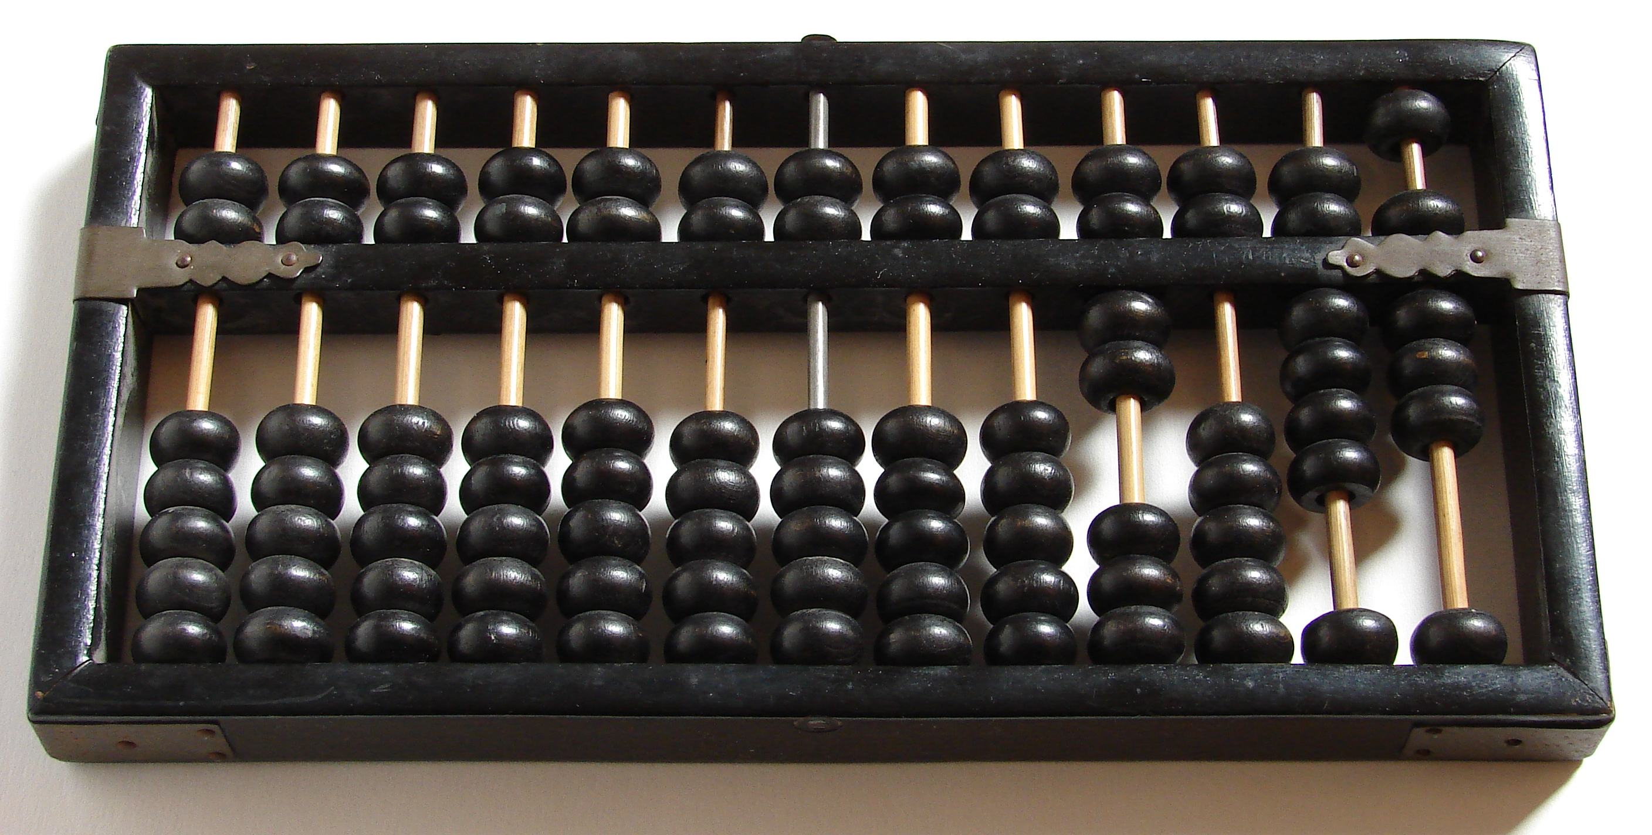
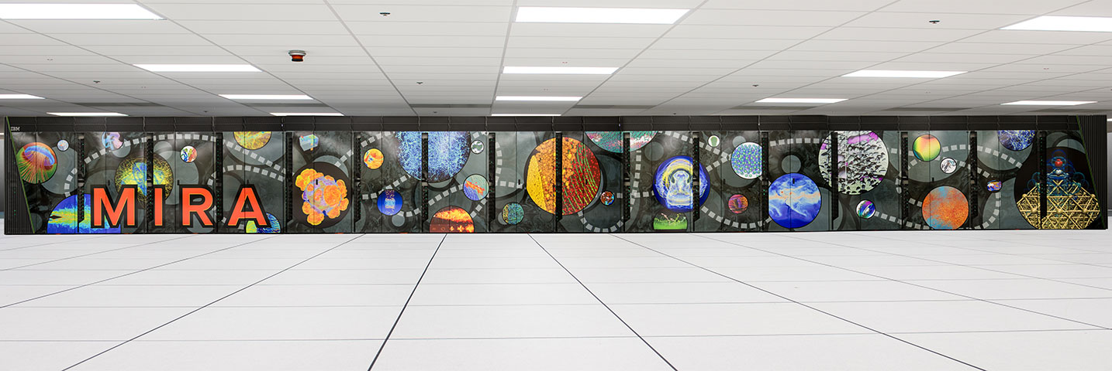
This is faster than an abacus
10 petaflops (2.08 gigaflops/Watt)
1.25 quadrillion abacuses
~172,000 abacuses per living person
Notes:
1.25 quadrillion abacuses
172,413 abacuses per person

Slide 5
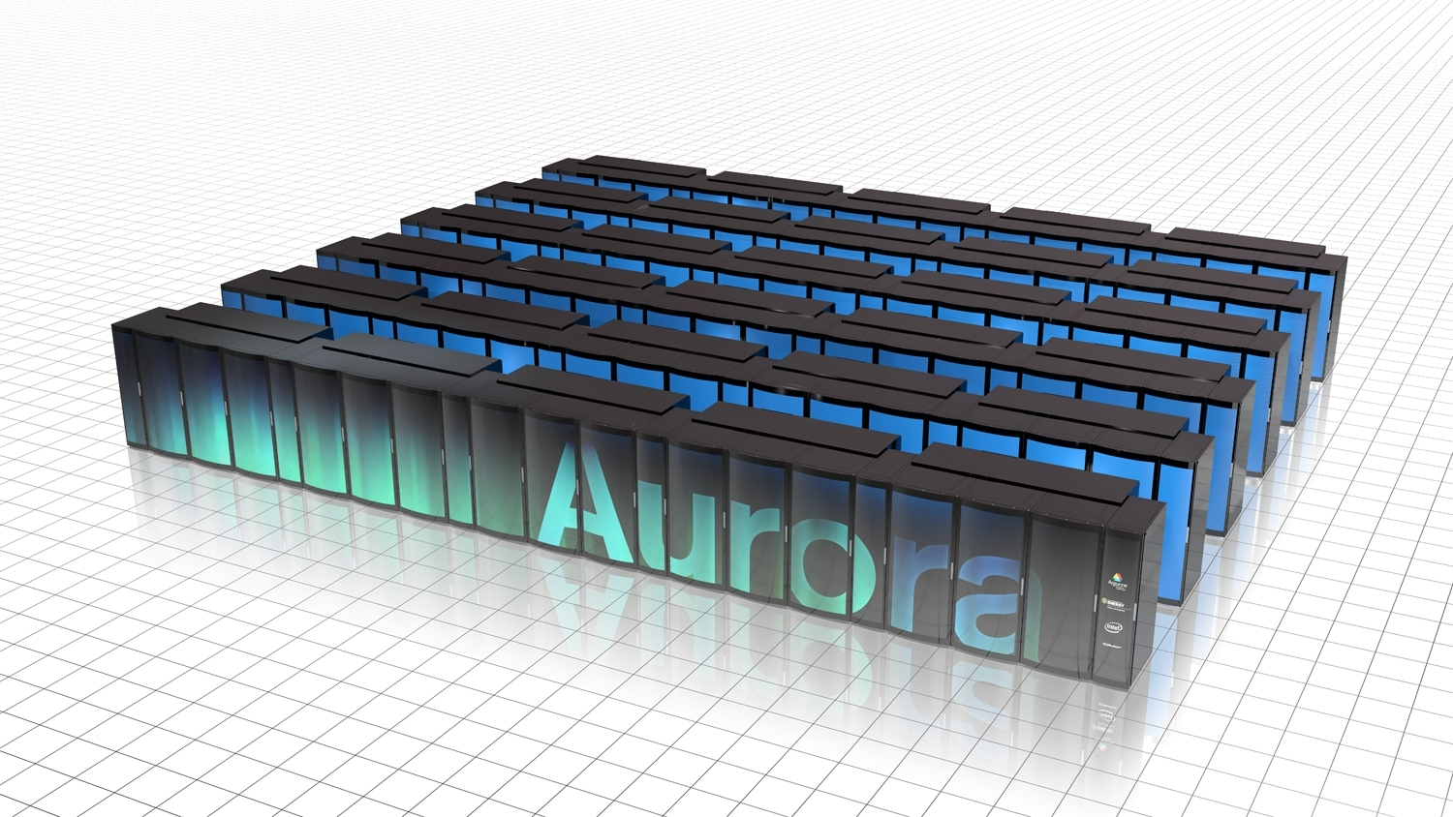
This is even faster
180 petaflops (5.62 gigaflops/Watt)
22.5 quadrillion abacuses
~3.1M abacuses per living person

Slide 6

Unfreeze your science fish!
Performance engineering tools are essential to success.
Increase your capability to answer the hard questions.
Reduce time-to-solution
(i.e. publish first).
Lower costs.
Credibility, provenance, etc.
You
Delicious science

Slide 7
Performance Engineering
Intuitive Performance Engineering

Slide 8
Define your project
What are the target hardware and software?
  Shared memory via OpenMP, pthreads, etc?
  Distributed memory via MPI, SHMEM, etc?
  Intel compilers? IBM compilers?
What are the application features?
  What language(s)?
  MPI? OpenMP? CUDA?
  Compute-intense? Data intense? I/O intense?
What do I want to measure? And how?
  Wall clock time?
  Hardware performance counters?
  Probes? Library wrapping? Sampling?
  Profiles? Traces? Both?

Slide 9
T-A-M Model for Performance Engineering
Target
  Installed software
  Available compilers
  Host architecture/OS
Application
  MPI, OpenMP, CUDA, OpenACC, etc.
Measurement
  Profile, trace, or both
  Sample, source inst…
Measurement
Application
Target
Experiment =
(Target, Application, Measurement)

Slide 10
Which platform is best for my application?
Many targets
  Possibly same hardware, different software
One measurement
One application
Measurement
Application
Target 0
Target N
…

Slide 11
What are the performance characteristics of my application?
One target
Many measurements
One application
…
Measurement 0
Measurement N
Application
Target

Slide 12
How well does my target perform various tasks?
One target
One measurement
Many applications (e.g. benchmarks)
Measurement
Application 0
Application N
…
Target

Slide 13
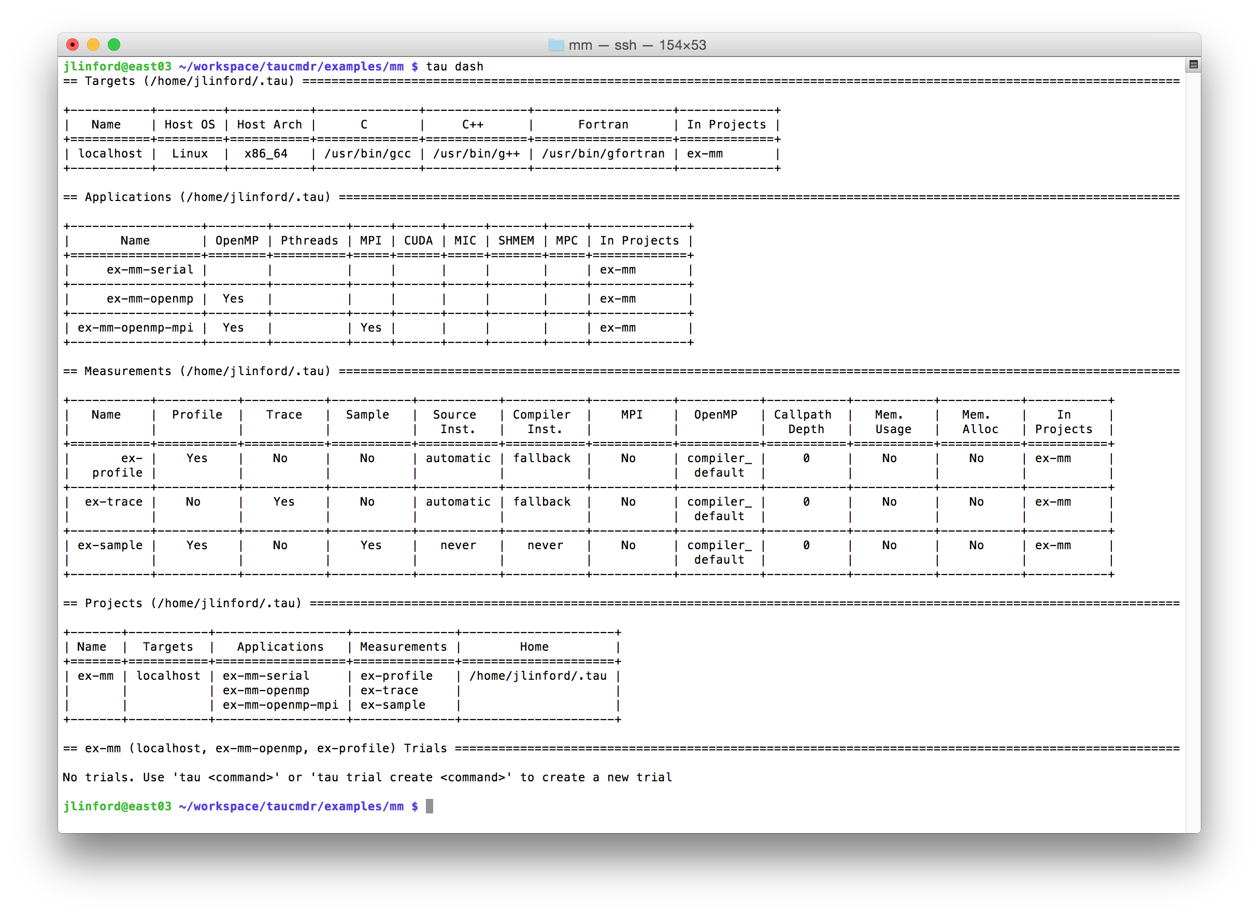
TAU Commander
Alpha release!

Slide 14
The Tau Performance System
Intuitive Performance Engineering

Slide 15
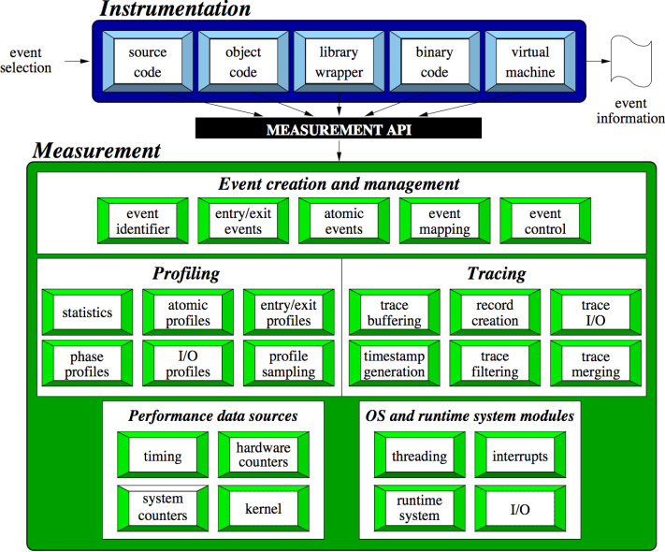
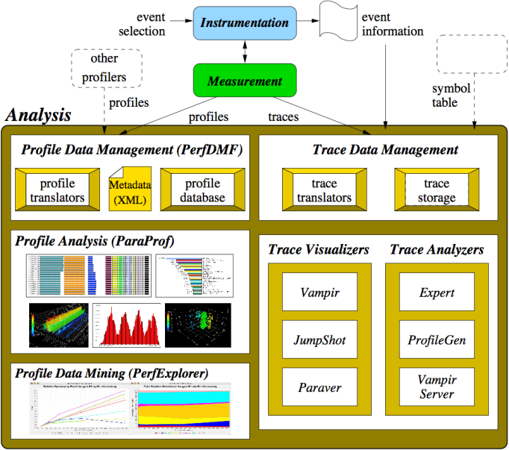
The TAU Performance System®
TAU Architecture
Integrated toolkit for performance problem solving
  Instrumentation, measurement, analysis, visualization
  Portable profiling and tracing
  Performance data management and data mining
Direct and indirect measurement
Free, open source, BSD license
Available on all HPC platforms (and some non-HPC)
http://tau.uoregon.edu/

Slide 16

The TAU Performance System®
Tuning and Analysis Utilities (20+ year project)
Comprehensive performance profiling and tracing
  Integrated, scalable, flexible, portable
  Targets all parallel programming/execution paradigms
Integrated performance toolkit
  Instrumentation, measurement, analysis, visualization
  Widely-ported performance profiling / tracing system
  Performance data management and data mining
  Open source (BSD-style license)
Integrates with application frameworks

Slide 17
TAU Supports All HPC Platforms
C/C++
CUDA
UPC
Python
GPI
Fortran
OpenACC
MPI
Java
pthreads
Intel MIC
OpenMP
Intel
GNU
PGI
Sun
LLVM
Cray
MinGW
AIX
Linux
Windows
Insert yours
here
BlueGene
Fujitsu
ARM
Android
MPC
OS X

Slide 18
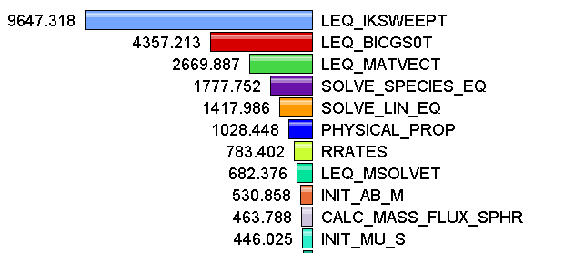
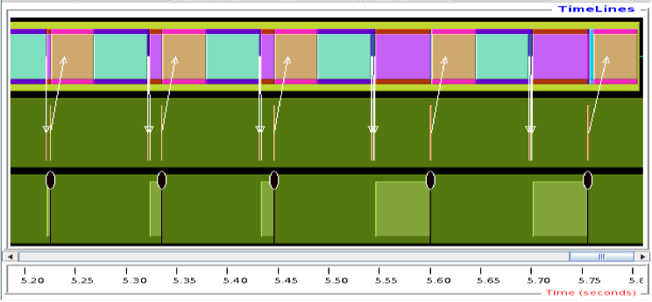
Measurement Approaches
Profiling
Tracing
Shows
how much time was spent in each routine
Shows
when events take place on a timeline

Slide 19
Types of Performance Profiles
Flat profiles
  Metric (e.g., time) spent in an event
  Exclusive/inclusive, # of calls, child calls, …
Callpath profiles
  Time spent along a calling path (edges in callgraph)
  “main=> f1 => f2 => MPI_Send”
  Set the TAU_CALLPATH_DEPTH environment variable
Phase profiles
  Flat profiles under a phase (nested phases allowed)
  Default “main” phase
  Supports static or dynamic (e.g. per-iteration) phases
Notes:
Collect basic routine-level timing profile to determine where most time is being spent
Collect routine-level hardware counter data to determine types of performance problems
Collect callpath profiles to determine sequence of events causing performance problems
Conduct finer-grained profiling and/or tracing to pinpoint performance bottlenecks
Loop-level profiling with hardware counters
Tracing of communication operations

Slide 20
How much data do you want?
Limited
Profile
Loop
Profile
Callpath
Profile
O(KB)
O(TB)
Flat
Profile
Phase
Profile
Trace
All levels support multiple metrics/counters

Slide 21
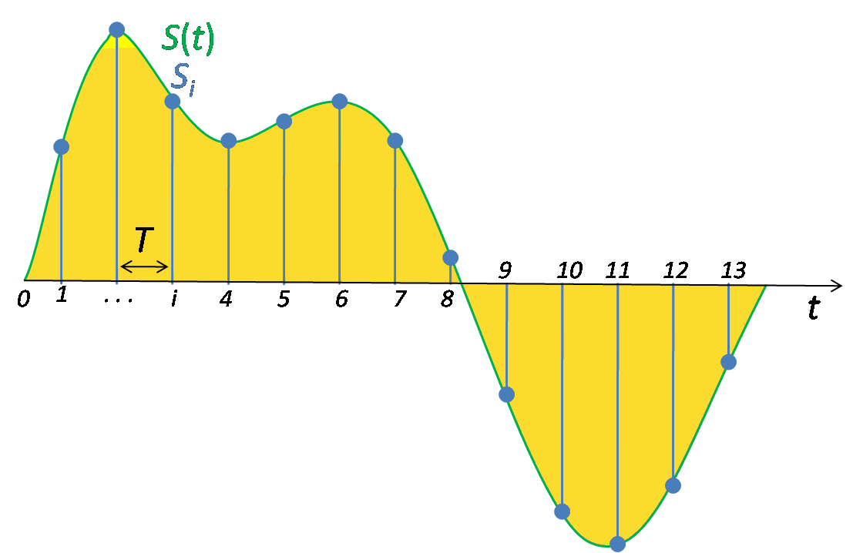
Performance Data Measurement
Direct via Probes
Indirect via Sampling
call TAU_START(‘potential’)
// code
call TAU_STOP(‘potential’)
Exact measurement
Fine-grain control
Calls inserted into code
No code modification
Minimal effort
Relies on debug symbols (-g option)

Slide 22
Insert TAU API Calls Automatically
Use TAU’s compiler wrappers
  Replace CXX with tau_cxx.sh, etc.
  Automatically instruments source code, links with TAU libraries.
Use tau_cc.sh for C, tau_f90.sh for Fortran, etc.
Makefile without TAU
Makefile with TAU
CXX = mpicxx
F90 = mpif90
CXXFLAGS =
LIBS = -lm
OBJS = f1.o f2.o f3.o … fn.o
app: $(OBJS)
$(CXX) $(LDFLAGS) $(OBJS) -o $@
$(LIBS)
.cpp.o:
$(CXX) $(CXXFLAGS) -c $<
CXX = tau_cxx.sh
F90 = tau_f90.sh
CXXFLAGS =
LIBS = -lm
OBJS = f1.o f2.o f3.o … fn.o
app: $(OBJS)
$(CXX) $(LDFLAGS) $(OBJS) -o $@ $(LIBS)
.cpp.o:
$(CXX) $(CXXFLAGS) -c $<

Slide 23
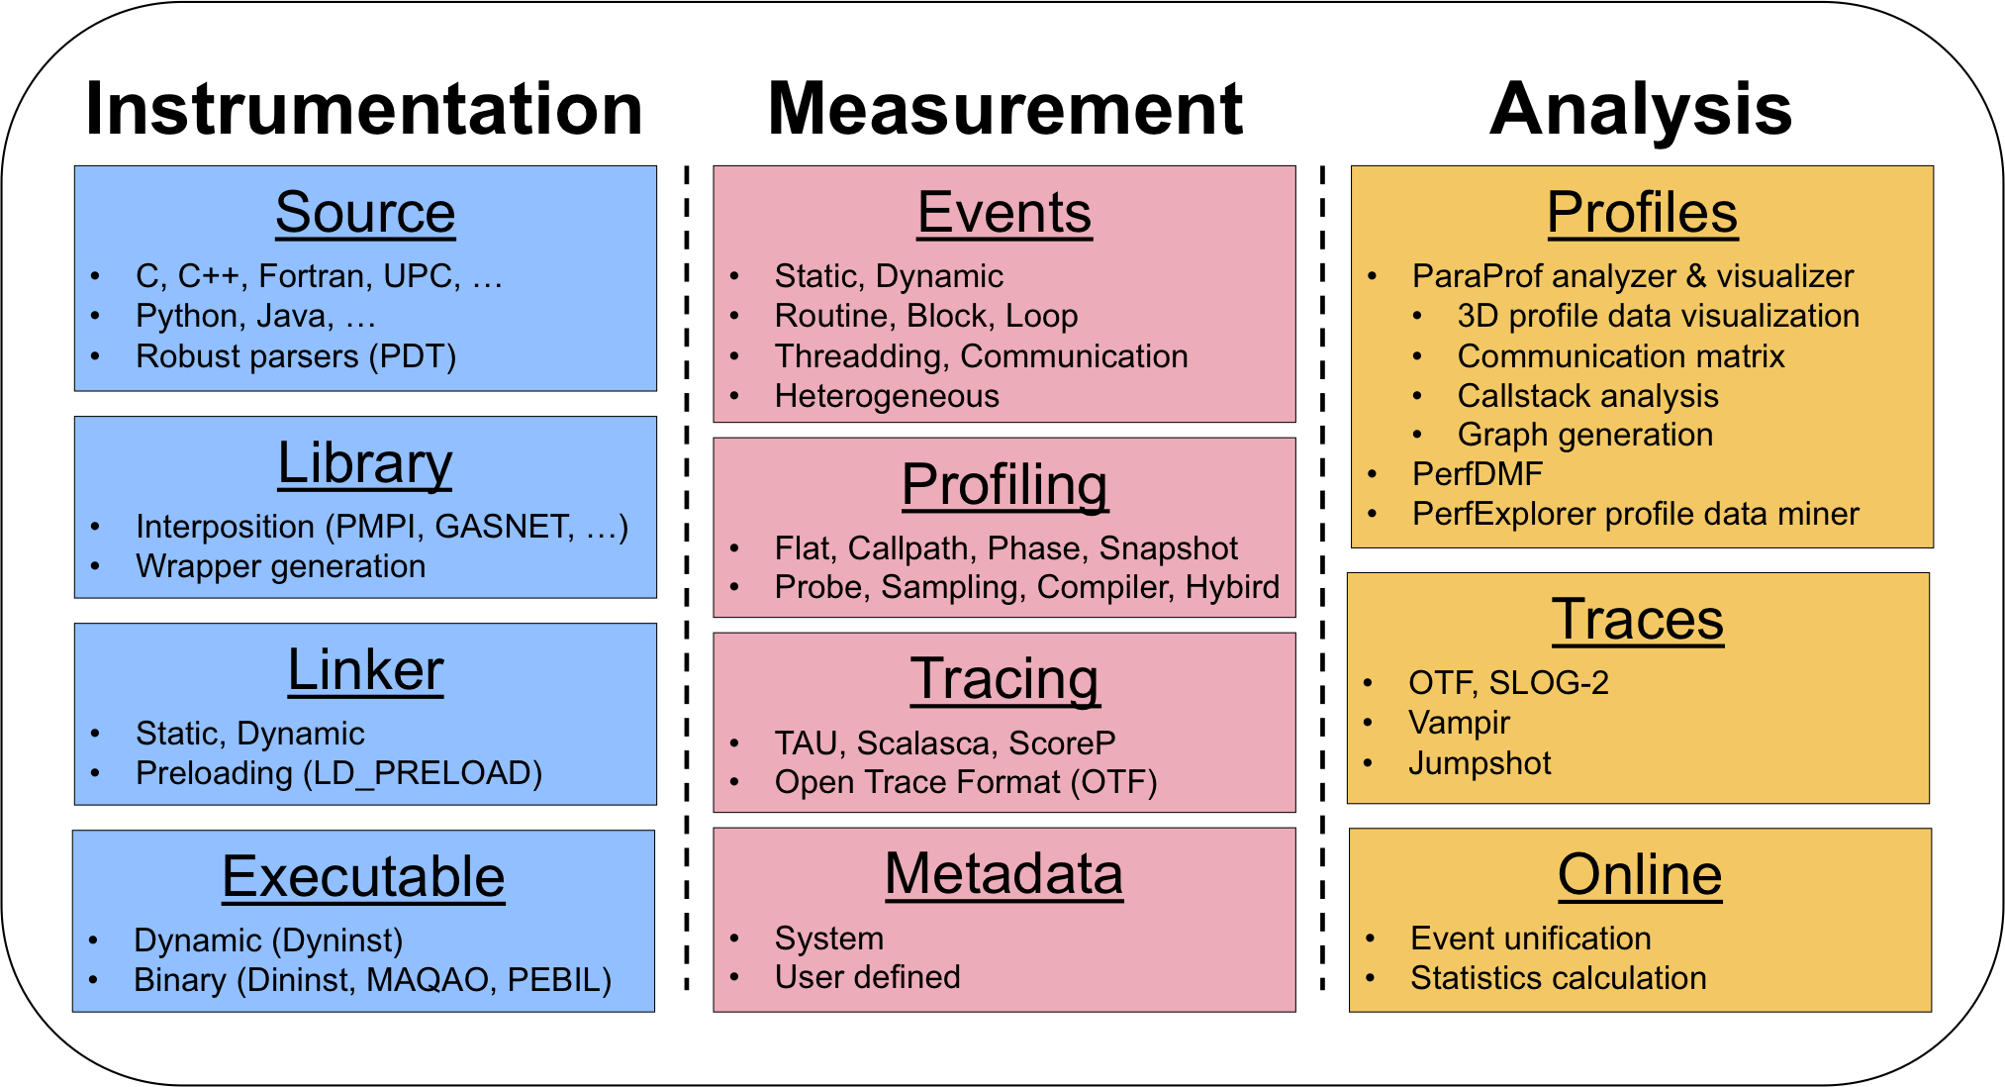
TAU Workflow

Slide 24
Instrument: Add Probes
  Source code instrumentation
    PDT parsers, pre-processors
  Wrap external libraries
    I/O, MPI, Memory, CUDA, OpenCL, pthread
  Rewrite the binary executable
    Dyninst, MAQAO

Slide 25
Measure: Gather Data
  Direct measurement via probes
  Indirect measurement via sampling
  Throttling and runtime control
  Interface with external packages (PAPI)

Slide 26
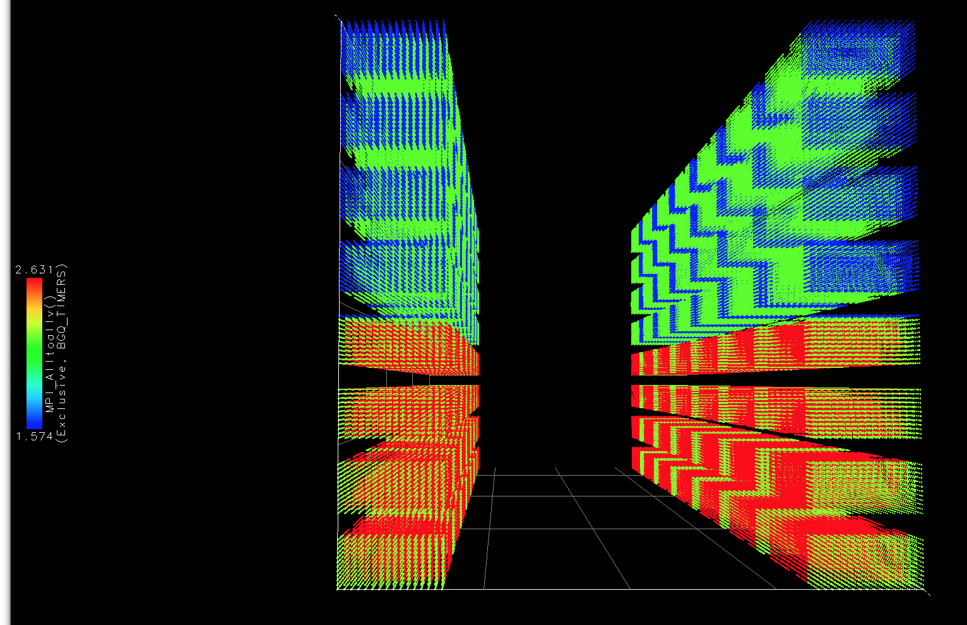
Analyze: Synthesize Knowledge
  Data visualization
  Data mining
  Statistical analysis
  Import/export performance data

Slide 27
Using TAU: A Brief Introduction
Each configuration of TAU corresponds to a unique stub makefile (TAU_MAKEFILE) in the TAU installation directory
% soft add +tau-latest
% ls $TAU/Makefile.*
Makefile.tau-bgqtimers-papi-gnu-ompt-pdt-openmp
Makefile.tau-bgqtimers-papi-mpi-pdt
Makefile.tau-bgqtimers-papi-mpi-pdt-openmp-opari
Makefile.tau-bgqtimers-papi-mpi-pdt-scorep
Makefile.tau-bgqtimers-papi-mpi-pthread-pdt
Makefile.tau-bgqtimers-papi-pdt
Makefile.tau-gnu-bgqtimers-papi-mpi-pdt
Makefile.tau-gnu-bgqtimers-papi-mpi-pdt-openmp-opari
Makefile.tau-gnu-bgqtimers-papi-mpi-pthread-pdt
% export TAU_MAKEFILE=$TAU/Makefile.tau-bgqtimers-papi-mpi-pdt

Slide 28
Using TAU: A Brief Introduction
Choose an appropriate TAU_MAKEFILE:
    % soft add +tau-latest
    % export TAU_MAKEFILE=/soft/perftools/tau/tau_latest/
    bgq/lib/Makefile.tau-bgqtimers-papi-mpi-pdt
    % export TAU_OPTIONS='-optVerbose …'
    # (see tau_compiler.sh -help for more options)
Use tau_f90.sh, tau_cxx.sh, etc. as Fortran, C++, etc. compiler:
    % mpixlf90_r foo.f90
    changes to
    % tau_f90.sh foo.f90
Execute application:
% qsub –A <queue> –q R.bc –n 256 –t 10 ./a.out
  Note: If TAU_MAKEFILE has “papi” in its name, set TAU_METRICS:
  % qsub --env TAU_METRICS=BGQ_TIMERS:PAPI_L2_DCM...
Analyze performance data:
  pprof (for text based profile display)
  paraprof (for GUI)

Slide 29
Hands-on (18:30 – 21:15)
% ssh mira.alcf.anl.gov
% tar xvzf /soft/perftools/tau/workshop.tgz
% cd workshop
% less README
For an MPI+F90 application, you may want to start with:
% soft add +tau-latest
% export TAU_MAKEFILE=
$TAU/Makefile.tau-bgqtimers-papi-mpi-pdt
% make CC=tau_cc.sh CXX=tau_cxx.sh F90=tau_f90.sh
% qsub –q R.bc –n 2 –-mode c16 –t 10 –A ... ./a.out
% paraprof

Slide 30
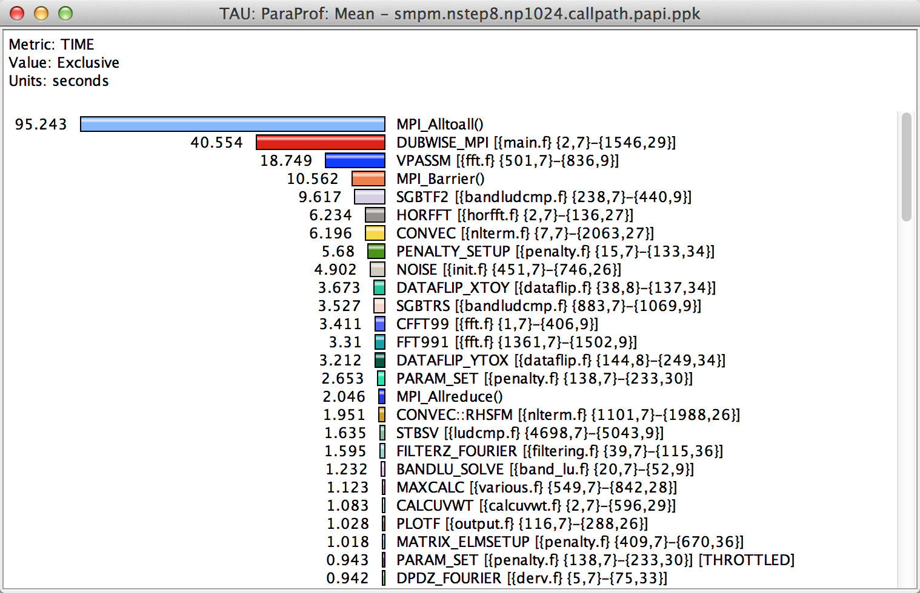
How Much Time per Code Region?
% paraprof (Click on label, e.g. “Mean” or “node 0”)
Notes:
How much time per code region?
How many instructions per code region?
What is the cost of each code statement?
L1 or L2 cache misses?

Slide 31
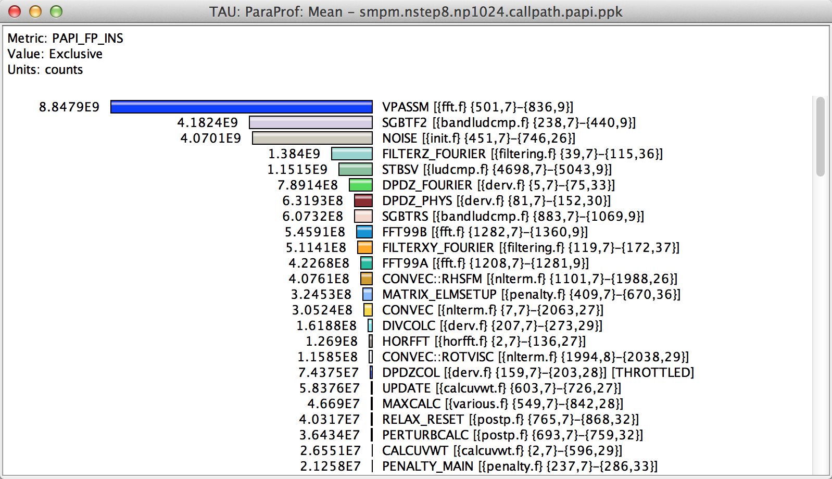
How Many Instructions per Code Region?
% paraprof (Options → Select Metric... → Exclusive… → PAPI_FP_INS)
Notes:
How much time per code region?
How many instructions per code region?
What is the cost of each code statement?
L1 or L2 cache misses?

Slide 32
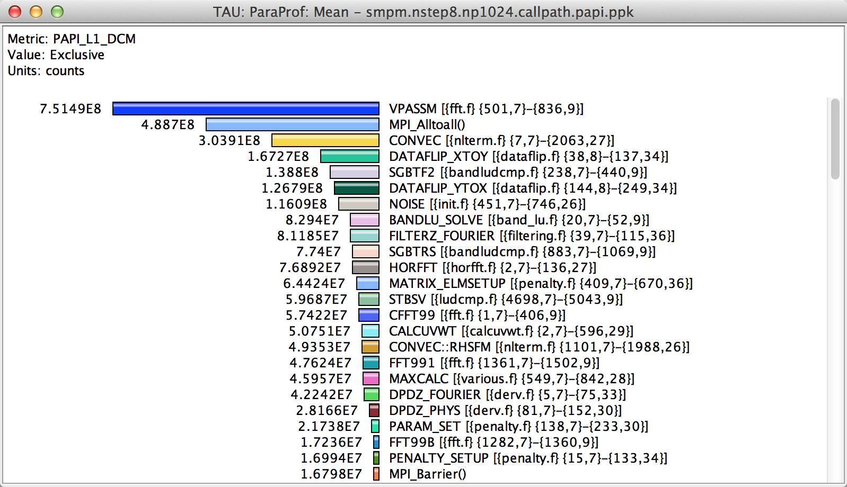
How Many L1 or L2 Cache Misses?
% paraprof (Options → Select Metric... → Exclusive… → PAPI_L1_DCM)
Notes:
How much time per code region?
How many instructions per code region?
What is the cost of each code statement?
L1 or L2 cache misses?

Slide 33
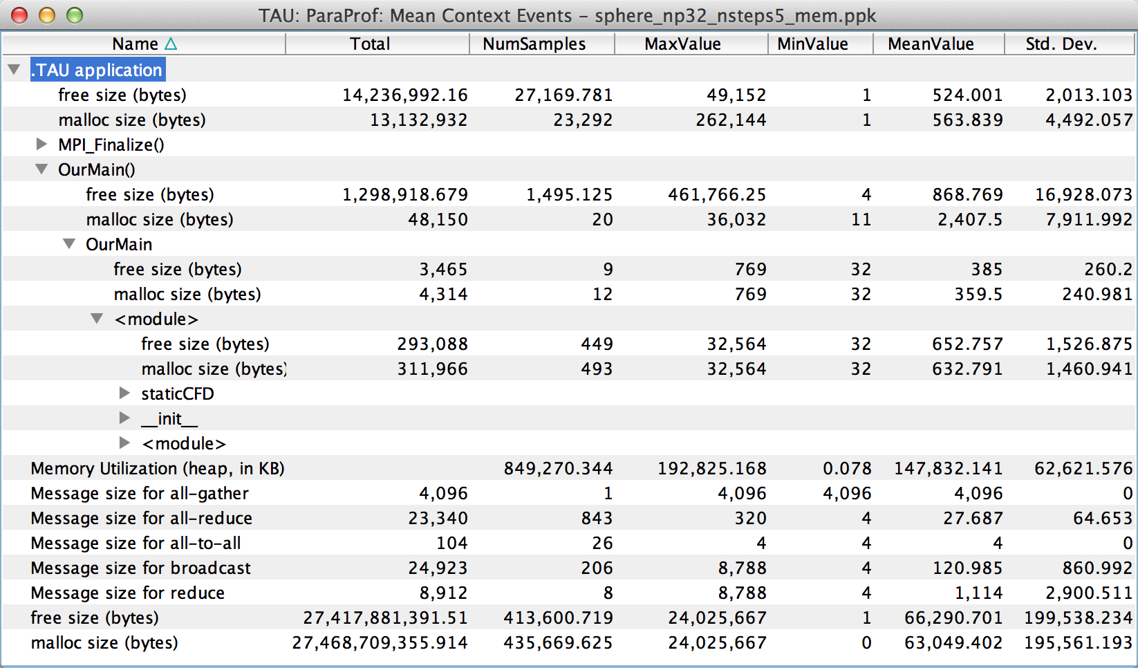
How Much Memory Does the Code Use?
High-water mark
% paraprof (Right-click label [e.g “node 0”] → Show Context Event Window)
Notes:
Heap memory usage reported by the mallinfo() call is not 64-bit clean.
32 bit counters in Linux roll over when > 4GB memory is used
We keep track of heap memory usage in 64 bit counters inside TAU
Compensation of perturbation introduced by tool
Only show what application uses
Create guards for TAU calls to not track I/O and memory allocations/de-allocations performed inside TAU
Provide broad POSIX I/O and memory coverage

Slide 34
How Much Memory Does the Code Use?
Total allocated/deallocated
% paraprof (Right-click label [e.g “node 0”] → Show Context Event Window)
Notes:
What is the memory usage of the code?
When/where is memory allocated?
Are there any memory leaks?
What are the I/O characteristics?

Slide 35
Where is Memory Allocated / Deallocated?
Allocation / Deallocation Events
% paraprof (Right-click label [e.g “node 0”] → Show Context Event Window)
Notes:
What is the memory usage of the code?
When/where is memory allocated?
Are there any memory leaks?
What are the I/O characteristics?

Slide 36
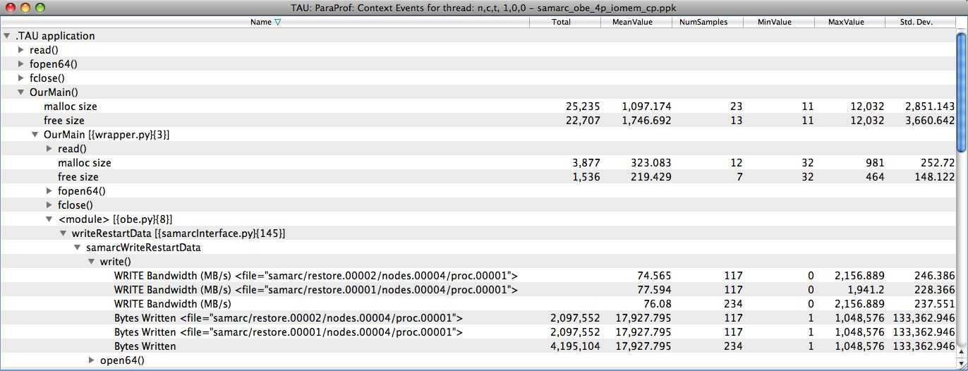
What are the I/O Characteristics?
Write bandwidth per file
Bytes written to each file
% paraprof (Right-click label [e.g “node 0”] → Show Context Event Window)
Notes:
What is the memory usage of the code?
When/where is memory allocated?
Are there any memory leaks?
What are the I/O characteristics?

Slide 37
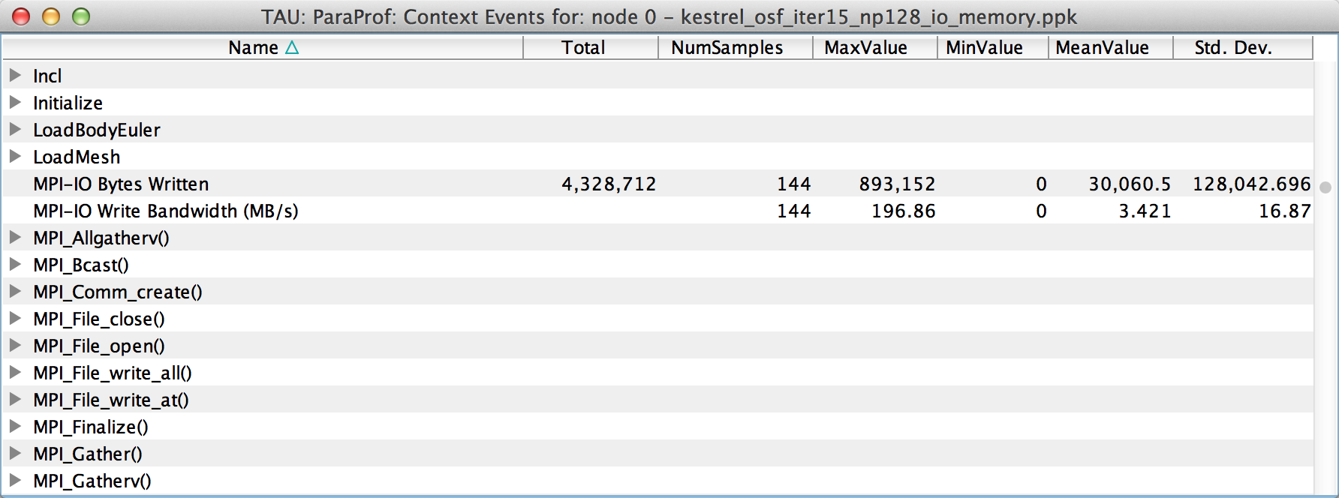
What are the I/O Characteristics?
Peak MPI-IO Write Bandwidth
% paraprof (Right-click label [e.g “node 0”] → Show Context Event Window)
Notes:
What is the memory usage of the code?
When/where is memory allocated?
Are there any memory leaks?
What are the I/O characteristics?

Slide 38
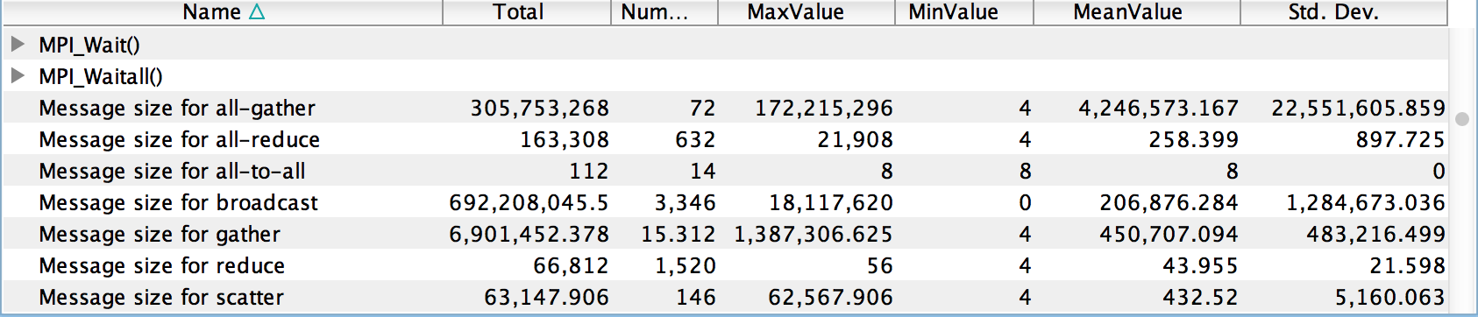
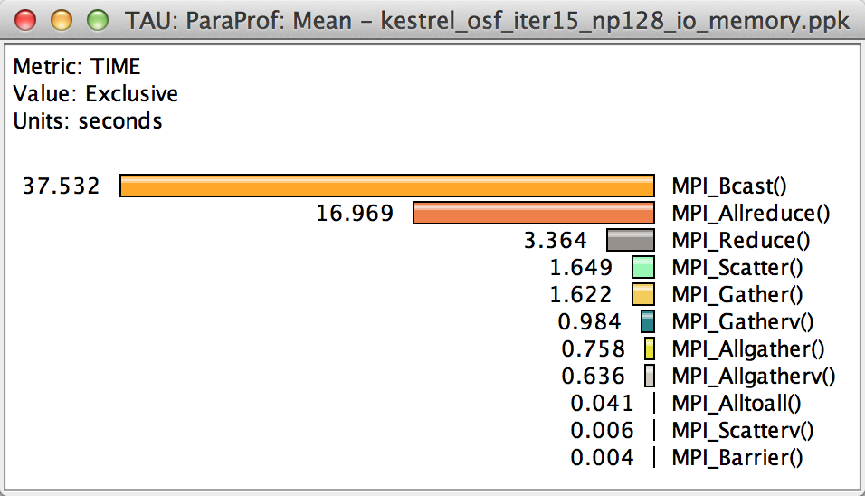
How Much Time is spent in Collectives?
Message sizes
Time spent in collectives
Notes:
What is the memory usage of the code?
When/where is memory allocated?
Are there any memory leaks?
What are the I/O characteristics?

Slide 39
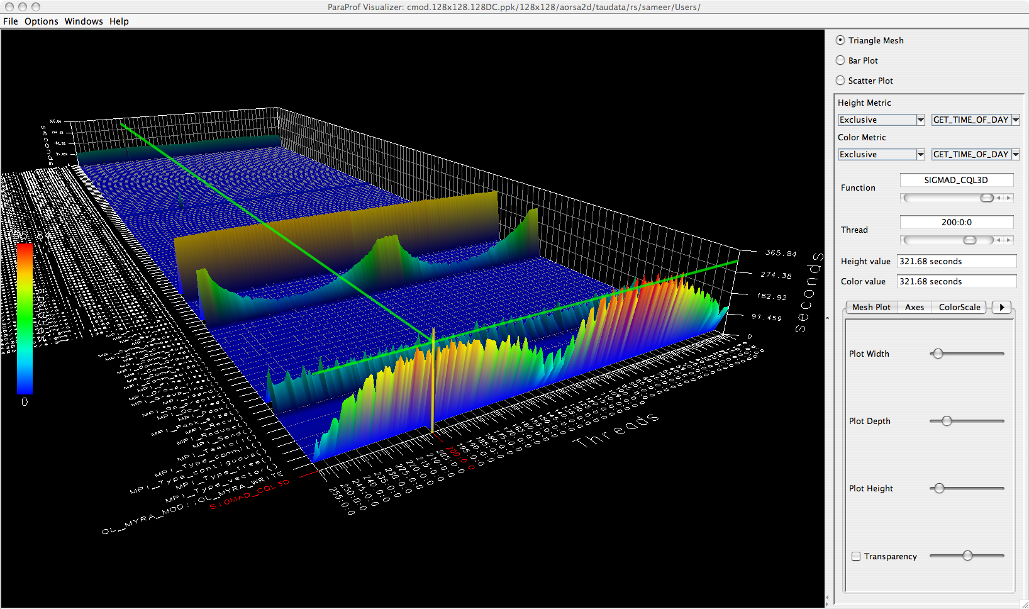
3D Profile Visualization
% paraprof (Windows → 3D Visualization)

Slide 40
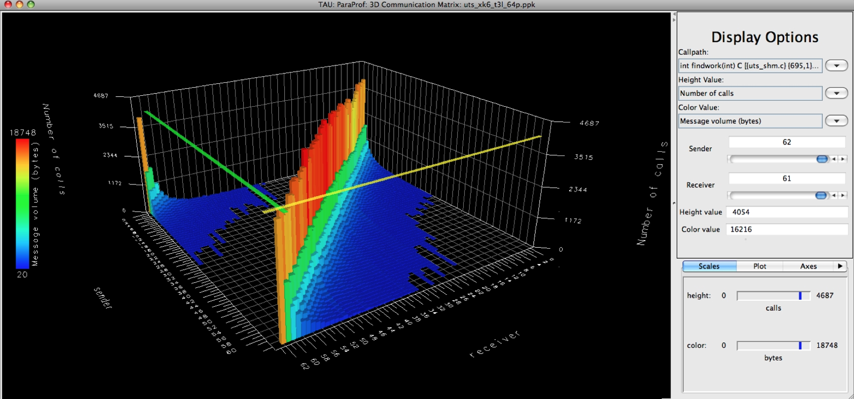
3D Communication Visualization
% qsub –env TAU_COMM_MATRIX=1 …
% paraprof (Windows → 3D Communication Matrix)

Slide 41
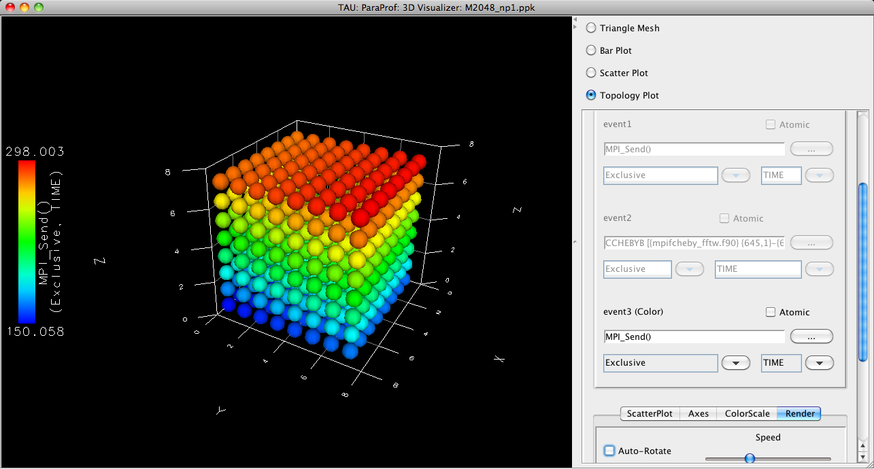
3D Topology Visualization
% paraprof (Windows → 3D Visualization → Topology Plot)
Notes:
MPI_Send on BG/Q

Slide 42
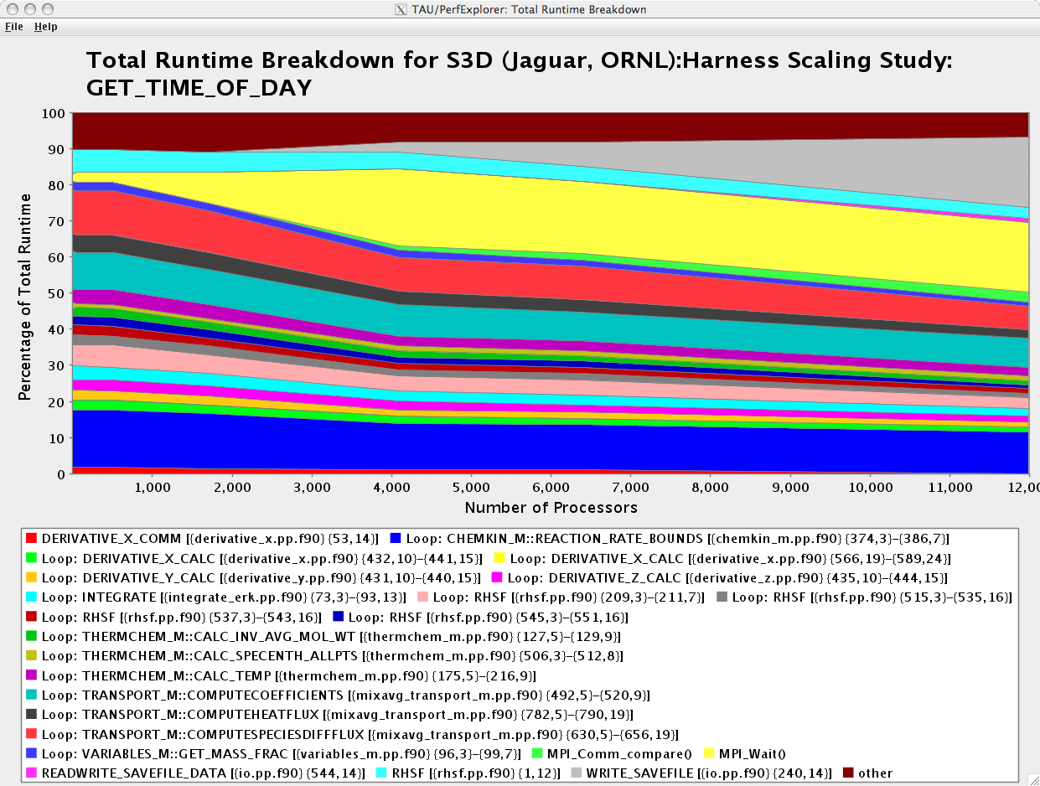
How Does Each Routine Scale?
WRITE_SAVEFILE
MPI_Waitall
% perfexplorer (Charts → Runtime Breakdown)

Slide 43
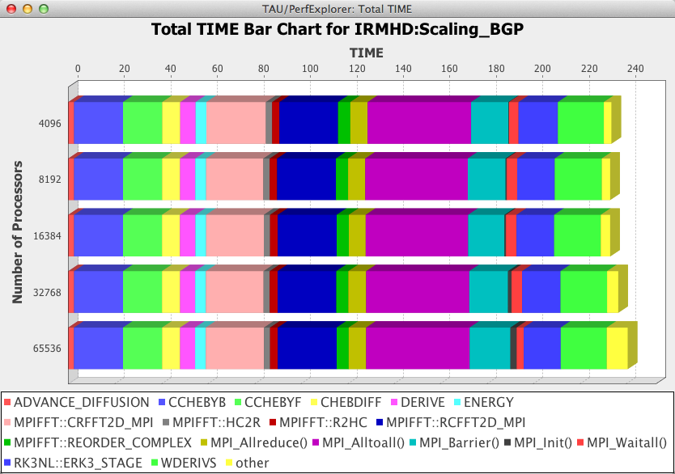
How Does Each Routine Scale?
% perfexplorer (Charts → Stacked Bar Chart)

Slide 44
Which Events Correlate with Runtime?
% perfexplorer (Charts → Correlate Events with Total Runtime)

Slide 45
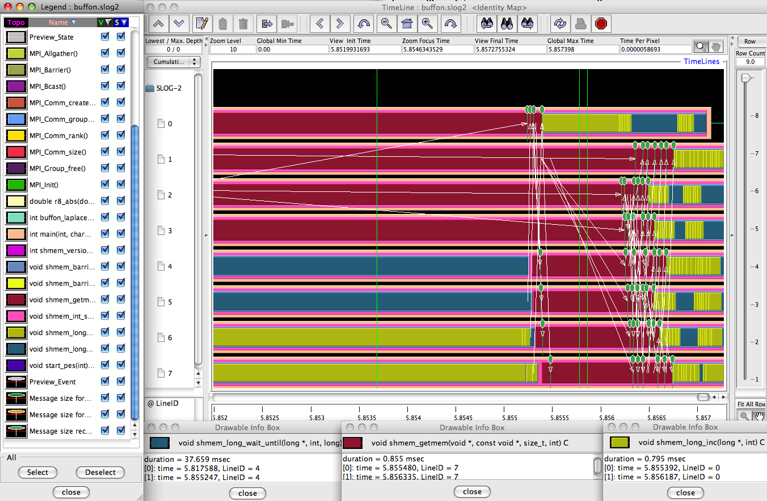
When do Events Occur?

Slide 46
When do Events Occur?
To generate a trace and visualize it in Jumpshot:
% qsub –env TAU_TRACE=1 …
% tau_treemerge.pl
% tau2slog2 tau.trc tau.edf –o app.slog2
% jumpshot app.slog2

Slide 47
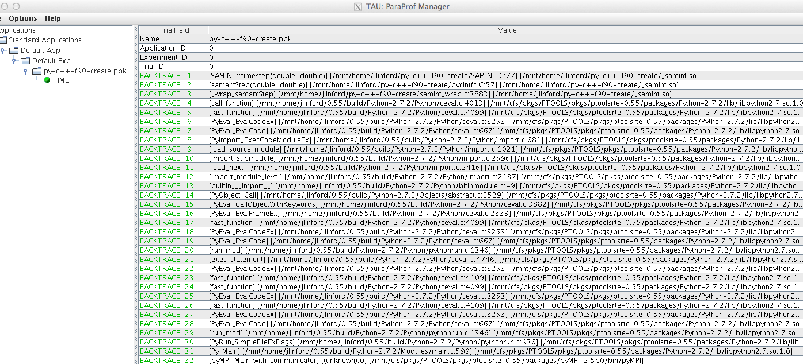
What Caused My Application to Crash?
% qsub –env TAU_TRACK_SIGNALS=1 …
% paraprof
Notes:
What caused the segfault?
What were the performance characteristics up to failure?
Which routines were or were not called?
Were there any memory errors?

Slide 48
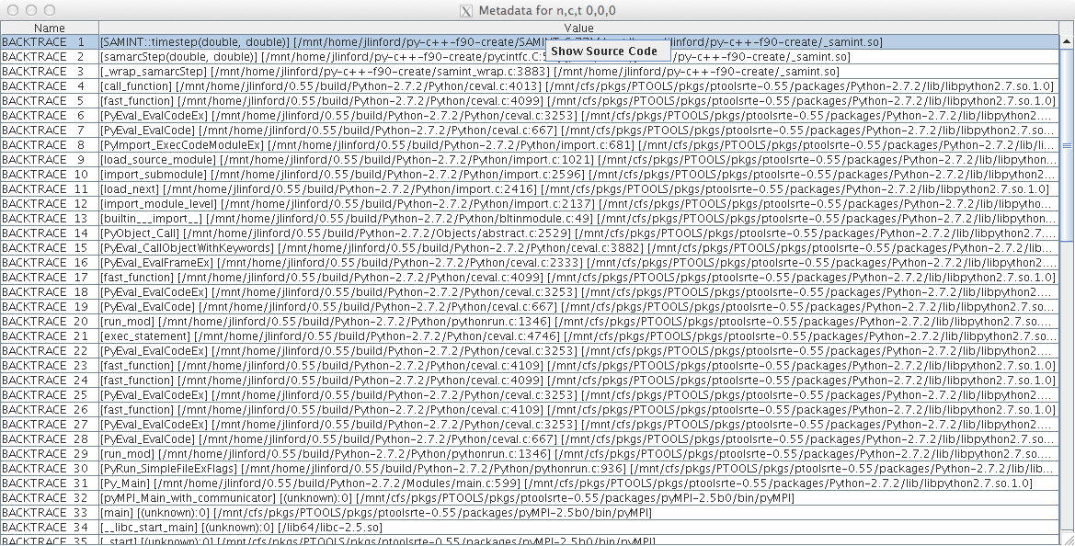
What Caused My Application to Crash?
Right-click to see source code

Slide 49
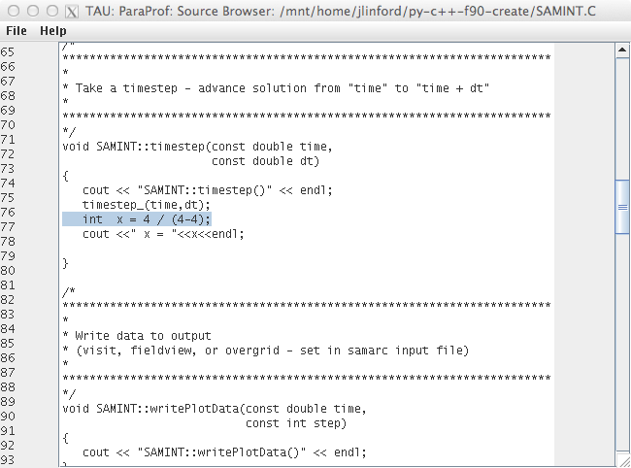
What Caused My Application to Crash?
Error shown in ParaProf Source Browser

Slide 50
Tau commander
(Alpha release!)
Intuitive Performance Engineering

Slide 51
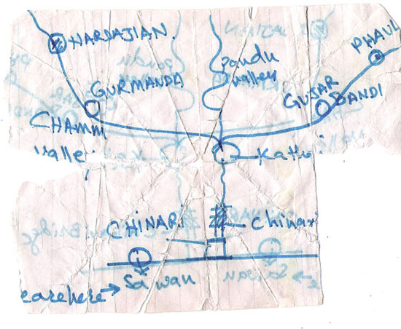
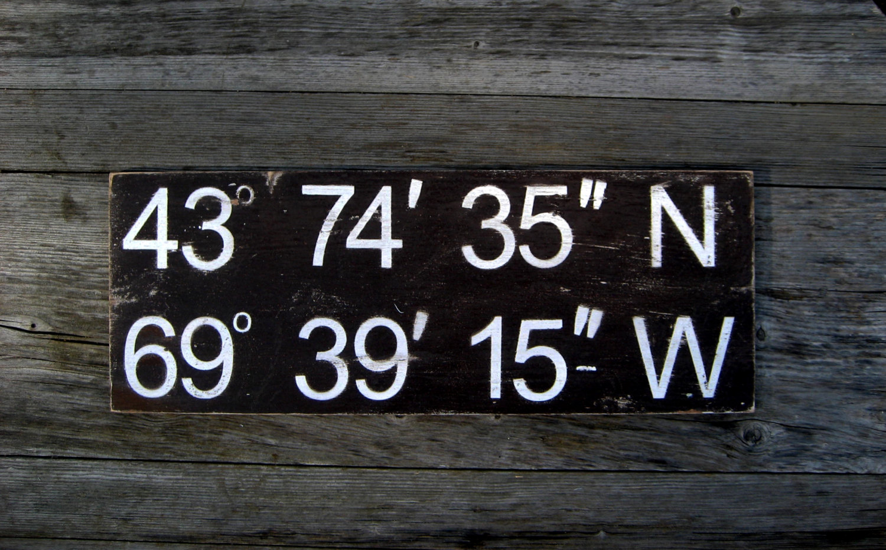
The TAU Commander Approach
Say where you’re going, not how to get there
TAU Projects give context to the user’s actions
  Defines desired metrics and measurement approach
  Defines operating environment
  Establishes a baseline for error checking
vs.

Slide 52
TAU Commander CLI Dashboard

Slide 53
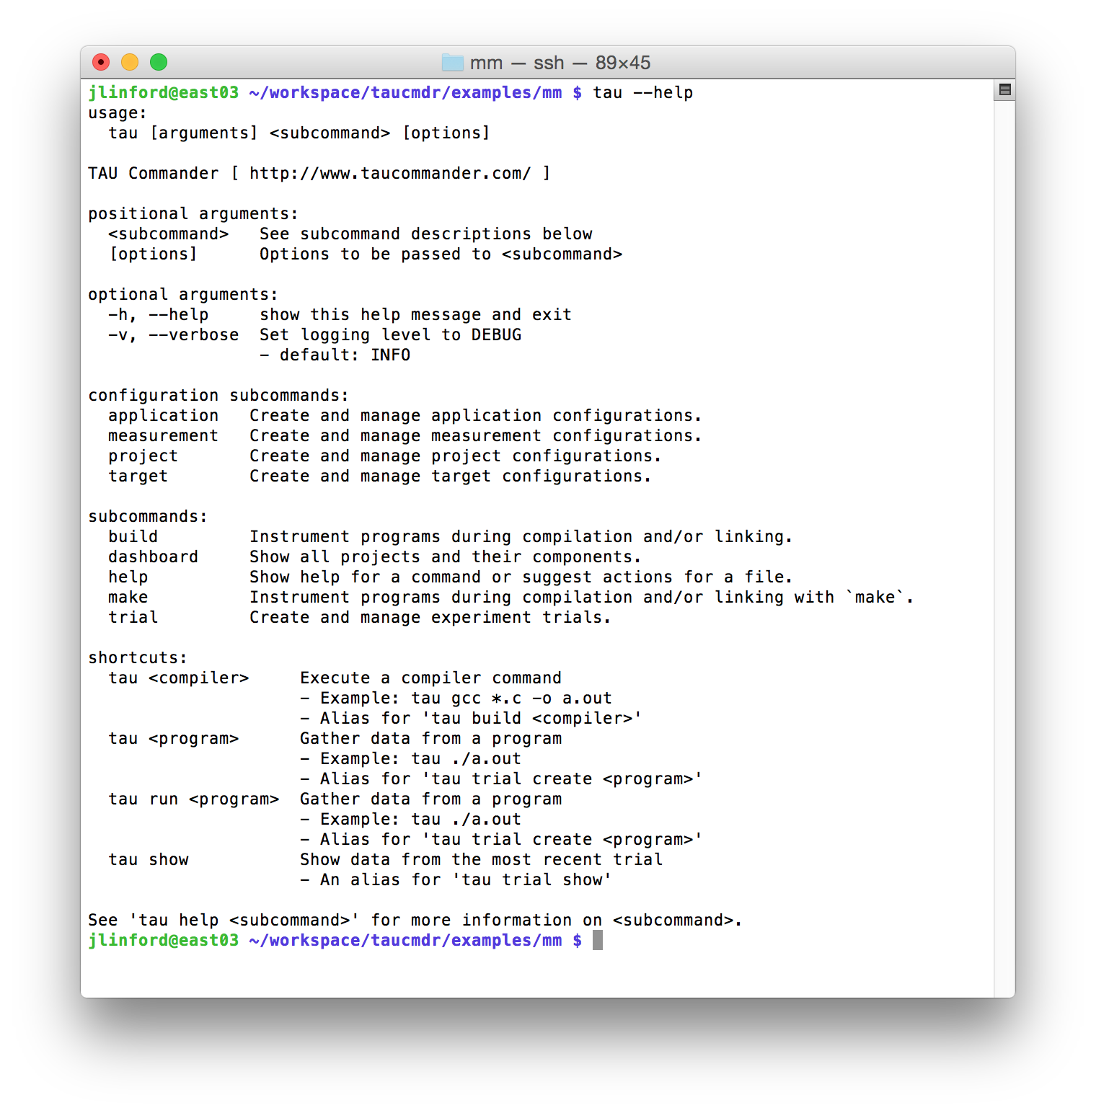
TAU Commander CLI
--help
This command’s usage
Subcommand usage
Shortcuts

Slide 54
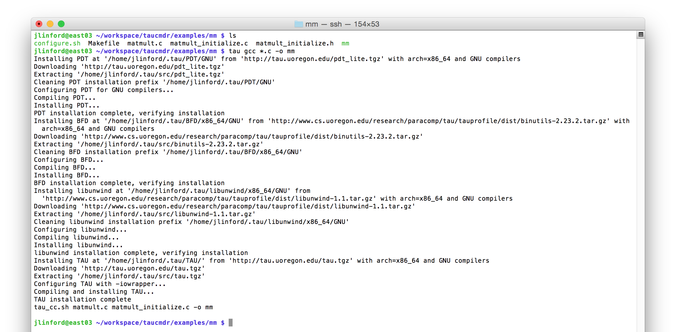
First use on a “vanilla” system
Put tau in front of every command
Detects, downloads, and installs required dependencies
Configures environment, wraps compiler

Slide 55
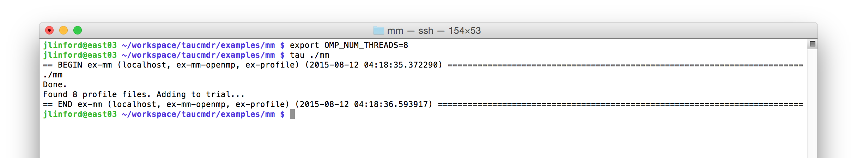
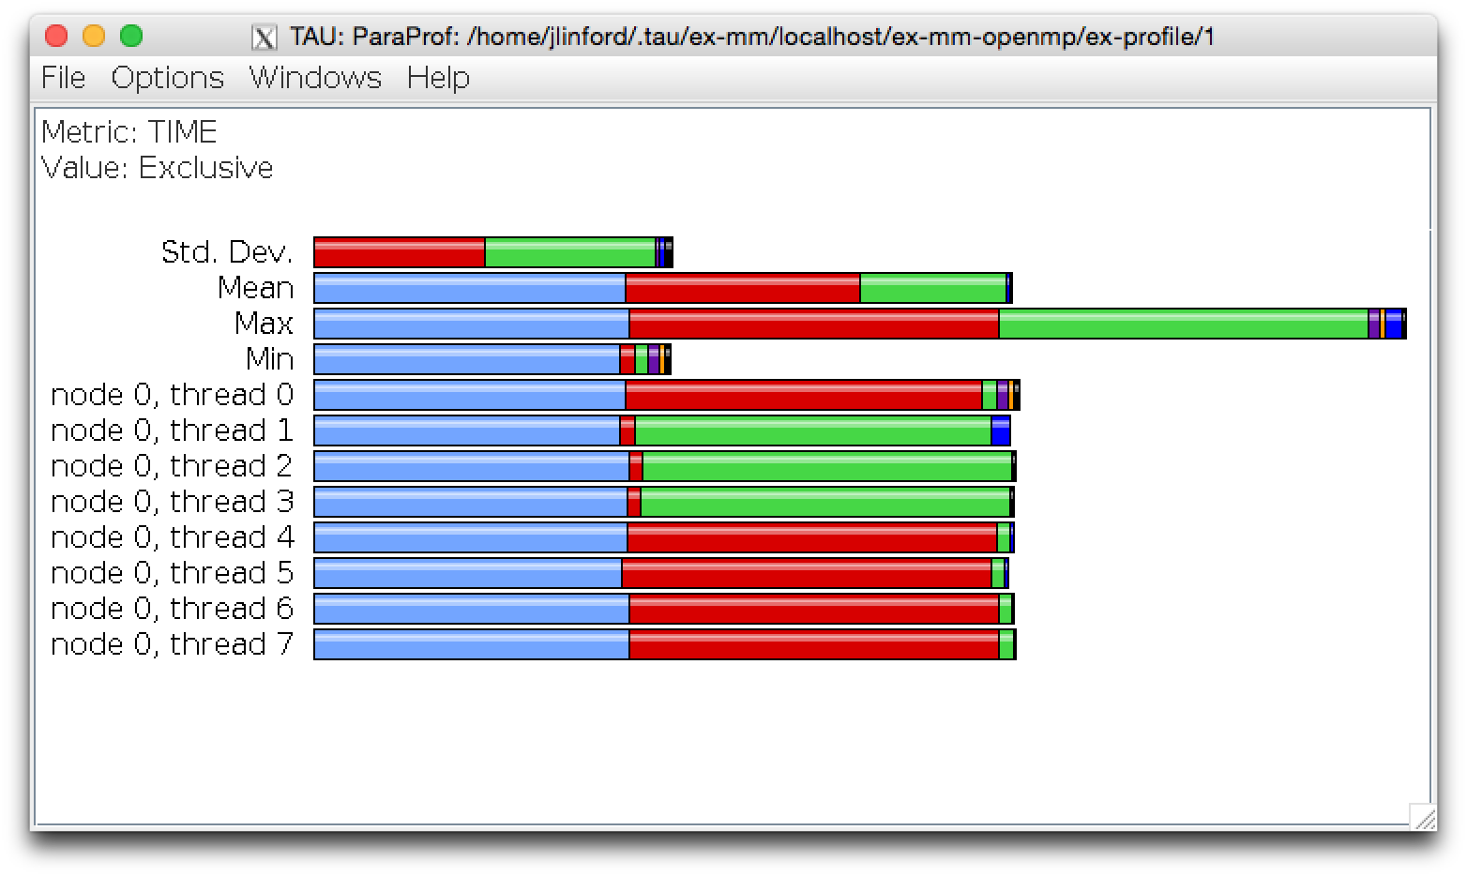
Executions create experiment trials
Put tau in front of every command
`tau show` to see data from last trial

Slide 56

Executions create experiment trials
Each execution is a new trial

Slide 57
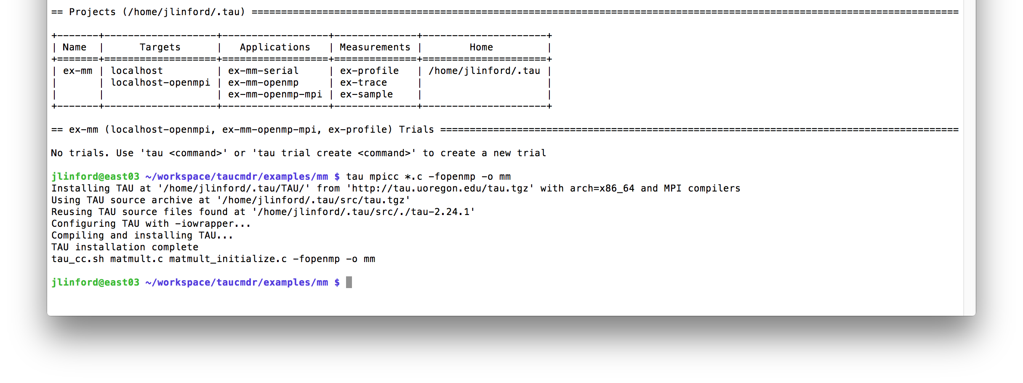
Changing from serial to MPI+OpenMP
Put tau in front of every command
Automatically reconfigures TAU for MPI+OpenMP

Slide 58
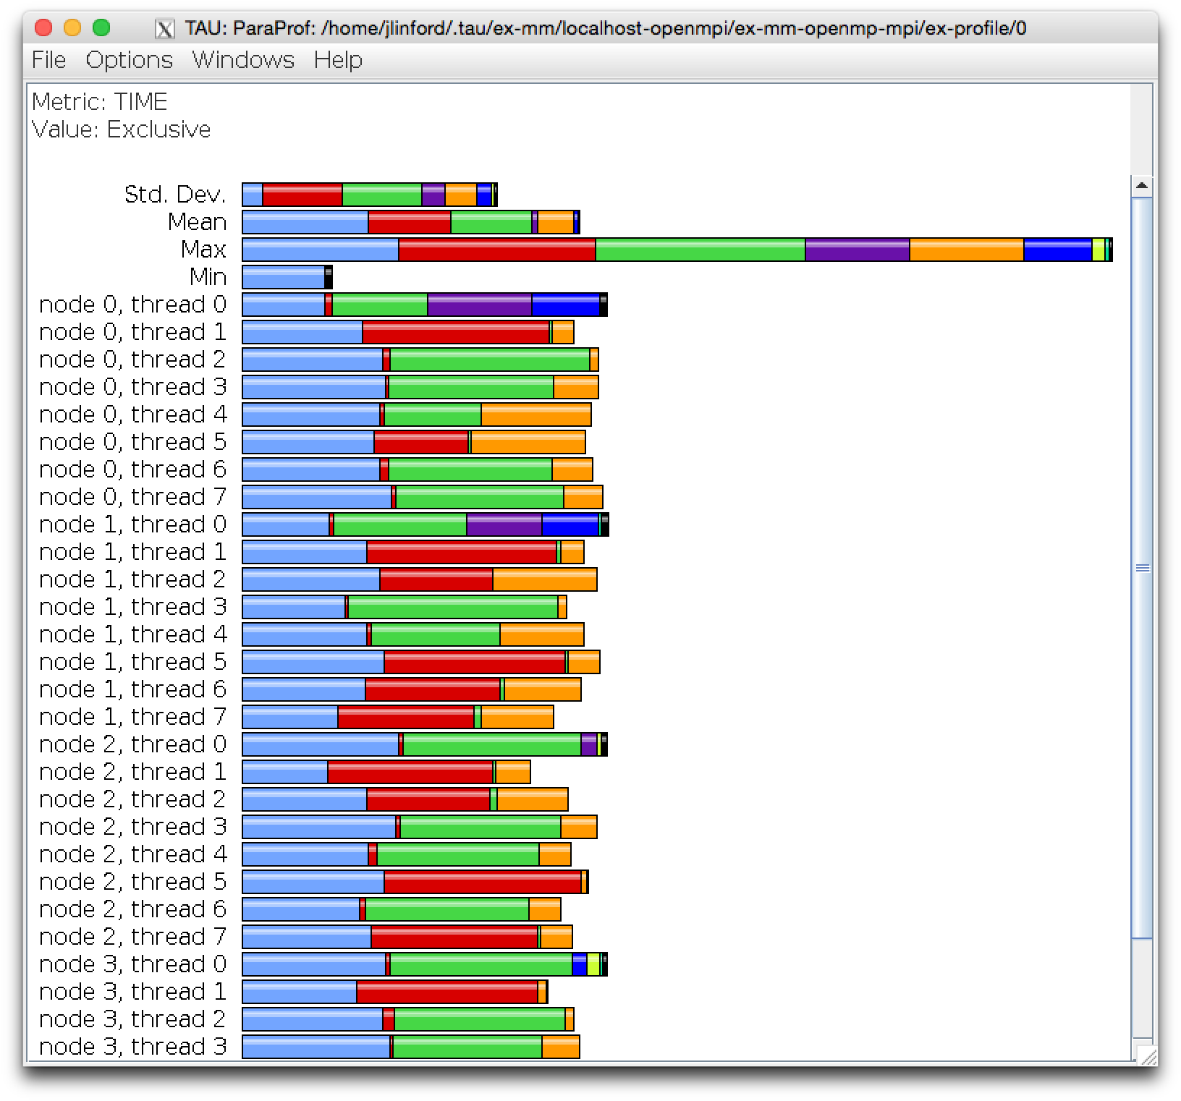
Workflow is unchanged
`tau show` to see data from last trial

Slide 59
Case Studies
Intuitive Performance Engineering

Slide 61
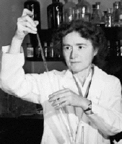
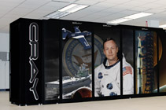
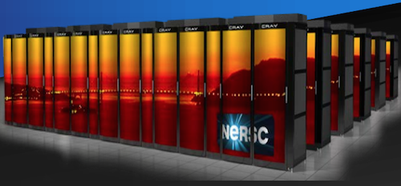

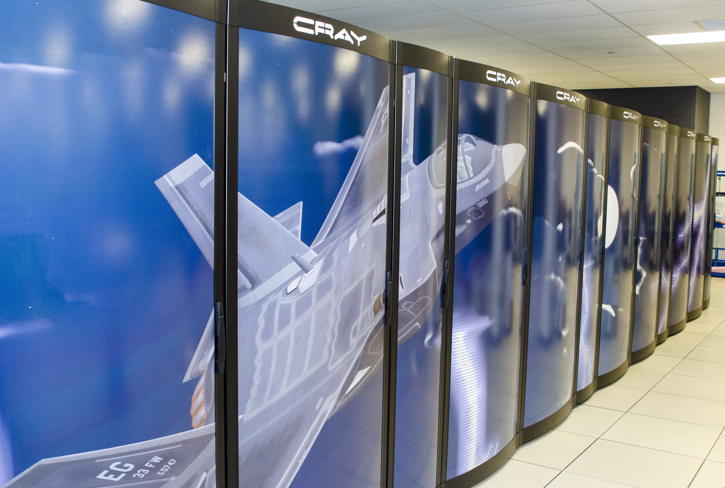

Target Platforms
Armstrong [XC30]
Cori
Haise [iDataPlex]
Lightning [XC30]
Kilrain [iDataPlex]

Slide 62
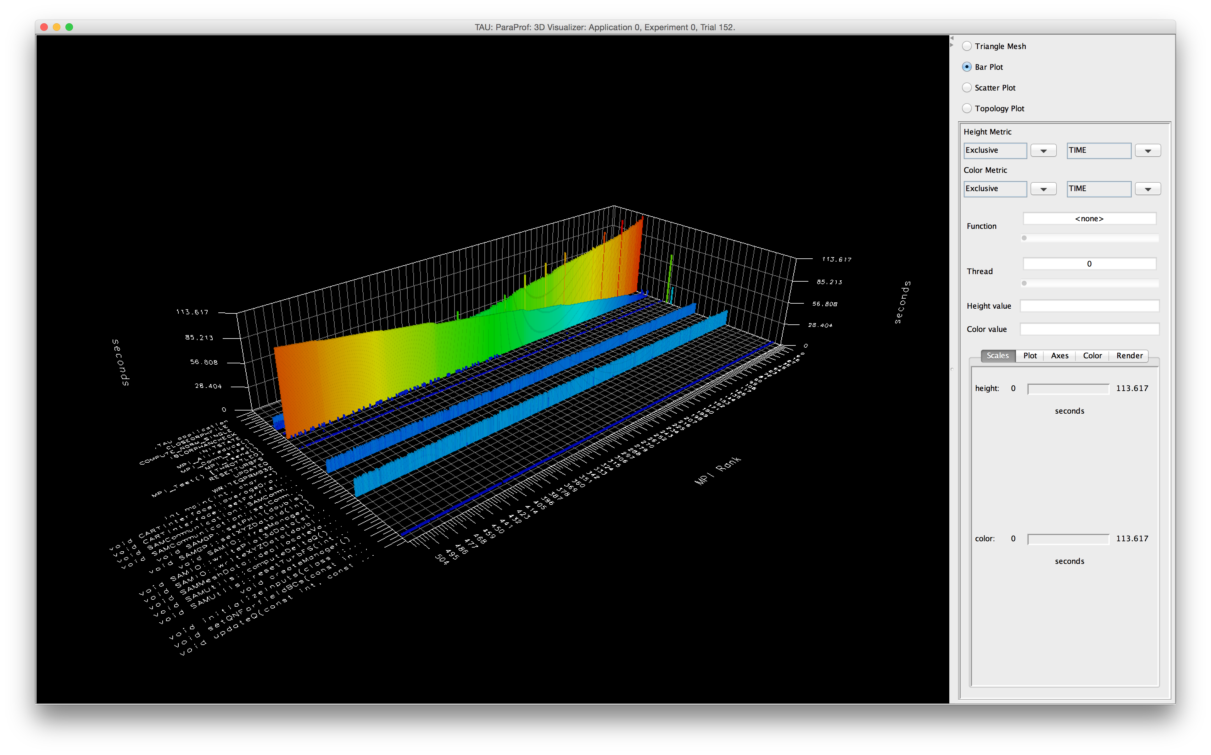
Initial Profile on Babbage
MPI_Barrier
MPI_Send
File I/O
Useful Work!

Slide 63
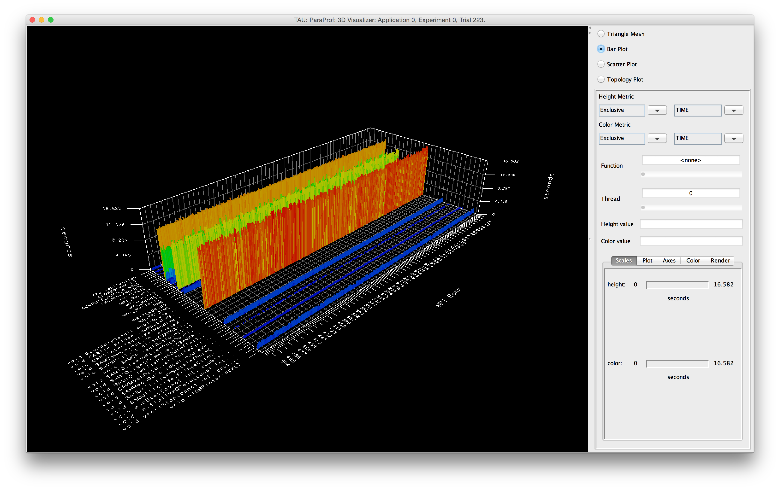
Hot Spot Optimization
MPI_Waitall
Useful work!
Useful work!
File I/O

Slide 64
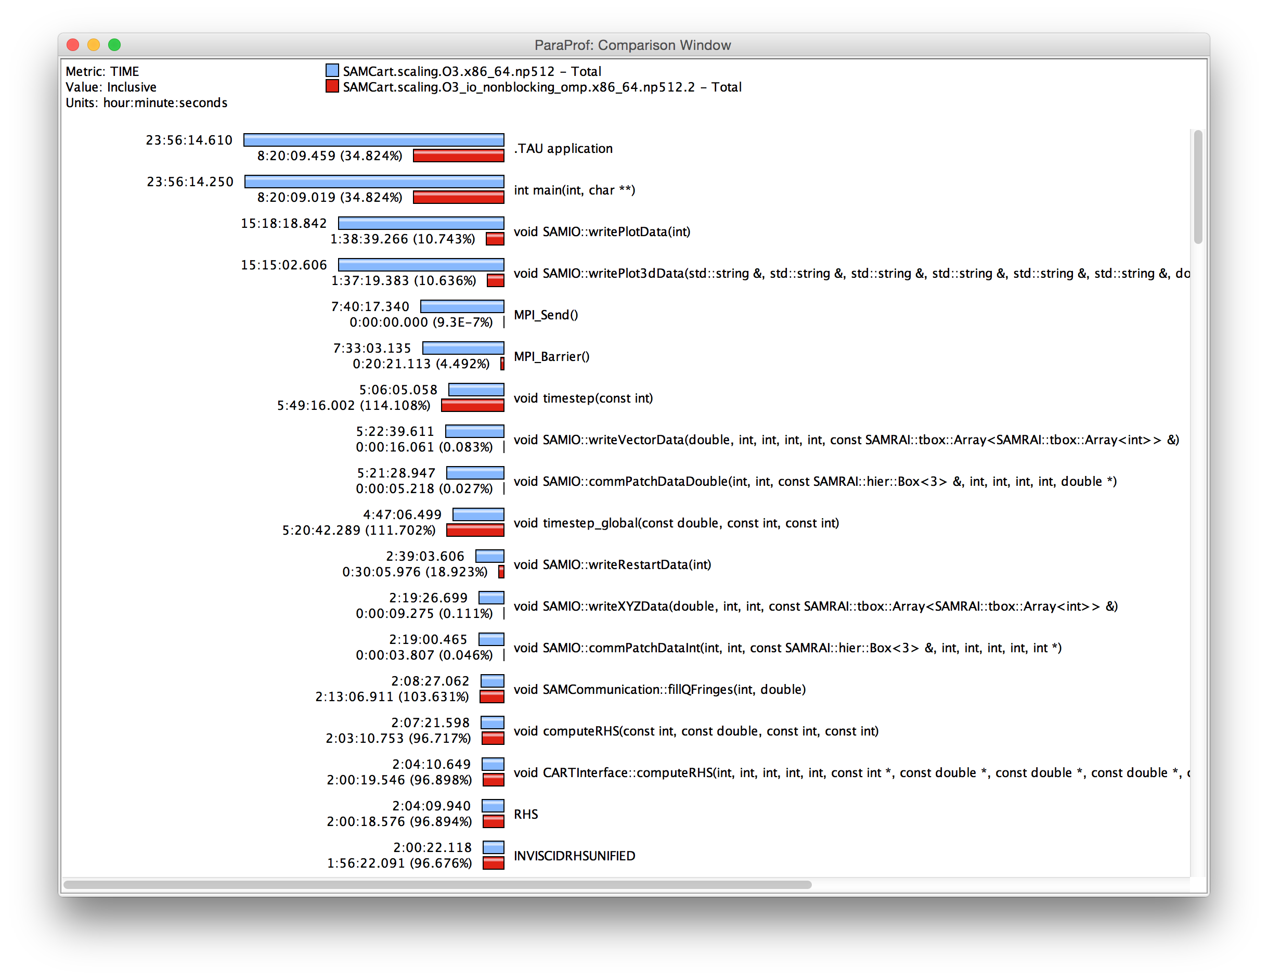
65% Runtime Reduction (~2x faster)

Slide 65
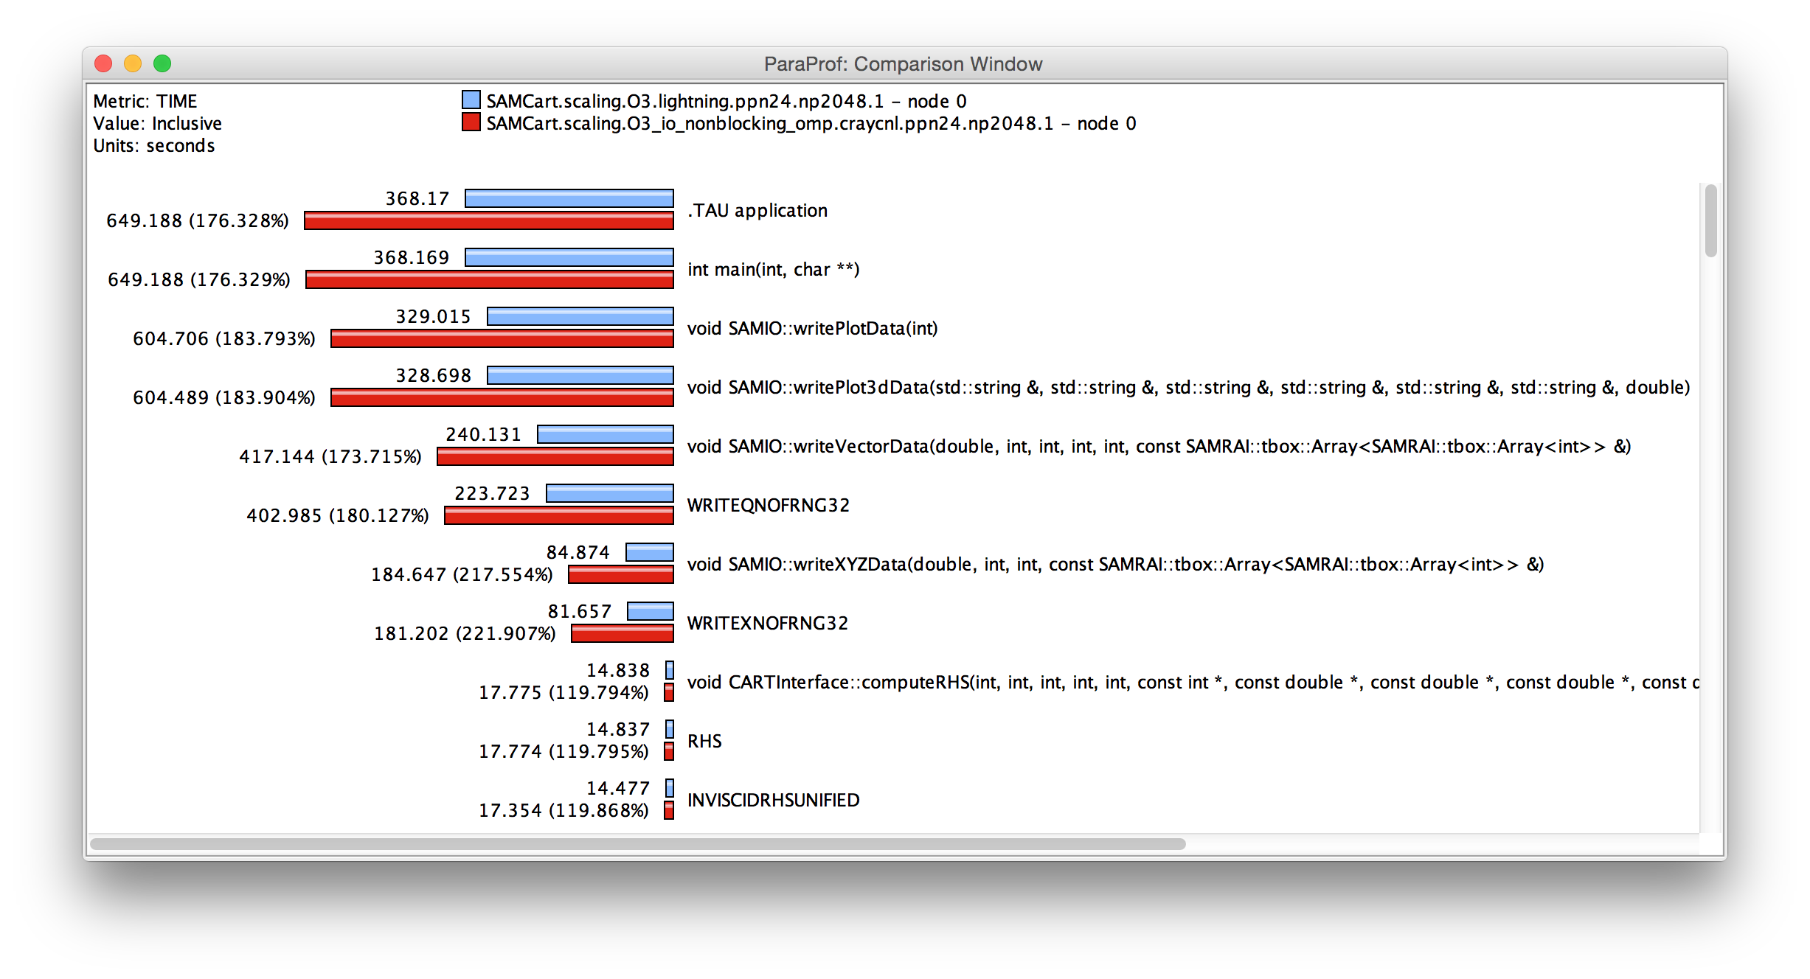
Cray XC30
Slower! What happened???

Slide 66
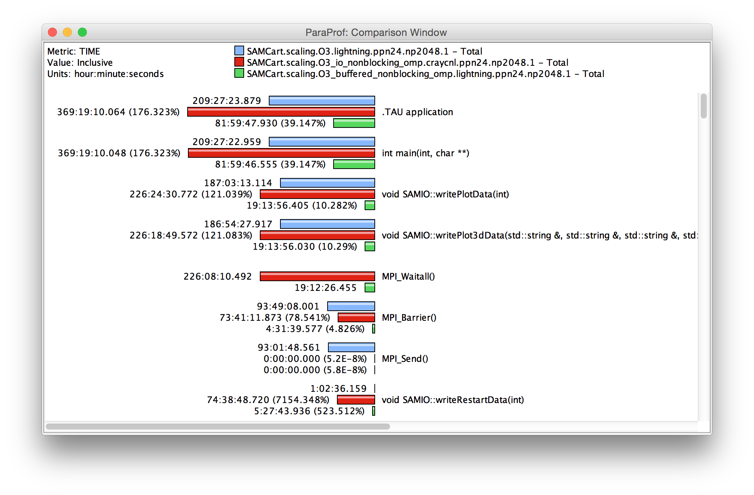
No worries, I fix it

Slide 67
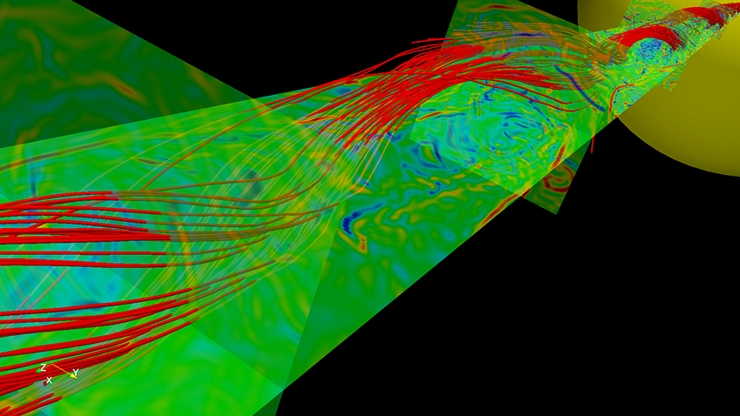
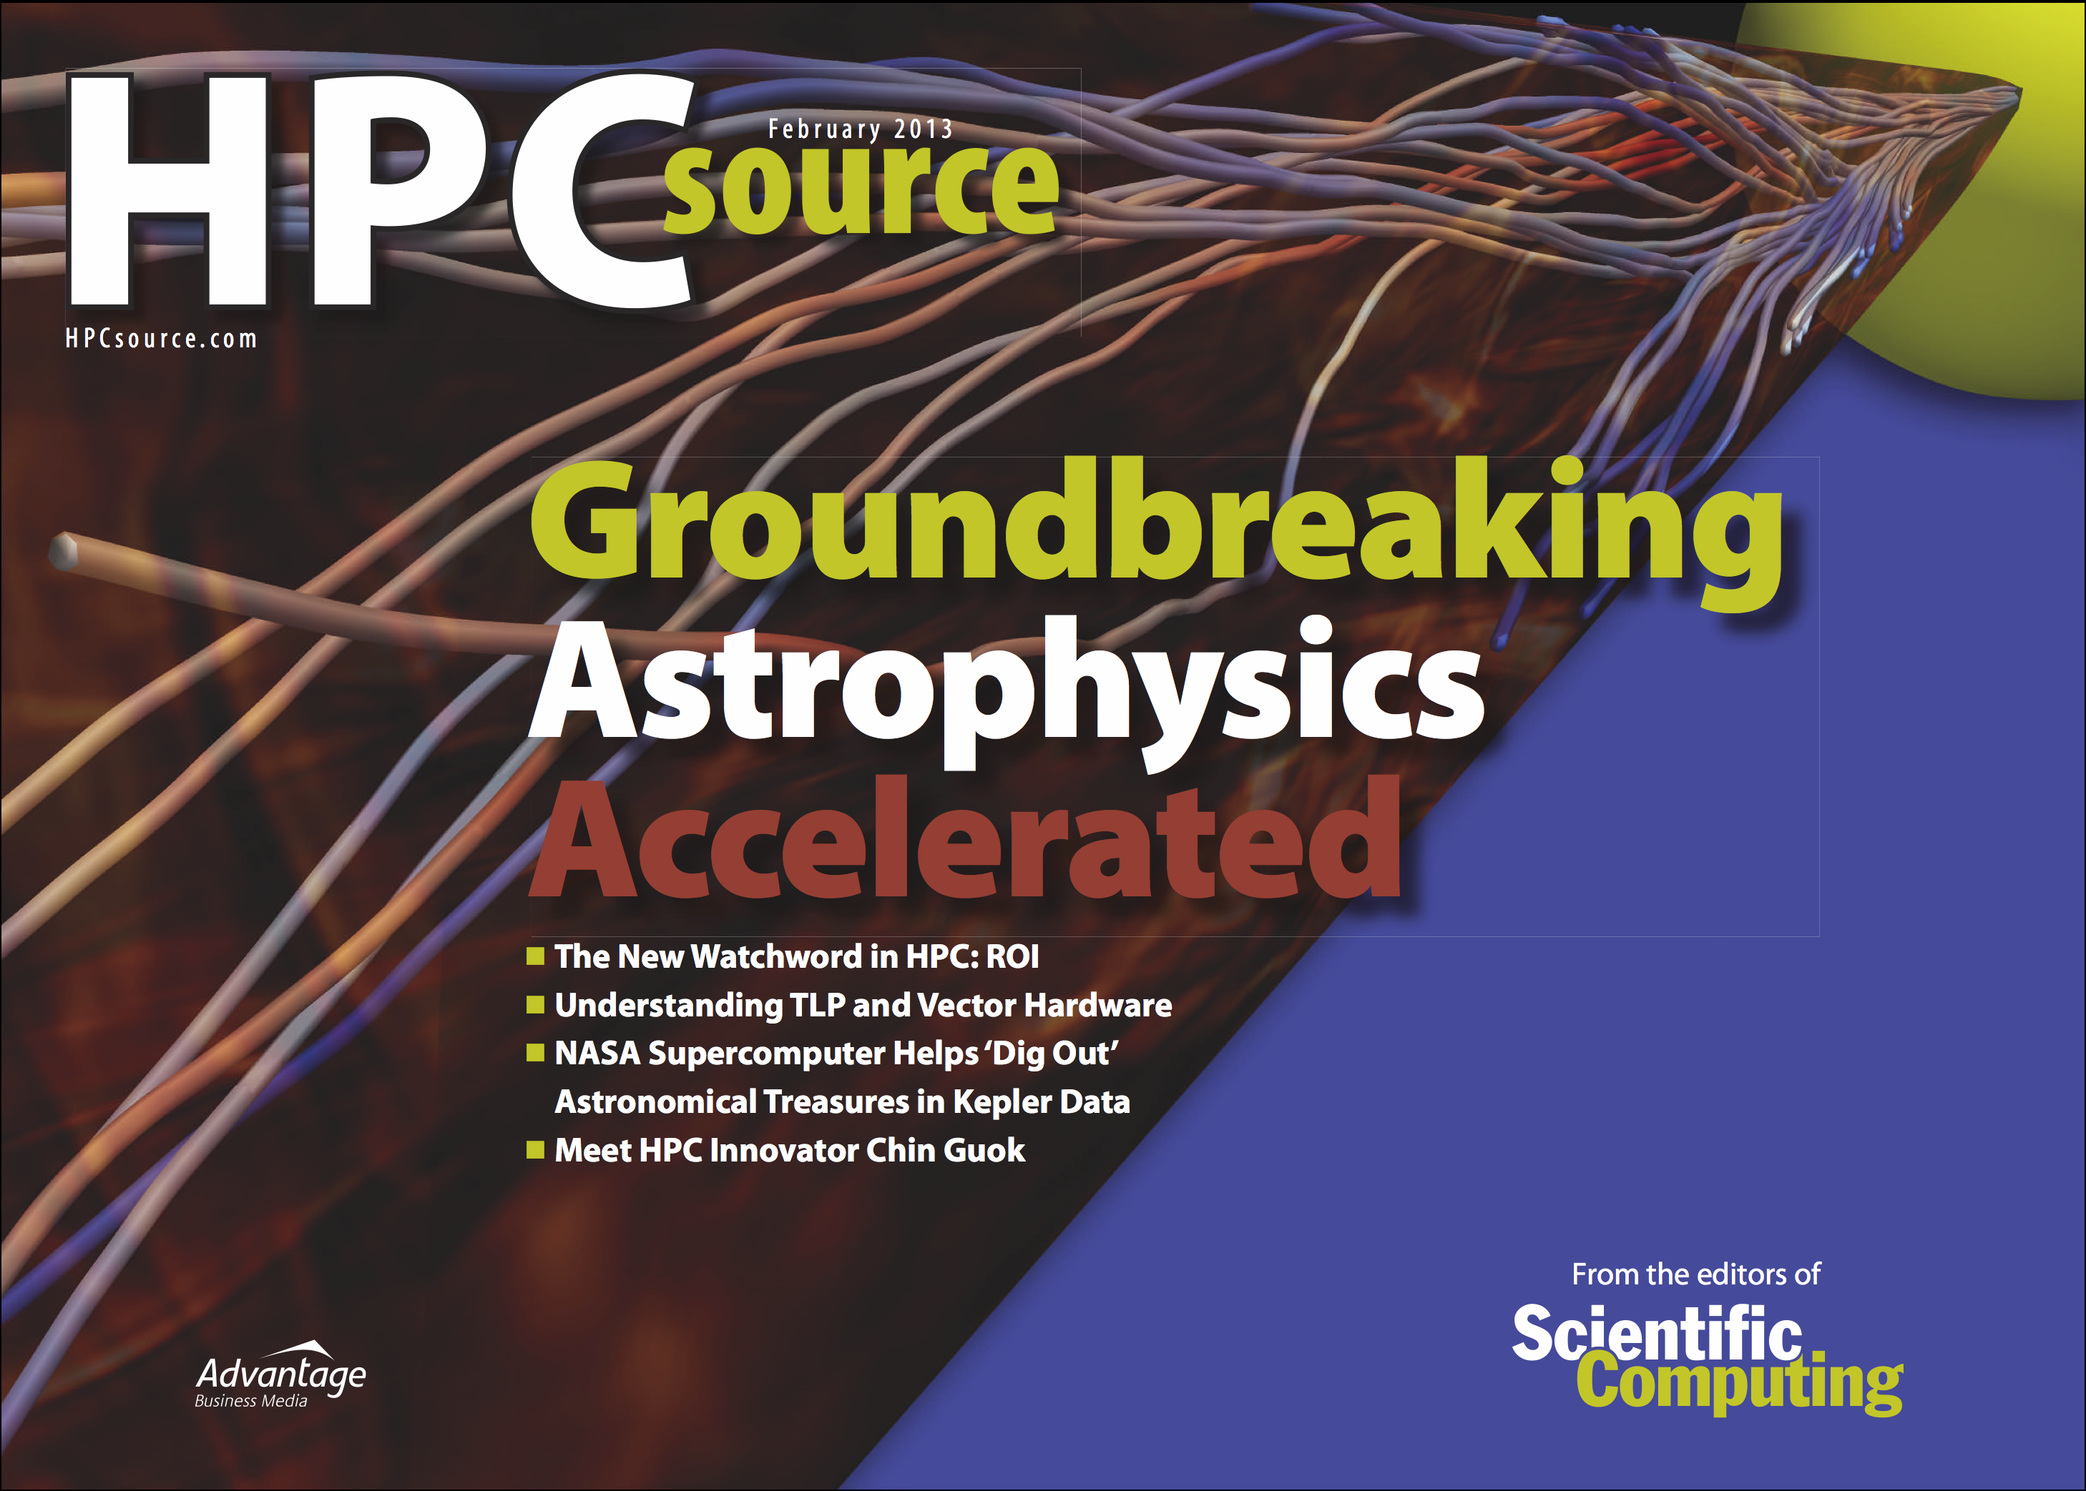
IRMHD on Intrepid and Mira
INCITE magnetohydrodynamcis simulation to understand solar winds and coronal heating
  First direct numerical simulations
  of Alfvén wave (AW) turbulence in
  extended solar atmosphere
  accounting for inhomogeneities
  Team
    University of New Hampshire
    (Jean Perez and Benjamin Chandran)
    ALCF (Tim Williams)
    University of Oregon (Sameer Shende)
IRMHD (Inhomogeneous Reduced Magnetohydrodynamics)
  Fortran 90 and MPI
  Excellent weak and strong scaling properties
  Tested and benchmarked on Intrepid and Mira
HPC Source article and ALCF news
https://www.alcf.anl.gov/articles/furthering-understanding-coronal-heating-and-solar-wind-origin

Slide 68

IRMHD Communication Analysis
Source-based (direct) instrumentation
MPI instrumentation and volume measurement
IRMHD exhibited significant synchronous communication bottlenecks
On 2,408 cores of BG/P:
  MPI_Send and MPI_Bcast
  take significant time
  Opportunities for
  communication/
  computation overlap
  Identified possible targets
  for computation improvements
MPI_Barrier
MPI_Send

Slide 69

IRMHD Optimization on Intrepid (BG/P)
On 2,408 cores, overall execution time reduced from 528.18 core hours to 70.8 core hours
(>7x improvement)
Non-blocking communication substrate
More efficient implementation of underlying FFT

Slide 70

IRMHD Optimization on MIRA (BG/Q)
Oversubscribe nodes: 32k ranks vs. 16k per node
Overall time improvement: 71.23% of original

Slide 71
Conclusion
Intuitive Performance Engineering

Slide 72

Downloads
http://tau.uoregon.edu
http://github.com/ParaToolsInc/taucmdr
http://www.hpclinux.com
Free download, open source, BSD license

Slide 73
















Acknowledgements
Department of Energy
  Office of Science
  Argonne National Laboratory
  Oak Ridge National Laboratory
  NNSA/ASC Trilabs (SNL, LLNL, LANL)
HPCMP DoD PETTT Program
National Science Foundation
  Glassbox, SI-2
University of Tennessee
    University of New Hampshire
      Jean Perez, Benjamin Chandran
University of Oregon
  Allen D. Malony, Sameer Shende
  Kevin Huck, Wyatt Spear
TU Dresden
  Holger Brunst, Andreas Knupfer
  Wolfgang Nagel
Research Centre Jülich
  Bernd Mohr
  Felix Wolf

Slide 74
Reference
Intuitive Performance Engineering

Slide 75
Online References
PAPI:
  PAPI documentation is available from the PAPI website:
  http://icl.cs.utk.edu/papi/
TAU:
  TAU Users Guide and papers available from the TAU website: http://tau.uoregon.edu/
VAMPIR:
  VAMPIR website:
  http://www.vampir.eu/
Scalasca:
  Scalasca documentation page:
  http://www.scalasca.org/
Eclipse PTP:
  Documentation available from the Eclipse PTP website:
  http://www.eclipse.org/ptp/

Slide 76
Compiling Fortran Codes with TAU
If your Fortran code uses free format in .f files (fixed is default for .f):
% export TAU_OPTIONS='-optPdtF95Opts="-R free" -optVerbose'
To use the compiler based instrumentation instead of PDT (source-based):
% export TAU_OPTIONS='-optCompInst -optVerbose'
If your Fortran code uses C preprocessor directives (#include, #ifdef, #endif):
% export TAU_OPTIONS='-optPreProcess –optVerbose'
To use an instrumentation specification file:
% export TAU_OPTIONS=
'-optTauSelectFile=select.tau -optVerbose -optPreProcess’
Example select.tau file
  BEGIN_INSTRUMENT_SECTION
  loops file="*" routine="#"
  memory file="foo.f90" routine=”#"
  io file="abc.f90" routine="FOO"
  END_INSTRUMENT_SECTION

Slide 77
Generate a PAPI profile with 2 or more counters
% export TAU_MAKEFILE=$TAU/Makefile.tau-bgqtimers-papi-mpi-pdt
% export TAU_OPTIONS=‘-optTauSelectFile=select.tau –optVerbose’
% cat select.tau
BEGIN_INSTRUMENT_SECTION
loops routine=“#”
END_INSTRUMENT_SECTION
% export PATH=$TAU_ROOT/bin:$PATH
% make F90=tau_f90.sh
(Or edit Makefile and change F90=tau_f90.sh)
%
% qsub --env TAU_METRICS=TIME:PAPI_FP_INS:PAPI_L1_DCM –n 4 –t 15 ./a.out
% paraprof -–pack app.ppk
Move the app.ppk file to your desktop.
% paraprof app.ppk
Choose Options -> Show Derived Metrics Panel -> “PAPI_FP_INS”, click “/”, “TIME”, click “Apply” and choose the derived metric.

Slide 78
Tracking I/O in static binaries
% export TAU_MAKEFILE=$TAU/Makefile.tau-bgqtimers-papi-mpi-pdt
% export PATH=$TAU_ROOT/bin:$PATH
% export TAU_OPTIONS=‘-optTrackIO –optVerbose’
% make CC=tau_cc.sh CXX=tau_cxx.sh F90=tau_f90.sh
% mpirun –n 4 ./a.out
% paraprof –pack ioprofile.ppk
% export TAU_TRACK_IO_PARAMS 1
% mpirun –n 4 ./a.out (to track parameters used in POSIX I/O calls as context events)

Slide 79
Installing and Configuring TAU
Installing PDT:
  wget http://tau.uoregon.edu/pdt.tgz
  ./configure –prefix=<dir>; make ; make install
Installing TAU:
  wget http://tau.uoregon.edu/tau.tgz
  ./configure -bfd=download -pdt=<dir> -papi=<dir> ...
  make install
Using TAU:
  export TAU_MAKEFILE=<taudir>/<arch>/lib/Makefile.tau-<TAGS>
  make CC=tau_cc.sh CXX=tau_cxx.sh F90=tau_f90.sh

Slide 80
Compile-Time Options (TAU_OPTIONS)
% tau_compiler.sh
  -optVerbose Turn on verbose debugging messages
  -optCompInst Use compiler based instrumentation
  -optNoCompInst Do not revert to compiler instrumentation if source instrumentation fails.
  ﻿-optTrackIO Wrap POSIX I/O call and calculates vol/bw of I/O operations
  ﻿-optMemDbg Runtime bounds checking (see TAU_MEMDBG_* env vars)
  -optKeepFiles Does not remove intermediate .pdb and .inst.* files
  -optPreProcess Preprocess sources (OpenMP, Fortran) before instrumentation
  -optTauSelectFile=”<file>" Specify selective instrumentation file for tau_instrumentor
  -optTauWrapFile=”<file>" Specify path to link_options.tau generated by tau_gen_wrapper
  -optHeaderInst Enable Instrumentation of headers
  -optTrackUPCR Track UPC runtime layer routines (used with tau_upc.sh)
  -optPdtF95Opts="" Add options for Fortran parser in PDT (f95parse/gfparse) …

Slide 81
Runtime Environment Variables
Environment Variable | Default | Description
TAU_TRACE | 0 | Setting to 1 turns on tracing
TAU_CALLPATH | 0 | Setting to 1 turns on callpath profiling
TAU_TRACK_MEMORY_LEAKS | 0 | Setting to 1 turns on leak detection (for use with –optMemDbg or tau_exec)
TAU_MEMDBG_PROTECT_ABOVE | 0 | Setting to 1 turns on bounds checking for dynamically allocated arrays. (Use with –optMemDbg or tau_exec –memory_debug).
TAU_CALLPATH_DEPTH | 2 | Specifies depth of callpath. Setting to 0 generates no callpath or routine information, setting to 1 generates flat profile and context events have just parent information (e.g., Heap Entry: foo)
TAU_TRACK_IO_PARAMS | 0 | Setting to 1 with –optTrackIO or tau_exec –io captures arguments of I/O calls
TAU_TRACK_SIGNALS | 0 | Setting to 1 generate debugging callstack info when a program crashes
TAU_COMM_MATRIX | 0 | Setting to 1 generates communication matrix display using context events
TAU_THROTTLE | 1 | Setting to 0 turns off throttling. Enabled by default to remove instrumentation in lightweight routines that are called frequently
TAU_THROTTLE_NUMCALLS | 100000 | Specifies the number of calls before testing for throttling
TAU_THROTTLE_PERCALL | 10 | Specifies value in microseconds. Throttle a routine if it is called over 100000 times and takes less than 10 usec of inclusive time per call
TAU_COMPENSATE | 0 | Setting to 1 enables runtime compensation of instrumentation overhead
TAU_PROFILE_FORMAT | Profile | Setting to “merged” generates a single file. “snapshot” generates xml format
TAU_METRICS | TIME | Setting to a comma separated list generates other metrics. (e.g., TIME:P_VIRTUAL_TIME:PAPI_FP_INS:PAPI_NATIVE_<event>\\:<subevent>)

