Slide 1
ParaTools ThreadSpotter
ParaTools, Inc.
John C. Linford et al.
jlinford@paratools.com
Army HPC User Group Review
18 May 2017, ARL

Slide 2
ParaTools ThreadSpotter
Shrinking cache memory per core is causing some applications to spend over half their runtime waiting for data to arrive in cache.
ThreadSpotter can:
  Analyze memory bandwidth and latency, data locality and thread communications.
  Identify specific issues and pinpoints troublesome areas in source code.
  Provide guidance towards a resolution.
Supports mixed language distributed memory applications like CREATE-AV HELIOS and KESTREL.
  Integrates with the TAU Performance System®.

Slide 3
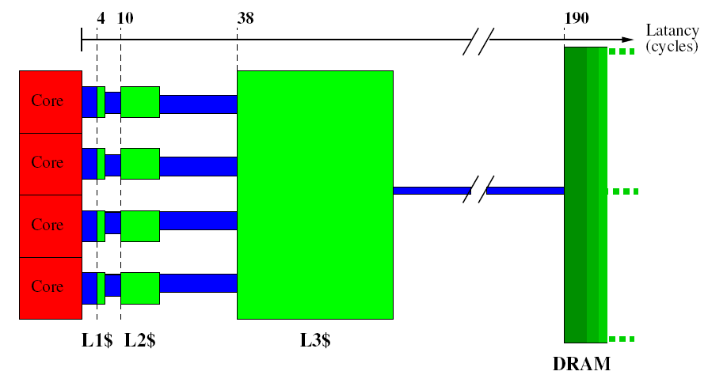
Cache Capacity/Latency/BW
Latency
(cycles)

Slide 4
Intel i7
QuickPath Interconnect (QPI)
4 x DDR-3
L3 $ 24MB
X-bar
L2 $
256kB
L2 $
256kB
L2 $
256kB
L2 $
256kB
L2 $
256kB
...
D$
64kB
I$
64kB
D$
64kB
I$
64kB
D$
64kB
I$
64kB
D$
64kB
I$
64kB
D$
64kB
I$
64kB
CPU, 2 thr
CPU, 2 thr.
CPU, 2 thr.
CPU, 2 thr.
CPU
8 cores x 2 threads

Slide 5
Typical Cache Implementation
Cacheline, here 64B:
AT
S
Data = 64B
Generic Cache:
SRAM:
C
MSB LSB
Addr [63..0]
L3 $ 24MB
tag
index
Cache Set:
Associativity = 8-way
L2 $
256kB
...
D1 ¢
64kB
I1 ¢
64kB
Hit
Sel way ”6”
mux
Data = 64B

Slide 6
ThreadSpotter Reports
Army HPC User Group Review

Slide 7
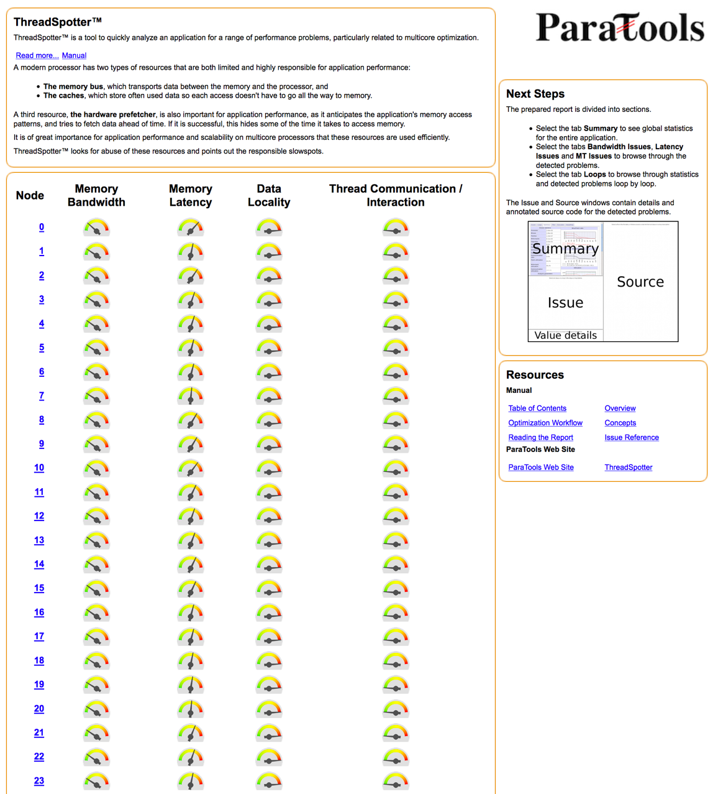
Report Index for 2040 MPI Ranks

Slide 8
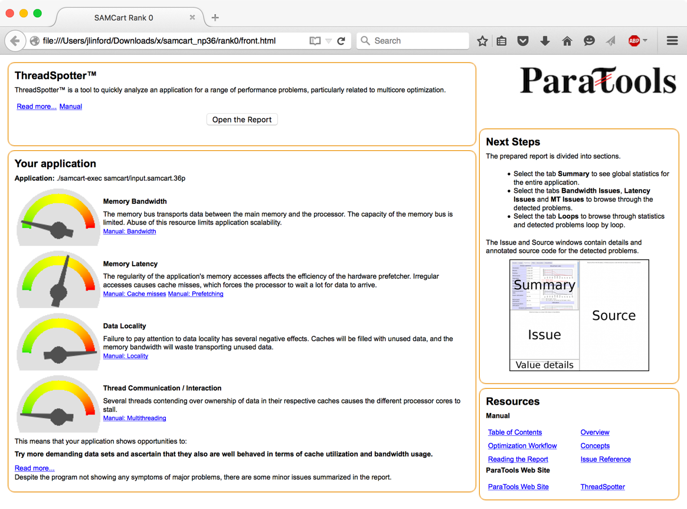
Report Cover page
No memory bandwidth issues
Data locality issues identified

Slide 9
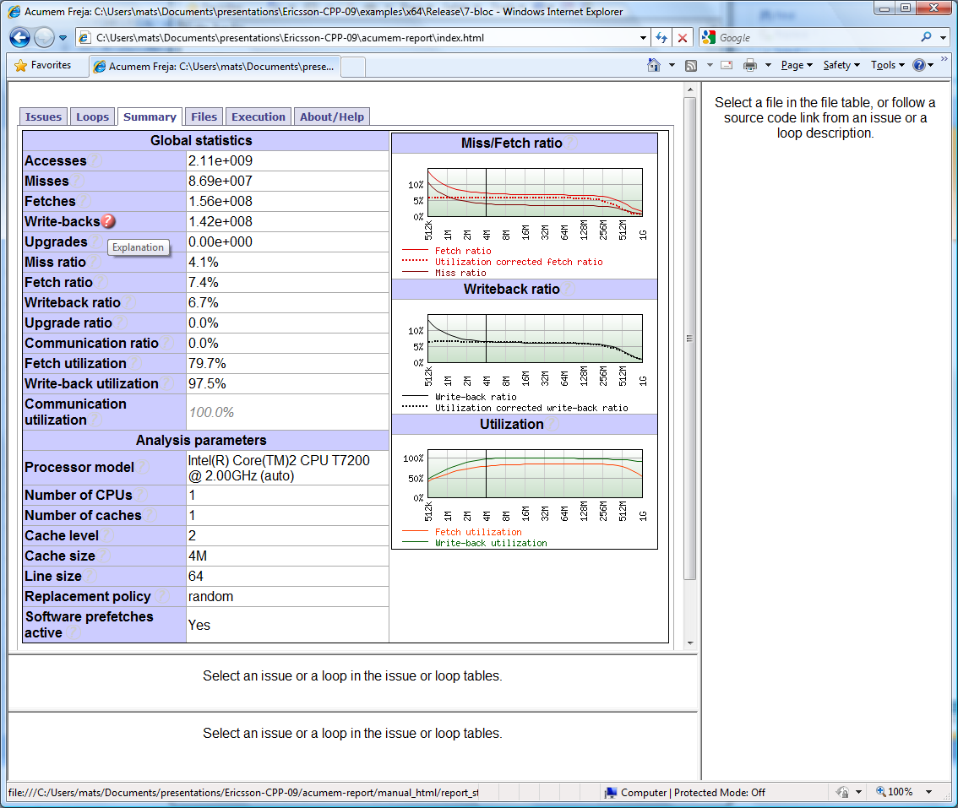
Global statistics

Slide 10
ThreadSpotter Concepts
Issue
  A problem or opportunity to improve performance
  Presented with backing statistics and source navigation
  Online help to explain details
Loop
  An instruction cycle usually corresponding to a code loop
Instruction group
  A collection of instructions touching related data

Slide 11
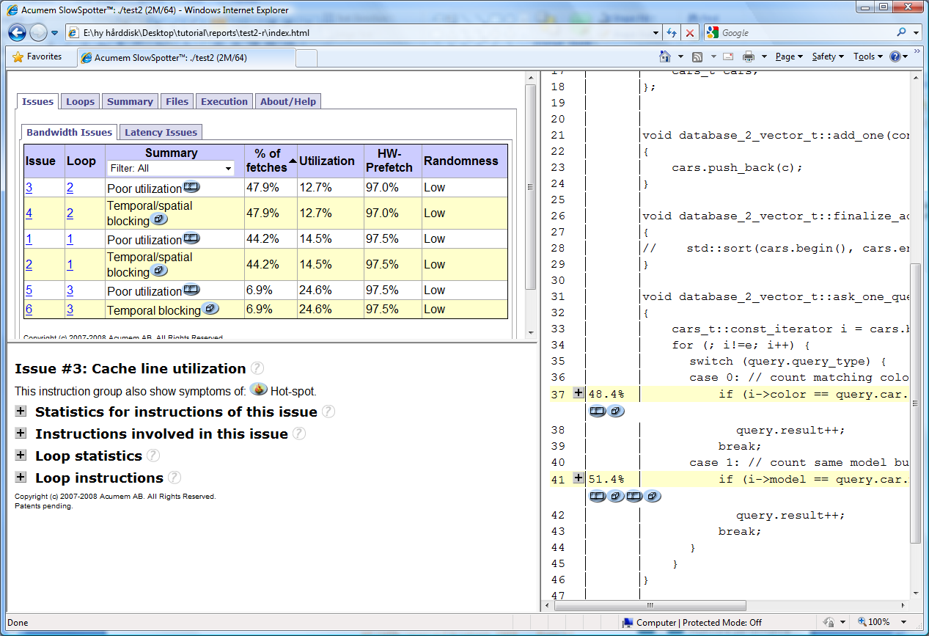
ParaTools ThreadSpotter report: Issues

Slide 12
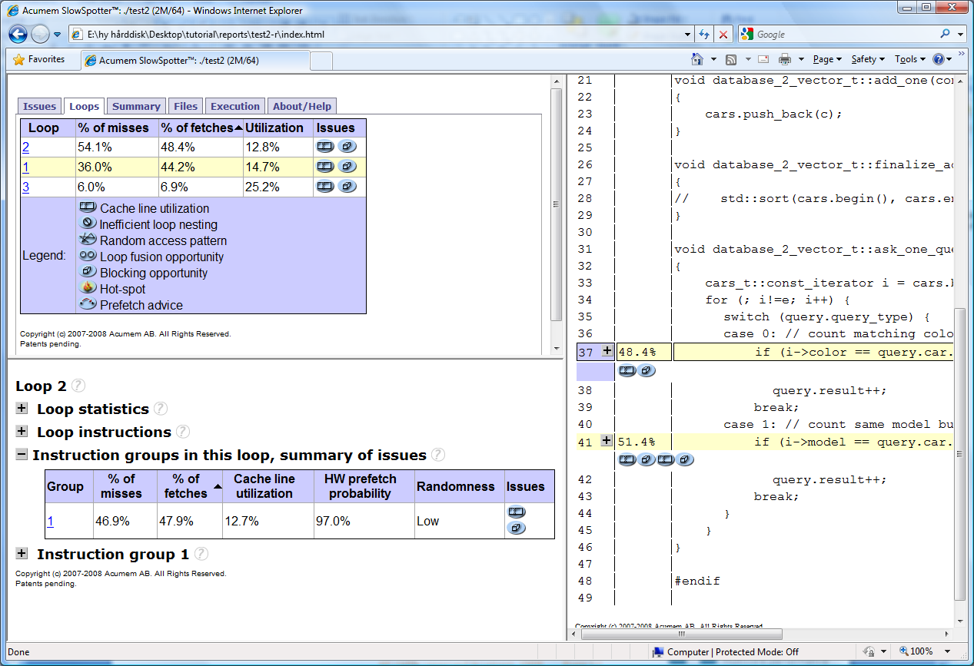
ParaTools ThreadSpotter report: Loops

Slide 13
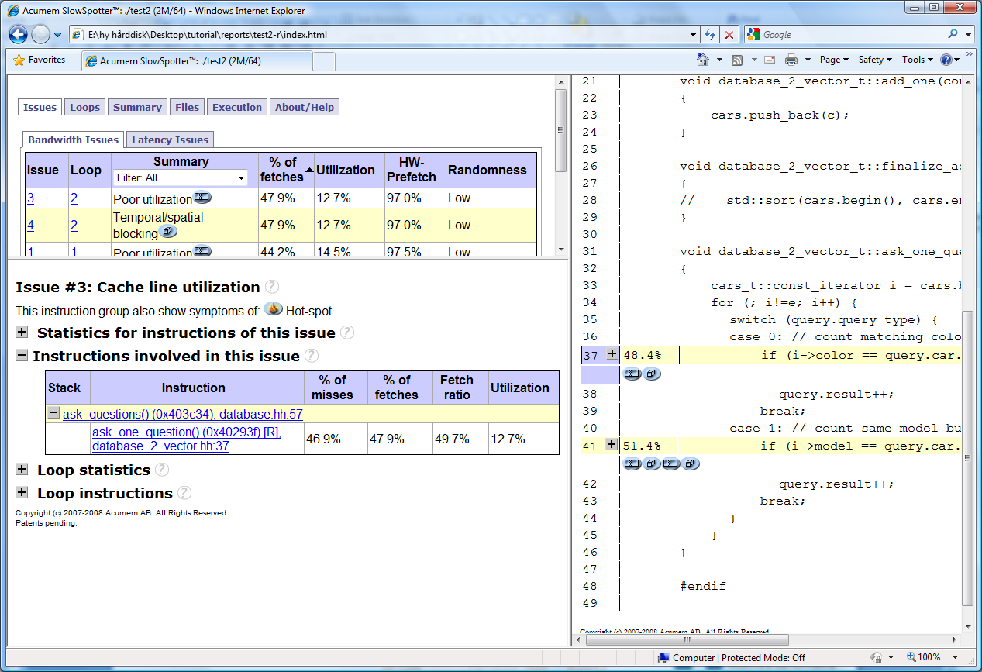
ParaTools ThreadSpotter report: Details

Slide 14
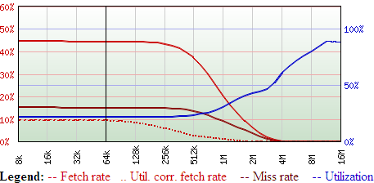
Metrics as a function of cache size
Fetch ratio
  Memory operations
  that cause a data transfer to/from RAM
Miss ratio
  Memory operations that stall due to cache misses.
Fetch utilization
  Fraction of the data loaded into the cache that are actually used

Slide 15
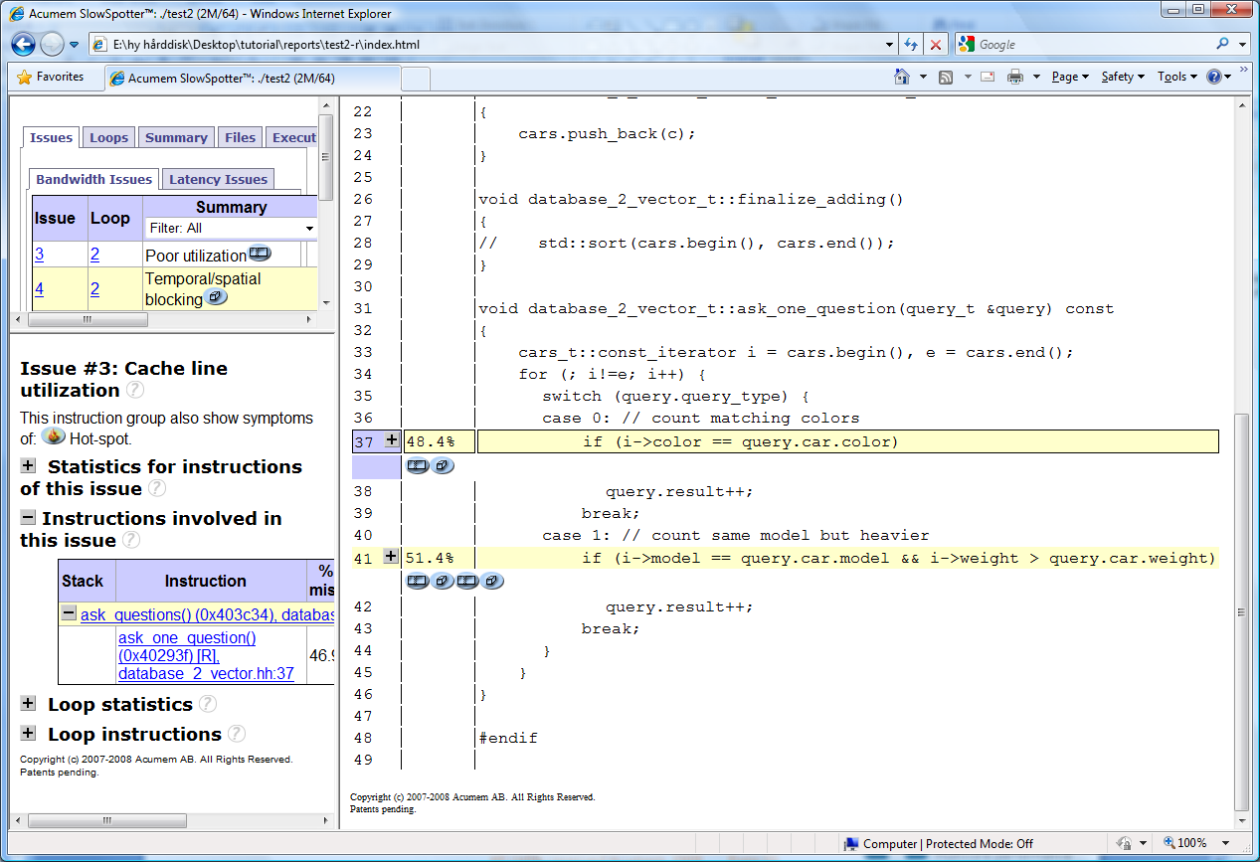
ParaTools ThreadSpotter report: Source annotation

Slide 16
Report Vocabulary
Miss ratio: What is the likelihood that a memory access will miss in a cache?
Miss rate: Misses per unit, e.g. per-second or
per-1000-instructions
Fetch ratio/rate: What is the likelihood that a memory access will cause a fetch to the cache (including HW prefetching)
Fetch utilization: What fraction of a cacheline was used before it got evicted
Writeback utilization: What fraction of a cacheline written back to memory contains dirty data
Communication utilization: What fraction of a communicated cacheline is ever used?

Slide 17
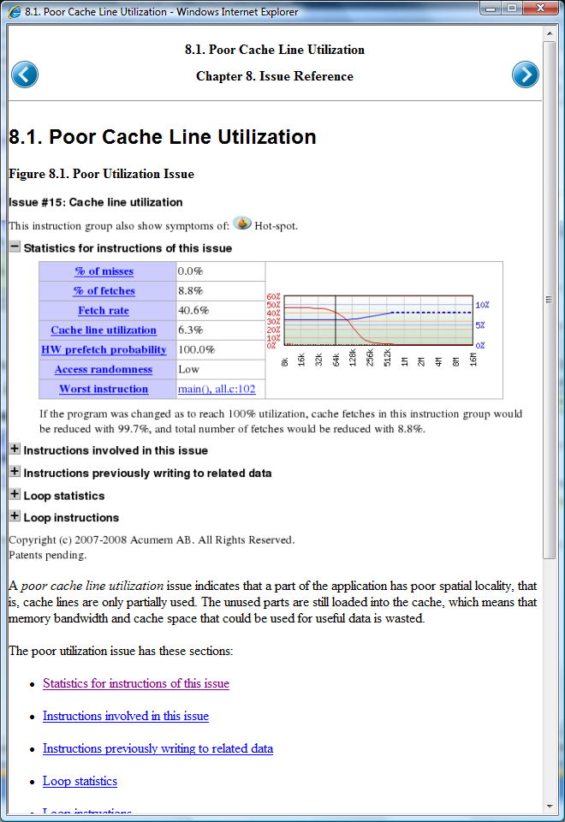
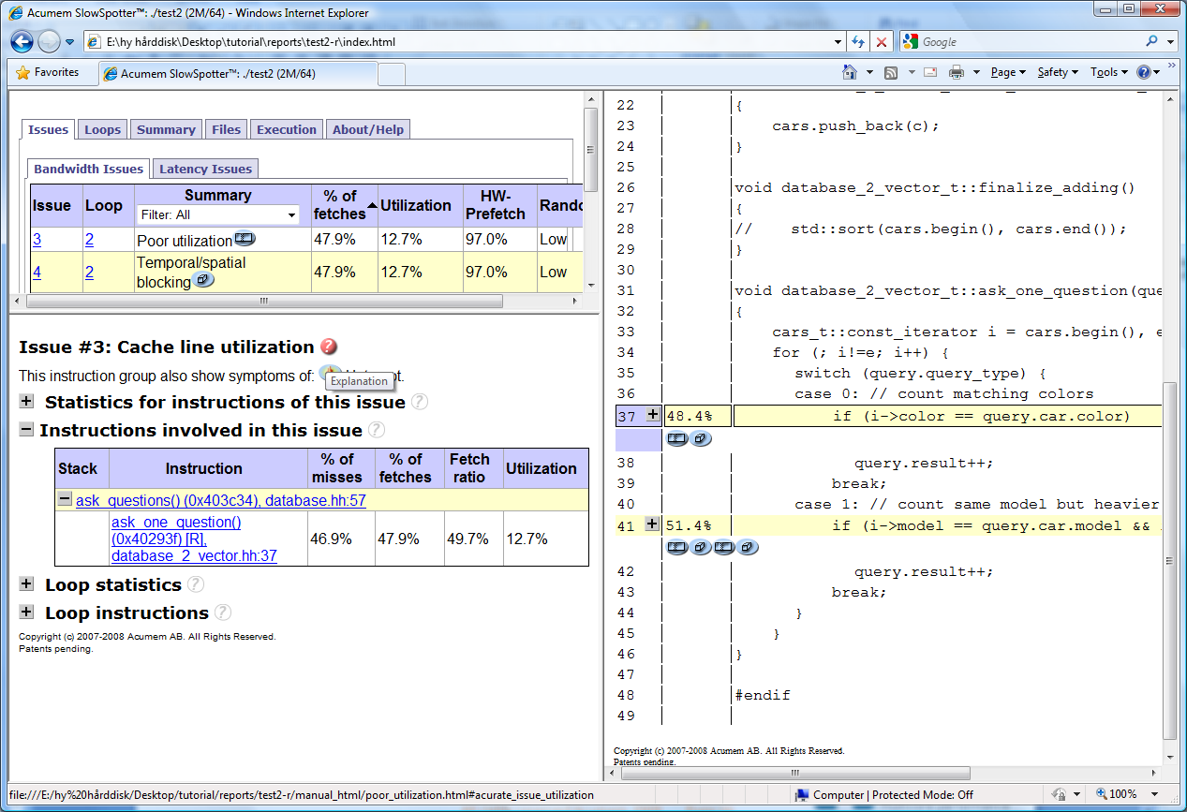
ParaTools ThreadSpotter report: help

Slide 18
Example: Temporal Blocking
Army HPC User Group Review
Gaussian Elimination with Pivoting

Slide 19
Overview of the forward elimination stage
for i=1 to n-1
find pivotPos in column i
if pivotPos ≠ i
exchange rows(pivotPos,i)
end if
for j=i+1 to n
A(i,j) = A(i,j)/A(i,i)
end for j
for j=i+1 to n+1
for k=i+1 to n
A(k,j)=A(k,j)-A(k,i)×A(i,j)
end for k
end for j
end for i
!$omp parallel do private ( i ,j )

Slide 20
First approach speed up
nThreads
ParaTools ThreadSpotter report

Slide 21
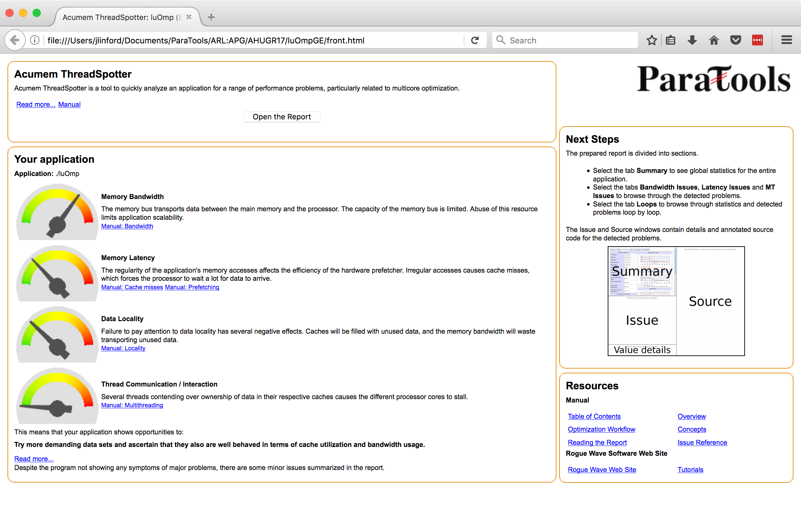

Slide 22
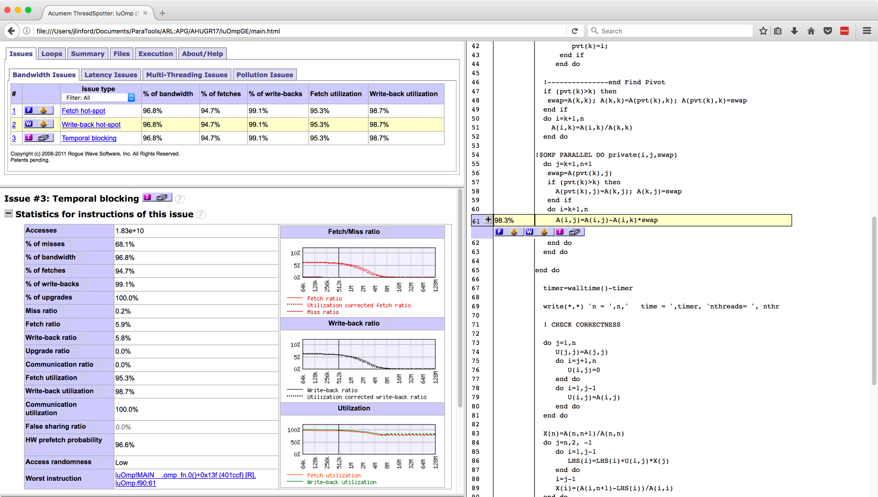

Slide 23
What went wrong!
For each prepared pivot, the whole matrix is accessed. The algorithm requires pivots to be calculated in order.
Repeated eviction of the matrix’ cache lines.

Slide 24
What went wrong!
For each prepared pivot, the whole matrix is accessed. The algorithm requires pivots to be calculated in order.
Repeated eviction of the matrix’ cache lines.
Making things right!
Observation: Each column is an accumulation of eliminations using previous columns!
Temporal Blocking Advice says:
  Use each column many times before it gets evicted
  → Arrange code to make more pivots available!

Slide 25
Blocking GE
for k=1 to n-1, step C
BlockEnd=min(k+C-1,n)
GE on A(k:n,k:BlockEnd) &
Store C pivots’ positions
for each column j after BlockEnd
for i=k to BlockEnd
swap using pivots(i)
elimination i on j
end for i
end for each j
End for k
The row exchange turned into a two- element swap before column elimination
1
Pivots array
!$omp parallel do private ( i ,j )
2
C
C
Rest of columns

Slide 26
Speed up w.r.t sequential time
6.22x
nThreads

Slide 27
Command Line Usage
Army HPC User Group Review

Slide 28
PTTS Integration with TAU
tau_exec --ptts
  Sampling (sample_ts)
    Generates sample files named ptts/sample.#.smp
  Issue Identification (report_ts)
    Generates report files named ptts/report.#.tsr
  Reporting (view-static_ts )
    Generates node_# directories with html reports
Each rank produces log files for each step
  sample_ts.#.log, report_ts.#.log, and view-static_ts.#.log

Slide 29
PTTS Integration with TAU
Flag | Description
-ptts | Use PTTS to generate performance data.
-ptts-post | Skip application sampling and post-process existing sample files. Useful for analyzing performance at each cache layer, or predicting performance on other architectures.
-ptts-num=<N> | Indicate number of MPI ranks if the size of the MPI communicator cannot be automatically detected, e.g. on Cray.
-ptts-sample-flags=<flags> | Additional flags to pass to the sample_ts command. Can also be specified in the TAU_TS_SAMPLE_FLAGS environment variable.
-ptts-report-flags=<flags> | Additional flags to pass to the report_ts command. Can also be specified in the TAU_TS_REPORT_FLAGS environment variable.

Slide 30
Sampler settings: Start & Stop
Controlling when to start and stop sampling
Start conditions
  delay, -d <seconds>
  --start-at-function <function name>
  --start-at-address <0x1234123>
  --start-at-ignore <pass count>
Stop conditions
  Duration, -t <seconds>
  --stop-at-function <function name>
  --stop-at-address <0x123123>
  --stop-at-ignore <pass count>

Slide 31
Report settings: Issue selection
depth
  How long call stack to consider while differentiating instructions
  --depth 0 – just consider the PC
  --depth 1 – consider the PC and the site which called this function
percentage
  cutoff. Suppress uninteresting issues
  --percentage 3 (% of fetches)

Slide 32
Report settings: Source/debug
source directory – look for source in other places
  Useful if the directories are not recorded in the debug information
  -s directory
binary – look for binaries (containing debug information in other places)
  Useful if the binary has moved since sampling
  -b path-to-actual-binary
debug directory (for debug information stored external to the elf file)
  -D directory
debug level (varying degree of information)
  --debug-level 0-3

