Slide 1
TAU Commander
Hands On Exercises
Dr. John C. Linford
ParaTools, Inc.
jlinford@paratools.com
Dr. John Wohlbier
Engility Corp.
John.Wohlbier.ctr@engilitycorp.com
KNL Workshop
25 April 2017, ARL, Aberdeen, MD

Slide 2
MINIAPP 1 Code Structure
do sweep = 1, n_sweeps
do color = sweep_start, sweep_end, sweep_stride
do ipass = 1, 2
start = color_indices(1,color)
end = color_boundary_end(color)
do n = start, end
istart = iam(n)
iend = iam(n+1)-1
f(1:5) = (+/-)res(1:5)
do j = istart, iend
icol = jam(j)
do i = 1, 5
f(1:5) = f(1:5) - a_off(1:5,i,j)*dq(i,icol)
end do
Unknown loop trip count
Low FLOP vector(5) kernel
Indirect index

Slide 3
MINIAPP 1 Kernel Unrolled
do j = istart,iend
icol = jam(j)
f1 = f1 - a_off(1,1,j)*dq(1,icol)
f2 = f2 - a_off(2,1,j)*dq(1,icol)
f3 = f3 - a_off(3,1,j)*dq(1,icol)
f4 = f4 - a_off(4,1,j)*dq(1,icol)
f5 = f5 - a_off(5,1,j)*dq(1,icol)
f1 = f1 - a_off(1,2,j)*dq(2,icol)
f2 = f2 - a_off(2,2,j)*dq(2,icol)
f3 = f3 - a_off(3,2,j)*dq(2,icol)
f4 = f4 - a_off(4,2,j)*dq(2,icol)
f5 = f5 - a_off(5,2,j)*dq(2,icol)
f1 = f1 - a_off(1,3,j)*dq(3,icol)
f2 = f2 - a_off(2,3,j)*dq(3,icol)
f3 = f3 - a_off(3,3,j)*dq(3,icol)
f4 = f4 - a_off(4,3,j)*dq(3,icol)
f5 = f5 - a_off(5,3,j)*dq(3,icol)
f1 = f1 - a_off(1,4,j)*dq(4,icol)
f2 = f2 - a_off(2,4,j)*dq(4,icol)
f3 = f3 - a_off(3,4,j)*dq(4,icol)
f4 = f4 - a_off(4,4,j)*dq(4,icol)
f5 = f5 - a_off(5,4,j)*dq(4,icol)
f1 = f1 - a_off(1,5,j)*dq(5,icol)
f2 = f2 - a_off(2,5,j)*dq(5,icol)
f3 = f3 - a_off(3,5,j)*dq(5,icol)
f4 = f4 - a_off(4,5,j)*dq(5,icol)
f5 = f5 - a_off(5,5,j)*dq(5,icol)
end do
do j = istart, iend
icol = jam(j)
do i = 1, 5
f(1:5) = f(1:5) - a_off(1:5,i,j)*dq(i,icol)
end do
56 Loads
26 Stores
50 FP-ops
  Fused to 25
~0.17 FP-ops / byte
  Fused: 0.083 FP-ops / byte

Slide 4
ARL’s KNL System
Utility server as a SSH gateway
$ ssh -Y -K us.arl.hpc.mil
$ ssh -Y knl01
Show available SLURM partitions
$ sinfo
Start an interactive job
$ srun --pty -p pettt-qf $SHELL

Slide 5
ARL’s KNL System
Submit a batch job
$ sbatch script.sh
#!/bin/bash
#SBATCH --partition=quadrant-flat
cd $HOME/FUN3D_Miniapp1
module load intel intelmpi
numactl -m 1 ./point_solve

Slide 6
TAU Commander on ARL’s KNL
$ module load intel intelmpi
$ export PATH=\
$PET_HOME/pkgs/taucmdr-latest/bin:$PATH
This path works on nearly all DSRC systems

Slide 7
TAU Commander on Thunder
$ ssh -Y thunder.afrl.hpc.mil
$ export PATH=\
$PET_HOME/pkgs/taucmdr-latest/bin:$PATH

Slide 8
Getting Started with TAU Commander
tau init [options | --help]
tau <<your compiler>> foo.c
  e.g. tau mpif90 foo.f90
tau mpirun -np 8 ./a.out
Online Help
tau --help
tau help <something>

Slide 9
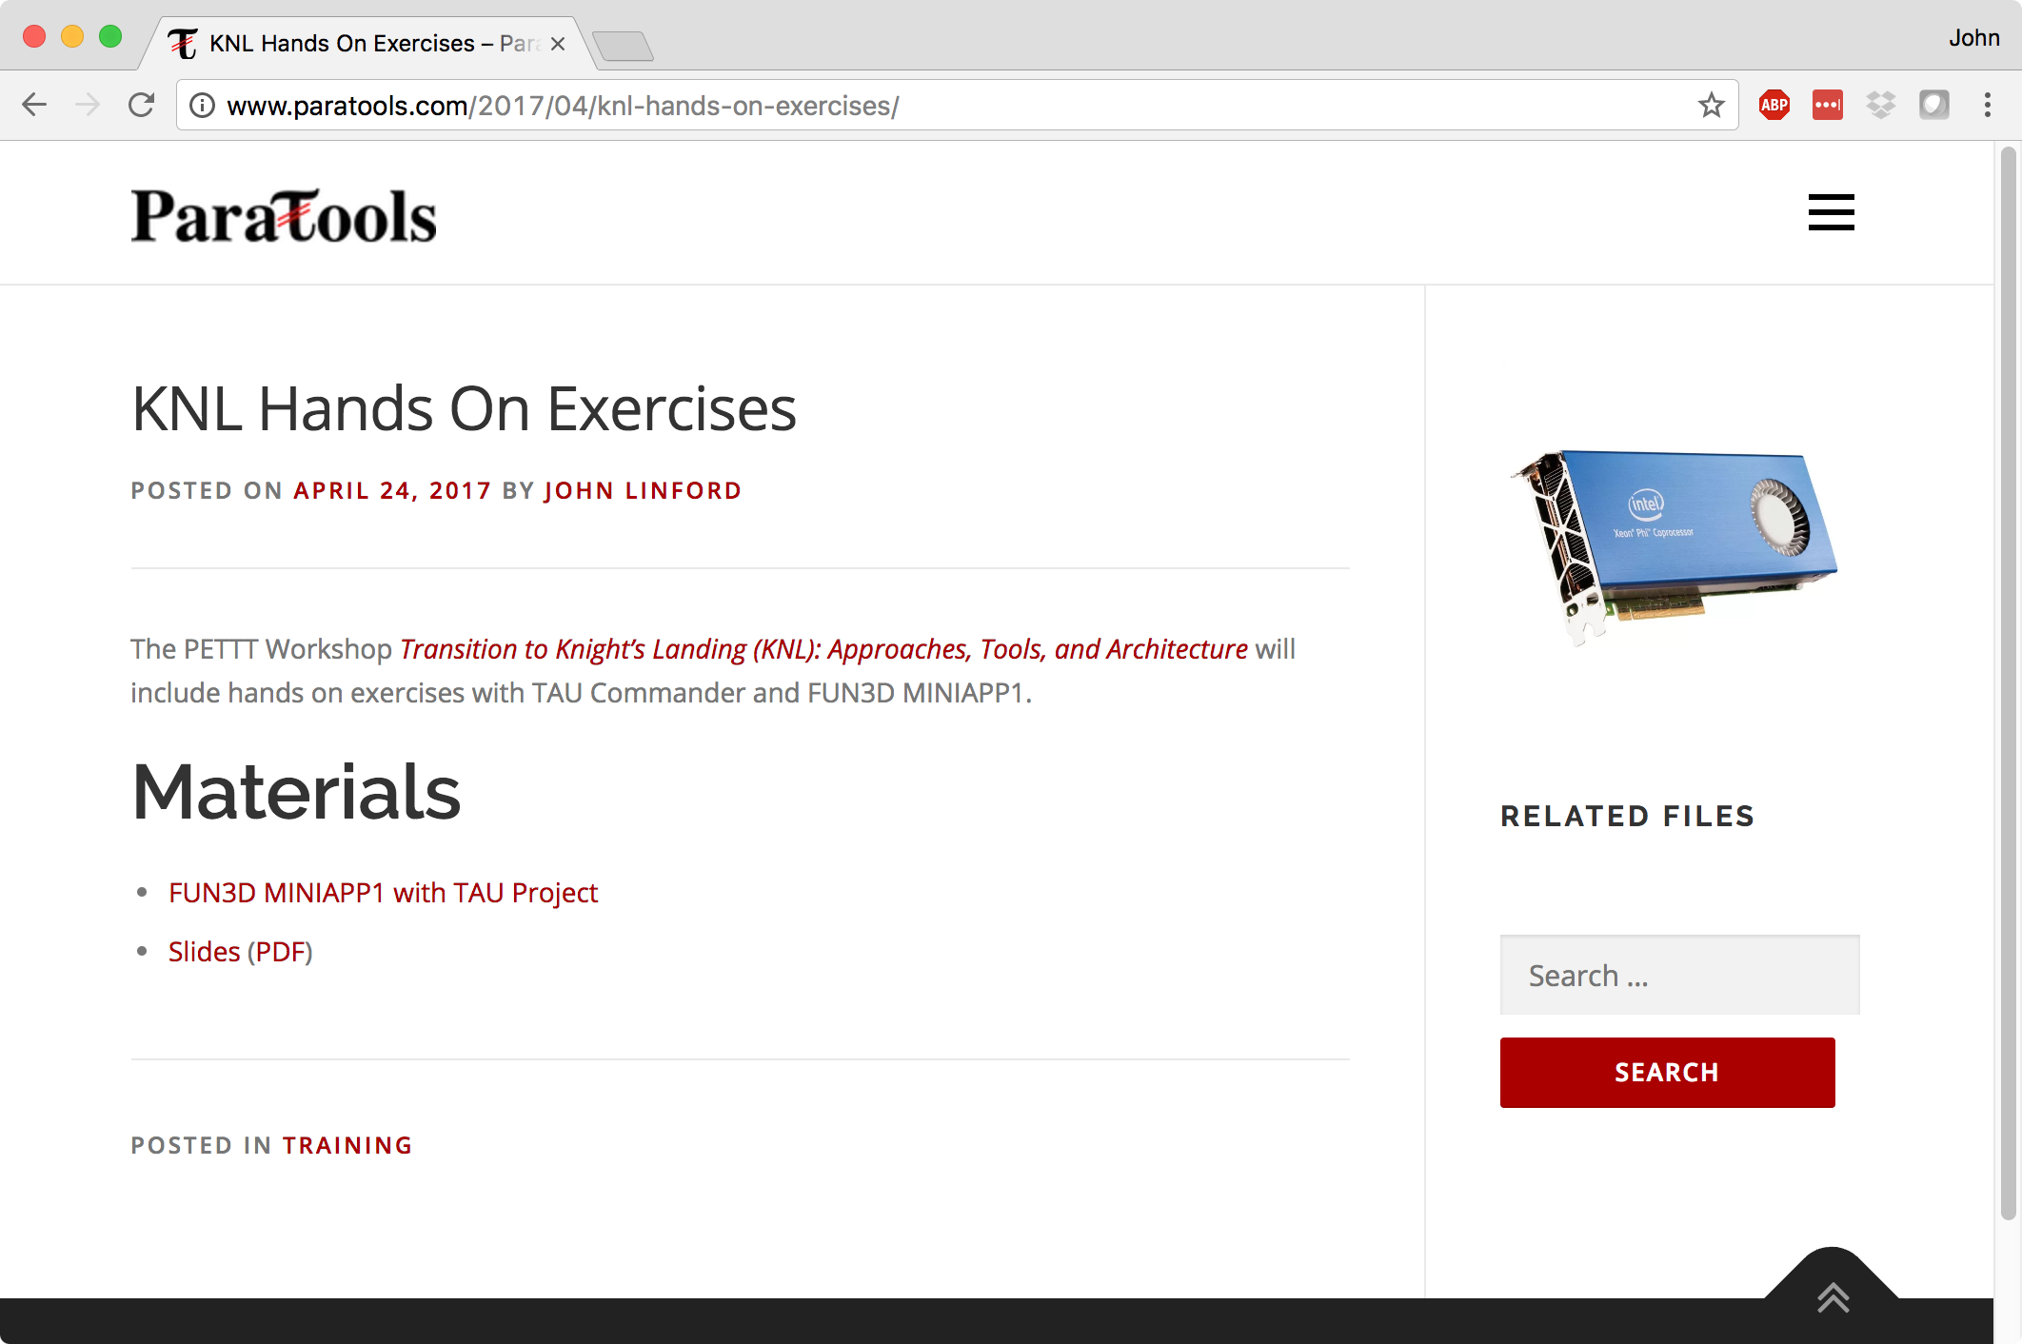
Workshop Materials
http://www.paratools.com/knl-hands-on-exercises/

Slide 10
Initialize the TAU Project
Workshop materials on KNL:
$ tar xzf $PET_HOME/pkgs/FUN3D_Miniapp1.tgz
Download from paratools.com if on another system
$ cd FUN3D_Miniapp1/
$ tau initialize --arch KNL
x86_64 on Thunder,
or don’t use --arch

Slide 11
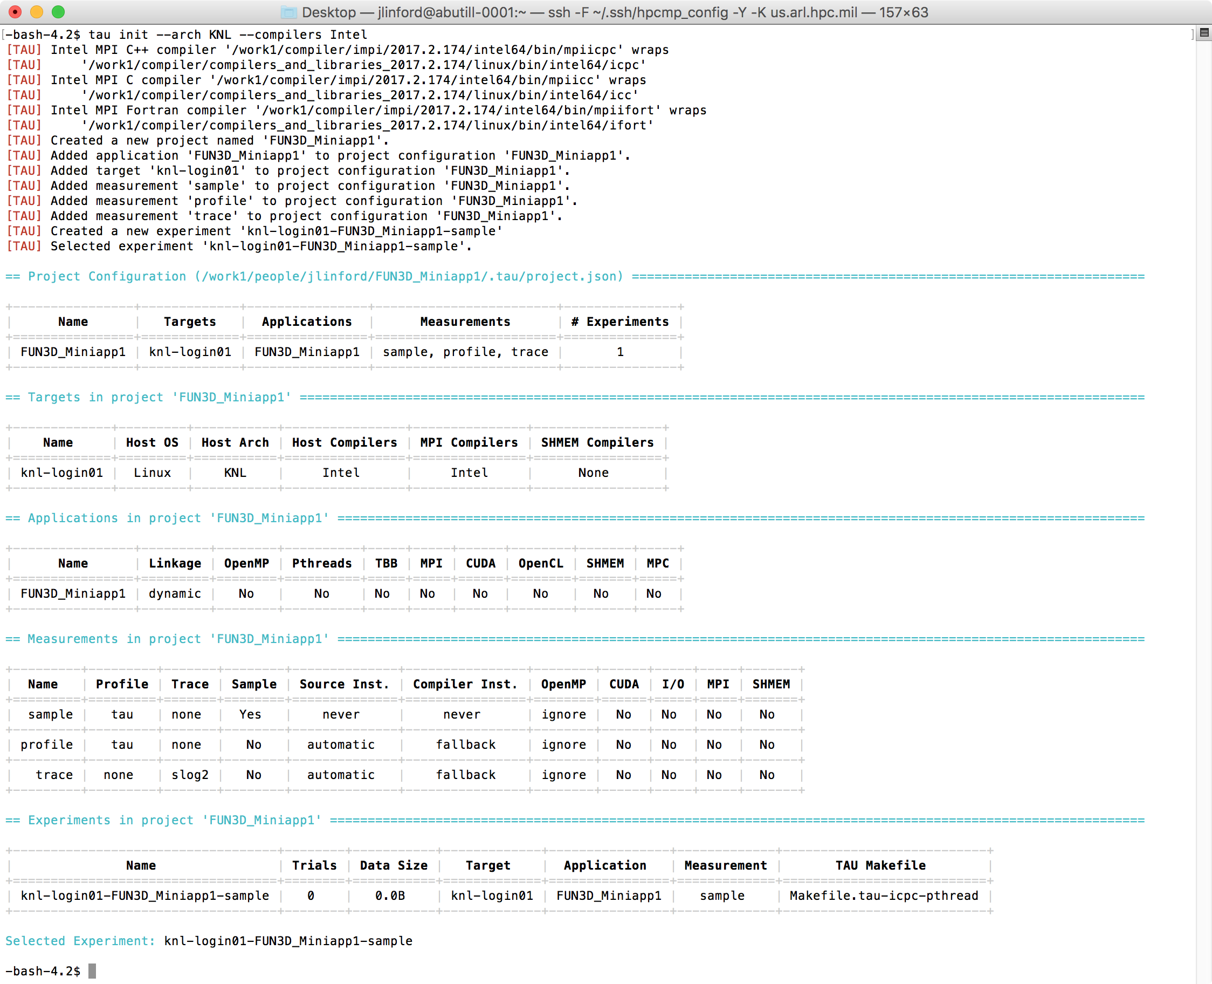
Default TAU Project for Miniapp 1

Slide 12
Modify project if needed
$ tau target --help
usage: tau target <subcommand> [arguments]
Create and manage target configurations.
Positional Arguments:
<subcommand> See 'subcommands' below.
[arguments] Arguments to be passed to <subcommand>.
Optional Arguments:
-h, --help Show this help message and exit.
Subcommands:
copy Copy and modify target configurations.
create Create target configurations.
delete Delete target configurations.
edit Modify target configurations.
list Show target configuration data.
metrics Show metrics available on this target.
See 'tau target <subcommand> --help' for more information on <subcommand>.
$ tau target edit knl-login01 --new-name knl

Slide 13
Use `tau` to compile
$ cd baseline
$ vi Makefile
1 # Fortran Compiler
2 FC = tau ifort
3 #FC = mpif90
4
...
16
17 # Program name(s)
18 PROGRAMS = point_solve
19
20 .PHONY: all clean run
21
22 all: $(PROGRAMS)
23
24 run: all
25 tau ./point_solve
26
Prepend `tau` command
Prepend `tau` command

Slide 14
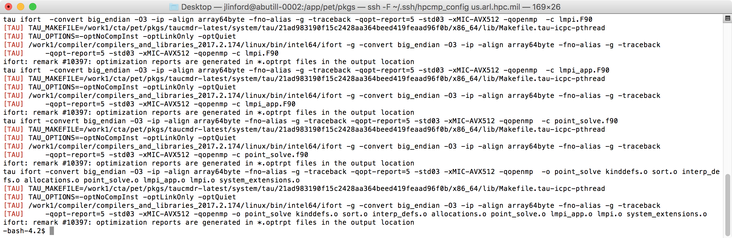
Use `tau` to compile
$ make
TAU Commander constructs a new command line to match the selected experiment.
  May replace compiler commands with TAU’s compiler wrapper scripts.
  May set environment variables, parse configuration files, etc.
  If no changes are required then nothing is changed.

Slide 15
Use `tau` to run
$ pwd
~/FUN3D_Miniapp1/baseline
$ srun --pty -p pettt-qf $SHELL
Or, on Thunder
$ qsub -A <proj> -l ncpus=36 -q debug \
-l walltime=00:30:00 -I
$ tau ./point_solve
Same on all platforms: X86_64, KNL, PowerPC…

Slide 16
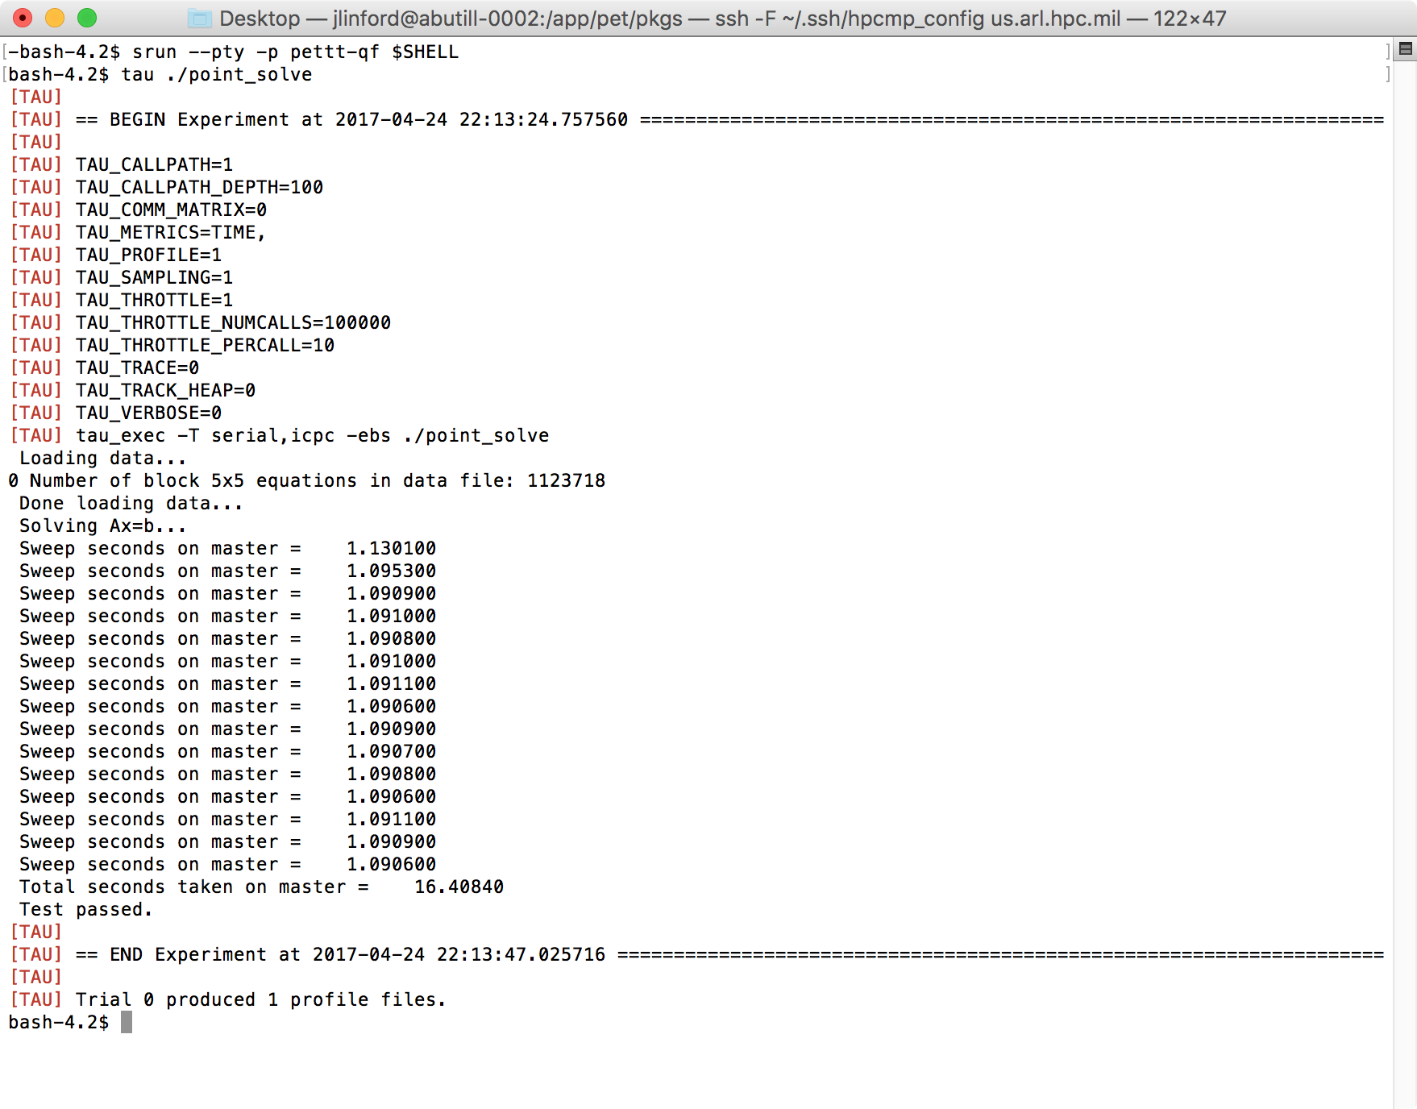
Miniapp 1 Output with TAU
Tracks experiment metadata
Sets appropriate environment variables
Stores generated data in a performance database.

Slide 17
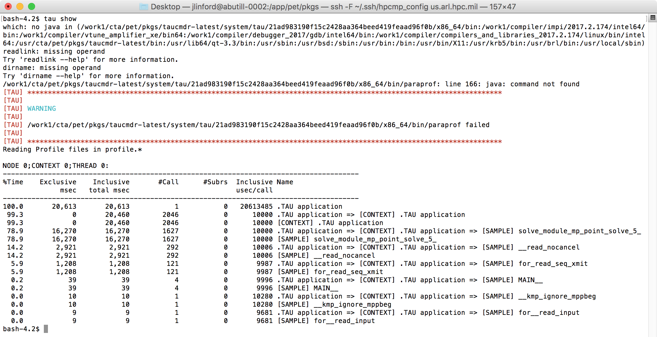
Use `tau` to view data
$ tau show
No java on compute nodes
Fall back to console output

Slide 18
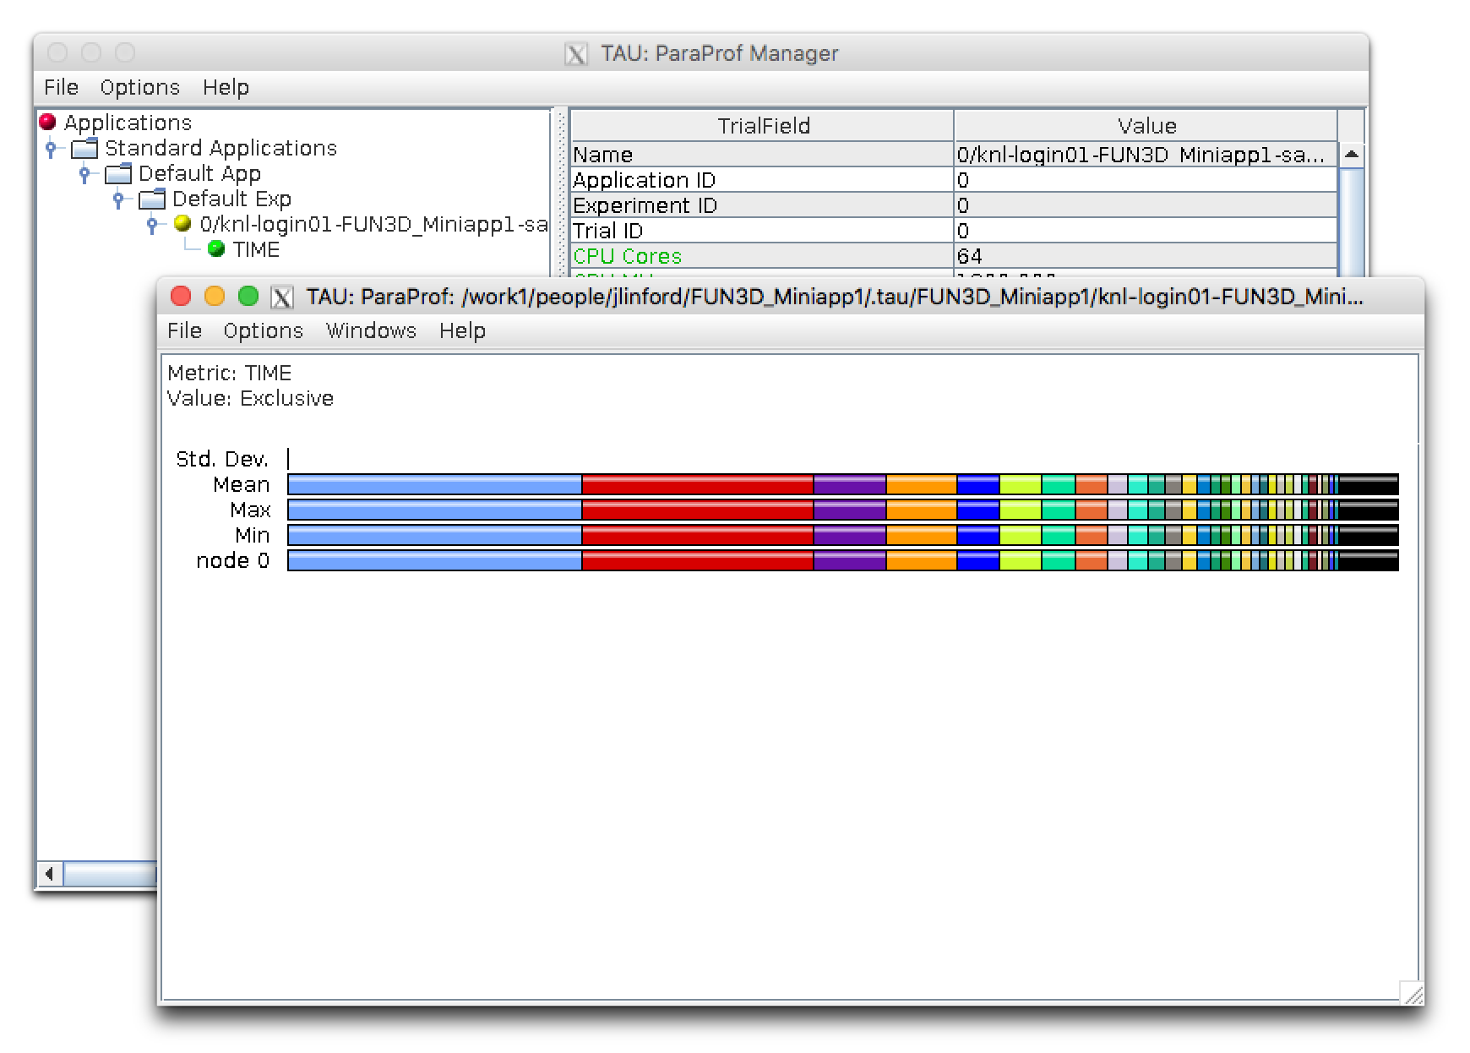
View profile from the head node
$ tau show

Slide 19
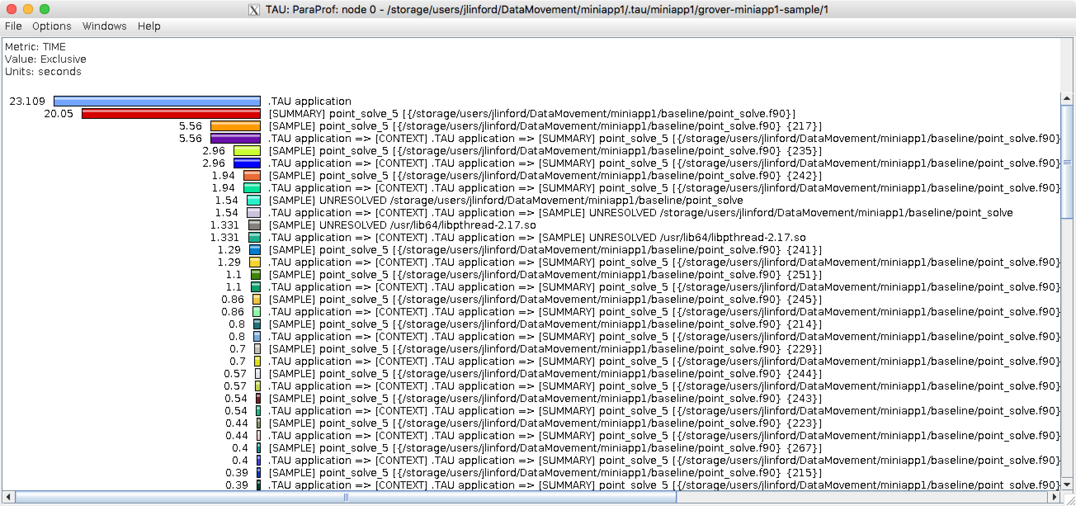
Node 0 Exclusive Time Profile

Slide 20
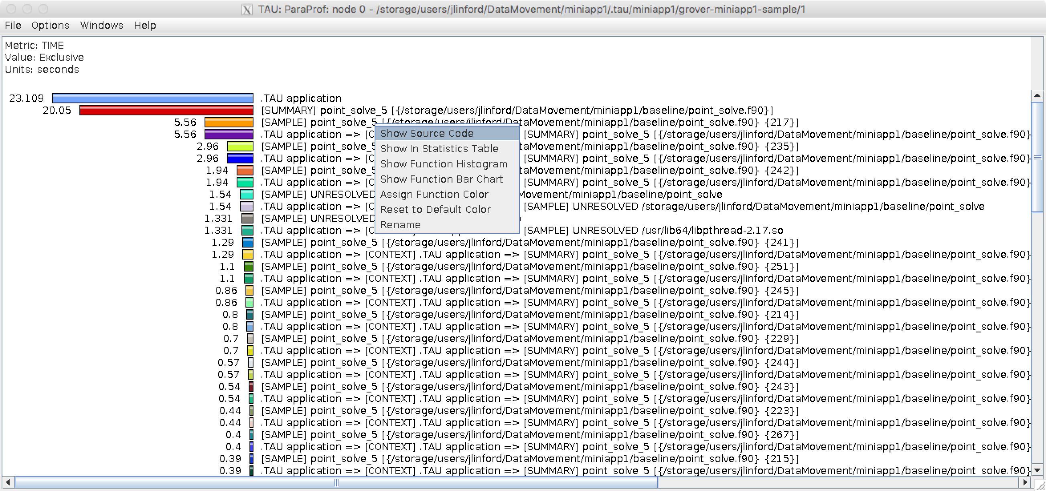
View Source Code
Right-click

Slide 21
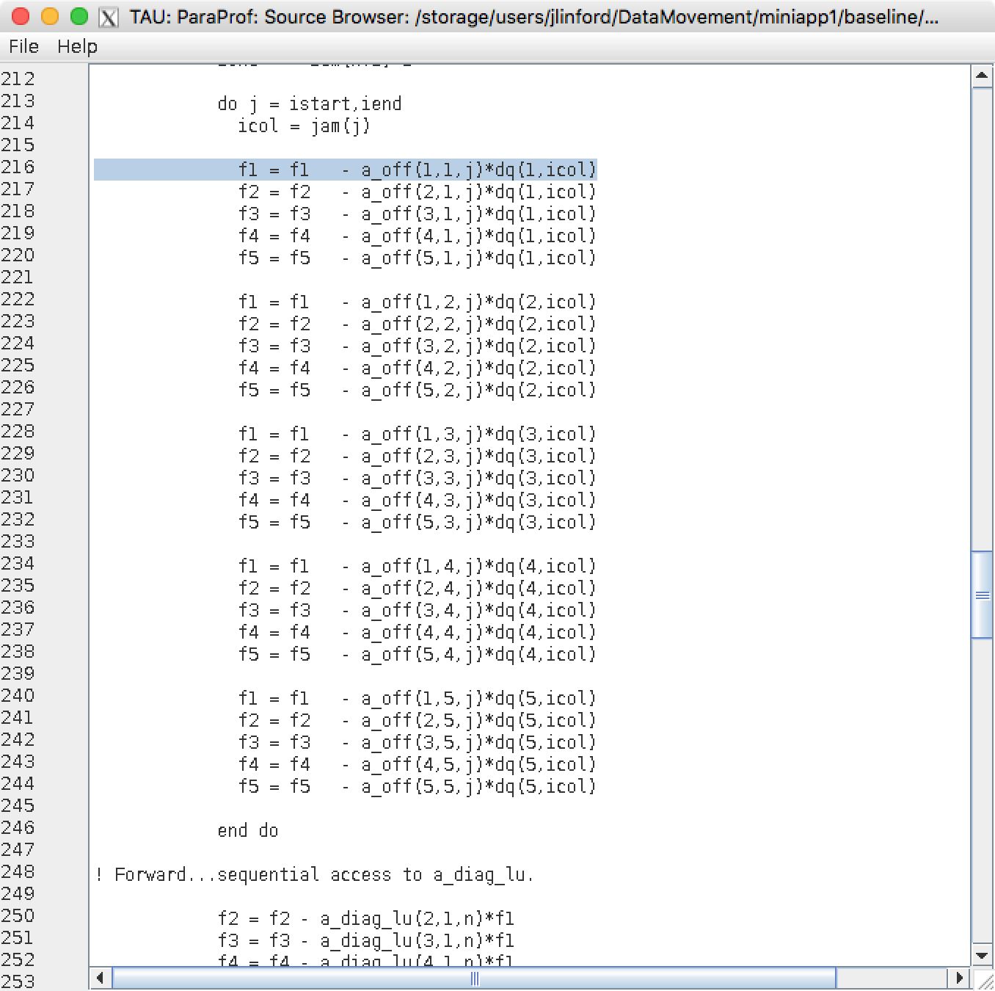
View Source Code
Most expensive source code line
Reminder: We built with -O3. Samples from nearby lines may have resolved here.

Slide 22
How to find most expensive line of code
tau initialize
tau ifort *.f90 -o foo
tau ./foo
tau show
This works on any supported system, even if TAU is not installed or has not been configured appropriately.
TAU and all its dependencies will be downloaded and installed if required.
Just put `tau` in front of everything and see what happens.

Slide 23
Use MCDRAM via numactl -m
$ tau app copy FUN3D_Miniapp1 miniapp1.MCDRAM
[TAU] Added application 'miniapp1.MCDRAM' to project configuration 'miniapp1'.
$ tau select miniapp1.MCDRAM sample
[TAU] Created a new experiment named 'grover-miniapp1.MCDRAM-sample'.
[TAU] Selected experiment 'grover-miniapp1.MCDRAM-sample'.
$ numactl -m 1 tau ./point_solve

Slide 24
Hardware Performance Counters
Execute these commands on a KNL node:
$ srun --pty -p pettt-qf $SHELL
$ tau target metrics knl
“knl” is the target configuration name. Yours may be different.

Slide 25
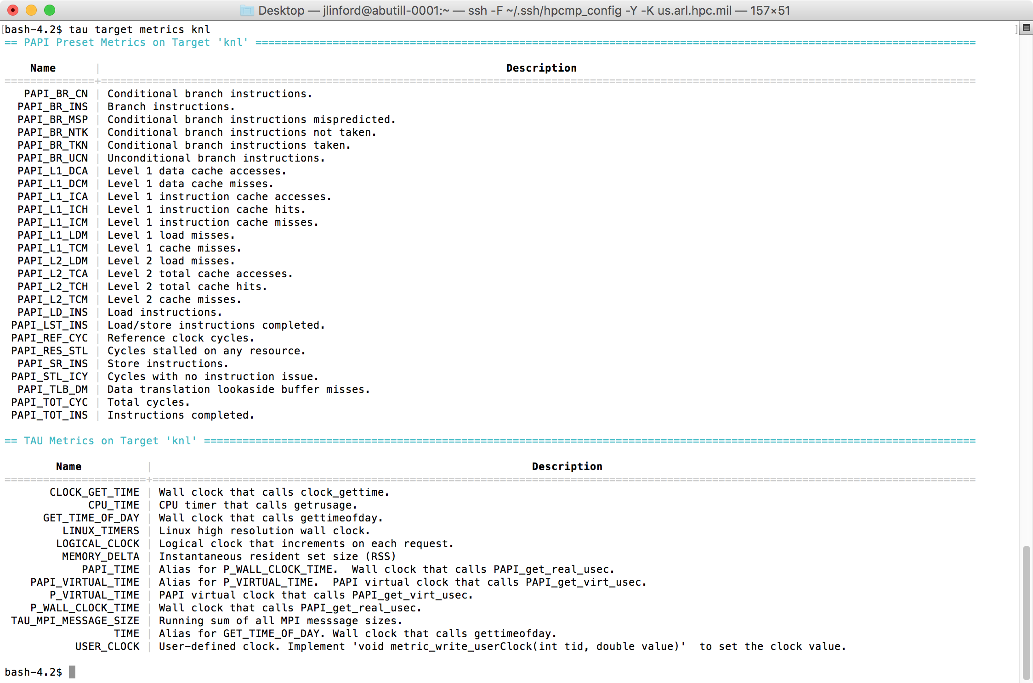
`tau target metrics`

Slide 26
Measuring PAPI Counters
Space-separated list of metrics
$ tau measurement copy sample sample.papi \
--metrics TIME PAPI_L1_DCM PAPI_L2_TCM
$ tau select sample.papi miniapp1.MCDRAM
[TAU] Created a new experiment 'knl-FUN3D_Miniapp1-sample.papi'
[TAU] Selected experiment 'knl-FUN3D_Miniapp1-sample.papi'.
[TAU] Application rebuild required:
[TAU] - metrics changed from [TIME] to [TIME, PAPI_L1_DCM, PAPI_L2_TCM]
TAU Commander advises when application should be rebuilt.

Slide 27
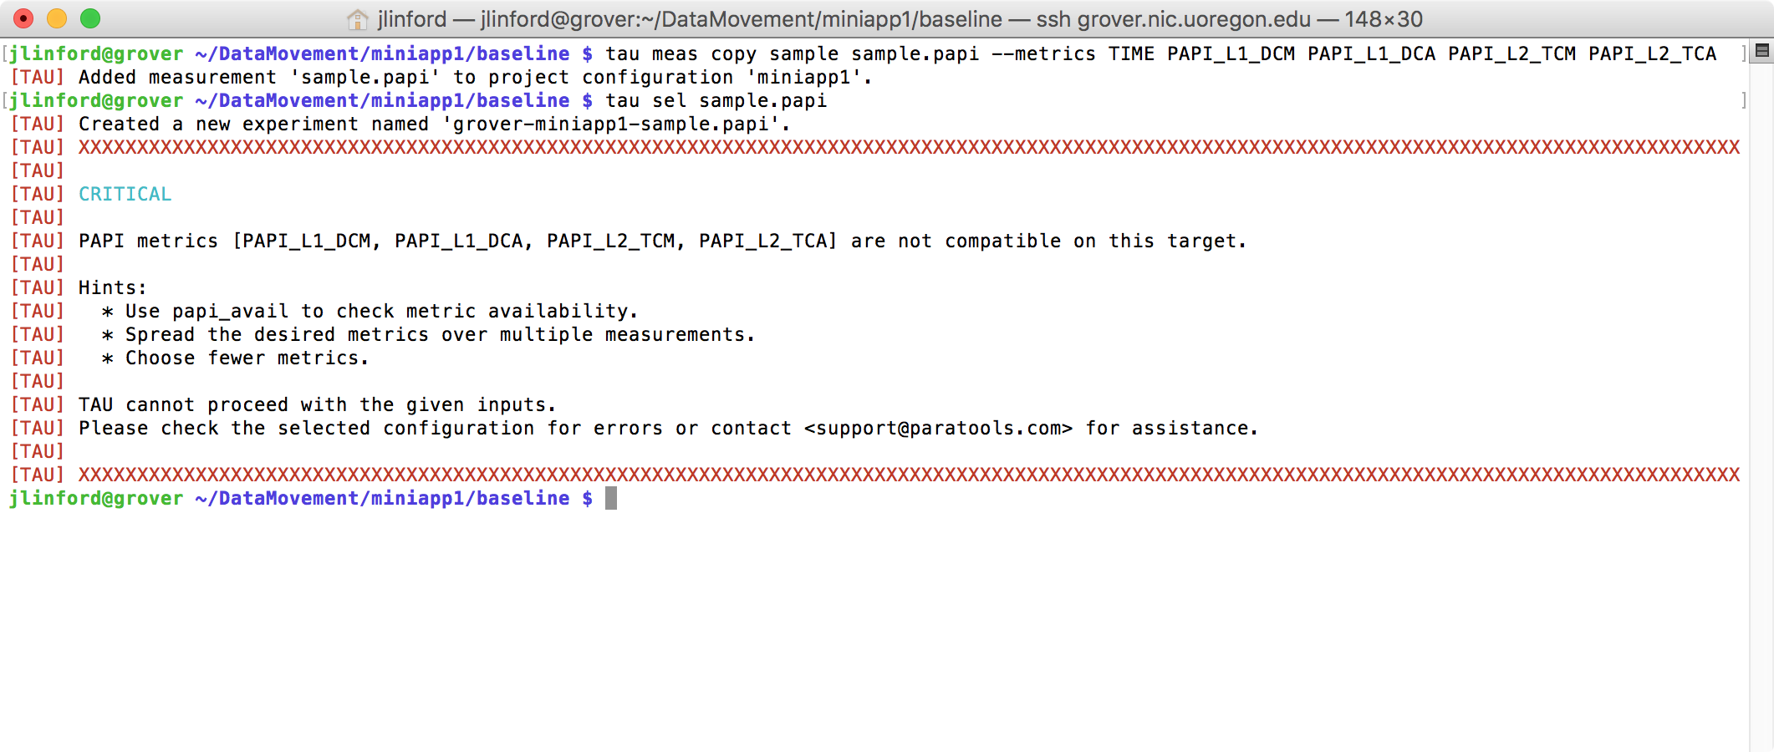
PAPI Metric Compatibility Checks
Internally uses papi_event_chooser to check metric compatibility.

Slide 28
Run exactly as before: `tau ./point_solve`
$ make run
tau ./point_solve
[TAU]
[TAU] == BEGIN Experiment at 2016-12-05 18:59:55.777171 ===============================================================
[TAU]
[TAU] TAU_CALLPATH=1
[TAU] TAU_CALLPATH_DEPTH=100
[TAU] TAU_COMM_MATRIX=0
[TAU] TAU_METRICS=TIME,PAPI_L1_DCM,PAPI_L2_TCM
[TAU] TAU_PROFILE=1
[TAU] TAU_SAMPLING=1
[TAU] TAU_THROTTLE=1
[TAU] TAU_THROTTLE_NUMCALLS=100000
[TAU] TAU_THROTTLE_PERCALL=10
[TAU] TAU_TRACE=0
[TAU] TAU_TRACK_HEAP=0
[TAU] TAU_VERBOSE=0
[TAU] tau_exec -T serial,papi,icpc -ebs ./point_solve
Loading data...
0 Number of block 5x5 equations in data file: 1123718
Done loading data...
Solving Ax=b...
Sweep seconds on master = 1.369700
Sweep seconds on master = 1.356500
Sweep seconds on master = 1.358500
Sweep seconds on master = 1.353100
Sweep seconds on master = 1.347900
Sweep seconds on master = 1.348200
Sweep seconds on master = 1.348400
Sweep seconds on master = 1.345000
Sweep seconds on master = 1.350200
Sweep seconds on master = 1.344700
Sweep seconds on master = 1.344700
Sweep seconds on master = 1.344000
Sweep seconds on master = 1.343200
Sweep seconds on master = 1.343400
Sweep seconds on master = 1.343500
Total seconds taken on master = 20.24260
Test passed.
[TAU]
[TAU] == END Experiment at 2016-12-05 19:00:19.648510 ===================================================================
[TAU]
[TAU] Trial 0 produced 3 profile files.
Trial produced one profile for each metric.

Slide 29
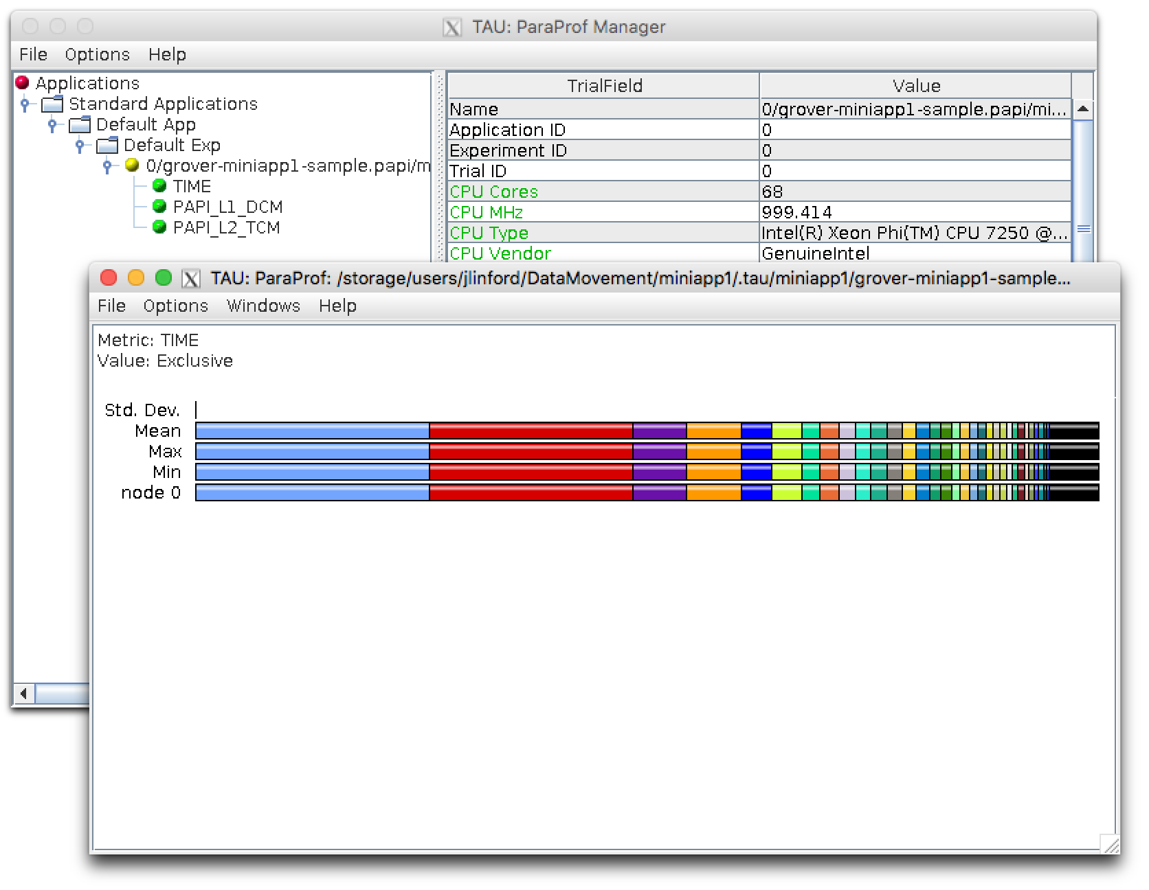
View profiles: `tau show`

Slide 30
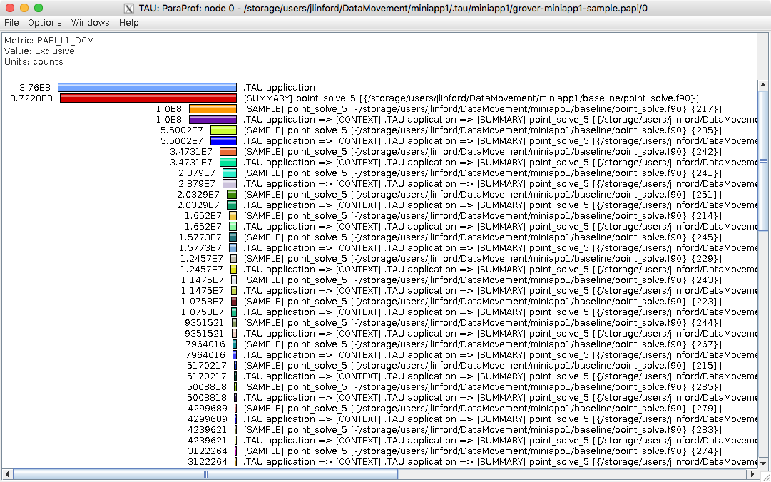
L1 Data Cache Misses

Slide 31
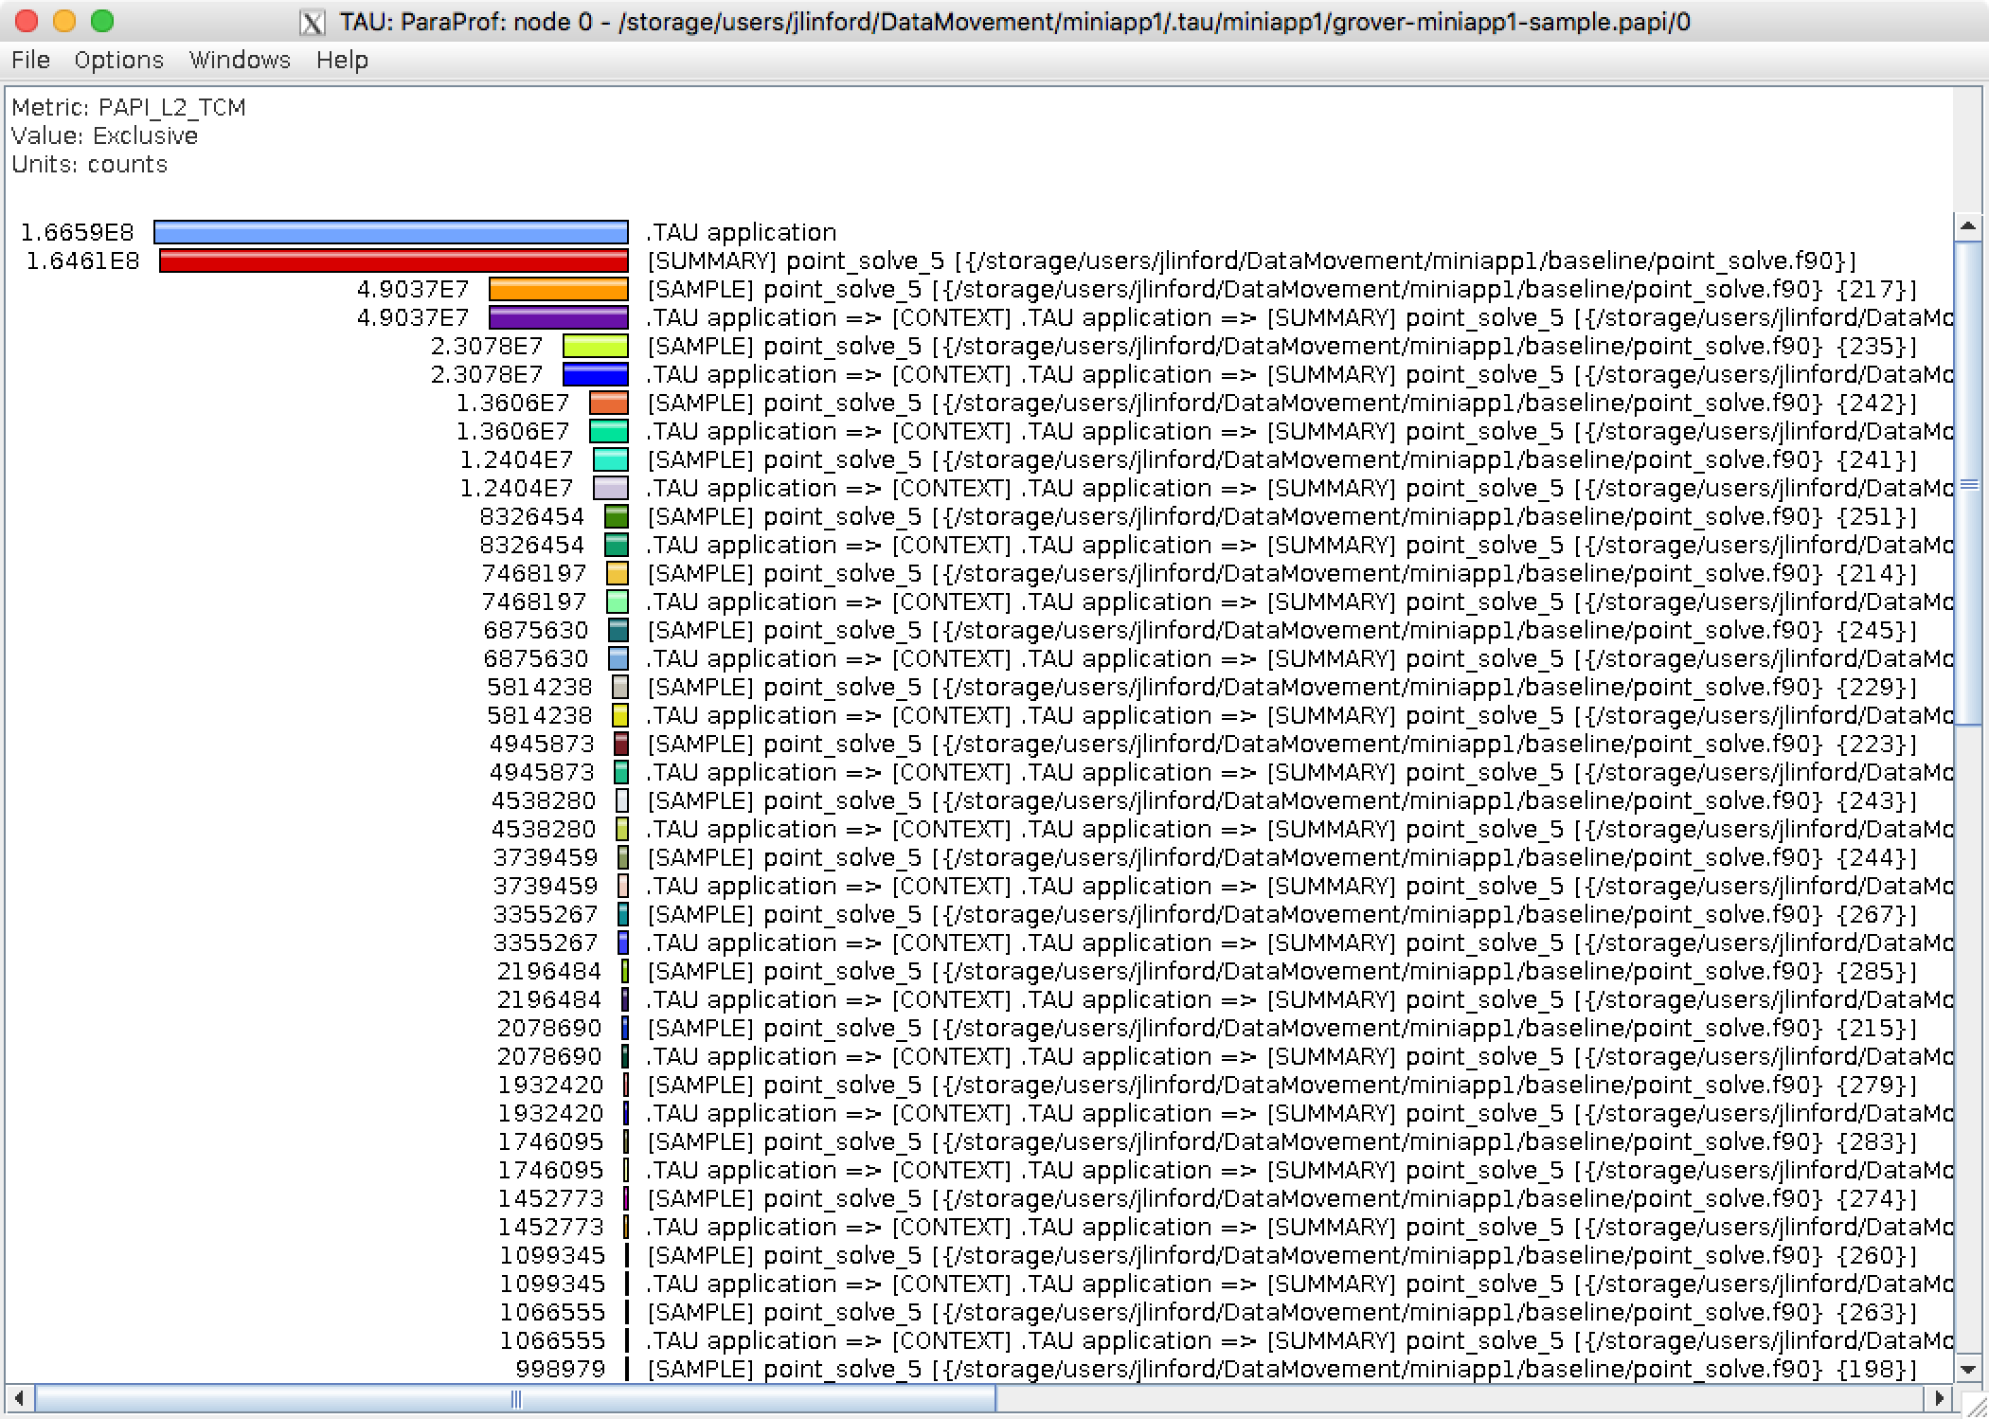
L2 Total Cache Misses

Slide 32
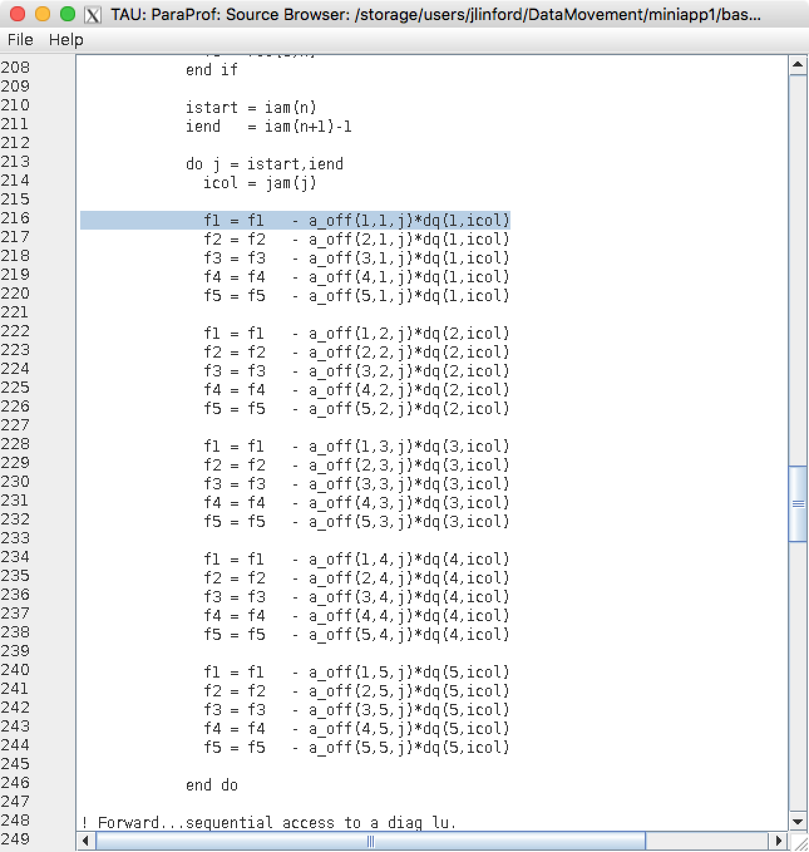
Line with the most L1/L2 misses

Slide 33
What percent of L2 accesses are misses?
$ tau meas copy sample.papi "sample.L2%" --metrics TIME PAPI_L2_TCM PAPI_L2_TCA
[TAU] Added measurement 'sample.L2%' to project configuration 'miniapp1'.
$ tau sel sample.L2%
[TAU] Created a new experiment named 'grover-miniapp1-sample.L2%'.
[TAU] Selected experiment 'grover-miniapp1-sample.L2%'.
$ make run
tau ./point_solve
[TAU]
[TAU] == BEGIN Experiment at 2016-12-05 19:29:24.677341 ===============
[TAU]
[TAU] TAU_CALLPATH=1
[TAU] TAU_CALLPATH_DEPTH=100
[TAU] TAU_COMM_MATRIX=0
[TAU] TAU_METRICS=TIME,PAPI_L2_TCM,PAPI_L2_TCA

Slide 34
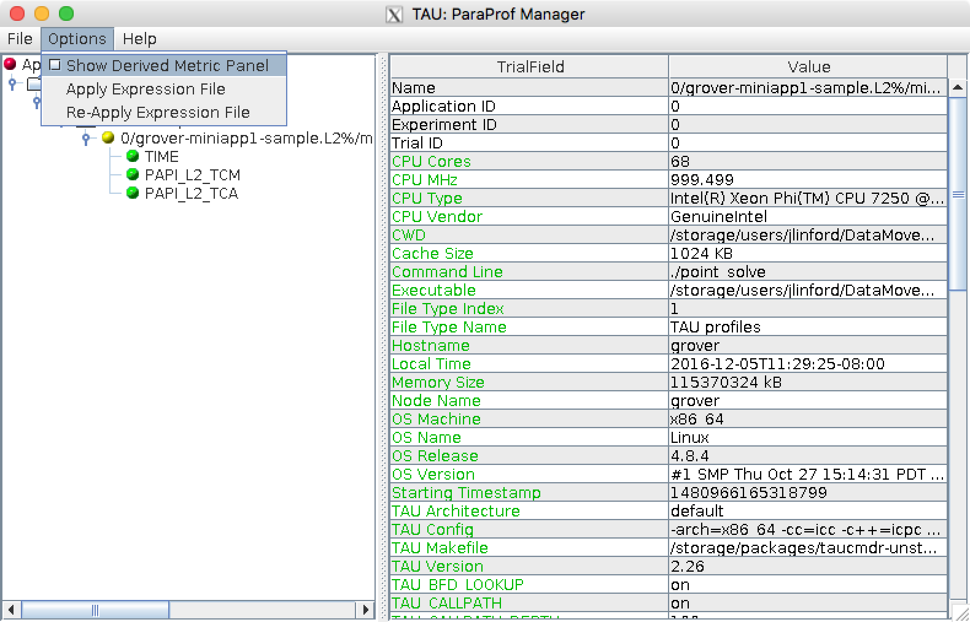
Create a new derived metric

Slide 35
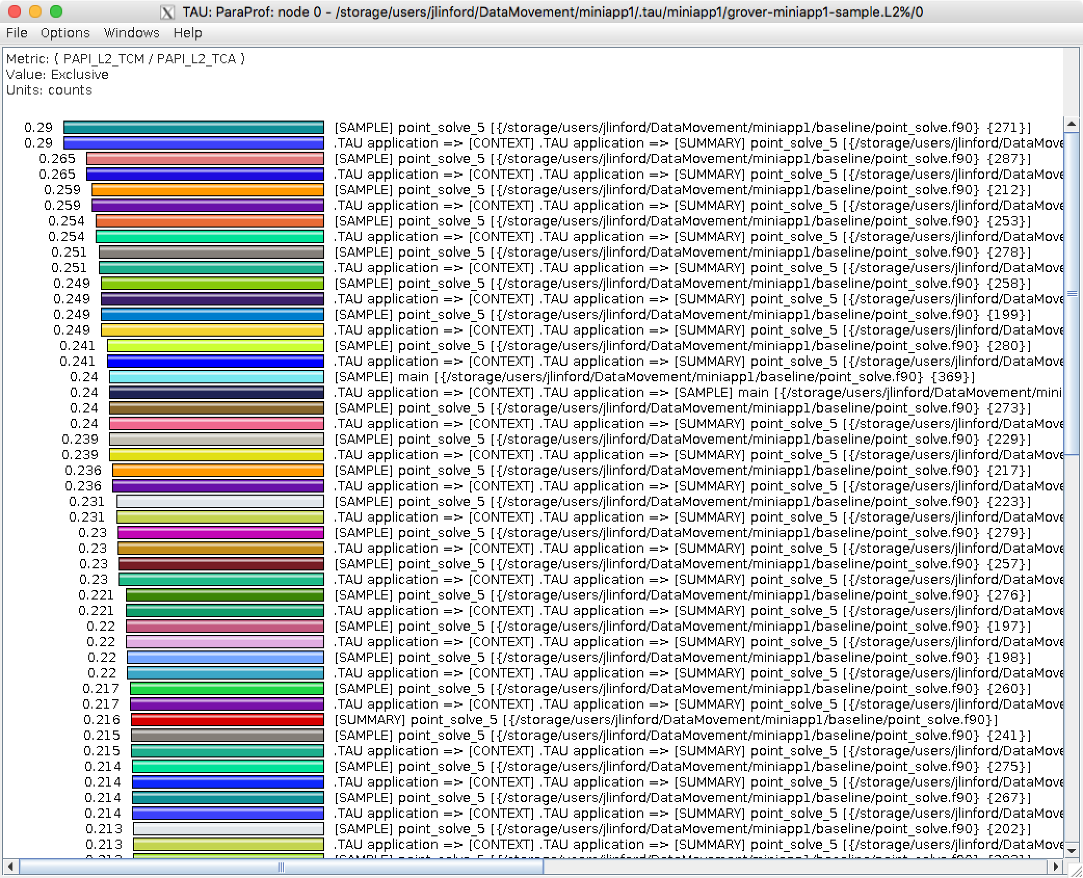
At worst, 29% of L2 fetches miss

Slide 36
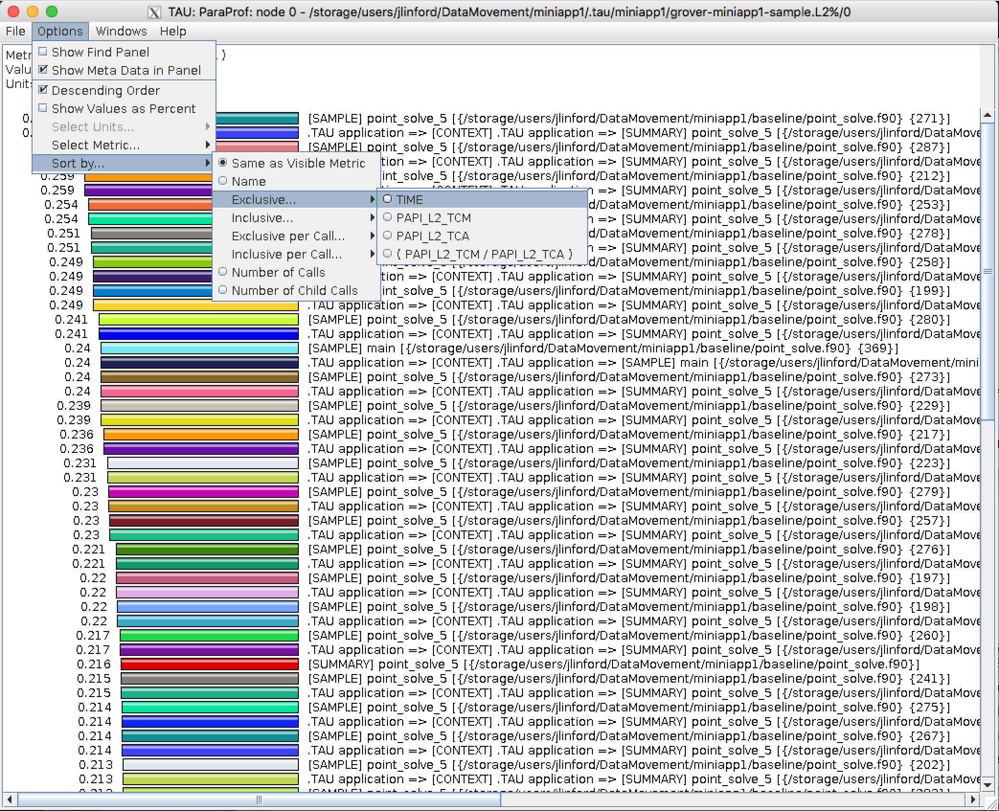
Sort by exclusive time

Slide 37
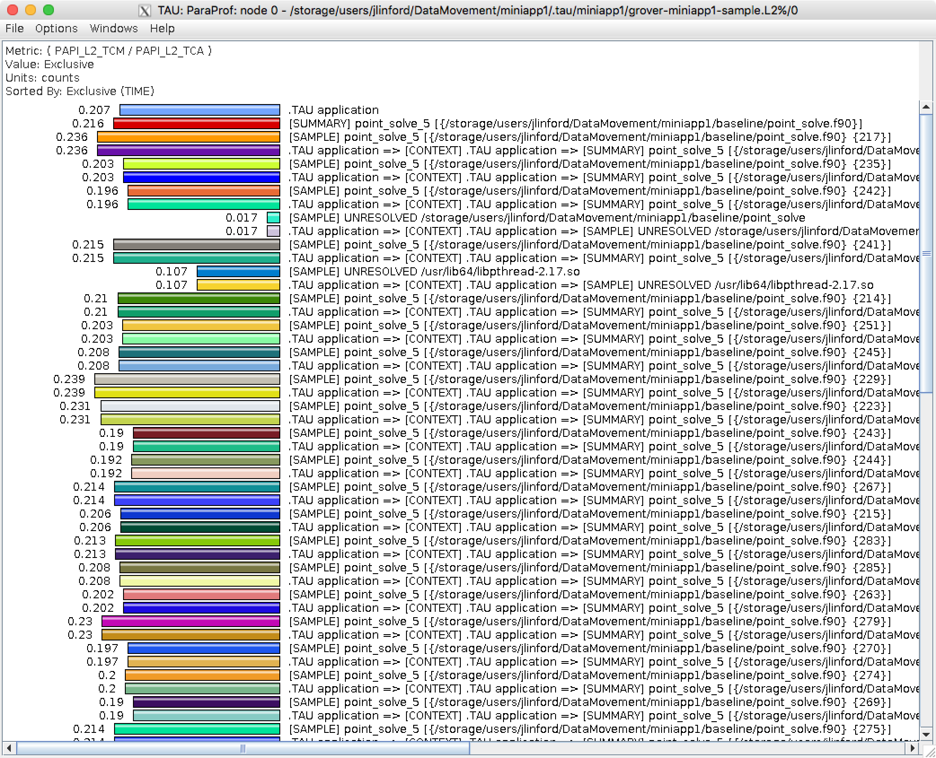
About 21% L2 fetches miss in kernel

Slide 38
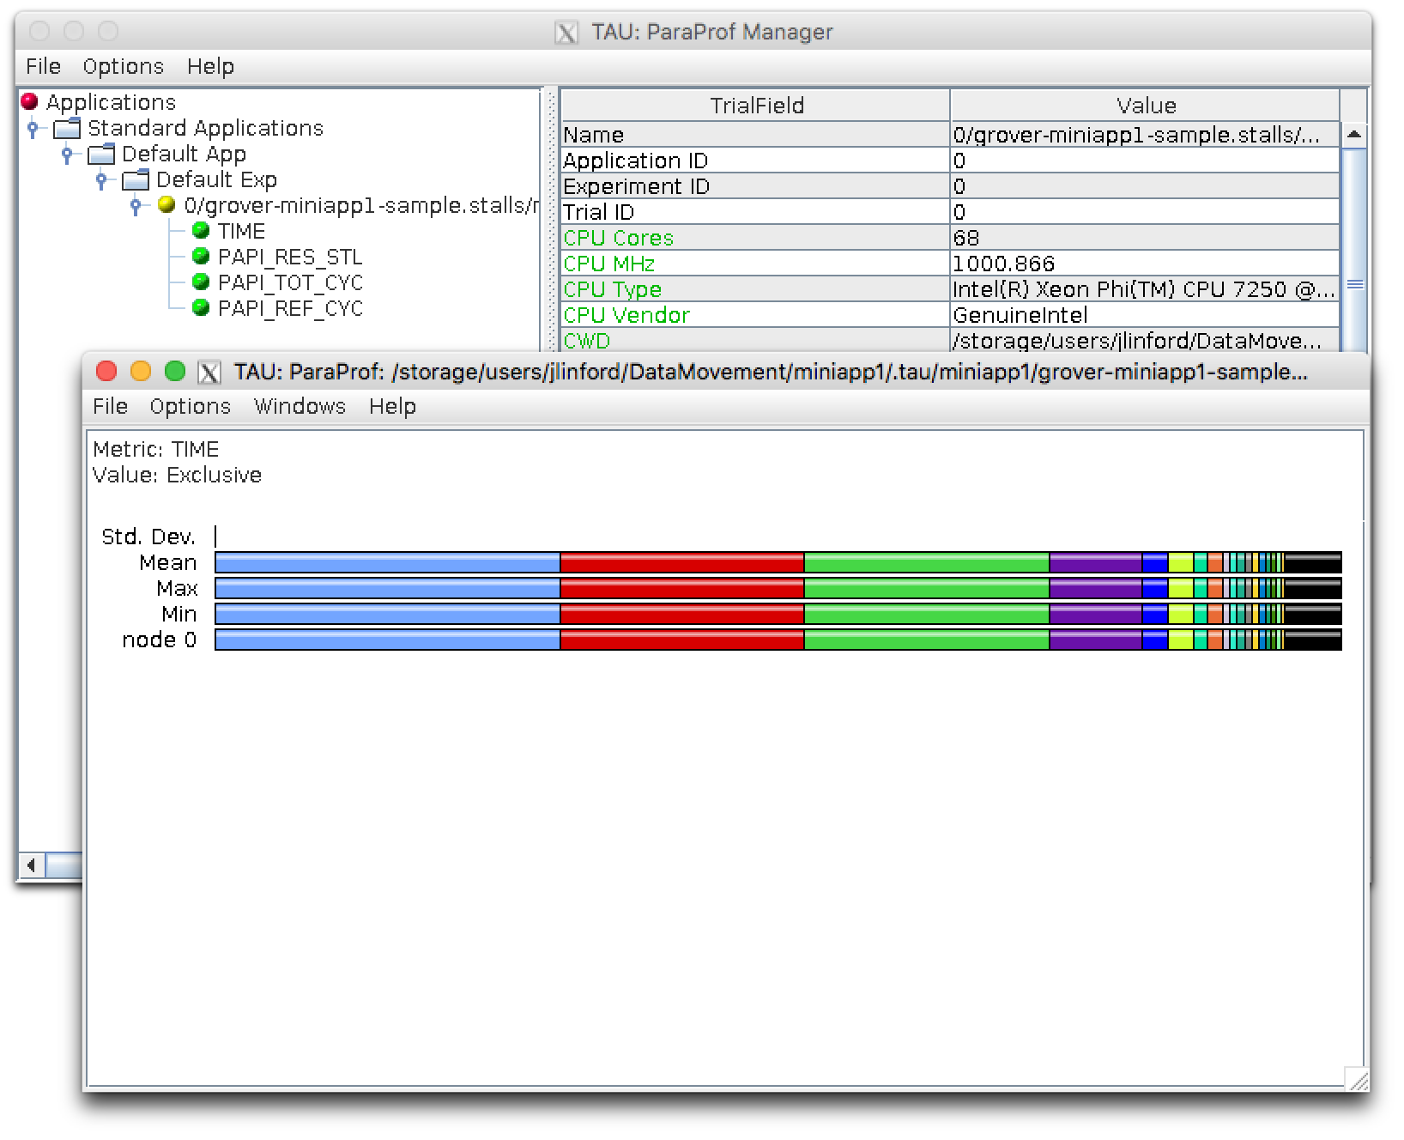
% Cycles Stalled Waiting for Memory

Slide 39
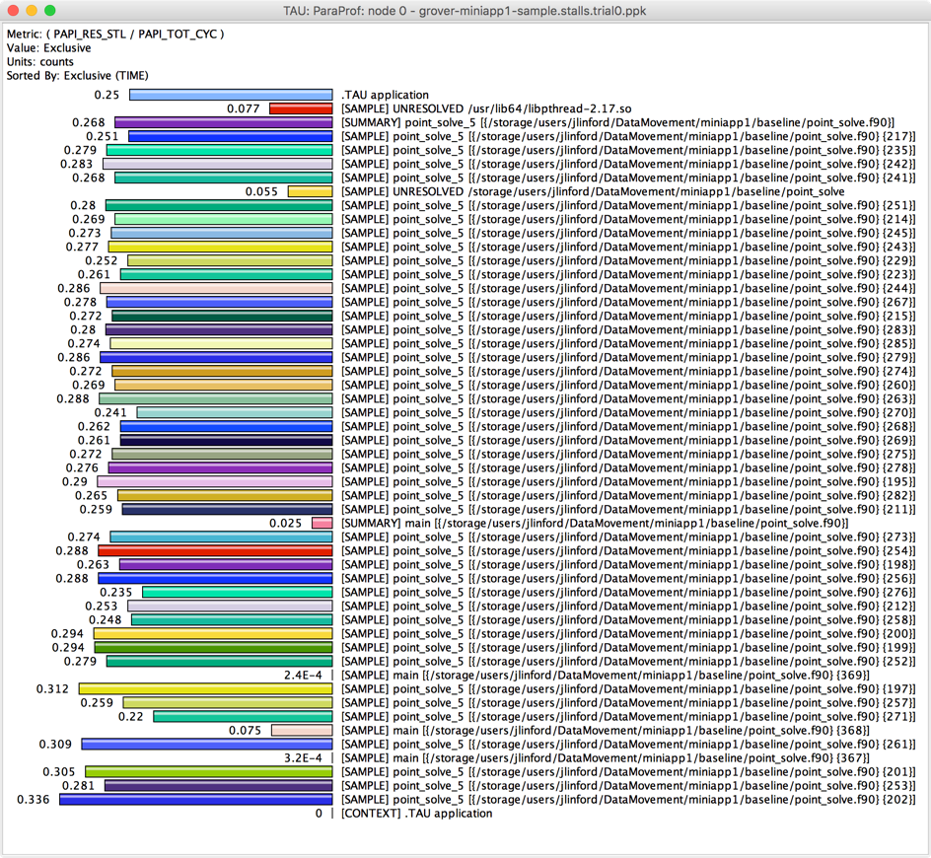
% Cycles Stalled Waiting for Memory

Slide 40
OpenMP Parallelization
$ cd ~/FUN3D_Miniapp1/openmp
!$omp parallel default(shared)
do sweep = 1, n_sweeps
do color = sweep_start, sweep_end, sweep_stride
do ipass = 1, 2
start = color_indices(1,color)
end = color_boundary_end(color)
!$omp do private(f1,f2,f3,f4,f5,n,j,icol,istart,iend) schedule(auto)
do n = start, end
istart = iam(n)
iend = iam(n+1)-1
f(1:5) = (+/-)res(1:5)
do j = istart, iend
icol = jam(j)
do i = 1, 5
f(1:5) = f(1:5) - a_off(1:5,i,j)*dq(i,icol)
end do

Slide 41
Create a new OpenMP Application Config
$ cd ~/FUN3D_Miniapp1/openmp
# Edit Makefile as before
$ tau app copy FUN3D_Miniapp1 miniapp1.openmp --openmp
[TAU] Added application 'miniapp1.openmp' to project configuration 'miniapp1'.
$ tau select miniapp1.openmp sample
[TAU] Selected experiment 'grover-miniapp1.openmp-sample'.
[TAU] Application rebuild required:
[TAU] - openmp changed from False to True

Slide 42
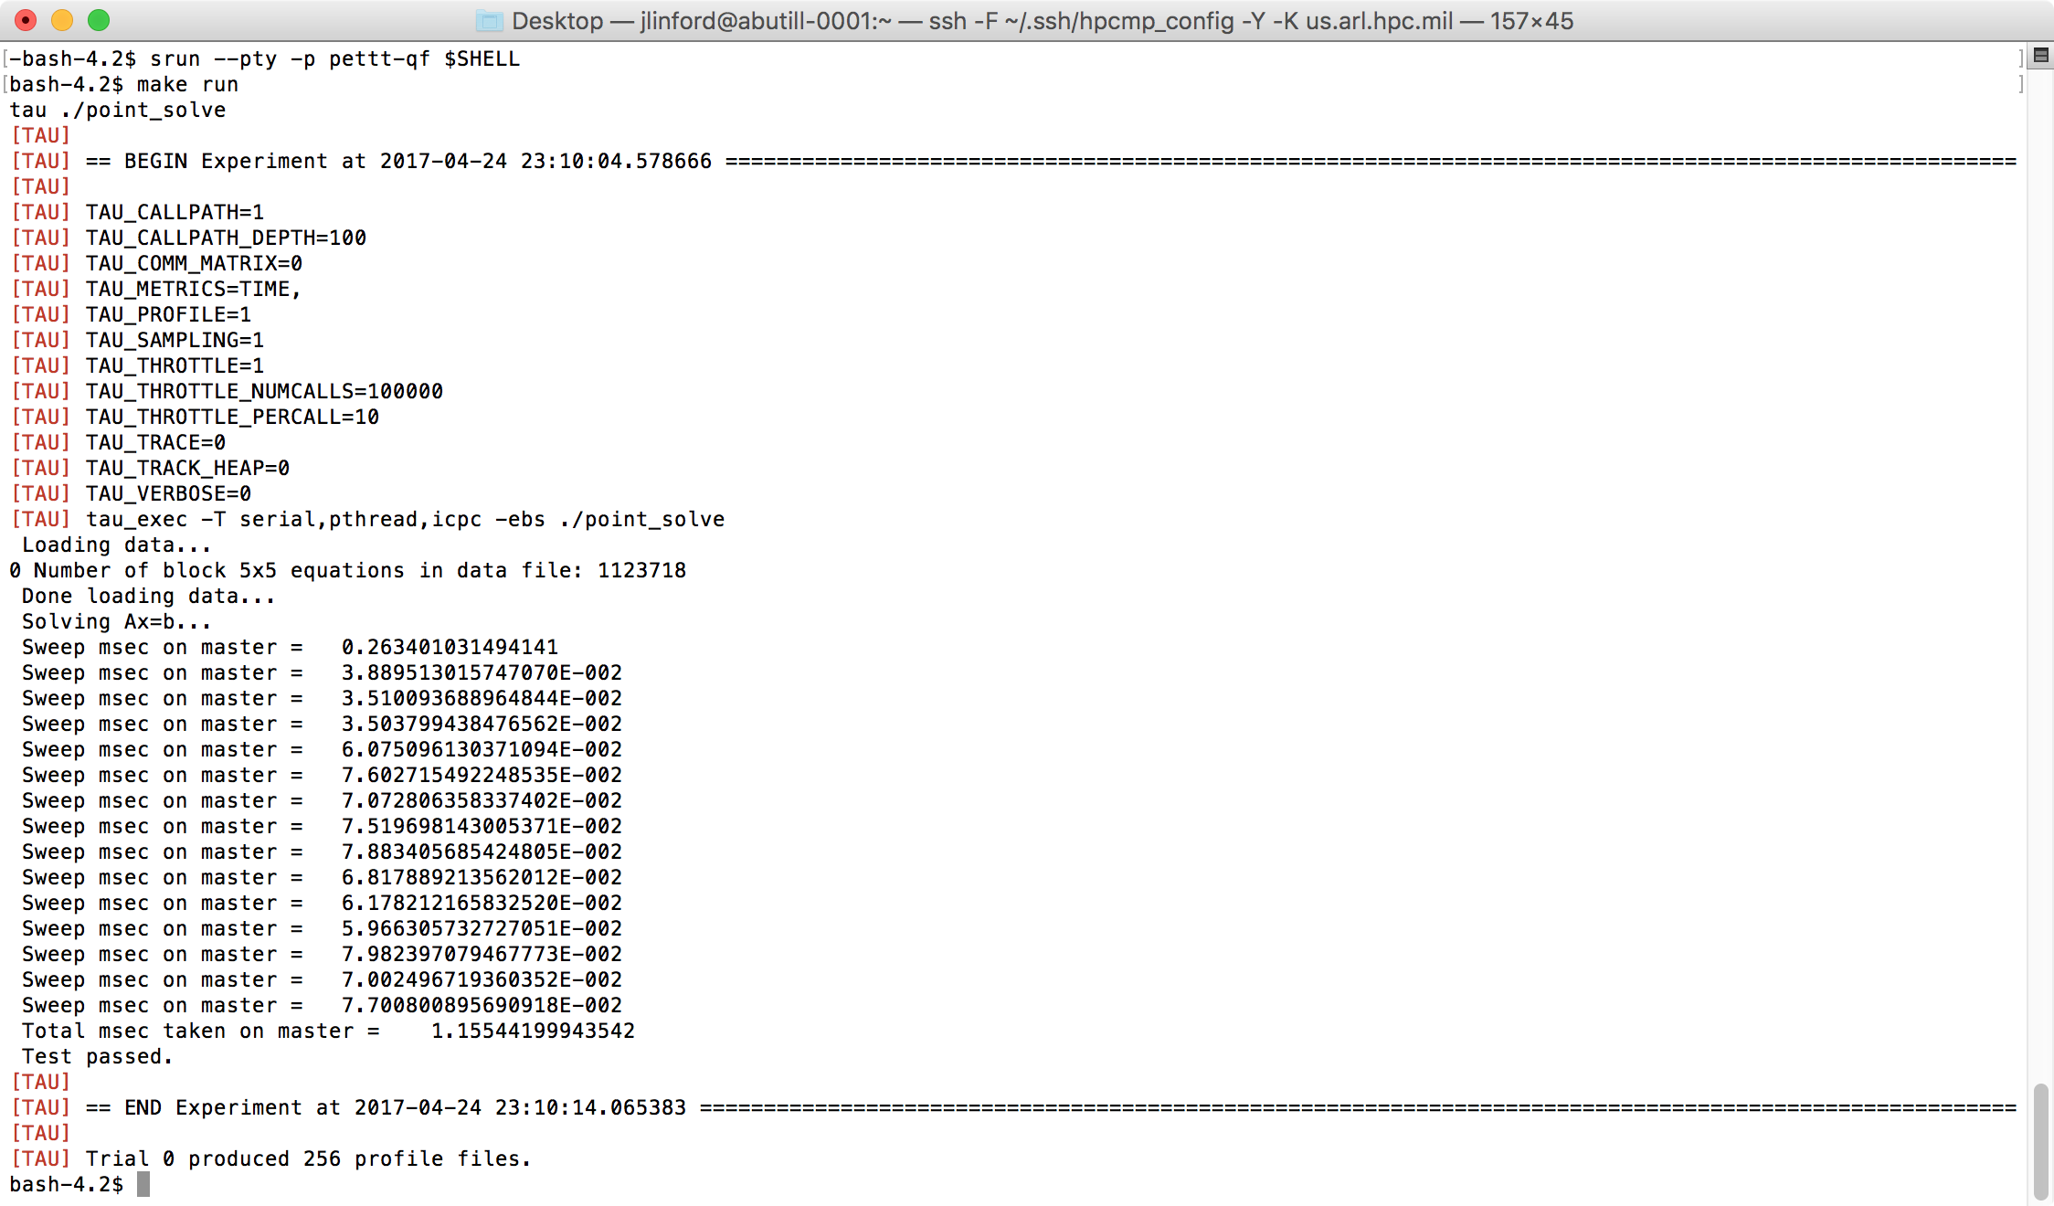
Compile and run exactly as before
14.2x faster with OpenMP
One profile per thread

Slide 43
Reference
KNL Hands On Exercises

Slide 44
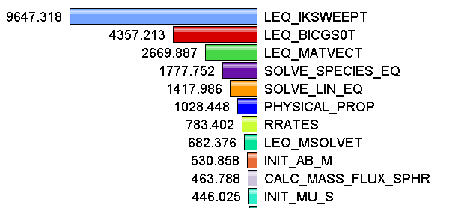
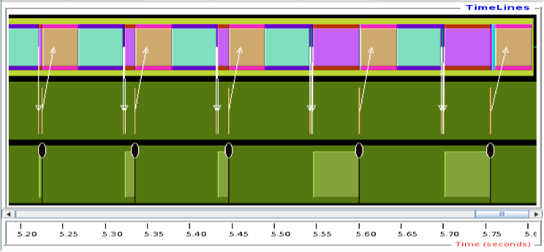
Measurement Approaches
Profiling
Tracing
Shows
how much time was spent in each routine
Shows
when events take place on a timeline

Slide 45
Types of Performance Profiles
Flat profiles
  Metric (e.g., time) spent in an event
  Exclusive/inclusive, # of calls, child calls, …
Callpath profiles
  Time spent along a calling path (edges in callgraph)
  “main=> f1 => f2 => MPI_Send”
Phase profiles
  Flat profiles under a phase (nested phases allowed)
  Default “main” phase
  Supports static or dynamic (e.g. per-iteration) phases
Notes:
Collect basic routine-level timing profile to determine where most time is being spent
Collect routine-level hardware counter data to determine types of performance problems
Collect callpath profiles to determine sequence of events causing performance problems
Conduct finer-grained profiling and/or tracing to pinpoint performance bottlenecks
Loop-level profiling with hardware counters
Tracing of communication operations

Slide 46
Direct Observation Events
Interval events (begin/end events)
  Measures exclusive & inclusive durations between events
  Metrics monotonically increase
  Example: Wall-clock timer
Atomic events (trigger with data value)
  Used to capture performance data state
  Shows extent of variation of triggered values (min/max/mean)
  Example: heap memory consumed at a particular point

Slide 47
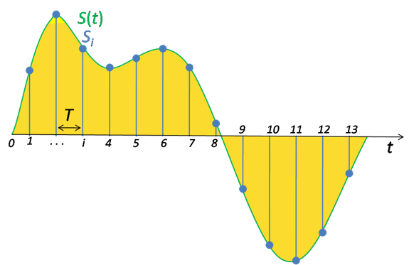
Direct vs. Indirect Measurement
Direct via Probes
Indirect via Sampling
call TAU_START(‘potential’)
// code
call TAU_STOP(‘potential’)
Exact measurement
Fine-grain control
Calls inserted into code
No code modification
Minimal effort
Relies on debug symbols (-g option)

Slide 48
Inclusive vs. Exclusive Measurements
Exclusive measurements for region only
Inclusive measurements includes child regions
int foo()
{
int a;
a =a + 1;
bar();
a =a + 1;
return a;
}
Inclusive
duration
Exclusive
duration

