Slide 1
TAU Commander and ParaTools ThreadSpotter
ParaTools, Inc.
John C. Linford, Sameer Shende, et al.
{jlinford,sameer}@paratools.com
Data Movement Workshop
6 December 2016, ARL, Aberdeen, MD

Slide 2
Hands On
Connect to HECC_Public_Wireless
Pick a number [1-20]
ssh studentXX@knl.nic.uoregon.edu
password: paratools@XX
  Replace XX with your number, e.g. student03
cd DataMovement
DMW_APG16-TAU.pdf DMW_APG16-TAU.pptx miniapp1 miniapp1-with-tau
TAU Project with profiles

Slide 3
ParaTools ThreadSpotter
A cache and memory optimization tool
  Analyzes memory bandwidth and latency, data locality and thread communications
  Identifies specific issues and pinpoints troublesome areas in source code
  Provides guidance towards a resolution
  Increase productivity for experts and non-experts

Slide 4
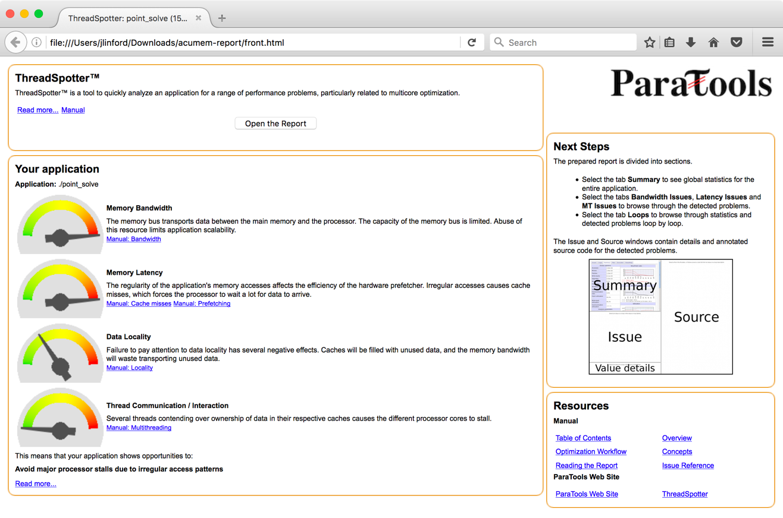
ThreadSpotter Report Front Page

Slide 5
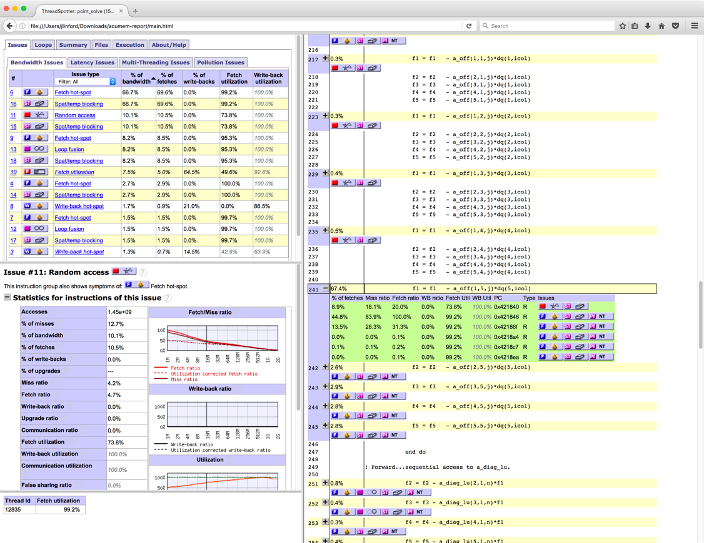
ThreadSpotter Report

Slide 6
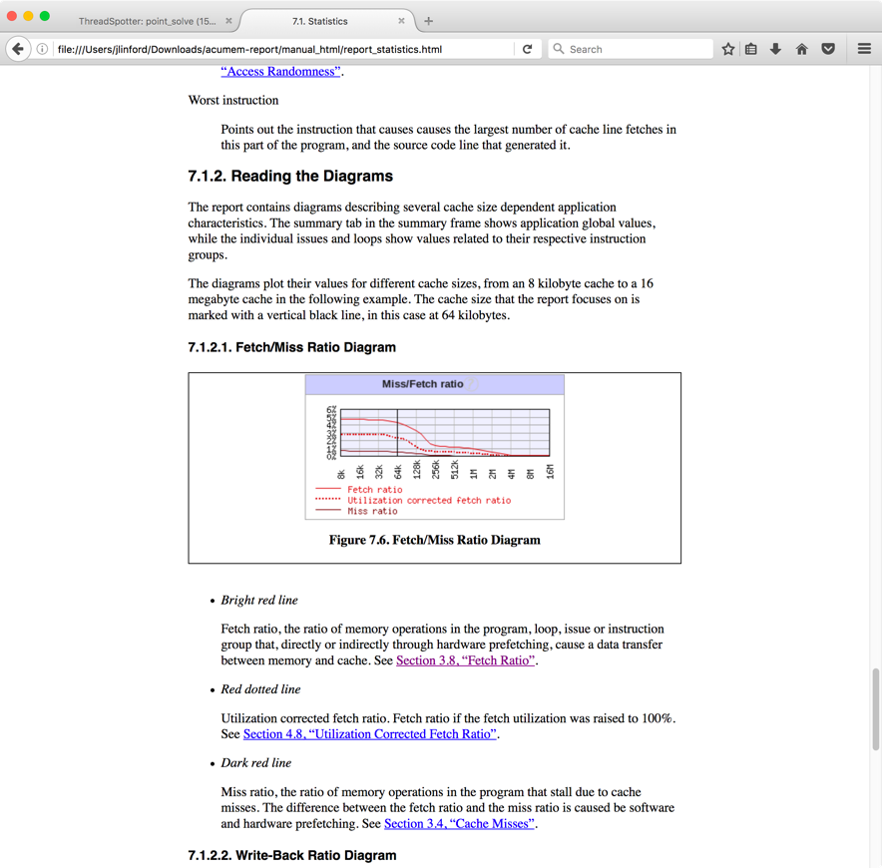
ThreadSpotter Online Help

Slide 7
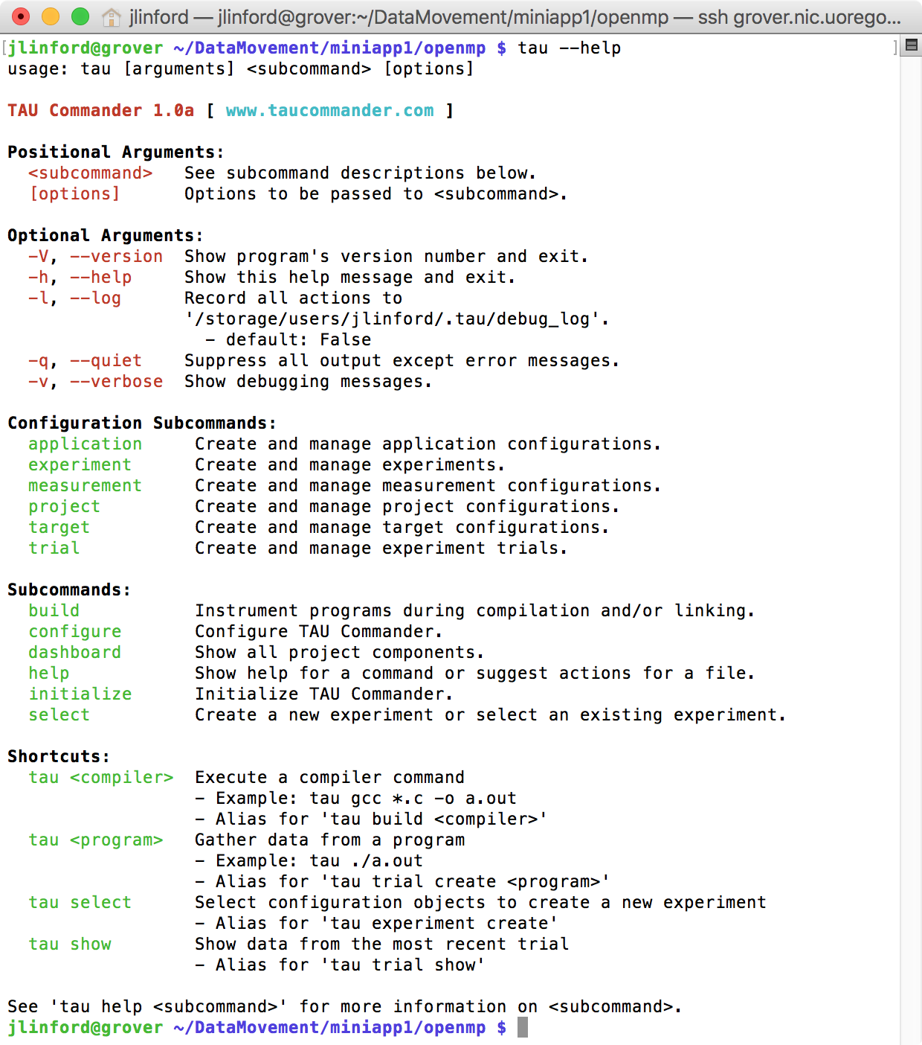
TAU Commander: The TAU User Interface

Slide 8
Questions TAU Can Answer
How much time is spent in each application routine and outer loops? Within loops, what is the contribution of each statement?
How many instructions are executed in these code regions?
Floating point, Level 1 and 2 data cache misses, hits, branches taken, vector instructions?
What is the memory usage of the code? When and where is memory allocated/de-allocated? Are there any memory leaks?
What are the I/O characteristics of the code? What is the peak read and write bandwidth of individual calls, total volume?
What is the time spent waiting for collectives?
How does the application scale?

Slide 9
TAU Supports All HPC Platforms
C/C++
CUDA
UPC
Python
GPI
Fortran
OpenACC
MPI
Java
pthreads
Intel MIC
OpenMP
Intel
GNU
PGI
Sun
LLVM
Cray
MinGW
AIX
Linux
Windows
Insert yours
here
BlueGene
Fujitsu
ARM
Android
MPC
OS X

Slide 10
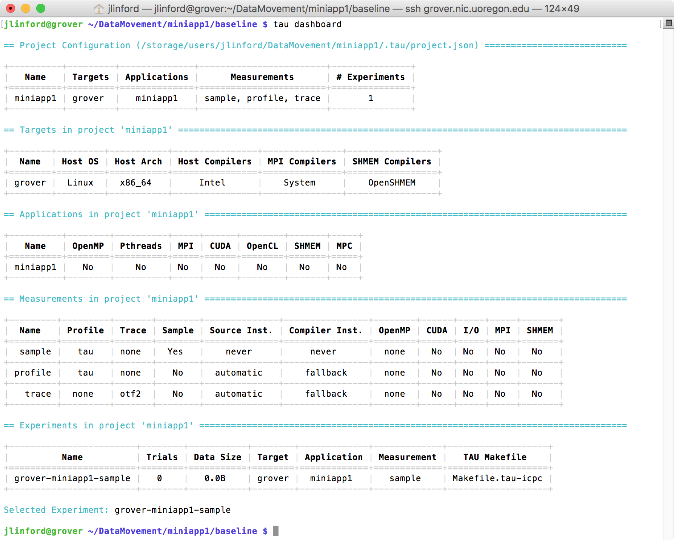
Example TAU Project

Slide 11
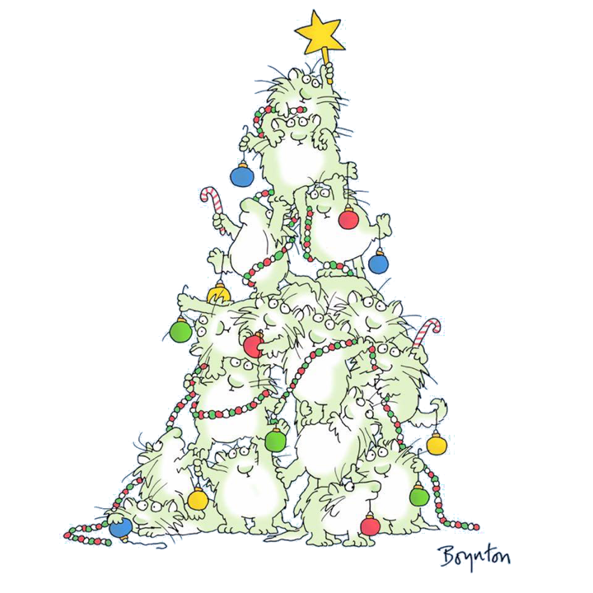

TAU Commander
Tell the tool what you want, not how to get it
vs.

Slide 12
Getting Started with TAU Commander
tau init [options | --help]
tau <<your compiler>> foo.c
  e.g. tau mpif90 foo.f90
tau mpirun -np 8 ./a.out
Online Help
tau --help
tau help <something>

Slide 13
Tools Summary
ParaTools ThreadSpotter
  High-level cache and memory optimization tool.
  Generates “plain English” reports with annotated source code.
TAU Commander
  Broad scope, powerful performance engineering tool.
  Built on the TAU Performance System.
  Easy way to get a wide variety of performance data.
    PAPI, etc.
  Installs and manages TAU and its dependencies.

Slide 14
five Point Solver MINIAPP
Data Movement Workshop

Slide 15
MINIAPP 1 Code Structure
do sweep = 1, n_sweeps
do color = sweep_start, sweep_end, sweep_stride
do ipass = 1, 2
start = color_indices(1,color)
end = color_boundary_end(color)
do n = start, end
istart = iam(n)
iend = iam(n+1)-1
f(1:5) = (+/-)res(1:5)
do j = istart, iend
icol = jam(j)
do i = 1, 5
f(1:5) = f(1:5) - a_off(1:5,i,j)*dq(i,icol)
end do

Slide 16
MINIAPP 1 Code Structure
do sweep = 1, n_sweeps
do color = sweep_start, sweep_end, sweep_stride
do ipass = 1, 2
start = color_indices(1,color)
end = color_boundary_end(color)
do n = start, end
istart = iam(n)
iend = iam(n+1)-1
f(1:5) = (+/-)res(1:5)
do j = istart, iend
icol = jam(j)
do i = 1, 5
f(1:5) = f(1:5) - a_off(1:5,i,j)*dq(i,icol)
end do
Unknown loop trip count
Low FLOP vector(5) kernel
Indirect index

Slide 17
MINIAPP 1 Kernel Unrolled
do j = istart,iend
icol = jam(j)
f1 = f1 - a_off(1,1,j)*dq(1,icol)
f2 = f2 - a_off(2,1,j)*dq(1,icol)
f3 = f3 - a_off(3,1,j)*dq(1,icol)
f4 = f4 - a_off(4,1,j)*dq(1,icol)
f5 = f5 - a_off(5,1,j)*dq(1,icol)
f1 = f1 - a_off(1,2,j)*dq(2,icol)
f2 = f2 - a_off(2,2,j)*dq(2,icol)
f3 = f3 - a_off(3,2,j)*dq(2,icol)
f4 = f4 - a_off(4,2,j)*dq(2,icol)
f5 = f5 - a_off(5,2,j)*dq(2,icol)
f1 = f1 - a_off(1,3,j)*dq(3,icol)
f2 = f2 - a_off(2,3,j)*dq(3,icol)
f3 = f3 - a_off(3,3,j)*dq(3,icol)
f4 = f4 - a_off(4,3,j)*dq(3,icol)
f5 = f5 - a_off(5,3,j)*dq(3,icol)
f1 = f1 - a_off(1,4,j)*dq(4,icol)
f2 = f2 - a_off(2,4,j)*dq(4,icol)
f3 = f3 - a_off(3,4,j)*dq(4,icol)
f4 = f4 - a_off(4,4,j)*dq(4,icol)
f5 = f5 - a_off(5,4,j)*dq(4,icol)
f1 = f1 - a_off(1,5,j)*dq(5,icol)
f2 = f2 - a_off(2,5,j)*dq(5,icol)
f3 = f3 - a_off(3,5,j)*dq(5,icol)
f4 = f4 - a_off(4,5,j)*dq(5,icol)
f5 = f5 - a_off(5,5,j)*dq(5,icol)
end do
do j = istart, iend
icol = jam(j)
do i = 1, 5
f(1:5) = f(1:5) - a_off(1:5,i,j)*dq(i,icol)
end do
56 Loads
26 Stores
50 FP-ops
  Fused to 25
~0.17 FP-ops / byte
  Fused: 0.083 FP-ops / byte

Slide 18
MINIAPP 1 BOTE Analysis
56 loads, 26 stores, 25 FP-ops ➔ Memory bound
Vector(5) is a pain:
  Want Vector(4) for SSE, Vector(8) for AVX2, Vector(16) for AVX512
  Padding to improve vectorization hurts cache line utilization
Indirect access, unknown loop trip
  Calculated load/store in innermost loop
  Dynamic dispatch for vectorized loop
Already have coarse grain MPI parallelization
  OpenMP parallelization in n=start,end straightforward,
  but will it help?
do j = istart, iend
icol = jam(j)
do i = 1, 5
f(1:5) = f(1:5) - a_off(1:5,i,j)*dq(i,icol)
end do

Slide 19
MINIAPP1 Questions
Question | Primary Tool | Secondary Tool
Runtime hot spots? | TAU | system_clock
Will OpenMP help? | TAU | ThreadSpotter
Cache utilization? | ThreadSpotter | TAU
Can MCDRAM help? | ThreadSpotter | TAU
Can we shuffle a_off for better performance? | ThreadSpotter | TAU
Can we vectorize? How hard should we try? | TAU | ThreadSpotter
Reminder: The compiler optimization report is not a todo list.

Slide 20
ThreadSpotter Analysis
Data Movement Workshop

Slide 21
ParaTools ThreadSpotter
$ sample_ts -r ./point_solve
$ report_ts -i sample.smp
$ view-static_ts -i report.tsr
$ tar cvzf acumem-report.tgz acumem-report.html acumem-report
$ scp acumem-report.tgz <somewhere with a browser>
Note: When running with MPI use tau_exec:
$ mpirun -np 256 tau_exec -ptts ./point_solve

Slide 22
Report Front Page

Slide 23
Fetch Hotspots

Slide 24
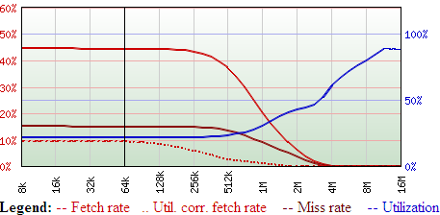
Metrics as a function of cache size
Fetch ratio
  Memory operations
  that cause a data transfer to/from RAM
Miss ratio
  Memory operations that stall due to cache misses.
Fetch utilization
  Fraction of the data loaded into the cache that are actually used

Slide 25
TAU Commander Analysis
Data Movement Workshop

Slide 26
Initialize TAU Project
$ cd ~/DataMovement/miniapp1
$ which tau
/usr/local/packages/taucmdr-unstable/bin/tau
$ tau initialize
Creates a new project configuration using defaults
Project files exist in a directory named “.tau”
Like git, all directories below the directory containing the “.tau” directory can access the project
  E.g. `tau dashboard` works in miniapp1/baseline

Slide 27
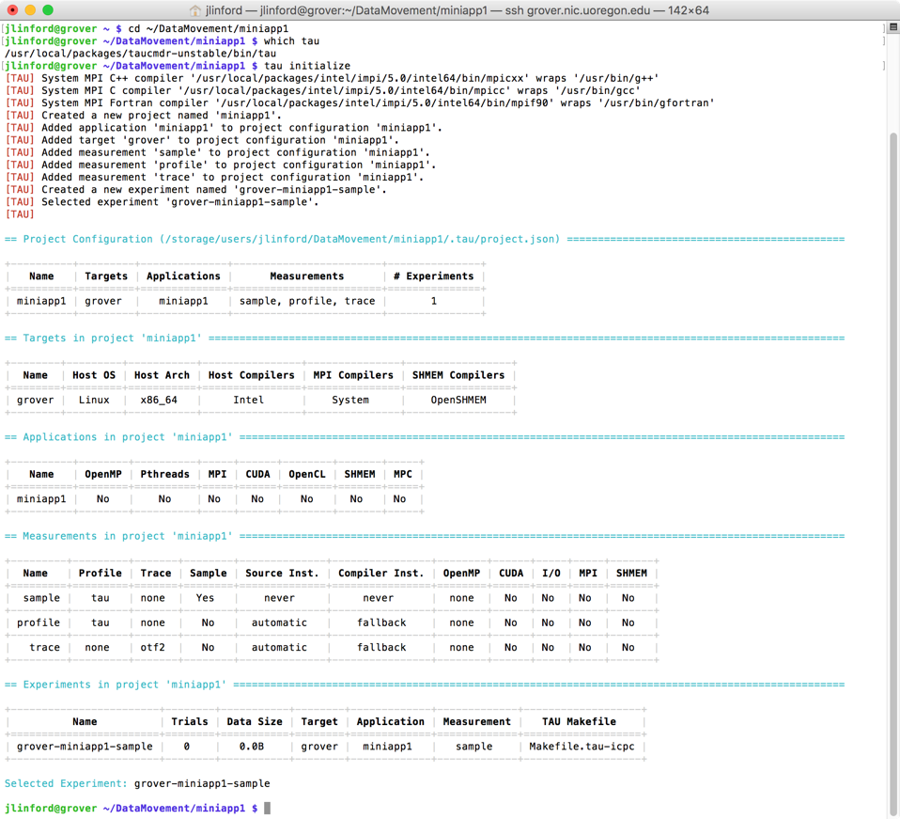
MINIAPP1 TAU Project

Slide 28
Use `tau` to compile
$ cd ~/DataMovement/miniapp1/baseline
$ vi Makefile
1 # Fortran Compiler
2 FC = tau ifort
3 #FC = mpif90
4
...
16
17 # Program name(s)
18 PROGRAMS = point_solve
19
20 .PHONY: all clean run
21
22 all: $(PROGRAMS)
23
24 run: all
25 tau ./point_solve
26
Prepend `tau` command
Prepend `tau` command

Slide 29
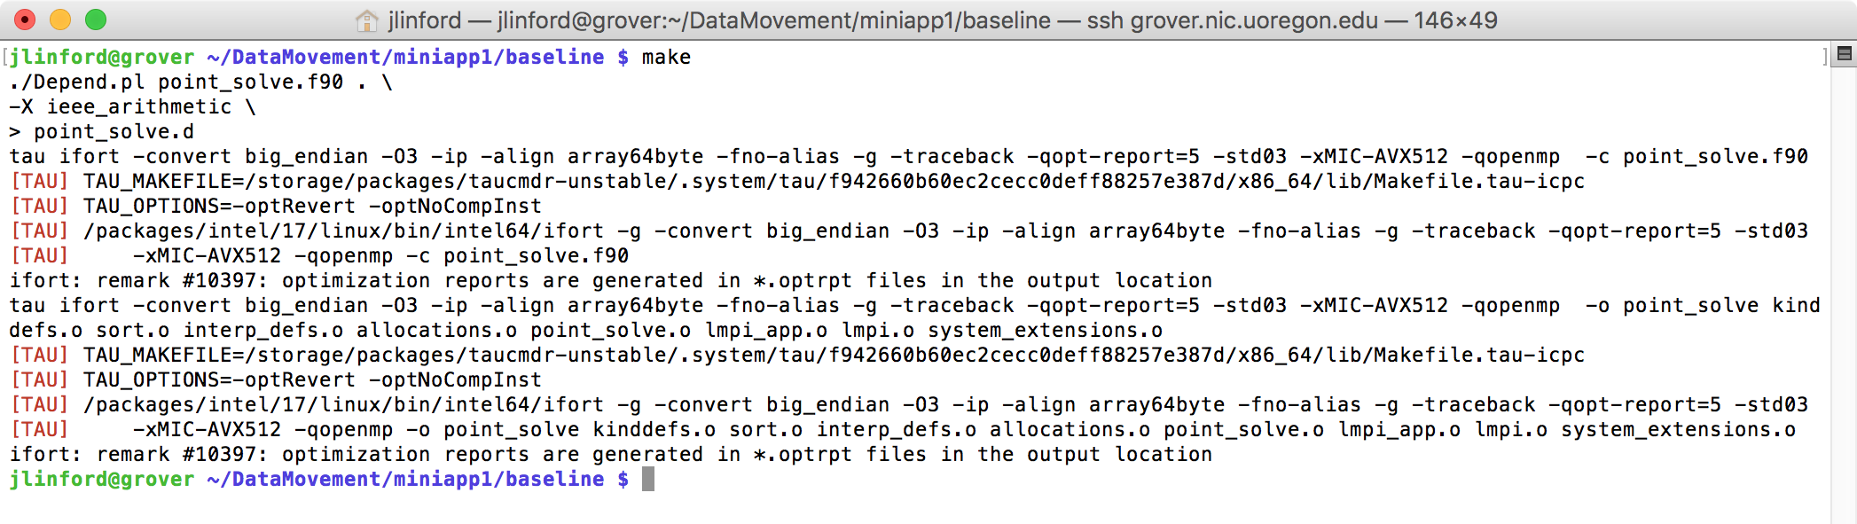
Use `tau` to compile
TAU Commander constructs a new compilation command line to match the selected experiment.
  May replace compiler commands with TAU’s compiler wrapper scripts.
  May set environment variables, parse configuration files, etc.
  If no changes are required then nothing is changed.

Slide 30
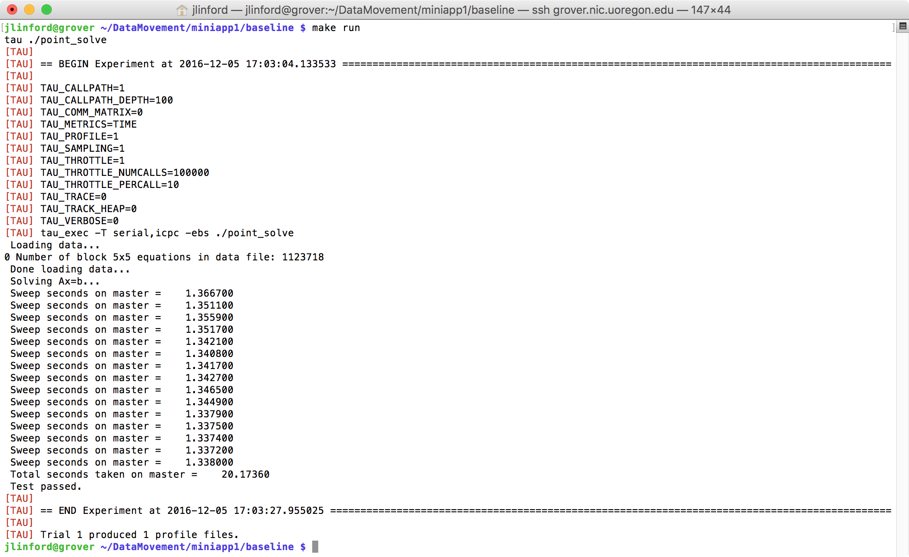
Use `tau` to run
Tracks experiment metadata
Sets appropriate environment variables
Stores generated data in a performance database.

Slide 31
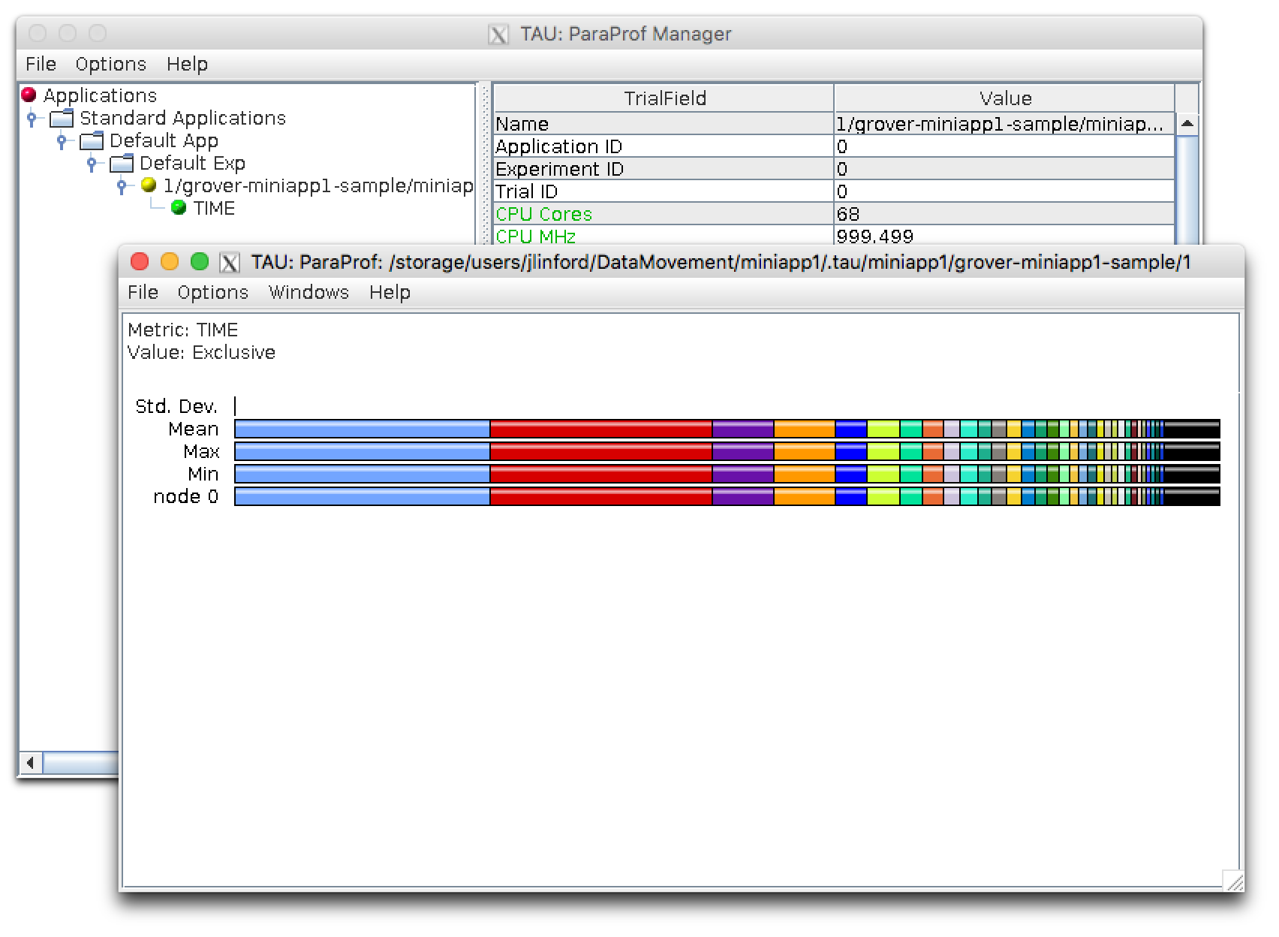
View profile
$ tau show

Slide 32
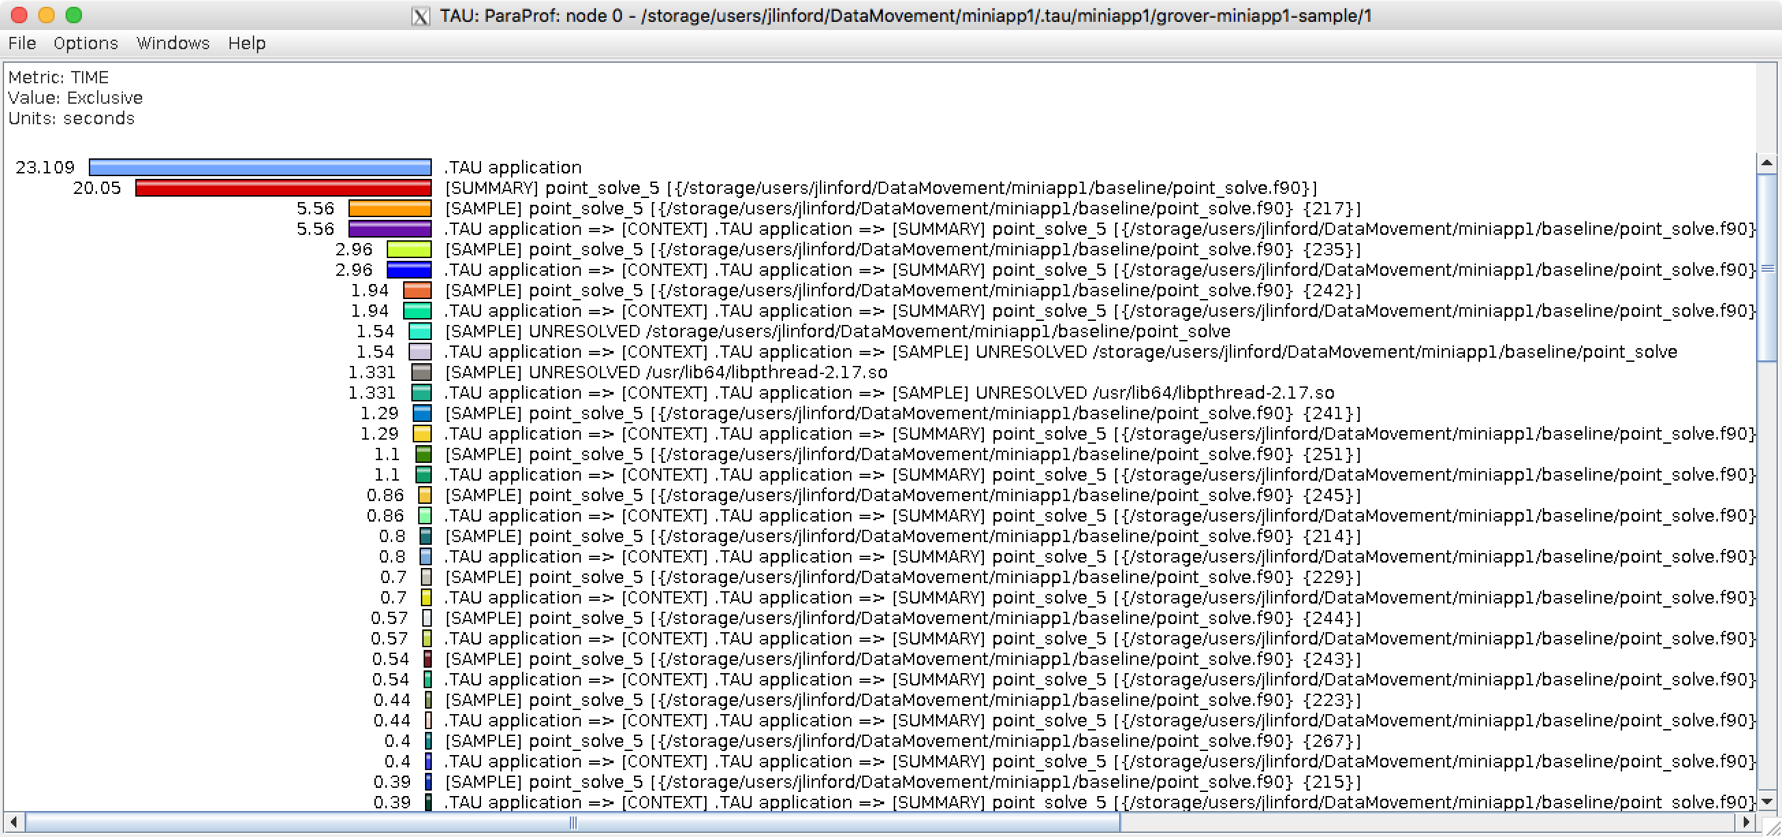
Node 0 Exclusive Time Profile

Slide 33
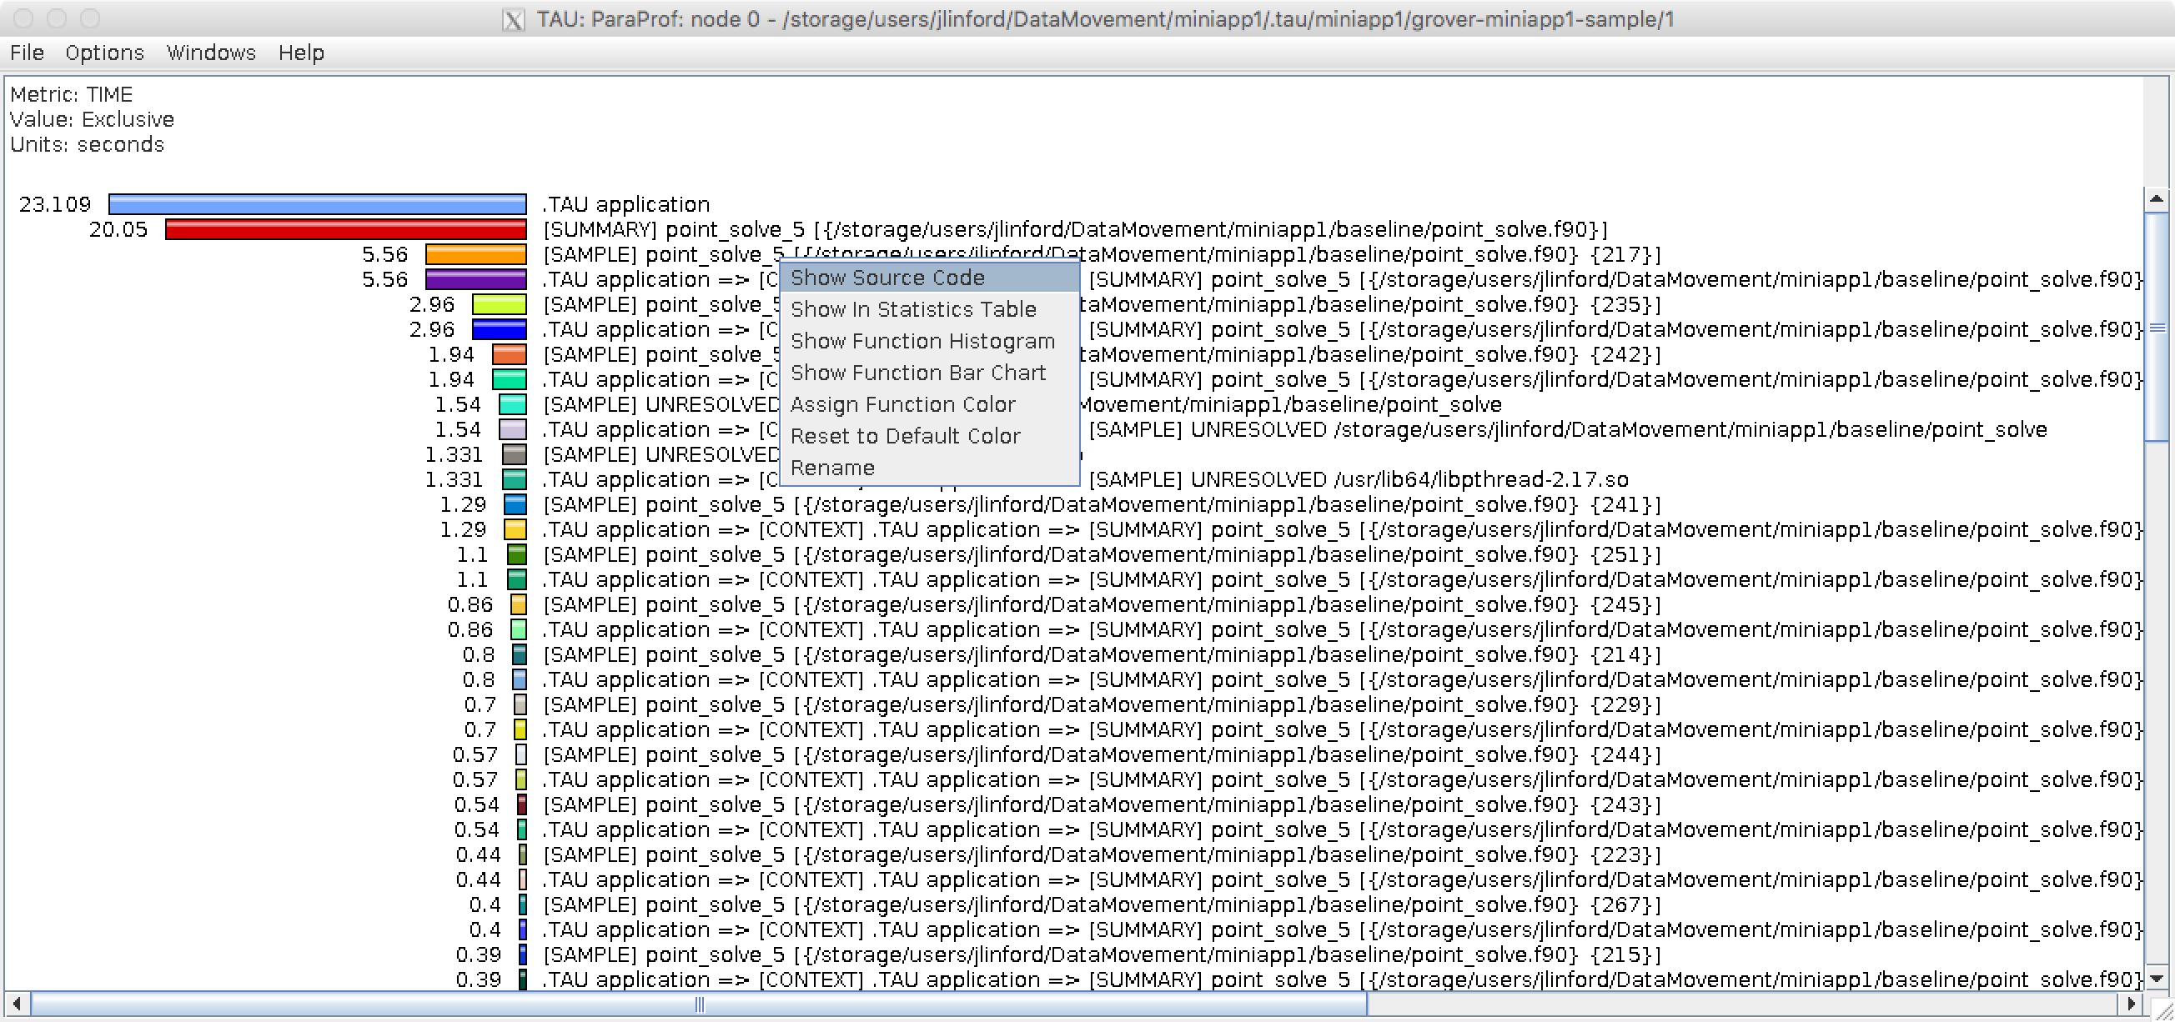
View Source Code
Right-click

Slide 34
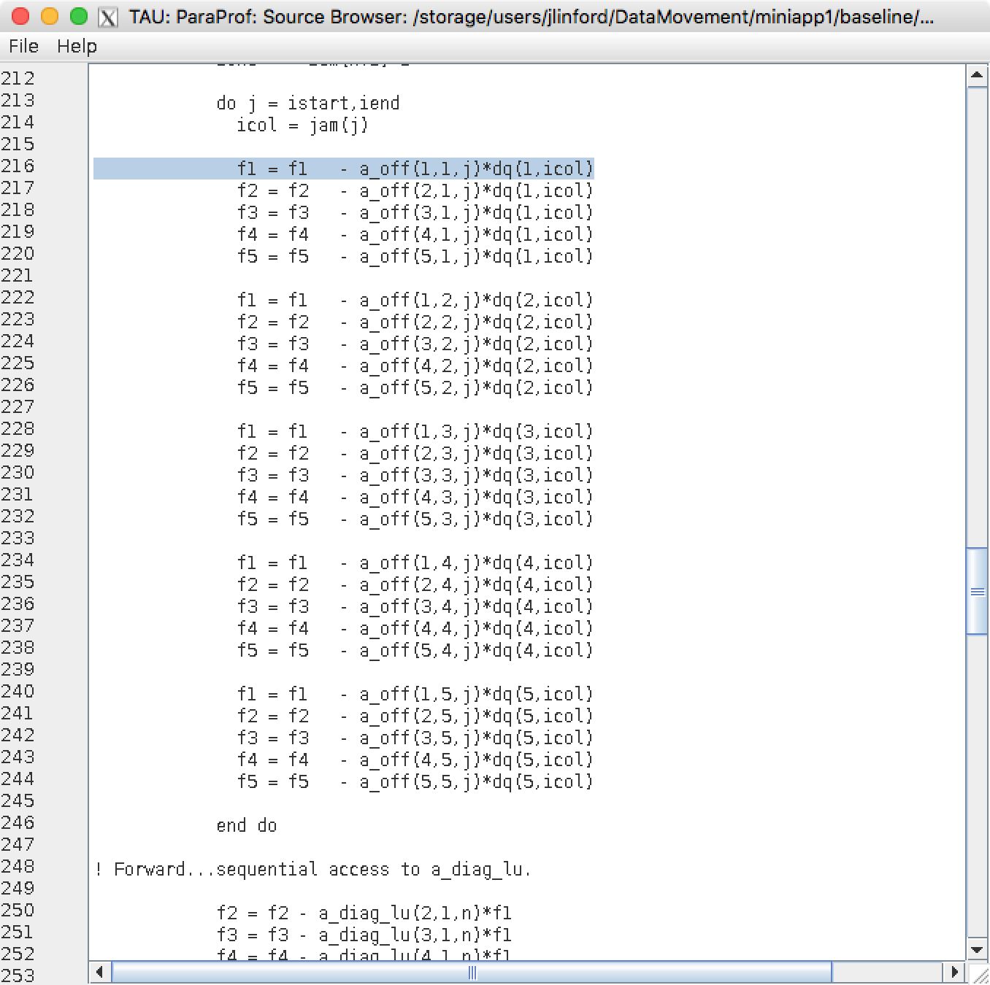
View Source Code
Most expensive source code line
Reminder: We built with -O3. Samples from nearby lines may have resolved here.

Slide 35
How to find most expensive line of code
tau initialize
tau ifort *.f90 -o foo
tau ./foo
tau show
This works on any supported system, even if TAU is not installed or has not been configured appropriately.
TAU and all its dependencies will be downloaded and installed if required.
Just put `tau` in front of everything and see what happens.

Slide 36
papi_avail on U. Oregon KNL (Grover)
$ papi_avail | grep Yes
PAPI_L1_DCM 0x80000000 Yes No Level 1 data cache misses
PAPI_L1_ICM 0x80000001 Yes No Level 1 instruction cache misses
PAPI_L1_TCM 0x80000006 Yes Yes Level 1 cache misses
PAPI_L2_TCM 0x80000007 Yes No Level 2 cache misses
PAPI_TLB_DM 0x80000014 Yes No Data translation lookaside buffer misses
PAPI_L1_LDM 0x80000017 Yes No Level 1 load misses
PAPI_L2_LDM 0x80000019 Yes No Level 2 load misses
PAPI_STL_ICY 0x80000025 Yes No Cycles with no instruction issue
PAPI_BR_UCN 0x8000002a Yes Yes Unconditional branch instructions
PAPI_BR_CN 0x8000002b Yes No Conditional branch instructions
PAPI_BR_TKN 0x8000002c Yes No Conditional branch instructions taken
PAPI_BR_NTK 0x8000002d Yes Yes Conditional branch instructions not taken
PAPI_BR_MSP 0x8000002e Yes No Conditional branch instructions mispredicted
PAPI_TOT_INS 0x80000032 Yes No Instructions completed
PAPI_LD_INS 0x80000035 Yes No Load instructions
PAPI_SR_INS 0x80000036 Yes No Store instructions
PAPI_BR_INS 0x80000037 Yes No Branch instructions
PAPI_RES_STL 0x80000039 Yes No Cycles stalled on any resource
PAPI_TOT_CYC 0x8000003b Yes No Total cycles
PAPI_LST_INS 0x8000003c Yes Yes Load/store instructions completed
PAPI_L1_DCA 0x80000040 Yes Yes Level 1 data cache accesses
PAPI_L1_ICH 0x80000049 Yes No Level 1 instruction cache hits
PAPI_L1_ICA 0x8000004c Yes No Level 1 instruction cache accesses
PAPI_L2_TCH 0x80000056 Yes Yes Level 2 total cache hits
PAPI_L2_TCA 0x80000059 Yes No Level 2 total cache accesses
PAPI_REF_CYC 0x8000006b Yes No Reference clock cycles

Slide 37
Measuring PAPI Counters
Space-separated list of metrics
$ tau measurement copy sample sample.papi \
--metrics TIME PAPI_L1_DCM PAPI_L2_TCM
$ tau select sample.papi
[TAU] Selected experiment 'grover-miniapp1-sample.papi'.
[TAU] Application rebuild required:
[TAU] - metrics changed from [TIME] to [TIME, PAPI_L1_DCM, PAPI_L2_TCM]
TAU Commander advises when application should be rebuilt.

Slide 38
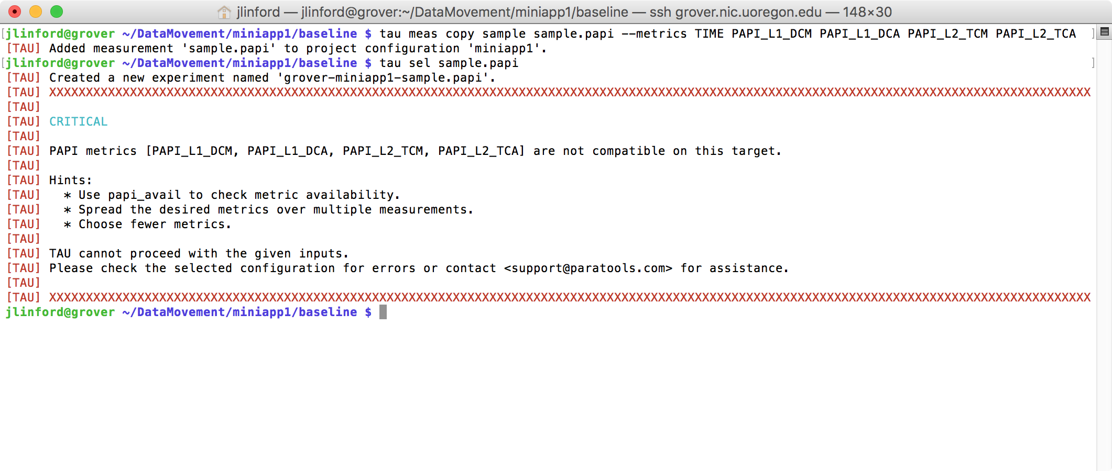
PAPI Metric Compatibility Checks
Uses papi_event_chooser to check metric compatibility.

Slide 39
Run exactly as before: `tau ./point_solve`
$ make run
tau ./point_solve
[TAU]
[TAU] == BEGIN Experiment at 2016-12-05 18:59:55.777171 ===============================================================
[TAU]
[TAU] TAU_CALLPATH=1
[TAU] TAU_CALLPATH_DEPTH=100
[TAU] TAU_COMM_MATRIX=0
[TAU] TAU_METRICS=TIME,PAPI_L1_DCM,PAPI_L2_TCM
[TAU] TAU_PROFILE=1
[TAU] TAU_SAMPLING=1
[TAU] TAU_THROTTLE=1
[TAU] TAU_THROTTLE_NUMCALLS=100000
[TAU] TAU_THROTTLE_PERCALL=10
[TAU] TAU_TRACE=0
[TAU] TAU_TRACK_HEAP=0
[TAU] TAU_VERBOSE=0
[TAU] tau_exec -T serial,papi,icpc -ebs ./point_solve
Loading data...
0 Number of block 5x5 equations in data file: 1123718
Done loading data...
Solving Ax=b...
Sweep seconds on master = 1.369700
Sweep seconds on master = 1.356500
Sweep seconds on master = 1.358500
Sweep seconds on master = 1.353100
Sweep seconds on master = 1.347900
Sweep seconds on master = 1.348200
Sweep seconds on master = 1.348400
Sweep seconds on master = 1.345000
Sweep seconds on master = 1.350200
Sweep seconds on master = 1.344700
Sweep seconds on master = 1.344700
Sweep seconds on master = 1.344000
Sweep seconds on master = 1.343200
Sweep seconds on master = 1.343400
Sweep seconds on master = 1.343500
Total seconds taken on master = 20.24260
Test passed.
[TAU]
[TAU] == END Experiment at 2016-12-05 19:00:19.648510 ===================================================================
[TAU]
[TAU] Trial 0 produced 3 profile files.
Trial produced 3 profile files, one for each metric.

Slide 40
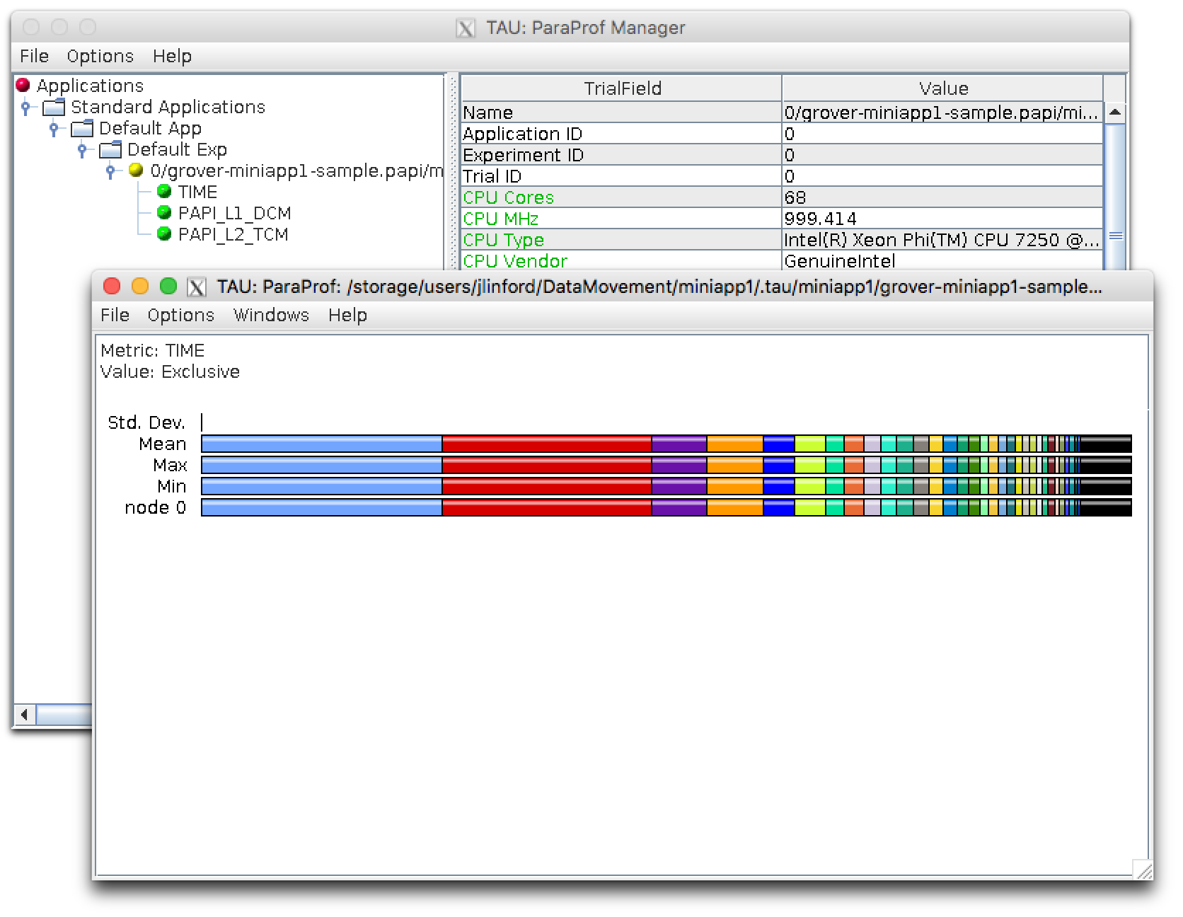
View profiles: `tau show`

Slide 41
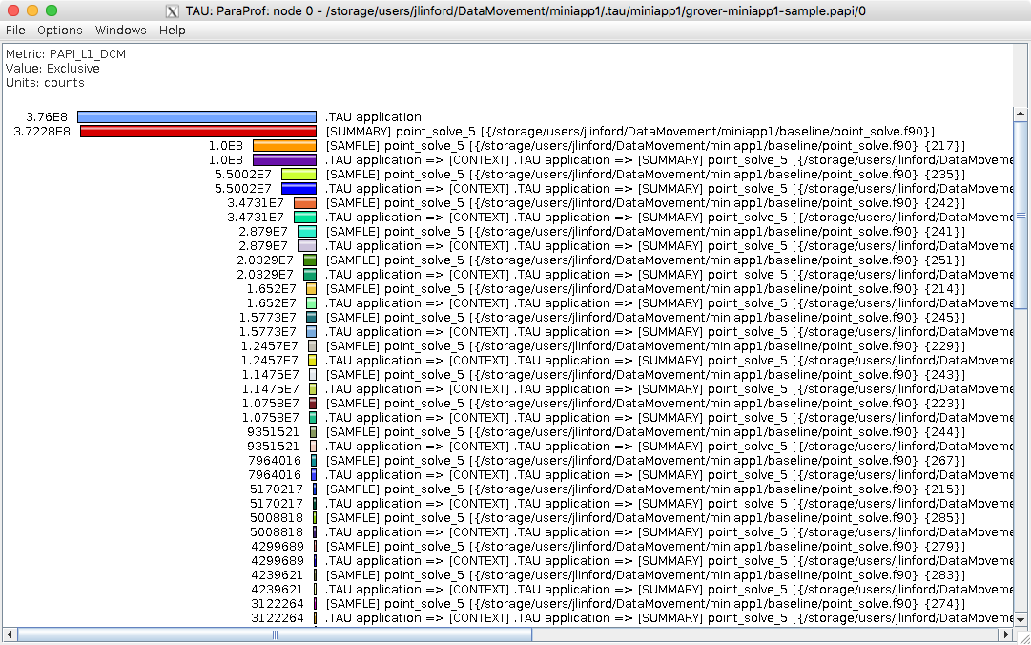
L1 Data Cache Misses

Slide 42
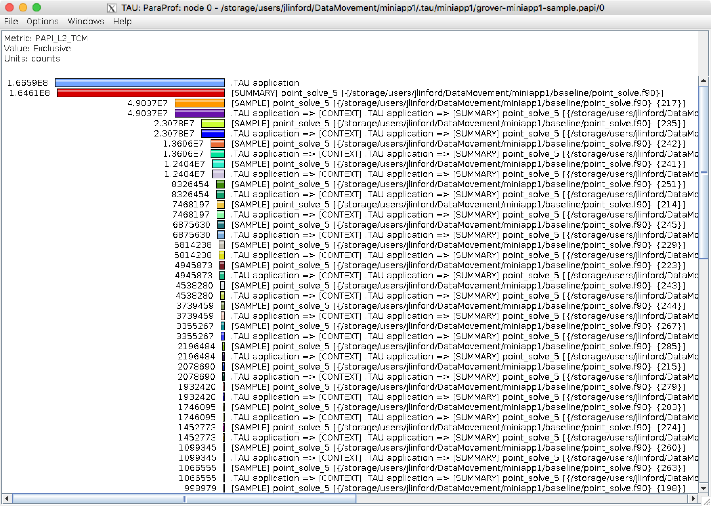
L2 Total Cache Misses

Slide 43
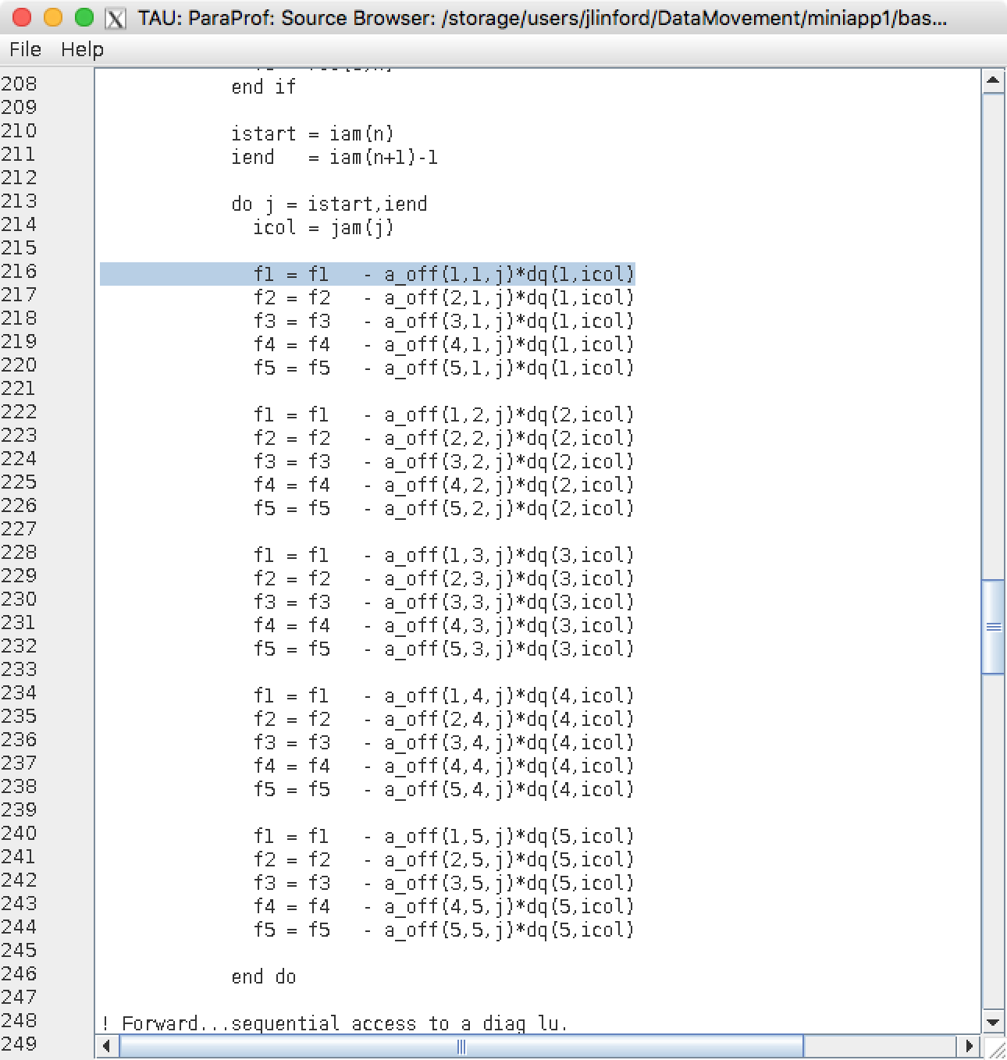
Line with the most L1/L2 misses

Slide 44
What percent of L2 accesses are misses?
$ tau meas copy sample.papi "sample.L2%" --metrics TIME PAPI_L2_TCM PAPI_L2_TCA
[TAU] Added measurement 'sample.L2%' to project configuration 'miniapp1'.
$ tau sel sample.L2%
[TAU] Created a new experiment named 'grover-miniapp1-sample.L2%'.
[TAU] Selected experiment 'grover-miniapp1-sample.L2%'.
$ make run
tau ./point_solve
[TAU]
[TAU] == BEGIN Experiment at 2016-12-05 19:29:24.677341 ===============
[TAU]
[TAU] TAU_CALLPATH=1
[TAU] TAU_CALLPATH_DEPTH=100
[TAU] TAU_COMM_MATRIX=0
[TAU] TAU_METRICS=TIME,PAPI_L2_TCM,PAPI_L2_TCA

Slide 45
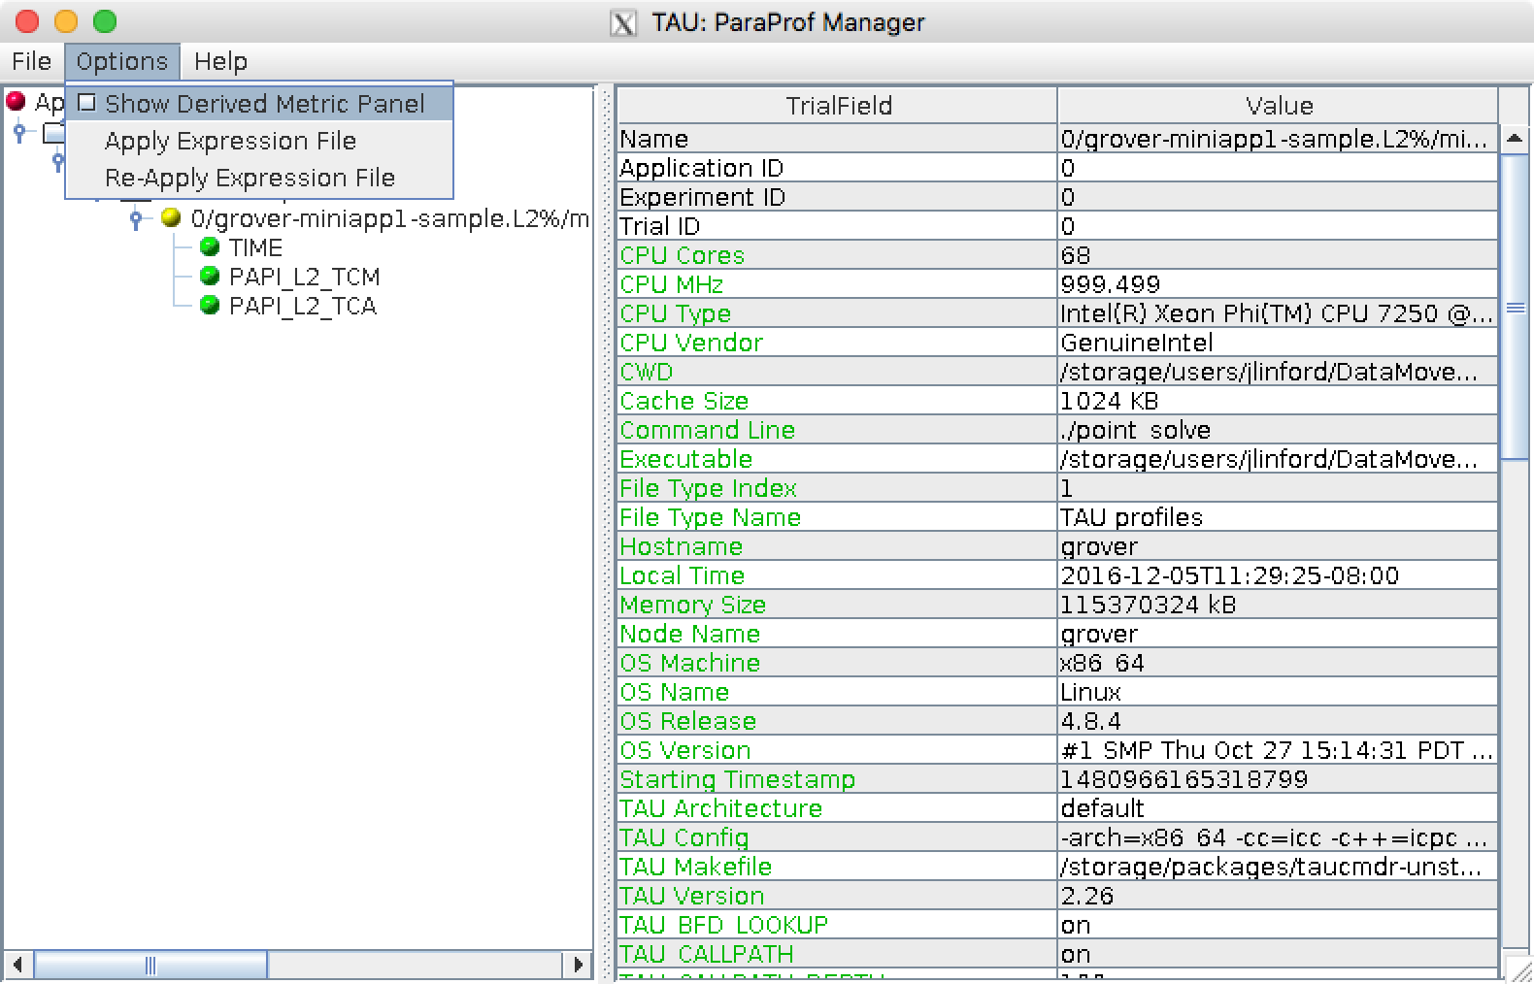
Create a new derived metric

Slide 46
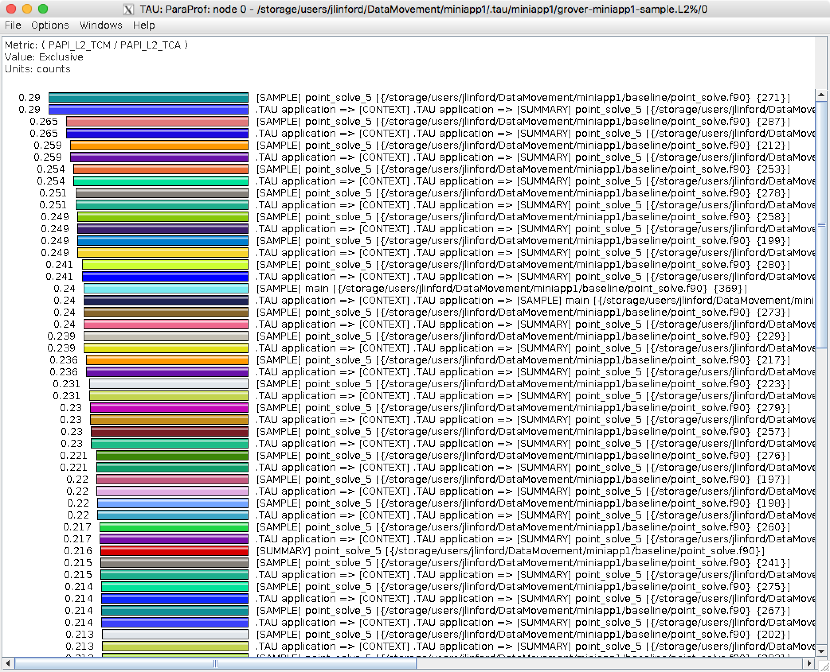
At worst, 29% of L2 fetches miss

Slide 47
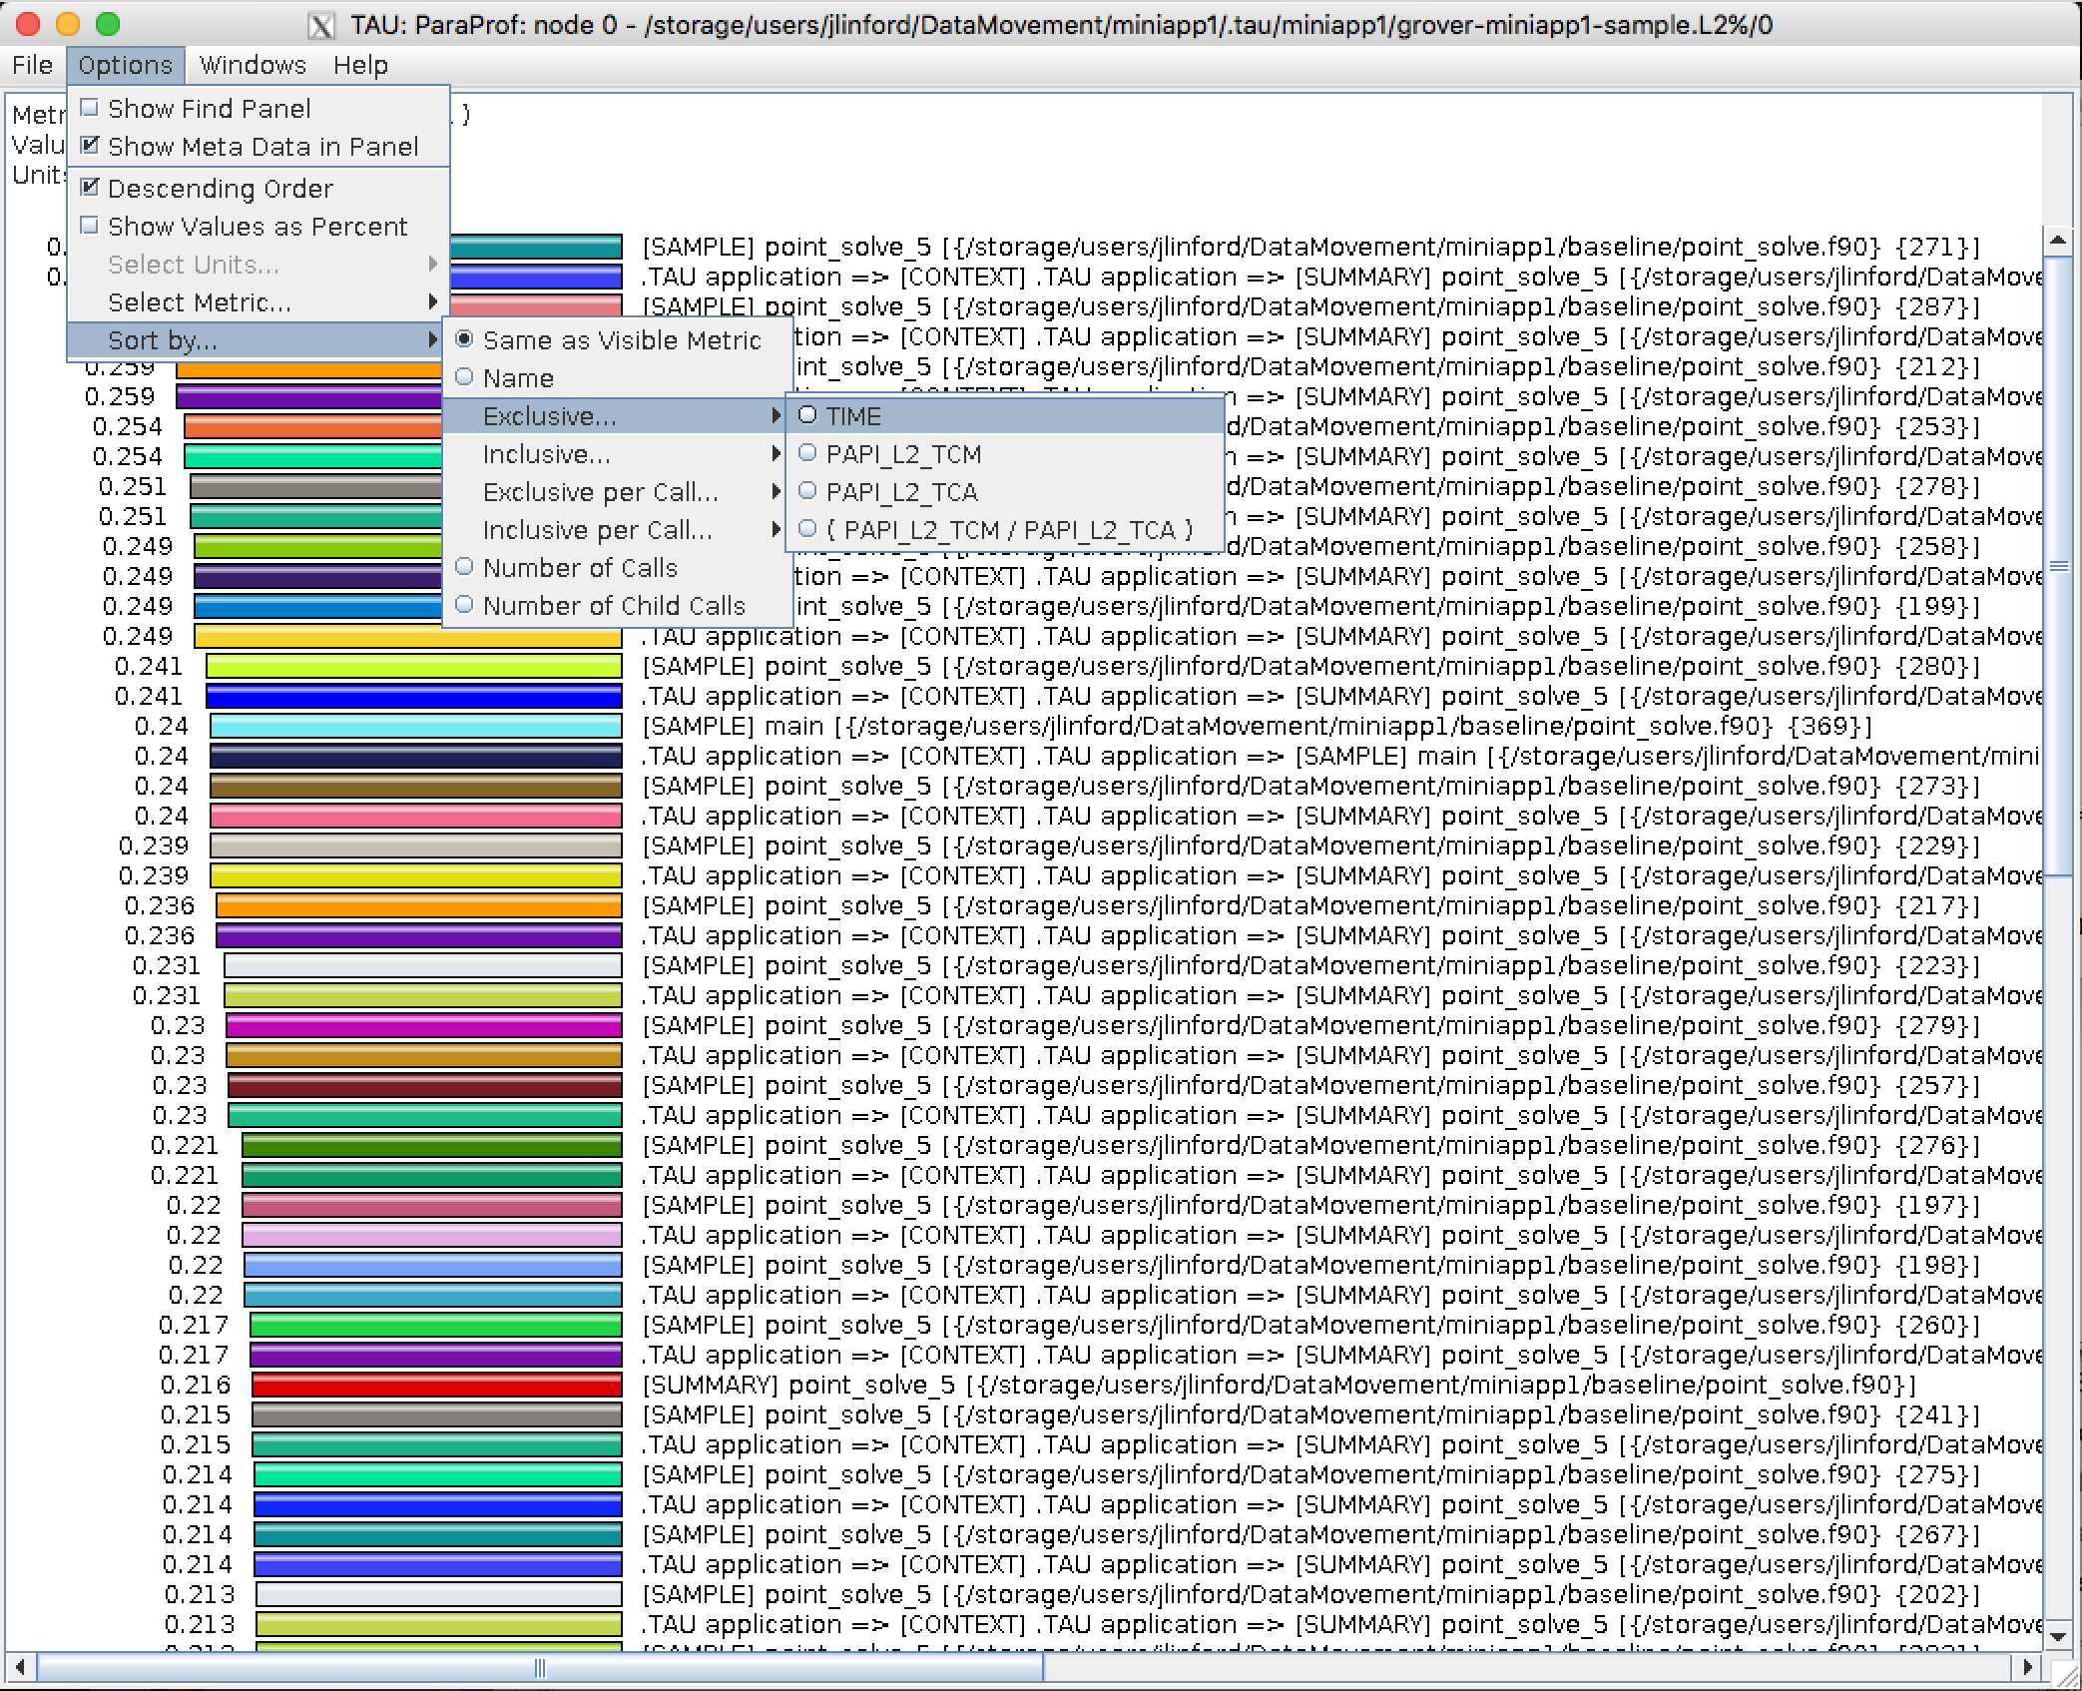
Sort by exclusive time

Slide 48
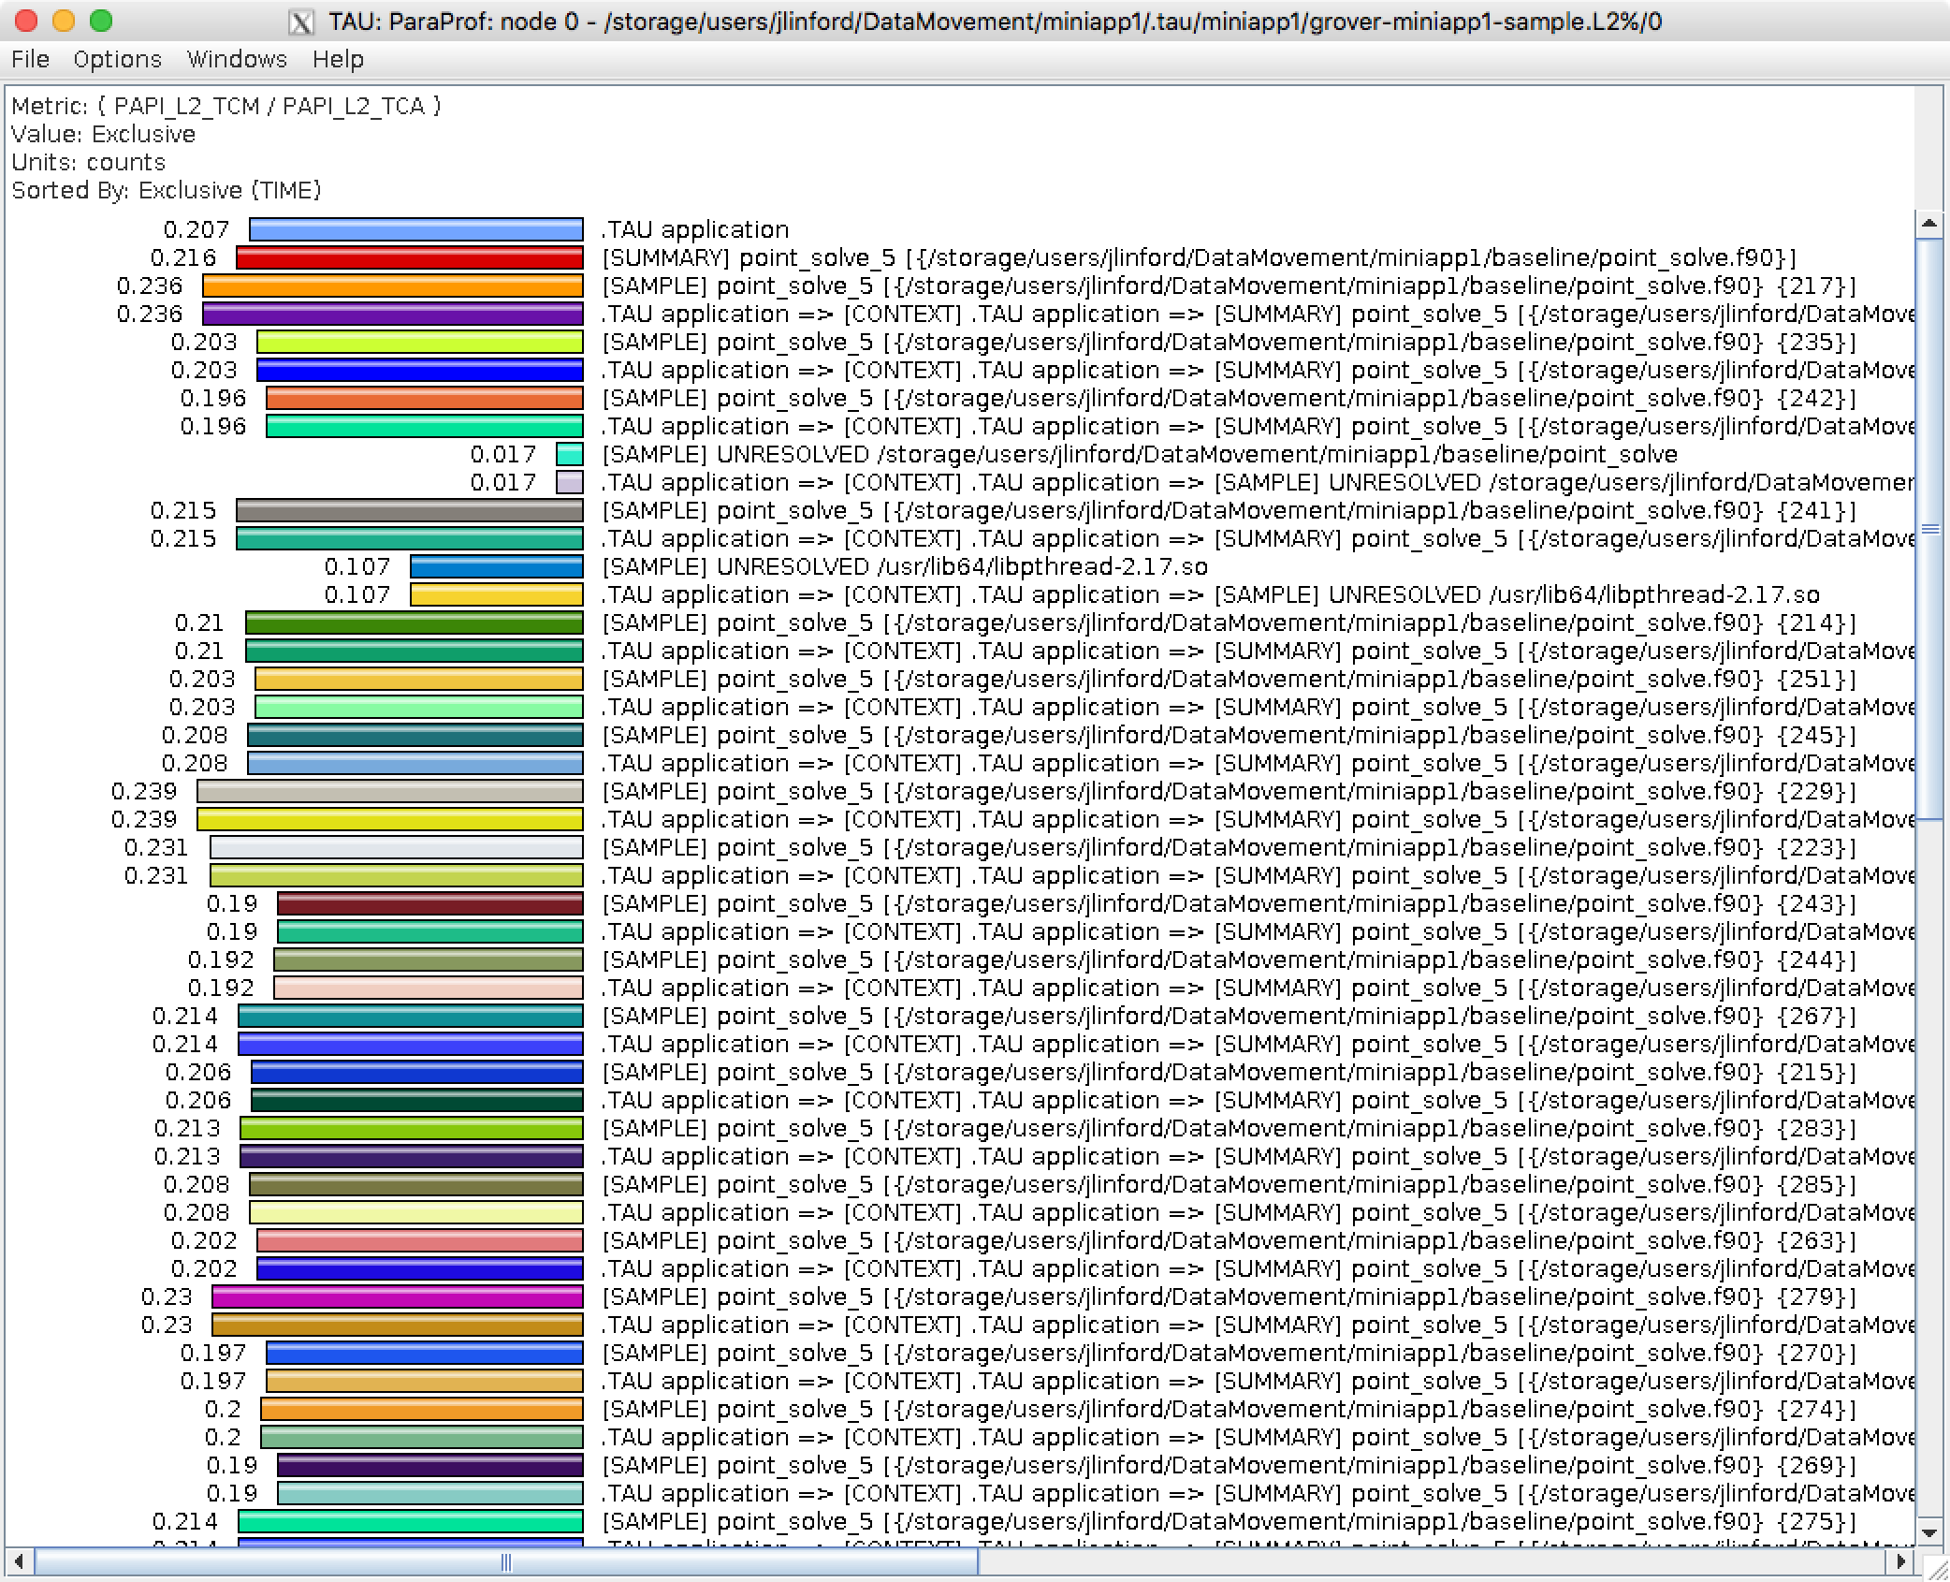
About 21% L2 fetches miss in kernel

Slide 49
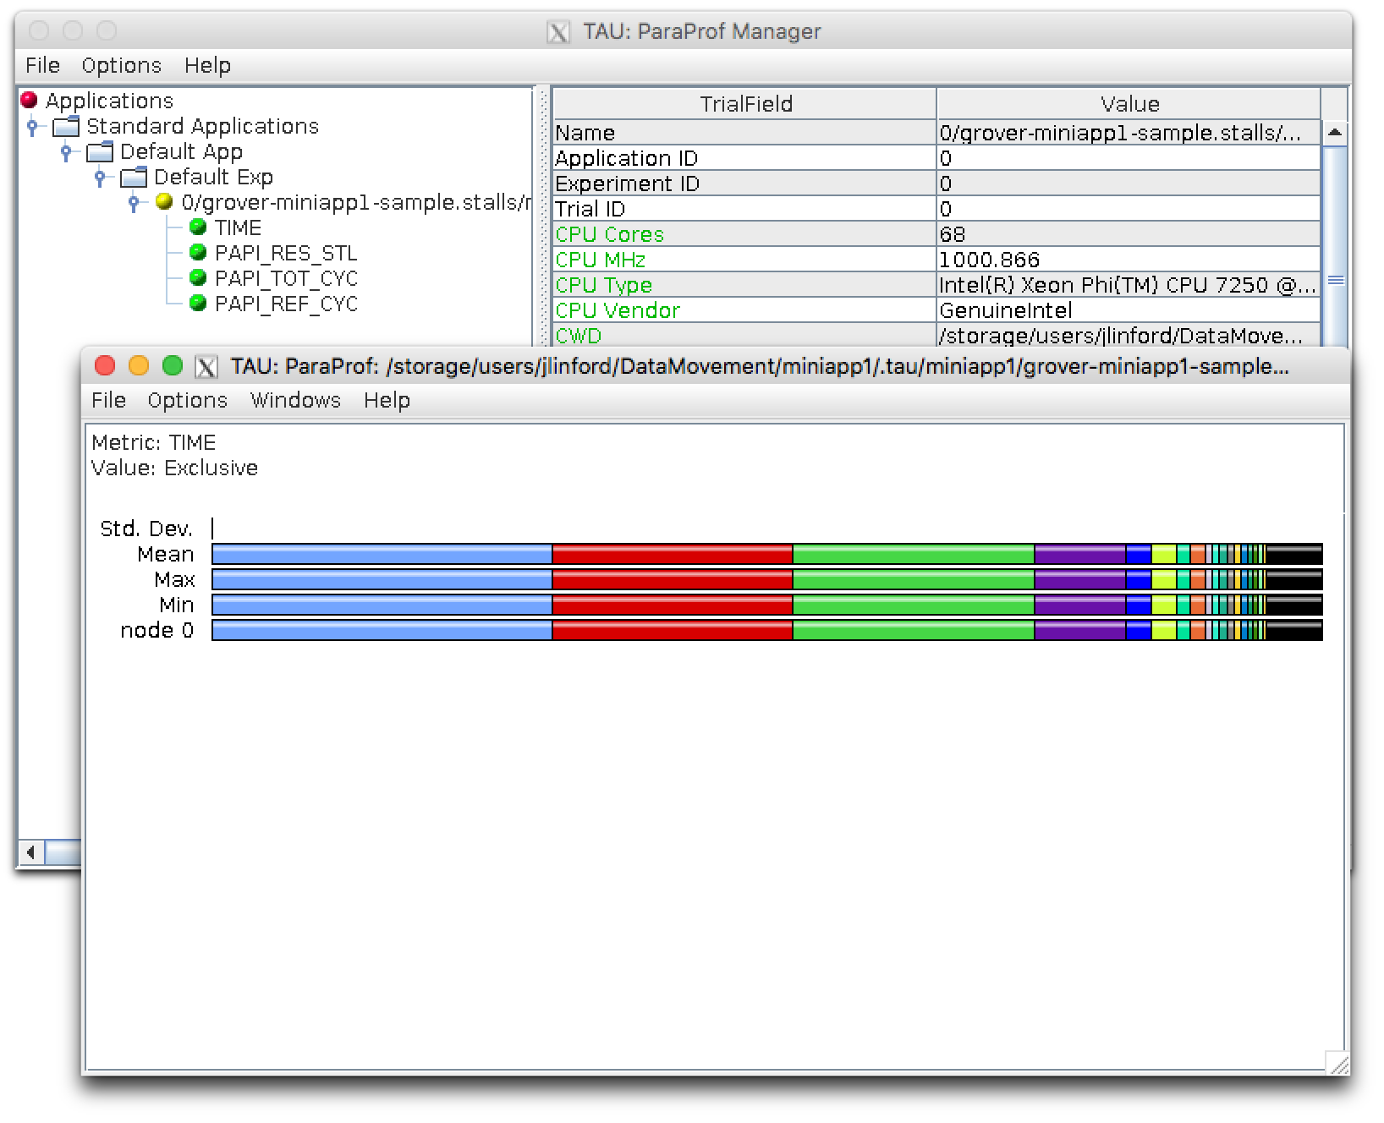
% Cycles Stalled Waiting for Memory

Slide 50
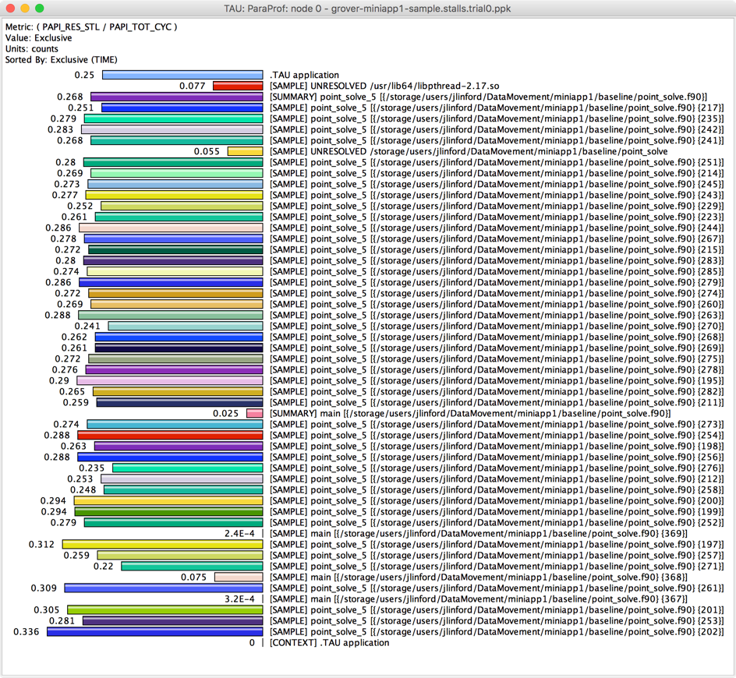
% Cycles Stalled Waiting for Memory

Slide 51
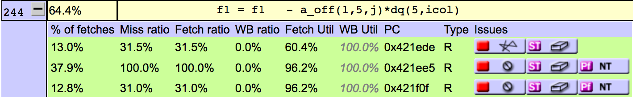
Analysis Summary
We know all runtime hot spots
We know cache utilization characteristics
  DRAM is the bottleneck
MCDRAM will likely help
OpenMP will likely help
Can we shuffle a_off for better performance?
  No: fetch utilization is already close to 100%
Can we vectorize?
  Yes, but don’t try too hard

Slide 52
Improving MINIAPP1
Data Movement Workshop

Slide 53
OpenMP Parallelization
$ cd ~/DataMovement/miniapp1/openmp
!$omp parallel default(shared)
do sweep = 1, n_sweeps
do color = sweep_start, sweep_end, sweep_stride
do ipass = 1, 2
start = color_indices(1,color)
end = color_boundary_end(color)
!$omp do private(f1,f2,f3,f4,f5,n,j,icol,istart,iend) schedule(auto)
do n = start, end
istart = iam(n)
iend = iam(n+1)-1
f(1:5) = (+/-)res(1:5)
do j = istart, iend
icol = jam(j)
do i = 1, 5
f(1:5) = f(1:5) - a_off(1:5,i,j)*dq(i,icol)
end do

Slide 54
Create a new OpenMP Application Config
$ cd ~/DataMovement/miniapp1/openmp
# Edit Makefile as before
$ tau app copy miniapp1 miniapp1.openmp --openmp
[TAU] Added application 'miniapp1.openmp' to project configuration 'miniapp1'.
$ tau select miniapp1.openmp sample
[TAU] Selected experiment 'grover-miniapp1.openmp-sample'.
[TAU] Application rebuild required:
[TAU] - openmp changed from False to True

Slide 55
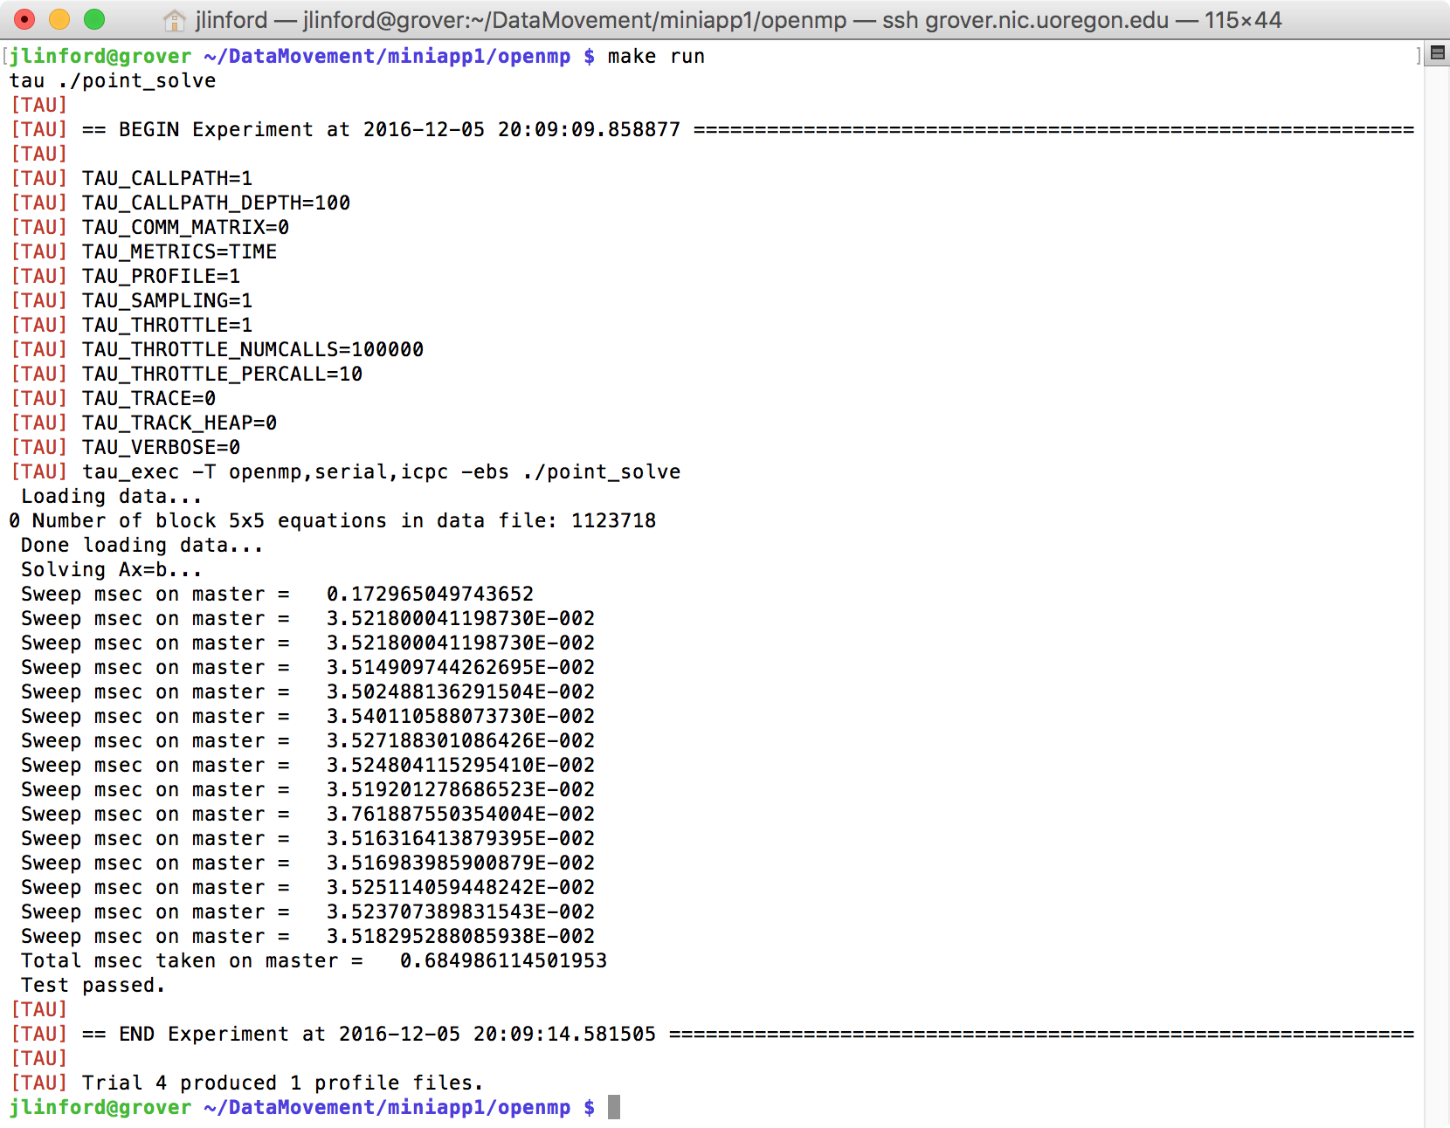
Compile and run exactly as before
About 30x speedup
2.5x vs 24 Haswell 2.4GHz cores

Slide 56
Use MCDRAM via numactl -m
$ tau app copy miniapp1 miniapp1.MCDRAM
[TAU] Added application 'miniapp1.MCDRAM' to project configuration 'miniapp1'.
$ tau select miniapp1.MCDRAM sample
[TAU] Created a new experiment named 'grover-miniapp1.MCDRAM-sample'.
[TAU] Selected experiment 'grover-miniapp1.MCDRAM-sample'.
$ numactl -m 1 tau ./point_solve
$ numastat $point_sovlve_pid
Per-node process memory usage (in MBs) for PID 236528 (point_solve)
Node 0 Node 1 Total
--------------- --------------- ---------------
Huge 0.00 0.00 0.00
Heap 0.00 0.08 0.08
Stack 0.00 0.04 0.04
Private 7.50 2169.79 2177.29
---------------- --------------- --------------- ---------------
Total 7.50 2169.91 2177.41

Slide 57
MEMKIND: Move a_off to MCDRAM
real(odp), dimension(:,:,:), allocatable, public :: a_off
!dec$ attributes fastmem :: a_off
And in Makefile:
MEMKIND = /usr/local/packages/memkind-1.0
LDFLAGS = -L$(MEMKIND)/lib –lmemkind
run: all
LD_LIBRARY_PATH=$(MEMKIND)/lib:$$LD_LIBRARY_PATH tau ./point_solve

Slide 58
OpenMP Tuning: Threads per Tile
One Thread per Tile
DRAM | 0.6992
MEMKIND | 0.6659
numactl | 0.6741
export KMP_AFFINITY=proclist=
[0,2,4,6,8,10,12,14,16,18,20,22,24,26,28,30,32,34,36,38,40,42,44,46,48,50,52,54,56,58,60,62,64,66],explicit
export OMP_NUM_THREADS=34
About 30x speedup
2.5x vs 24 Haswell 2.4GHz cores

Slide 59
OpenMP Tuning: Threads per Core
One Thread per Core
DRAM | 0.5604
MEMKIND | 0.4235
numactl | 0.4336
export KMP_HW_SUBSET=1T
export KMP_AFFINITY=compact
export OMP_NUM_THREADS=68
Two Threads per Core (1 per VPU)
DRAM | 0.5804
MEMKIND | 0.3829
numactl | 0.3830
export KMP_HW_SUBSET=2T
export KMP_AFFINITY=compact
export OMP_NUM_THREADS=136
Three Threads per Core
DRAM | 0.6280
MEMKIND | 0.4404
numactl | 0.4371
export KMP_HW_SUBSET=3T
export KMP_AFFINITY=compact
export OMP_NUM_THREADS=204
53x speedup
4.5x vs 24 Haswell 2.4GHz cores

Slide 60
2M Hugepages in MCDRAM: Fortran Side
use, intrinsic :: iso_c_binding, only: C_F_POINTER, C_FLOAT, C_PTR, C_INT, C_SIZE_T
type(C_PTR) :: a_off_huge_ptr
integer(C_SIZE_T) :: nelm
real(odp), dimension(:,:,:), allocatable, public :: a_off_huge
interface
function alloc_a_off(memptr, nelm) BIND(C, NAME='alloc_a_off')
import :: C_PTR, C_INT, C_SIZE_T
type(C_PTR) :: memptr
integer(C_SIZE_T), value :: nelm
integer(C_INT) :: alloc_a_off
end function alloc_a_off
end interface
nelm = nm*nm*nja
err = alloc_a_off(a_off_huge_ptr, nelm)
if (err /= 0) then
write(*,*) 'alloc_a_off failed:',err
stop
end if
call C_F_POINTER(a_off_huge_ptr, a_off_huge, [nm,nm,nja])
a_off_huge = a_off

Slide 61

2M Hugepages in MCDRAM: C side
#if PAGESIZE == 0x200000
#define PAGESIZE_FLAG HBW_PAGESIZE_2MB
#elif PAGESIZE == 0x1000
#define PAGESIZE_FLAG HBW_PAGESIZE_4KB
#endif
int alloc_a_off(void ** memptr, size_t nelm)
{
void * ptr;
char * poke;
size_t size;
size_t span;
int retval;·
size = nelm*sizeof(float);
span = (size + PAGESIZE-1) & ~(PAGESIZE-1);
retval = hbw_posix_memalign_psize(&ptr, PAGESIZE, nelm*sizeof(float), PAGESIZE_FLAG);
if (retval != 0) {
char const * errstr = strerror(errno);
printf("hbw_posix_memalign_psize failed: %s\n", errstr);
return retval;
}
retval = mlock(ptr, span);
if (retval != 0) {
char const * errstr = strerror(errno);
printf("mlock failed: %s\n", errstr);
return retval;
}
retval = posix_madvise(ptr, span, POSIX_MADV_WILLNEED | POSIX_MADV_SEQUENTIAL);
if (retval != 0) {
char const * errstr = strerror(errno);
printf("posix_madvise failed: %s\n", errstr);
return retval;
}
poke = ptr;
do {
*poke = 0xf;
poke += PAGESIZE;
} while (poke < (ptr+span));
*memptr = ptr;
return 0;
}

Slide 62
2M Hugepages in MCDRAM
Per-node process memory usage (in MBs) for PID 15047 (point_solve)
Node 0 Node 1 Total
--------------- --------------- ---------------
Huge 788.00 1024.00 1812.00
Heap 0.18 0.00 0.18
Stack 0.03 0.00 0.03
Private 455.11 1812.00 2267.11
---------------- --------------- --------------- ---------------
Total 1243.32 2836.00 4079.32
But no performance gain…

Slide 63
Conclusion
Army HPC User Group Review

Slide 64
MINIAPP1 Summary
What worked
What didn’t work
OpenMP directives
MEMKIND
numactl --membind
  But MEMKIND slightly faster.
2M hugepages
  No change in most tests, performance loss in some
Blocking in a_off(:,1,1)
  Facilitates vectorization, but average loop trip count is too low to gain anything.
Transposing a_off
  Facilitates vectorization, but average loop trip count is low.
Vectorizing via intrinsics
  Not CPU bound, no performance gain.

Slide 65
















Acknowledgements
HPCMP DoD PETTT Program
Department of Energy
  Office of Science
  Argonne National Laboratory
  Oak Ridge National Laboratory
  NNSA/ASC Trilabs (SNL, LLNL, LANL)
National Science Foundation
  Glassbox, SI-2
University of Tennessee
    University of New Hampshire
      Jean Perez, Benjamin Chandran
University of Oregon
  Allen D. Malony, Sameer Shende
  Kevin Huck, Wyatt Spear
TU Dresden
  Holger Brunst, Andreas Knupfer
  Wolfgang Nagel
Research Centre Jülich
  Bernd Mohr
  Felix Wolf

Slide 66
Vocabulary
Army HPC User Group Review

Slide 67
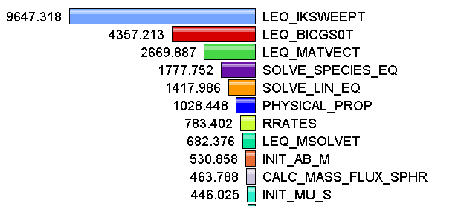
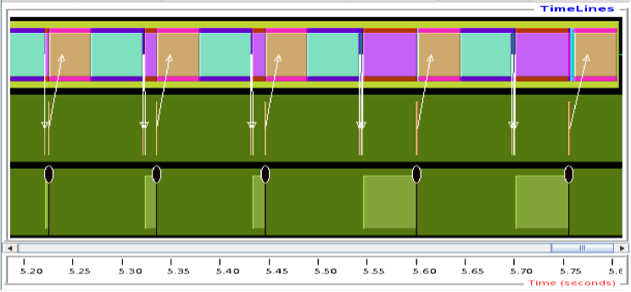
Measurement Approaches
Profiling
Tracing
Shows
how much time was spent in each routine
Shows
when events take place on a timeline

Slide 68
Types of Performance Profiles
Flat profiles
  Metric (e.g., time) spent in an event
  Exclusive/inclusive, # of calls, child calls, …
Callpath profiles
  Time spent along a calling path (edges in callgraph)
  “main=> f1 => f2 => MPI_Send”
Phase profiles
  Flat profiles under a phase (nested phases allowed)
  Default “main” phase
  Supports static or dynamic (e.g. per-iteration) phases
Notes:
Collect basic routine-level timing profile to determine where most time is being spent
Collect routine-level hardware counter data to determine types of performance problems
Collect callpath profiles to determine sequence of events causing performance problems
Conduct finer-grained profiling and/or tracing to pinpoint performance bottlenecks
Loop-level profiling with hardware counters
Tracing of communication operations

Slide 69
Direct Observation Events
Interval events (begin/end events)
  Measures exclusive & inclusive durations between events
  Metrics monotonically increase
  Example: Wall-clock timer
Atomic events (trigger with data value)
  Used to capture performance data state
  Shows extent of variation of triggered values (min/max/mean)
  Example: heap memory consumed at a particular point

Slide 70
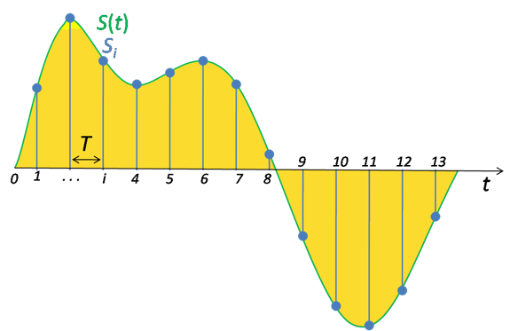
Direct vs. Indirect Measurement
Direct via Probes
Indirect via Sampling
call TAU_START(‘potential’)
// code
call TAU_STOP(‘potential’)
Exact measurement
Fine-grain control
Calls inserted into code
No code modification
Minimal effort
Relies on debug symbols (-g option)

Slide 71
Inclusive vs. Exclusive Measurements
Exclusive measurements for region only
Inclusive measurements includes child regions
int foo()
{
int a;
a =a + 1;
bar();
a =a + 1;
return a;
}
Inclusive
duration
Exclusive
duration

